Slide 1
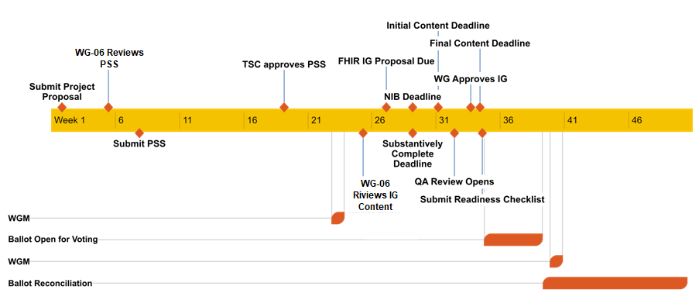
HL7 IG Workflow w/ WG-06 Reviews
https://confluence.hl7.org/display/FHIR/FHIR+Implementation+Guide+Process+Flow

Slide 2
FHIR IG Maturity Requirements
In order to be balloted or to published, a FHIR IG must reach a certain maturity level:
Balloting or publishing as Standard for Trial Use (STU) - FMM Level 2
Balloting or publishing as Normative - FMM Level 5
Balloting an IG as STU still requires completion of appropriate Connectathon testing
Connectathons happen during ballot cycles
Testing must therefore occur one cycle before ballot

Slide 3
FHIR IG Review Process
WG-20 will seek WG-06 review of managed FHIR Implementation Guides at the following stages:
Project Proposal / Project Scope Statement: Prior to PSS submission.
Ballot: Prior to all ballots
Typically includes 1 or more Standard for Trial Use ballots before a normative ballot

Slide 4
HL7 FHIR Resource Development Process
Resource proposals are reviewed and approved by FHIR Management Group (FMG)
Once approved, sponsoring WG drafts resource and progresses it through the FHIR Maturity Model

Slide 5
FHIR Maturity Model w/ WG-06 Reviews
Draft (0) | the resource or profile (artifact) has been published on the current build. This level is synonymous with Draft
FMM 1 | the artifact produces no warnings during the build process WG-20 has indicated that they consider the artifact substantially complete and ready for implementation the FHIR Management Group has approved the underlying resource proposal WG-06 has reviewed the current resource content and agrees that it is appropriately mature
FMM 2 | the artifact has been tested and successfully supports interoperability among at least three independently developed systems leveraging most of the scope (e.g. at least 80% of the core data elements) using semi-realistic data and scenarios based on at least one of the declared scopes of the artifact (e.g. at a connectathon). these interoperability results must have been reported to and accepted by the FMG
FMM 3 | the artifact has been verified by the work group as meeting the Conformance Resource Quality Guidelines the artifact has been subject to a round of formal balloting the artifact has at least 10 distinct implementer comments recorded in the tracker drawn from at least 3 organizations resulting in at least one substantive change
FMM 4 | the artifact has been tested across its scope (see below), published in a formal publication (e.g. Trial-Use), and implemented in multiple prototype projects WG-20 agrees the artifact is sufficiently stable to require implementer consultation for subsequent non-backward compatible changes
FMM 5 | the artifact has been published in two formal publication release cycles at FMM1+ (i.e. Trial-Use level) and has been implemented in at least 5 independent production systems in more than one country WG-06 has reviewed the current resource content and approved it becoming normative
Normative | the artifact is now considered stable
http://build.fhir.org/versions.html#maturity

Slide 6
FHIR Resource Review Process
WG-20 will seek WG-06 review of managed FHIR resources at the following stages:
Resource proposal: Depending on timing, may be before or after FHIR Management Group approval but prior to draft resource is added to the FHIR build
Resource Maturity 1: Prior to updating resource maturity in build
Equivalent to “Public Comment”
Resource Maturity 5: Prior to updating resource maturity in build
Equivalent to “Letter Ballot”
Transition from Maturity 5 to Normative to follow HL7 balloting process
WG-20 to notify DICOM membership of relevant ballots

