Slide 1
Supplement 239
Waveform Annotations SR
DICOM Working group 32
PUBLIC COMMENT
Silvia Winkler
January 2024

Slide 2
Use Cases
Which information should be stored and exchanged in which situation

Slide 3
Use Cases
Clinical Information related to a neurophysiology recording may be acquired at different occasions
  During the recording
  During post-hoc review
  During reporting
This clinical information shall be stored with the study in a structured, interoperable way.

Slide 4
Use Case: Recording
The EEG technologist may note power line noise on a particular channel and physically manipulate the scalp and EEG electrode of that channel to improve impedance (or if the notch filter is employed incorrectly they may fail to note quality problems on some channel). If abnormalities occur or if external circumstances change that could be of importance for the evaluation of the recording, the technologist adds event annotations at various timepoints in the recording.
In addition to the annotations, the recording system also saves any changes to the display filter settings and the montage selected for the display throughout the recording in a waveform presentation state object.

Slide 5
Use Case: post-hoc Review
A physician or technologist acting as a post-hoc reviewer looks through a completed EEG recording and marks potential epileptic patterns. The annotations added by the technologist during the recording are shown.
The physician has the option of using the settings for display filters and montage stored in the presentation state object generated during recording (so that the reviewer can view the EEG recording in the same manner as it was viewed by the technologist who made the recording).
If the physician or technologist reviewer adds annotations, these are stored as well.

Slide 6
Use Case: Electronic Health Record
A patient receives care in a new hospital system from a new neurologist which uses neurophysiology review workstations built by a OEM which is different from the OEM which made the equipment which recorded the patient’s previous video-EEG recordings.
The new neurologist receives the DICOM data from the patient’s previous video-EEG recordings made with the equipment of one OEM and is able to view this data using the review station made by a different OEM. The neurologist is able to view the:
  video-EEG data using the montages used by the technologist who made the recordings
  video-EEG data using his or own personal montages.
  Annotations made by the technologist during the video-EEG recording
  Annotations made by the neurologist who created the clinical report during the review process.
This involves review of data encoded with existing waveform IODs (EEG IOD, ECG IOD, video IOD) and also the Waveform Annotation SR and the Presentation State.

Slide 7
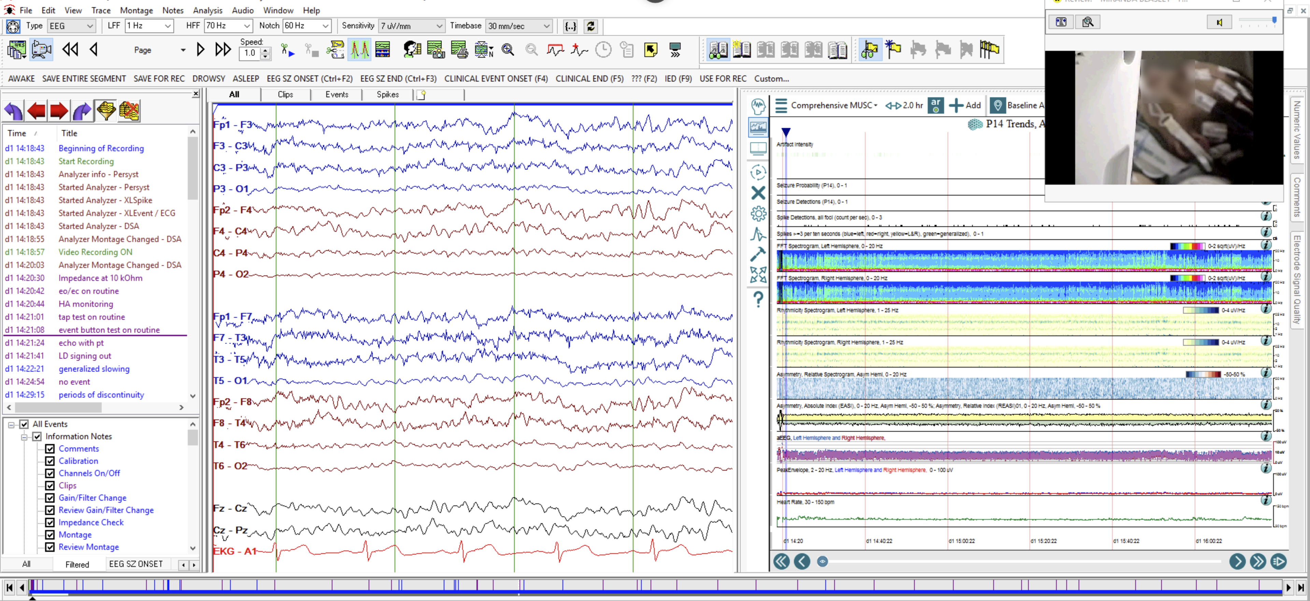
Annotations and Montages

Slide 8
Annotations / Observation
Waveform Annotation SR comprised
  Measurements, observations, free text Annotations
  observer and observation time point
  Defined CIDs (new ones, extension of existing), extensible
  time coordinates
  referenced Waveform objects
  referenced channels
Template is derived from TID 1500 Measurement Report

Slide 9
Annotations and their Relationship
Annotations in the WAVEFORM object
  Waveform Annotation Module
    PS3.3 A.34.12.4.7 Waveform Annotation Module​:
    Note​:
    Annotations can be stored either in the Waveform Annotation Module of the waveform to which they apply, or in a separate​ Structured Report object. The Waveform Annotation Module is only intended for annotations made at the time of acquisition.
    Annotations relate to the current object
    (0040,A0B0) Referenced Waveform Channels denotes the multiplex group and the channels; (M,C) value pairs (multi-value)
Observations and Measurements in an SR (VT WAVEFORM)
  Waveform Reference Macro:
    Composite SOP Instance Reference (SOP Instance UID + SOP Class UI)
    (0040,A0B0) Referenced Waveform Channels denotes the multiplex group and the channels; (M,C) value pairs

