Slide 1
DICOM
Second Generation Radiotherapy
Supplement 213
Enhanced RT Image
and
RT Patient Position Acquisition Instruction
DICOM Working Group 07
Radiotherapy

Slide 2
Supplement Scope
Radiotherapy Imaging for Patient Position Detection:
Various imaging technologies result in various IODs
Advice to Procedure Execution:
Acquisition Devices are instructed about details of Acquisition
Scope of Supplement 213 in red
Technology | Result IODs | Acquisition Instruction IOD
Projection / RT Image | Enhanced RT Image -> Sup 213 | Included -> Sup 213
CT | CT | Included -> Sup 213
MR | MR | Future Extension
Ultrasound | US | Future Extension
Surface Scanning | Surface | Future Extension
Transponder Marker | Segmentation, Fiducials | Future Extension
…others | …others | Future Extension

Slide 3
Supplement Content
2 IODs for RT Image
  Enhanced RT Image
  Enhanced Continuous RT Image
1 Instruction IOD
  RT Patient Position Acquisition Instruction
Several Macros
Applicability (to RT Radiation Sets, RT Radiations…)
Geometry (Image Source and Receptor in respect to Equipment)
Signal Generation (KV, MV, later: others)
Usage across all 3 IODs:
  RT Image IODs: Recording parameters used during acquisition
  Instruction IOD: Specifying parameters to be used during acquisition

Slide 4
RT Image Functional Scope
(substantially same scope of content as in 1st Generation)
Image Characteristics
Projection Image
May be:
  Single Frame
  Couple of Frames
  Continuous acquisition
  (MPEG)

Slide 5
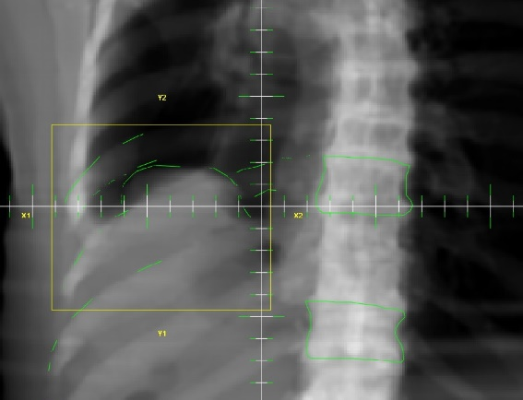
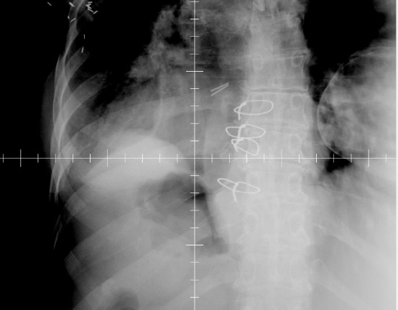
RT Image Clinical Role
Image Object may represent
Images acquired
before / during / after therapeutic Radiation
Images re-constructed from 3D Images prior to Treatment
‘DRRs’, ‘Reference Images’, constructed in Treatment Planning phase
  Used for verification:
  Comparison against acquired Images
DRR Acquired

Slide 6
RT Image Clinical Role
Patient Position Detection and Correction
Acquire RT Image with patient on table.
Relate current Patient Position in respect to treatment device
Determine correction of Patient Position:
  Determine current beam geometry in respect to patient
  Relate current beam geometry to planned beam geometry
  (in respect to patient)
  - as needed -
  Align position and orientation of patient to match planned beam geometry
RT Image provides well-defined path of geometric calculation:
  From: treatment beam in device coordinates
  To: Patient FOR
  For various type of treatment devices
  Crucial for correct placement of therapeutic radiation

Slide 7
RT Image Clinical Role
Patient Position Monitoring
RT Images acquired during Therapeutic Radiation Delivery
With various frequencies / trigger points
Various Modes of Use, namely
  During-treatment observation
  Ensure that position stays within certain limits
  Post-Treatment Monitoring
  To verify, that the position was within limits
  Assess amount of motion

Slide 8
Functional Requirements
Geometric Content
Generalized description of geometric relation of Image
  to Treatment device
  to Patient positioning device
Therapeutic Beam-related Content
State of Device where the Image relates to:
  Meterset / Time
  Related to device states (e.g. gantry rotation, collimation etc.)
  Description of Beam Modifiers in generalized approach of 2nd Gen
Therapeutic Context
RT Radiation, RT Radiation Set
Treatment Session and Treatment Fraction

Slide 9
Why 2nd Generation?
Use of 2nd Gen concepts
  RT Image Context to RT Radiation Sets, RT Radiations
  Using Equipment Coordinate System
  Generalizing geometry specification to handle variety of Imaging devices and Treatment Device geometries – re-use Macros
  Using 2nd generation macros to describe Patient Position,
  Beam Modifiers, Radiation – re-use Macros
Use of Enhanced Multi-Frame Approach
  Benefit from Multi-Frame Functional Groups formalism
  Stay in line with current Multi-Frame of other IODs
Cleaning up / strengthening / expanding…
  the historically grown patchy structure and representation
  of 1st Gen RT Image IOD

Slide 10
Part of 2nd Generation RT
2nd Gen Use of application of
Equipment FOR and Patient FOR

Slide 11
Acquisition Instruction
RT Patient Position Acquisition Instruction IOD
Contains specification for (as applicable):
RT Patient Support Device Position
  Specified Position in respect to Equipment Coordinate System at which acquisition shall be performed
Acquisition Device Position
Positions of Acquisition Devices in respect to Equipment Coordinate System when artifacts are acquired
Acquisition Execution Parameters
  Parameters to be used when artifacts are acquired
  Acquisition Triggers
  Specifies when devices should perform the acquisition
  Current Coverage in Supplement 213:
  MV / KV, Projection and Volumetric Image Acquisition
  Other modalities / technologies may be added to this IOD by future supplements
  IOD designed for extensibility

Slide 12
RT Pat. Position Instruction
Task
Index / Workitem Code
Applicability Scope
References to Radiation Instances / Treatment Groups
Subtask
(1-n)
Index / Specialized Workitem Code
Acquisition Template Identifier
Baseline Radiation Reference
RT Device Distance Reference
Acquisition Initiation
Source Signal Generation
- kV Generation
- MV Generation
RT Device to Patient Geometry
- Projection Imaging Geometry
- 3D Imaging Geometry
Device-Specific Parameters
Additional Devices / Parameters
Position Reference Instances

Slide 13
One Subtask Example
Task
Workitem Code = (121702, DCM, “RT Patient Position Acquisition, single plane MV“)
Applicability Scope = RT Radiation “AP”
Subtask 1
Index = 1
Workitem Code = (121702, DCM, “RT Patient Position Acquisition, single plane MV“)
Acquisition Initiation = (S213504, 99SUP213 “Acquisition Initiation at specified value”)
(Start Paramater) = (S213520, DCM, "Meterset") = 10 MU
MV Generation = 6 MV
Projection Geometry = Gantry Angle 0
Position Reference Instance = RT Image “AP”

Slide 14
Two Subtask Example kV/kV
Task
Workitem Code = (121705, DCM, “RT Patient Position Acquisition, dual plane kV“)
Applicability Scope = RT Radiation “AP”
Subtask 1
Index = 1
Workitem Code = (121704, DCM, “RT Patient Position Acquisition, single plane kV“)
Acquisition Initiation = (S213502, 99SUP213 “Acquisition Initiation before start of Radiation”)
kV Generation = 80 kV
Projection Geometry = Source Angle 0
Position Reference Instance = RT Image “AP”
Subtask 2
Index = 2
Workitem Code = (121704, DCM, “RT Patient Position Acquisition, single plane kV“)
Acquisition Initiation = (S213502, 99SUP213 “Acquisition Initiation before start of Radiation”)
kV Generation = 80 kV
Projection Geometry = Source Angle 90
Position Reference Instance = RT Image “LATR”

Slide 15
Two Subtask Example kV/MV
Task
Workitem Code = (121706, DCM, “RT Patient Position Acquisition, dual plane kV/MV“)
Applicability Scope = RT Radiation “AP”
Subtask 1
Index = 1
Workitem Code = (121704, DCM, “RT Patient Position Acquisition, single plane kV“)
Acquisition Initiation = (S213502, 99SUP213 “Acquisition Initiation before start of Radiation”)
kV Generation = 80 kV
Projection Geometry = Source Angle 90
Position Reference Instance = RT Image “LATR”
Subtask 2
Index = 2
Workitem Code = (121702, DCM, “RT Patient Position Acquisition, single plane MV“)
Acquisition Initiation = (S213502, 99SUP213 “Acquisition Initiation before start of Radiation”)
MV Generation = 6 MV
Projection Geometry = Source Angle 0
Position Reference Instance = RT Image “AP”

Slide 16
Acq Instr: Tasks to perform
One or more Acquisition Tasks
For example:
Task 1: One KV/MV Image pair prior to therapeutic beam
Task 2: 5 MV Images during beam
Task 3: One KV Image after beam
A task applies to:
a set of RT Radiation Sets
or a set RT Radiations
or a Treatment Position group.
One or more Subtasks per Task.
Per example of above:
Task 1: 2 subtasks: one for KV, one for MV
Task 2: 1 subtask for MV, with 5 trigger values defined
Task 3: 1 subtask for MV

Slide 17
Acq Instr: Specification Approaches
Parameters are specified by:
Indirectly by Protocol
Refer to a protocols knows to the acquisition device
  by Code, or
  by ID
User may fine-tune this protocol at the acquisition device any time
  Protocol identification stays the same
  Protocol Version tracking out of scope
  Device – based settings may be traced locally at the device
Directly by explicit Parameters:
As indicated in the following slides
Any combination of Protocol-inferred and explicit Parameters supported
Addresses variability of devices in terms of
Technology
Generation

Slide 18
Acq Instr: Geometry
Basis: Equipment FOR
Same approach as used for RT Radiation IODs as well
Device Geometries
Transformation Matrix from Equipment FOR to
Imaging Source Coordinate System
Image Receptor Coordinate System
User-readable decomposition optionally supported for applications, which can´t do this
    concept as used in RT Radiations as well
Patient Positioner Geometry
Use of existing 2nd Generation Approach
Relate Patient FOR to Equipment FOR
Library Approach
  Specify Patient Position once
  Apply many times by reference, since most treatments have static positions, but some do not

Slide 19
Acq Instr: Signal Generation
Generation of MV (therapeutic) Beam for Imaging
Use of 2nd Gen Radiation Generation Macro
Covers MV Photons and Particles
Incl. all beam generation specifics for the therapeutic beam devices
Generation of KV (therapeutic) Beam for Imaging
Use of existing (KV) X-Ray Attributes
Covers KV Photons
(future outlook: Addition of other technologies as needed)

Slide 20
Contacts
Christof Schadt
  Co-Chair WG-07
  Brainlab AG
christof.schadt@brainlab.com
Jim Percy
  Co-Chair WG-07
  Elekta
jim.percy@elekta.com
Ulrich Busch (Editor)
  Member WG-07
  Individual
ulrich.busch@bluewin.ch

