Slide 1
DICOM WG 31
June 2021
Revision of the DICOM Conformance Statement Template (Supplement 209)
Antje Schroeder (Siemens Healthineers)
Bruno Laffin (AGFA Healthcare)
Herve Hoehn (GE Healthcare)
Yogalakshmi Selvarajan (Philips)
Carolyn Hull (MITA)

Slide 2
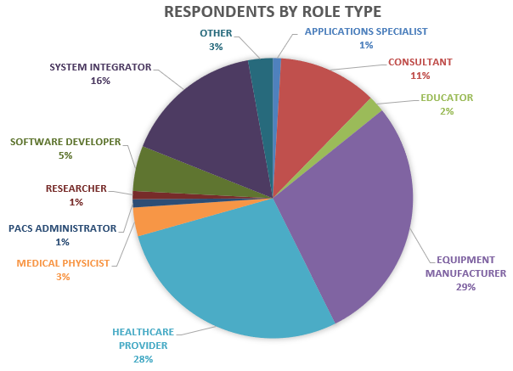
Background and motivation for revision
Based on a survey¹ the following problems were identified in current DICOM Conformance Statement (DSC) vendor documents
  Too technical, not suited for all user groups
  Too many differences across vendors
  Incomplete, making comparison difficult
  Too many repeats, much repetitive information
  Bad information grouping, information
  belonging together split across sections
  Missing information on display capabilities, web services, security…
  ^{I}) WG31 DSC Survey, 211 responses, May-June 2017

Slide 3
Objectives for the DSC template and instruction revision
Main improvements targeting content and structure to facilitate:
  Better meet needs of all user groups (service, R&D, testing, sales …)
  Better facilitate comparing different product’s DICOM functionality
  Provide essential information in table format for readability and processing
  Avoid ambiguities/inconsistencies between different vendor documentation
  Address currently not documented functionality (display functionality, web services, security)
  Provide a more detailed template to make it easier for vendors to populate

Slide 4
Structure of new DICOM Conformance Statement
Overview
Table of Contents
Introduction
Implementation Model
Service and Interoperability Description
  DIMSE, Web Services, Media
DICOM Configuration
Network and Media Communication Details
Security
  Annex A: Information Object Definitions
  Annex B: Structured Report Content Encoding
  Annex C: Security Details
  Annex D: Mapping of Attributes

Slide 5
Structure of New Overview Section
Most DCS readers will be able to get all key information from a concise Overview section:
High-level architectural diagram of the supported interfaces
All supported SOP classes, their usage (creation, display, and archival), and transfer syntaxes
All supported DIMSE, web, and media services
Summary of the structured reporting template identifiers (TIDs)
Supported deidentification profiles

Slide 6
Main drivers and contact info
Antje Schroeder (aschroeder@siemens-healthineers.com )
Bruno Laffin (bruno.laffin@agfa.com )
Herve Hoehn (herve.hoehn@med.ge.com )
Yogalakshmi Selvarajan (Yogalakshmi.S@philips.com)
Carolyn Hull (MITA) (chull@dicomstandard.org )
Submit comments to dicom@dicomstandard.org

