Slide 1
WEB SERVICES AND PROTOCOL IOD FOR VOLUMETRIC RENDERING WG-27 PUBLIC COMMENT
22 JUNE 2023

Slide 2
Scope
Introduces
Web services for server-side volumetric rendering
Volumetric Rendering Protocol IOD that specifies:
parameters for Volumetric Rendering
the algorithm for display,
criteria for selecting input images compatible with this protocol
Usage
A web service client can request a rendered result by provide rendering parameters and/or referencing a protocol IOD.
A Volumetric Rendering product can use a protocol IOD to produce a pre-defined rendering.

Slide 3
Guiding Principles
Focus on the most common rendering patterns
Derive parameters from existing Volumetric Presentation State attributes
Keep Volumetric Presentation State behaviors consistent with current Part 18 /rendered
Minimize client burden; can omit detailed parameters, leaving them to the servers’ discretion
Allow servers latitude to define and apply default behaviors (i.e., when in doubt, let the server decide)
State-less (client makes no assumptions about the server ...but server may cache the Volume for performance)
Target degree of rendering consistency similar to Volumetric Presentation State (PS17 XXX.1)
Utilize the same Volume Input Requirements specified for Volumetric Presentation State (PS3 C.11.23.1)

Slide 4
Web Clients
Basic Functions
Advanced Functions
Available in Query Parameters:
Pan
Zoom
Windowing
Set Quality
Rotate
Animate
Set Render Method
Available by referencing a Volumetric Presentation State or a Volumetric Rendering Protocol:
Display Color
Shading and Lighting
Crop
Merge Multiple Volumes
Define a Composite MPR
Annotate
Render projection or orthographic view
Render endoluminal view (i.e., fly through)

Slide 5
Web Services Basic Use Case
ER stroke patient is referred for a CT.
Non-contrast and CTA are acquired to rule out hemorrhage and intravascular thrombus.
Images are reviewed by ER physician.
The hanging protocol specifies a lossless JPEG-LS multi-frame image of thick slab axial MIPs of the CTA.
The viewer submits a web service request with corresponding image references, rendering mode, slab thickness and spacing parameters.
The ER physician views images that best demonstrate the Circle of Willis.
Render series 3 as an axial MIP slab
GET http://server.com.../

Slide 6
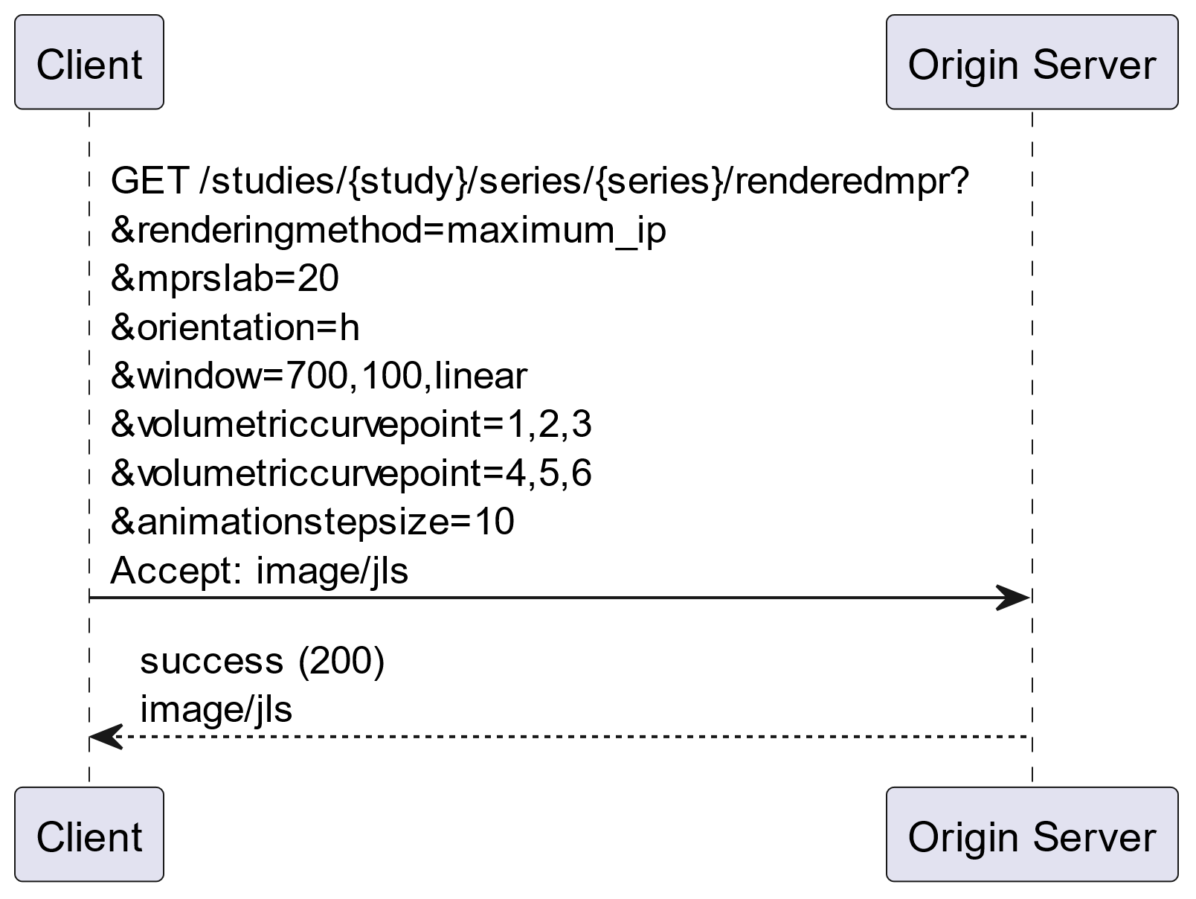
Web Services Basic Use Case
Render a Thick Slab MPR from a Series Target Resource

Slide 7
Web Service Using Volumetric Presentation State
A prospective liver donor is referred for a CT angiogram to assess their hepatic blood supply.
A technologist segments the hepatic vein, portal vein and hepatic arteries in volumetric models that are saved as a DICOM Volumetric Presentation State.
The surgeon selects the presentation state containing the rendered models of the anatomy of interest.
The viewer submits a web service request referencing the presentation state.
Save this segmentation as a presentation state
Render the models we segmented last week
GET http://server.com.../

Slide 8
Web Services Advanced Use Case
Render a Volume Rendering Volumetric Presentation State Target Resource

Slide 9
Relationship of Web Services to Presentation States
Volumetric Presentation States (supplements 156 and 190) save rendering parameters, segmentations and compositing, performed during post-processing of a specific patient study.
Volumetric Rendering services render volumes based on parameters that are specified in the API request or in a Volumetric Presentation State target resource.
Post-Processing
(server or workstation)
Render saved Presentation State
Modality
PACS
Rendering Server
Render based on Query parameters
or
Render a saved Presentation State
Modality
PACS

Slide 10
Relationship of Web Services to Volumetric PROTOCOL IOD
Volumetric Protocol saves rendering parameters as protocol that is generic, and not specific to a particular patient.
Rendering Server with Defined Protocols
Render based on a Defined Protocol
Modality
PACS

Slide 11
WEB Services Query Parameters
Derived from existing Volumetric Presentation State attributes
Used to control image set inputs, algorithm and presentation
When Query Parameters are omitted, the Origin Server is allowed to apply default behavior, or return an error
Query Parameters may override behavior established in a Volumetric Protocol
Query Parameters may not override behavior established in a Volumetric Presentation State, except for orientation

Slide 12
Web Services Rendering Pipeline

Slide 13
Simple Volume Pipeline
A set of frames that meets Volume Input Requirements (PS3 C.11.23.1)
Specify Input Instances or Frames
Resample Inputs that meet Input Requirements as Volume Data
Apply display algorithm and presentation parameters to the Volume Data to create a view
Return 2D representation of the view as requested media type
Volumetric Source Information
Display Algorithm
Desired Slices
Presentation
(View)
Media Type
Target Resource
Simple Volume Data
Algorithm
Presentation
{s}/studies/{study}/series/{series}/rendered3d?renderingmethod=volume_rendered&orientation=a Accept: image/jpeg

Slide 14
Simple Volume Pipeline
A set of frames that requires refinement to meet Volume Input Requirements
Specify Input Instances or Frames
Resample Inputs that meet Input Requirements as Volume Data
Apply display algorithm and presentation parameters to the Volume Data to create a view
Return 2D representation of the view as requested media type
Volumetric Source Information
Display Algorithm
Unrequired Slices
Desired Slices
Presentation
(View)
Media Type
Target Resource
Simple Volume Data
Algorithm
Presentation
...series/{series}/rendered3d?volumeinputreference={uid}&renderingmethod=volume_rendered&orientation=a Accept: image/jpeg

Slide 15
Multivolume Pipeline
A set of temporal frames that requires refinement to meet Volume Input Requirements
Specify Input Instances or Frames
Resample Inputs that meet Input Requirements as Volume Data
Apply display algorithm and presentation parameters to the Volume Data to create a view
Return 2D representation of the view as requested media type
Unrequired Slices
Volumetric Source Information
Display Algorithm
Desired Slices
Desired Slices
Presentation
(View)
Media Type
Target Resource
Multivolume Data
Algorithm
Presentation
{s}/studies/renderedmpr?CardiacRRIntervalSpecified=140-260&renderingmethod=maximum_ip&orientation=a
Accept: video/mp4

Slide 16
Web Services Key Terms
Volume Input Requirements: constraints on the input instances or frames identified as input to Volumetric Rendering. See PS3.3 C.11.23.1 Presentation Input Type Volume Input Requirements for a detailed definition. Only instances or frames conforming to Volume Input Requirements can be rendered
Volume Data: Instances or frames conforming to Volume Input Requirements are resampled into Volume Data, represented by a set of parallel XY planes whose positions are relative to each other, arranged in a cartesian voxel grid.

Slide 17
Specify Inputs & Volume Definition
Volumetric Source Information
Display Algorithm
Desired Slices
Presentation
(View)
Media Type

Slide 18
Web Services Types of Input
Source IOD Type | Target Resource | Target Description | Target Resource
Multi-frame | Instance | An instance containing only a set of frames that satisfy Volume Input Requirements. | /studies/{study}/series/{series}/instances/{instance}
Multi-frame | Instance | An instance containing a set of frames with a subset that satisfies Volume Input Requirements. The subset is explicitly identified by the user agent. | /studies/{study}/series/{series}/instances/{instance}/frames/{frames}
Multi-frame | Instance | An instance containing a set of frames with a subset that satisfies Volume Input Requirements. The subset is identified by the origin server based on characteristics provided by the user agent. | /studies/{study}/series/{series}/instances/{instance}
Volumetric Presentation State | Instance | An instance containing references (in the Volumetric Presentation Input Set Sequence) to a set of frames that satisfy the Volume Input Requirements | /studies/{study}/series/{series}/instances/{instance}
Single Frame | Series | A series containing only a set of instances that satisfy Volume Input Requirements. | /studies/{study}/series/{series}
Single Frame | Series | A series containing a set of instances with a subset that satisfies Volume Input Requirements. The subset is identified by the origin server based on characteristics provided by the user agent. | /studies/{study}/series/{series}

Slide 19
Web Services Related Parameters
Parameters to specify input frames within the Target Resource that meet Volume Input Requirements (PS3 C.11.23.1)
volumeinputreference: an image having characteristics of what is to be rendered (i.e., render images like this)
Attribute Matching: specifies common Attribute/Value pair characteristics of the Volume Data (PS3.18 8.3.4.1)
volumetricprotocol: includes optional modules with Volume Data input criteria

Slide 20
Web Services Examples
Target Resource | Parameter | Volume Type
Legacy Instances in 1 Series
/studies/{uid}/series/{uid}/ |  | Simple
Multiple Phases, each in its own series
/studies/{uid}/ | CardiacRRIntervalSpecified=140-260 *defines image set, server determines volume grouping | Muli-volume
Legacy Series Containing Multiple Phases
/studies/{uid}/series/{uid}/ | Acquisition​Number=1-3 *defines image set, server determines volume grouping | Muli-volume
1 Phase/Stack within a Legacy Series Containing Multiple Phases
/studies/{uid}/series/{uid}/ | Acquisition​Number=2 | Simple
1 Stack within an Enhanced Instance Containing Multiple Stacks
/studies/{uid}/series/{uid}/instance{uid}/ | StackId={n} | Simple

Slide 21
Web Services Use Case: Multiphase liver
3 scans through the liver are obtained , each corresponding to a contrast phase (arterial, portal-venous and venous)
All images are in a single series of Legacy CT Image objects.
The scanner used to acquire the images increments Acquisition Number (0020,0012) for each “pass” through the liver:
1 = arterial
2 = portal-venous
3 = venous
Example:
Acquisition 1
Acquisition 2
Acquisition 3
.../series/{series}/renderedmpr?AcquisitionNumber=1-3
&renderingmethod=maximum_ip
&orientation=a
&animationrate=10
Accept: video/mp4

Slide 22
Algorithm
Volumetric Source Information
Display Algorithm
Desired Slices
Presentation
(View)
Media Type

Slide 23
Web Services Related Parameters & RESOURCES
Control the rendering algorithm applied to the Volume Data
New Resources
/rendered3D: resource specifies 3D volumetric rendering
/renderedMPR: resource specifies planar reformatting
New Parameters
renderingmethod: the display algorithm, i.e., volume rendered, MIP, MINip, average
mprslab: MPR slab thickness
volumetricprotocol: advanced control (Volume Render Geometry, Render Shading, Render Display, Multi-Planar Reconstruction Geometry, MPR Volumetric Presentation State Display)

Slide 24
Web Services Related Parameters & RESOURCES
Control the rendering algorithm applied to the Volume Data
Existing Parameters (see PS3.18, Section 8.3.5.1.4)
Windowing: control window/center of MIP, MINip, average renderings

Slide 25
Web Services Examples
 | Rendering Type | Rendering Method | VOI | Color | Slab
3D VR | /rendered3D |  |  | volumetricprotocol
3D MIP | /rendered3D | =maximum_ip | window, center, function
Planar reformat (nominal thickness) | /renderedMPR | =average_ip | window, center, function
5mm slab, average | /renderedMPR | =average_ip | window, center, function |  | mprslab=5
25mm thick slab MIP | /renderedMPR | =maximum_ip | window, center, function |  | mprslab=25
2mm slab, minIP | /renderedMPR | =minimum_ip | window, center, function |  | mprslab=2
10mm slab VR | /renderedMPR |  |  | volumetricprotocol | mprslab=10
Copyright DICOM® 2023
25

Slide 26
Presentation
Volumetric Source Information
Display Algorithm
Desired Slices
Presentation
(View)
Media Type

Slide 27
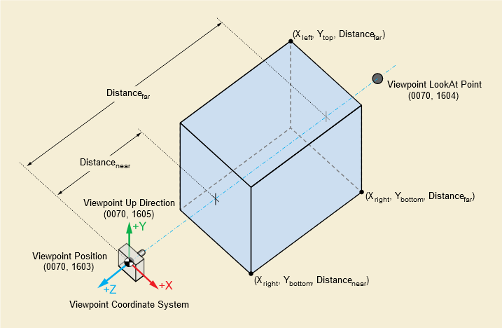
Web Services Related Parameters
viewport: control scaling (i.e., Render Field of View) of the rendered 2D image or video
Two mutually exclusive options to determine the initial orientation of the resampled Volume Data:
The “orientation” parameter establishes the standard anatomic position of the patient as viewed by the camera, and
Camera orientation parameters (“viewpointposition”, “viewpointlookat”, or “viewpointup”) establish the camera position and direction as it views the patient. See C.11.30.1 in PS3.3

Slide 28
Animation
Volumetric Source Information
Display Algorithm
Desired Slices
Presentation
(View)
Media Type

Slide 29
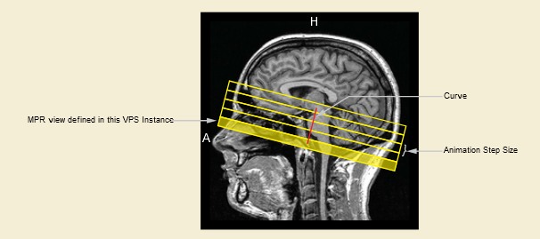
Related Parameters
Initial frame is established by orientation parameters. The animation parameters dictate subsequent frames. The origin server determines initial phase displayed for multivolume temporal data,
swivelrange: angular range over which a rendered volume rotates around the swivel axis
volumetriccurvepoint: specifies coordinates of points of the animation curve
animationstepsize: specifies distance between animation steps (degrees between steps in a swivel, or mm between steps along an animation curve)Identical to animation in a Volumetric Presentation State
volumetricprotocol: advanced control using the Presentation Animation Module
See PS3.17 XXX.3.4.1

Slide 30
Web Services Example
 | Media Type | Rendering Type | Animation | Direction | Rate
Single Volume | Image | /rendered3D /renderedMPR | none
 | Video | /rendered3D | Rotating 3D | swivel | animationrate steps
 | Video | /renderedMPR | Planar stack | volumetriccurvepoints | animationrate steps
 | Video | /renderedMPR | Radial batch stack | volumetriccurvepoints | animationrate steps
Temporal Volume
 | Video | /rendered3D /renderedMPR | Beating heart |  | animationrate
 | Video | /rendered3D | Rotating + Beating heart | swivel | animationrate steps
 | Video | /renderedMPR | Planar stack + Beating heart | volumetriccurvepoints | animationrate steps

Slide 31
Return Image
Volumetric Source Information
Display Algorithm
Desired Slices
Presentation
(View)
Media Type

Slide 32
Media Types
Volumetric Presentation | Resource Category (PS3.18 Table 8.7.2-1) | Return Media Type (PS3.18 Table 8.7.4-1) | Example
Static | Single Frame Image | image/jpeg image/gif image/png image/jp2 image/jls | Lateral projection of a 3D ankle
Animated | Multi-Frame Image | image/gif | Rotating 3D ankle
Animated | Video | video/mpeg video/mp4 video/H265 | Rotating 3D ankle

Slide 33
Returning RenderING Attributes
Use Case
A client requests a 3D volume rendering without query parameters
The origin server returns the rendering based on default values that it chose to apply
The client wants to request a new rendering, with different camera position parameters.
volumetricmetadata: return a response module containing attributes that can be specified by the client as Query Parameters in a future request

Slide 34
Volumetric Rendering Protocol

Slide 35
Volumetric Rendering Protocol
Facilitates post processing operations by offering the operator pre-defined rendering parameters, such as: color, shading, and lighting
Protocol parameters are reused from the existing Volumetric Presentation States
The Volumetric Rendering Protocol IOD is a part of the family of Defined Protocols, and provides a means to specify a set of general volumetric rendering parameters for a specific clinical application
Typical use case:
Select the images to be rendered
Identify the desired protocol by selecting a representative thumbnail view
Launch the volumetric rendering application
The volumetric rendering application applies the rendering parameters specified in the protocol to the selected images
Note:
Protocols may be specific to a manufacturer, modality, or a modality performed procedure protocol

Slide 36
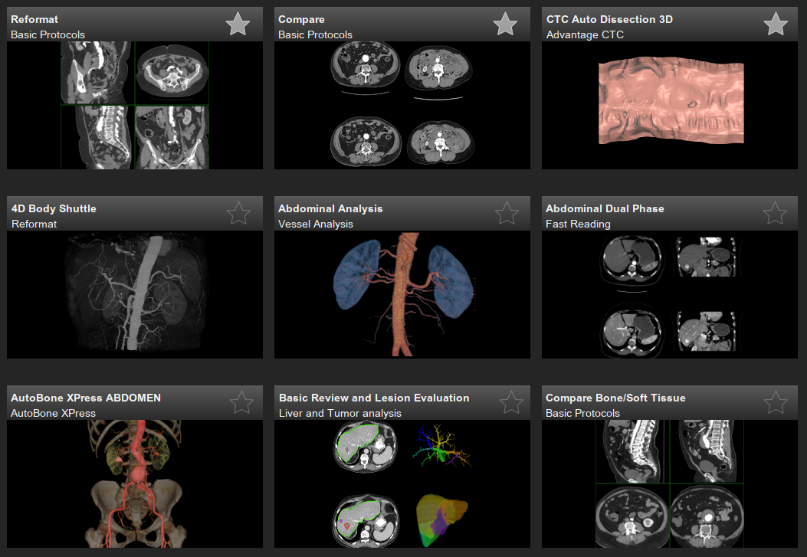
Typical Volumetric Rendering Protocol Workflow
Desired Slices
Input Images
+
Protocol
=
Rendering

Slide 37
Volumetric Protocol
Module | Purpose
Protocol Context | Reused from Defined Procedure Protocol IODs
General Equipment Module
Enhanced General Equipment Module
Instructions
Volumetric Rendering Protocol Module | Rendering type (3D vs MPR) Thumbnail Volume organization
Volume Data Input Image Set Module | Specifies inputs using the Attribute Value Constraint Macro
Volume Definition Module | Organize inputs into one or more Volume Data using the Attribute Value Constraint Macro
Volume Render Geometry | Reused from Volumetric Presentation States Sets multi-planar or volume rendering parameters
Render Shading
Render Display
Multi-Planar Reconstruction Geometry
MPR Volumetric Presentation State Display
VOI LUT
Presentation Animation

Slide 38
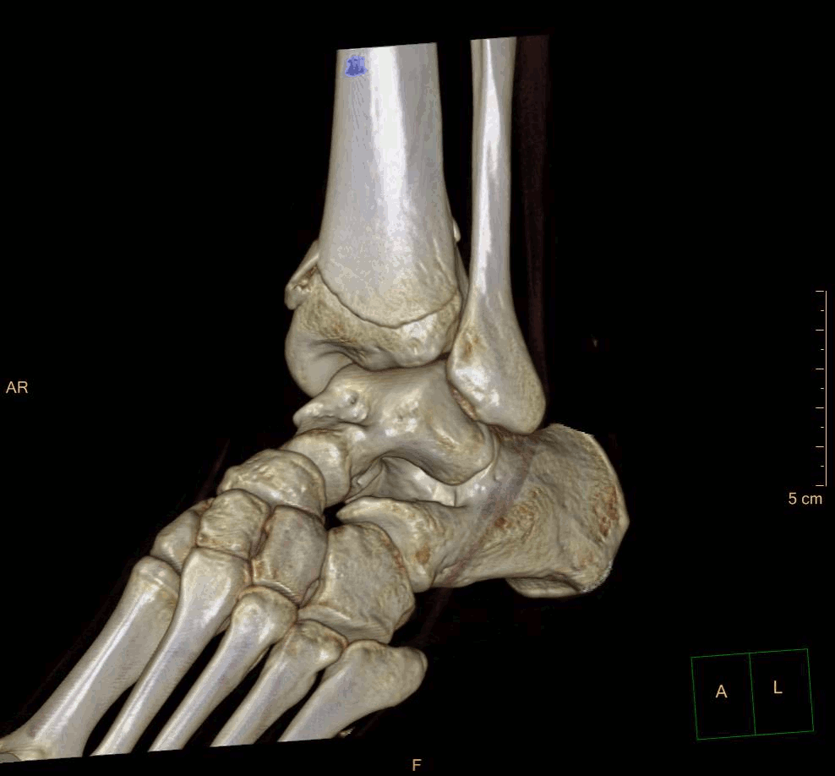
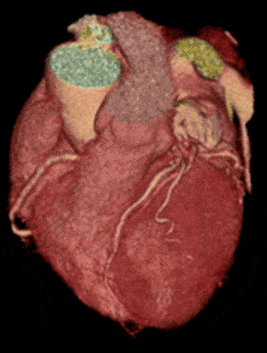
Volumetric Protocol Volume Organization Modules
Y
Simple volume
Z
X
Volumes can be organized as:
Simple volume
Temporal multi-volume
Multi-stack (spatially separated volumes)
Temporal multi-volume
t n
t 3
t 2
t 1
s1
Multi-stack
s2
s3

Slide 39
Volumetric Protocol Volume Organization Modules
Steps to organize input images into sorted volumes
Desired Slices
Unrequired Slices
Volumetric Source Information
Desired Slices
Desired Slices
Step 1: Identify Desired Images
(Volume Data Input Image Set Module)
Step 2: Define Volumes
(Volume Definition Module)
Step 3: Sort Volumes for Processing
(Volume Definition Module)

Slide 40
Volumetric Protocol Examples
Target Resource | Input Set | Volume Organization
Legacy Instances in 1 Series
/studies/{uid}/series/{uid}/ |  | VOLUME
Multiple Phases, each in its own series
/studies/{uid}/ | Selector Attribute Name = Cardiac R-R Interval Specified RANGE_INCL = 140\260 | TEMPORAL_VOLUME
Legacy Series Containing Multiple Phases
/studies/{uid}/series/{uid}/ | Selector Attribute Name = Acquisition ​Number RANGE_INCL = 1\3 | TEMPORAL_VOLUME
1 Phase/Stack within a Legacy Series Containing Multiple Phases
/studies/{uid}/series/{uid}/ | Selector Attribute Name = Acquisition ​Number EQUAL = 2 | VOLUME
1 Stack within an Enhanced Instance Containing Multiple Stacks
/studies/{uid}/series/{uid}/instance{uid}/ | Selector Attribute Name = Stack ID EQUAL= {n} | VOLUME

