Slide 1
Supplement 231
Adaptive Dynamic Range GSPS
Prepared by Steve Nichols & Wim Corbijn, On Behalf of DICOM Working group 06
Public Comment
4 April 2022

Slide 2
Introduction / Scope
This supplement defines a new SOP Class that relaxes the requirements of the existing GSPS SOP Class for modalities in which the dynamic range varies between images or frames
This SOP class will not include the GSPS Modality LUT and address handling of Modality LUT in the referenced image(s)
See also: https://groups.google.com/g/comp.protocols.dicom/c/Nh6gFWhvebg?pli=1

Slide 3
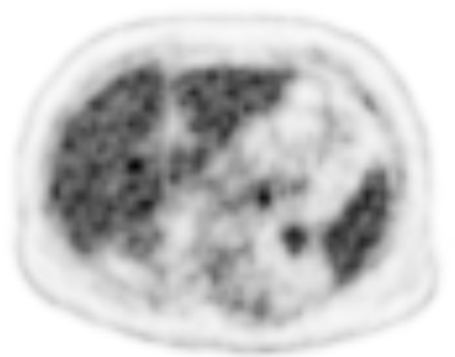
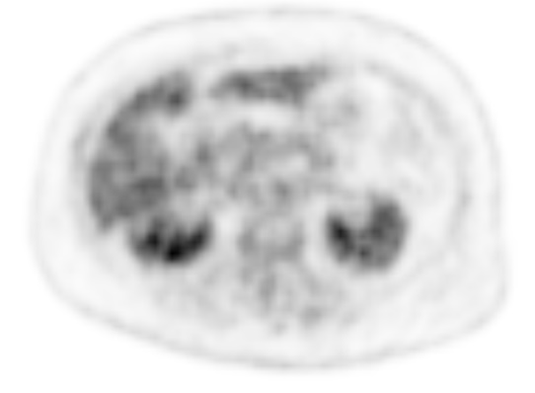
Example
Dynamic range varies per image based on tracer concentration, resulting in a varying per-image rescale slope.
Adaptive Dynamic Range GSPS enables a single object for presentation control

Slide 4
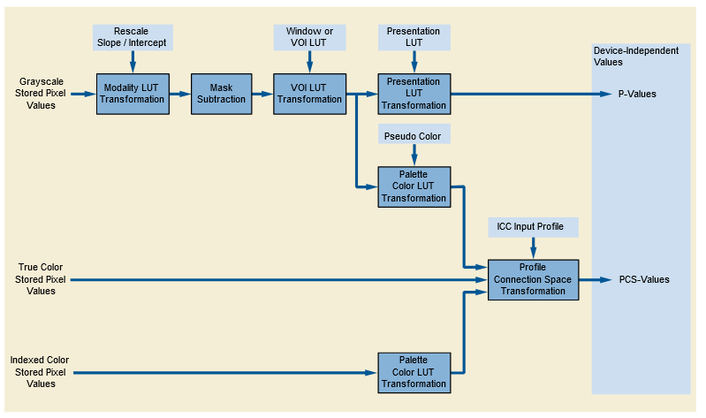
Referenced Image(s)
GSPS
Referenced Image(s)
Adaptive Dynamic Range GSPS
Modality LUT

Slide 5
Open Items
1. | Should there be a Corresponding Pseudo-Color Softcopy Presentation State? Public comment is sought on this.

Slide 6
Closed Items
1. | What is an appropriate name for the SOP class presented in this Supplement? Response: Adaptive Dynamic Range GSPS
2. | In GSPS, Spatial Transformations apply to all referenced images. Is there interest in including selective and/or multiple spatial transformations (i.e. flip and rotate) in this SOP class? Response: There is interest, however, WG-06 prefers to not to include spatial transformations in the scope of this supplement, as selective/multiple spatial transformations are not related to Modality LUT transformations.

