Slide 1
DICOM Educational Conference
Chennai, India
October 9-11, 2023
Unlocking a Hospital System’s Proprietary Laboratory Information System and Enabling Enterprise Imaging for Non-Whole Slide Imaging Pathology Data
DesAcc North America
Hugh Lyshkow
BSEE, CEO

Slide 2
Overview
Summary
  Stanford Healthcare’s move from a legacy pathology system was the perfect time to convert everything to DICOM
  The process of converting that data to DICOM encompassed discovery, mapping, validation and testing
Objectives
  Learn that pathology data encompasses more than just Whole Slide Imaging (WSI)
  Show that non-WSI pathology images, documents and reports can form a rich dataset
  Discovery how an entire silo of non-DICOM data can brought into the DICOM world

Slide 3
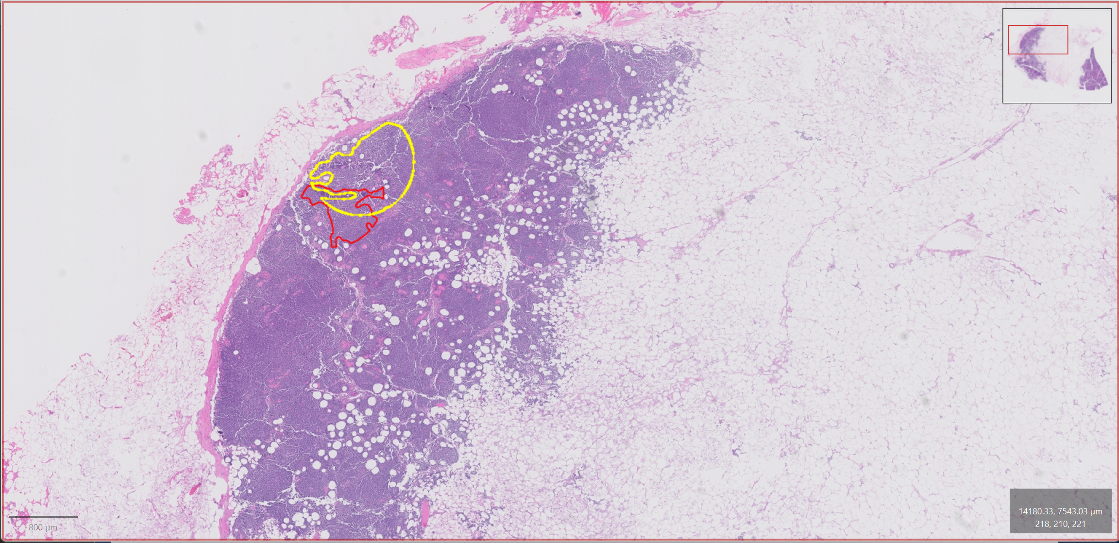
What is a Pathology Image in DICOM?
In the DICOM world, when we say “Pathology Images” we normally only think of Whole Slide Images (WSI)
Even then, proprietary file formats are more common than data in DICOM format

Slide 4
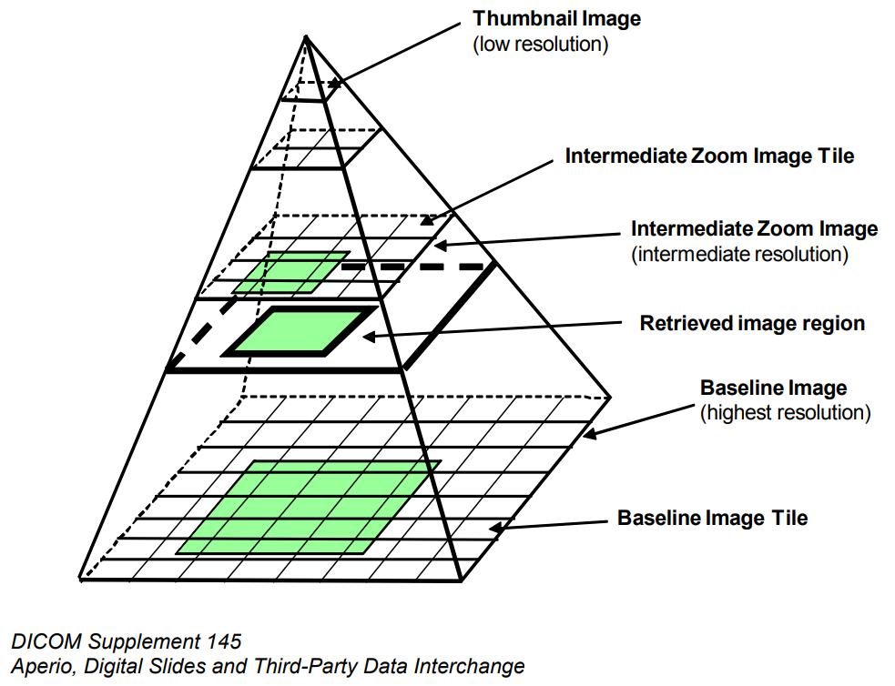
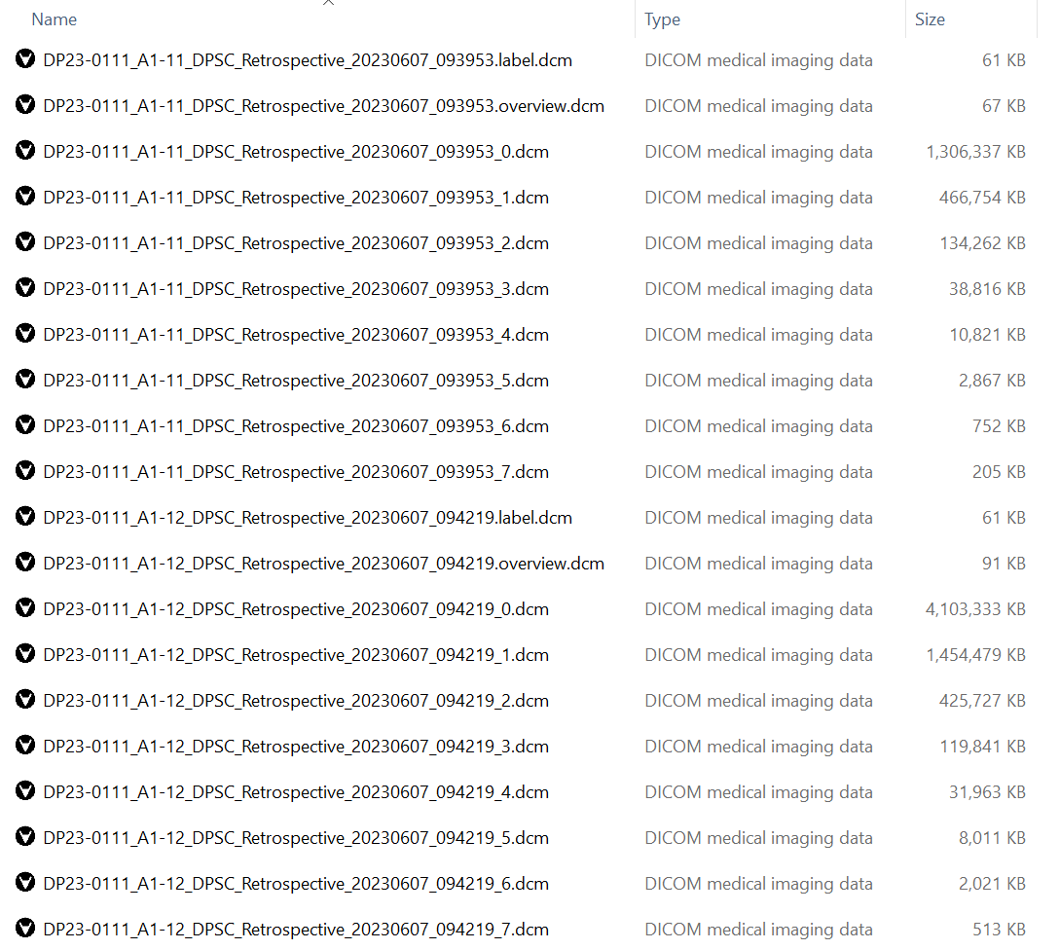
What is a WSI DICOM Instance?
WSI Instances are large and different than other types of DICOM
Each DICOM instance contains a level of the image pyramid
Secondary label and overview images are also separate instances
WSI requires a WSI-capable PACS to properly view this data
Non-WSI do not require a separate WSI-capable PACS
All files relate to a single slide

Slide 5
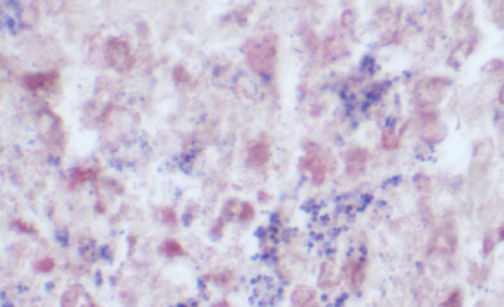
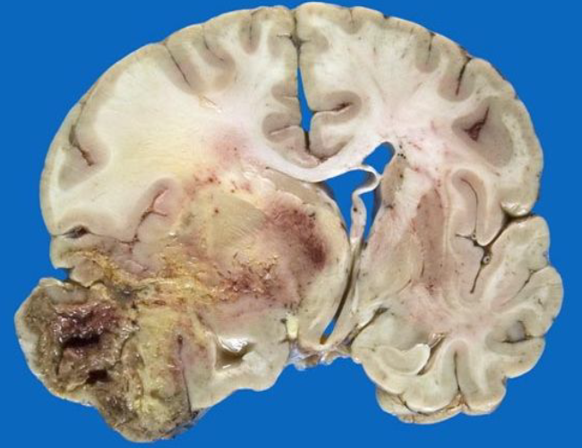
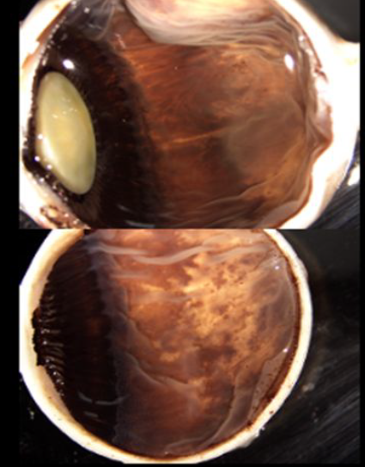
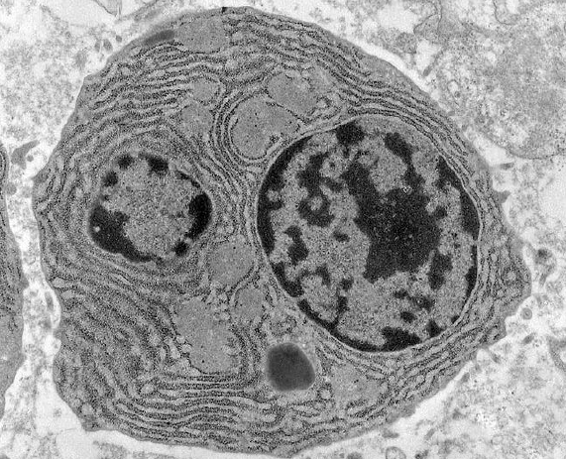
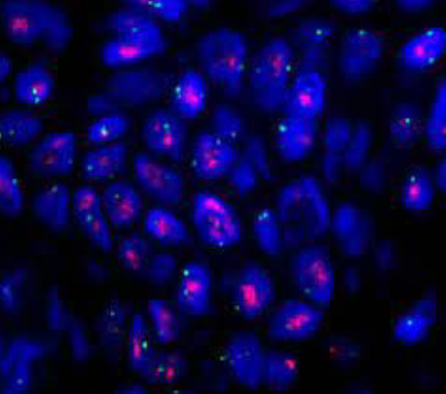
What Are Non-WSI Pathology Images?
Everything else related to patient pathology
There are an assortment of images taken within the Pathology Department
These include gross, electron microscopy, in-situ hybridization, autopsy and light microscopy images, among others

Slide 6
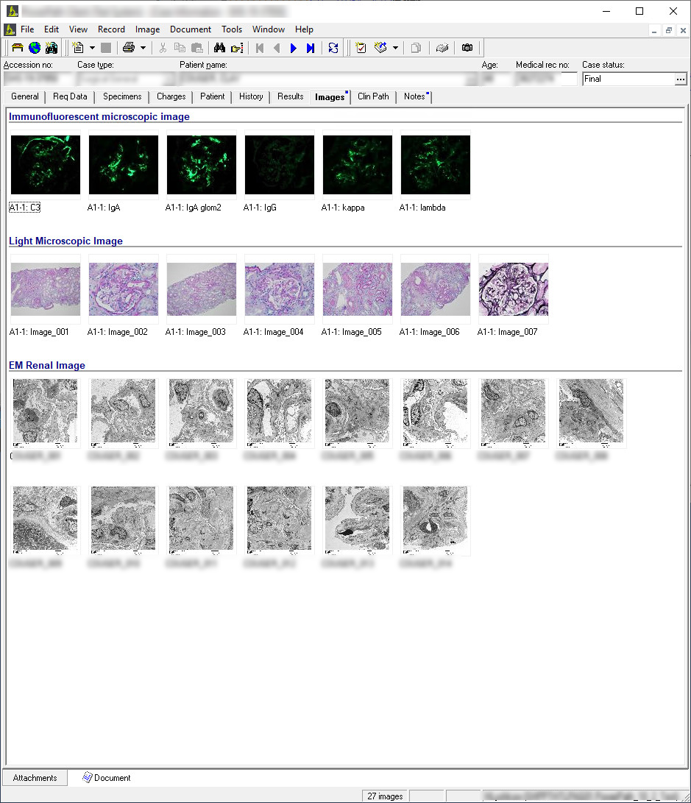
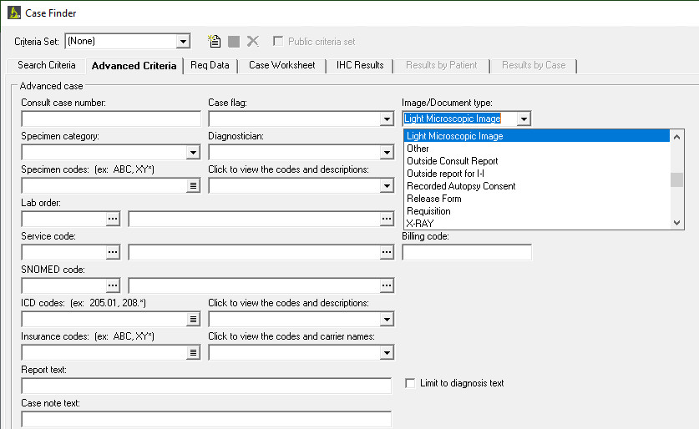
The Anatomical Pathology Laboratory Information System (APLIS)
The APLIS, where these images normally reside
  Proprietary
  Non-DICOM
  (May) contain links to WSI Images
  Highly customised

Slide 7
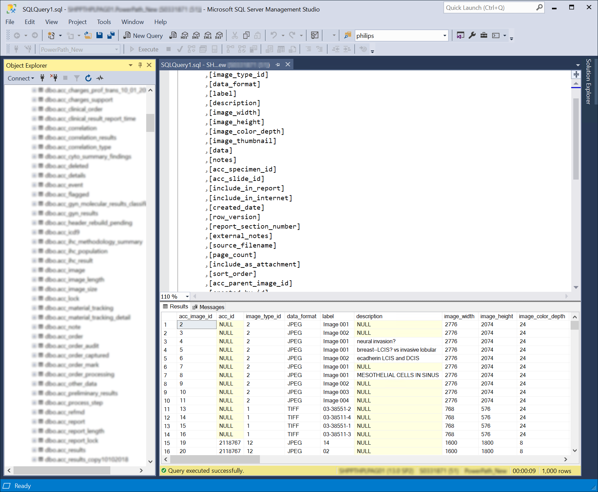
Each APLIS Represents Data In Its Own Way
Each APLIS database is different
  In Stanford’s case, there are more than 250 tables within their production database
  A hospital system will normally have a Database Administrator (DBA) with knowledge of the database schema, able to run custom queries and generate reports
  This is very different to the DICOM world, where the PACS is a black box, accessed using DICOM primitives such as
    C-FIND/C-MOVE (Query/Retrieve)
    C-STORE (DICOM Send/Receive)

Slide 8
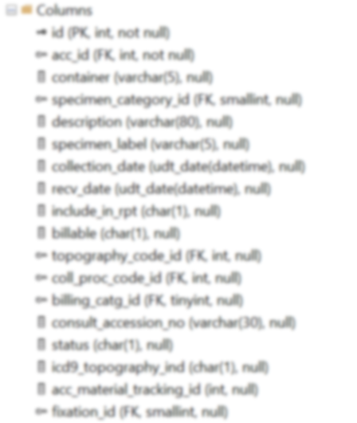
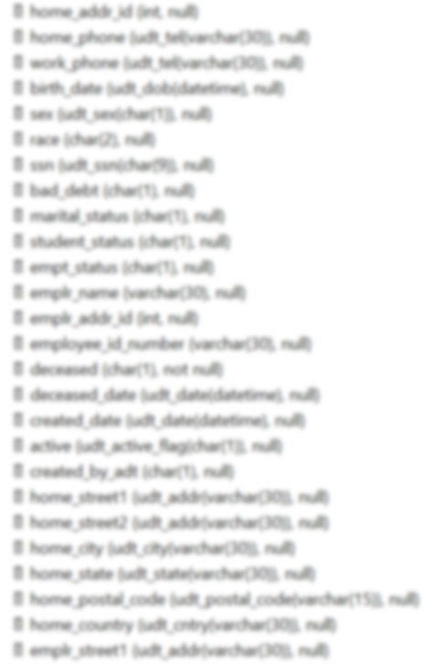
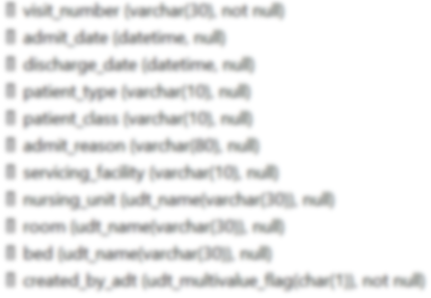
The First Steps to DICOM: Database Variable Discovery
The first step to any DICOM conversion is to identify the values that are required by DICOM
To begin with we looked for the basic, minimum required information required to make the simplest of DICOM Secondary Capture instances
These include patient identifiers and image specific information, such as image width, image height and pixel depth
“Keep it Simple” is the principle

Slide 9
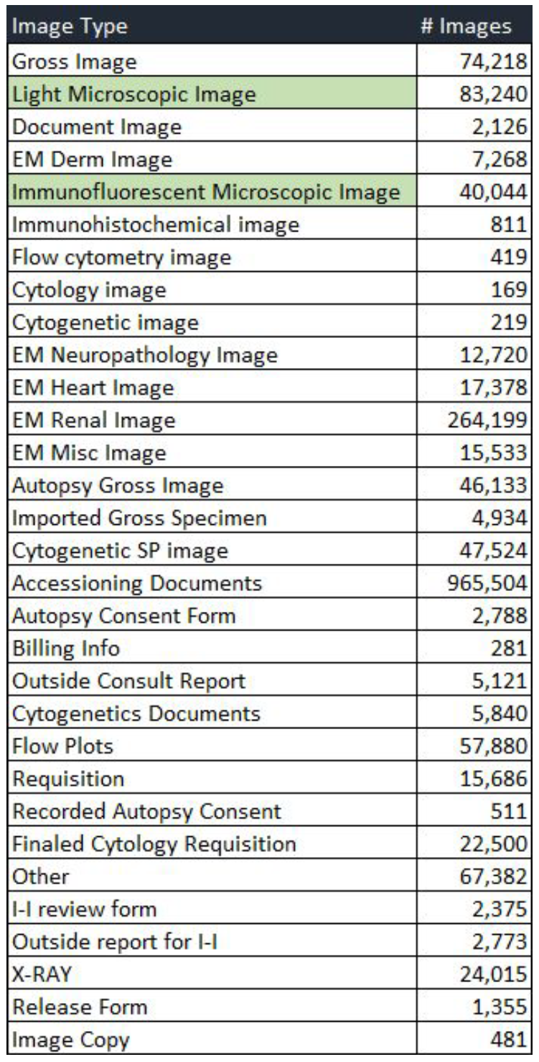
Examining the Types of Images Found within the APLIS
Pathology is not just Microscopy Images!
A break down of the image data stored on the APLIS shows that microscopy data makes up a small amount of the underlying image data.
It also shows the richness of the data that may not make its way into a PACS or VNA environment due to the radiology focus of DICOM.

Slide 10
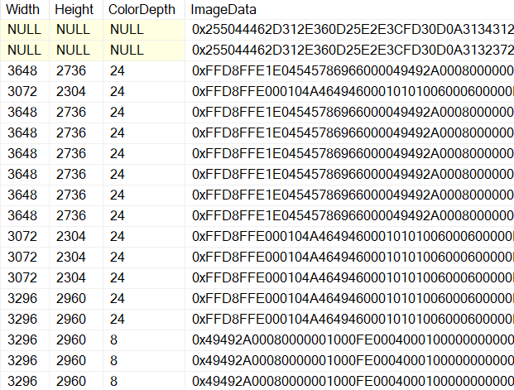
Where are the images? There don’t seem to be any files!
Databases can either contain references to external files or can contain the image data as blobs stored internally
In this case, data is stored internally as blobs
The first characters of each ImageData row indicate the file type:
  0x25 0x50 0x44 0x46 = “%PDF” (PDF File)
  0xFF 0xD8 = (JPEG Start Marker)
  0x49 0x49 0xA0 = “II*” (TIFF File)

Slide 11
Mapping APLIS Image Classes
ID | DESCRIPTION | TYPE | COUNT
1 | Gross Image | Specimen | 58,141
2 | Light Microscopic Image | Slide | 73,970
3 | Document Image | Document | 2,122
4 | EM Derm image | Document | 7,125
5 | Immunofluorescent microscopic image | Slide | 33,909
6 | Immunohistochemical image | Specimen | 658
7 | Flow cytometry image | Specimen | 337
8 | Cytology image | Specimen | 157
9 | Cytogenetic image | Specimen | 209
10 | EM Neuropathology Image | Document | 12,184
11 | EM Heart Image | Document | 16,426
12 | EM Renal Image | Document | 232,994
13 | EM Misc Image | Document | 14,281
14 | Autopsy Gross Image | Document | 42,233
15 | Imported Gross Specimen | Document | 4,930
16 | Cytogenetic SP image | Specimen | 41,902
17 | Accessioning Documents | Document | 856,703
18 | Autopsy Consent Form | Document | 2,577
19 | Billing Info | Document | 266
20 | Outside Consult Report | Document | 4,633
21 | Cytogenetics Documents | Document | 4,389
22 | Flow Plots | Document | 46,543
23 | Requisition | Document | 14,738
24 | Recorded Autopsy Consent | Document | 440
25 | Finaled Cytology Requisition | Document | 22,499
26 | Other | Document | 55,135
27 | I-I review form | Document | 2,346
28 | Outside report for I-I | Document | 2,620
29 | X-RAY | Specimen | 19,367
30 | Release Form | Document | 1,342
31 | Image Copy | Document | 293
Total |  |  | 1,575,469
Diving into the database, we found that all images were classified very distinct classes
Slides, Specimens and Documents
Specimens have links to the block of tissue used that the image relates to, Slides do not
Documents relate to the Study and have no direct anatomical information

Slide 12
Types of Non-WSI DICOM Image Objects
The next step is to map the three classes of database data into DICOM Image Objects
  Secondary Capture (OT)
  Visible Light External Camera (XC)
  General Microscopy (GM)
  DICOM Encapsulated (PDF)

Slide 13
The Database to DICOM Mapping
What we end up with is a mapping matrix
  Gives us a query that returns all elements required to created fully functional DICOM files
  Maps each APLIS source type Slide, Specimen, Document and PDF into the appropriate DICOM Image Object
We started simple initially, with a simple DICOM Secondary Capture (SC) Image Object and then built layers of richness onto this model

Slide 14
What We Found in the Stanford Healthcare APLIS
A proprietary database requiring extensive research to understand
Image data embedded into the database as opposed to stored as external files
The database was using Zip compression on some of the image data
Three different classes of image data as well as PDF documents
Data spanning +20 years
A rich source of information related to patient pathology
That we were able to map 100% of the APLIS into DICOM files
If this work had not been accomplished, all data would have been lost on moving to the new APLIS

Slide 15
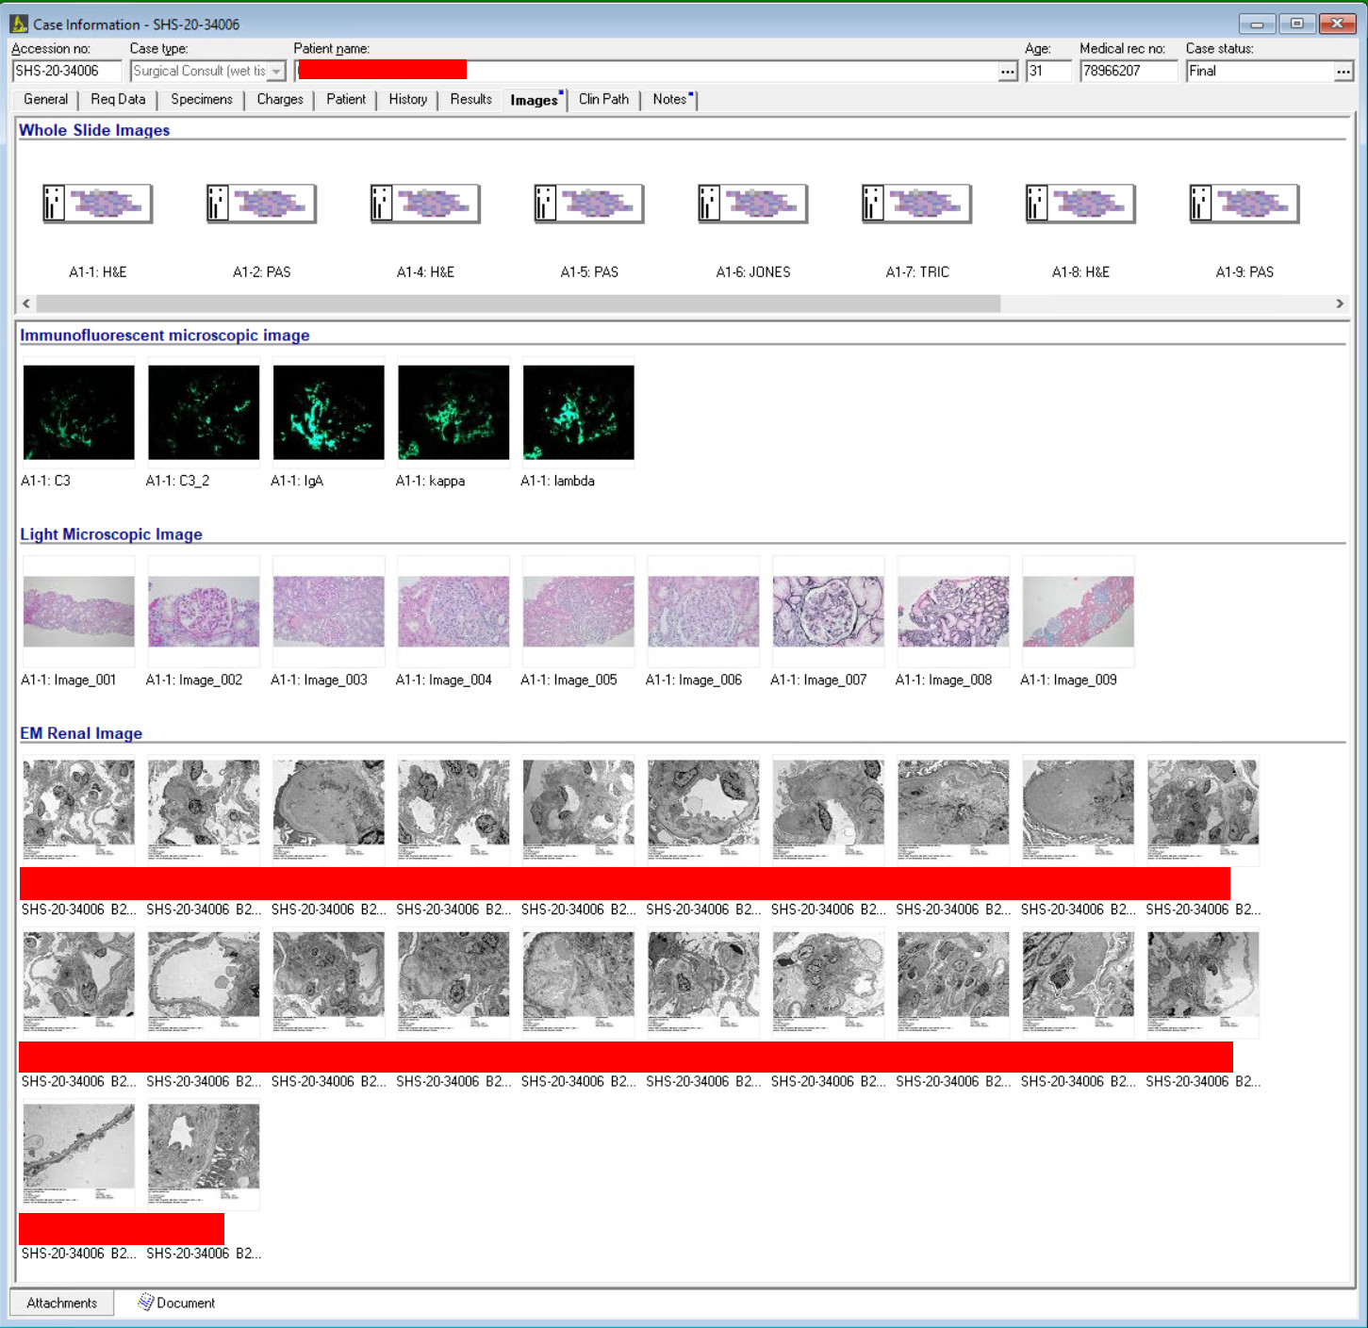
Image Display in the APLIS System
Original APLIS

Slide 16
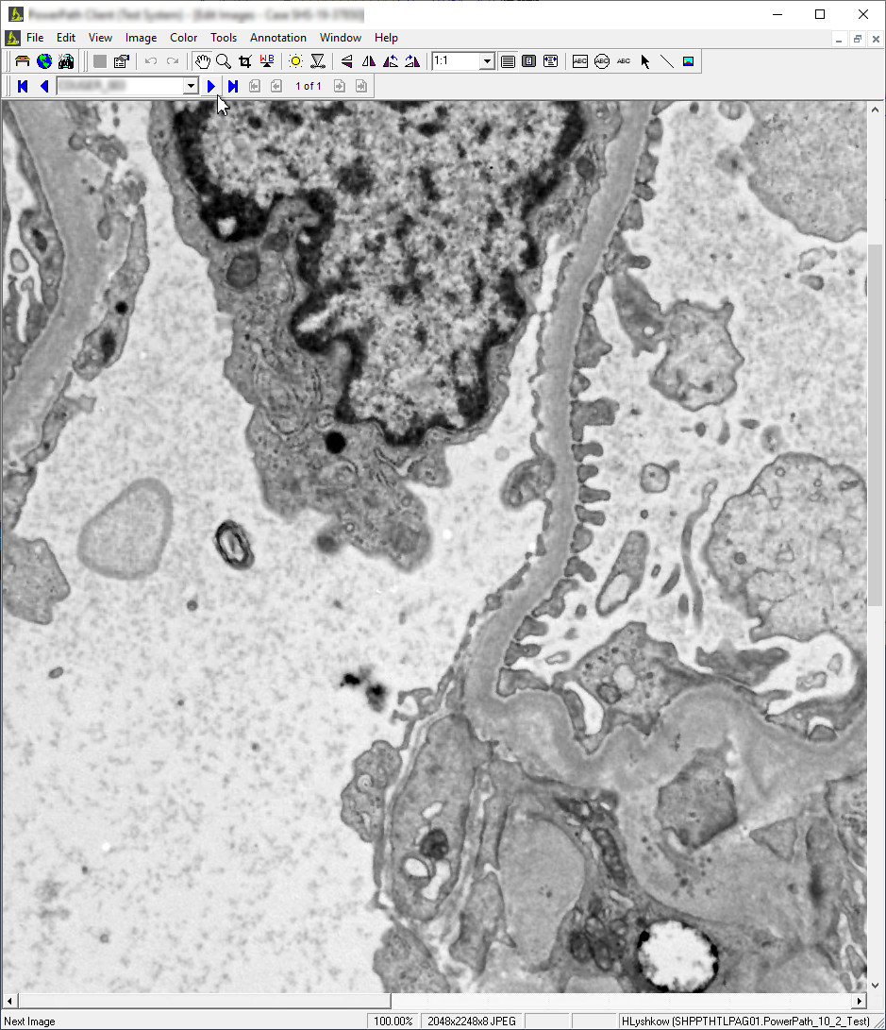
Image Display in the APLIS System
Original APLIS
  Double-clicking an icon brings up a single image window

Slide 17
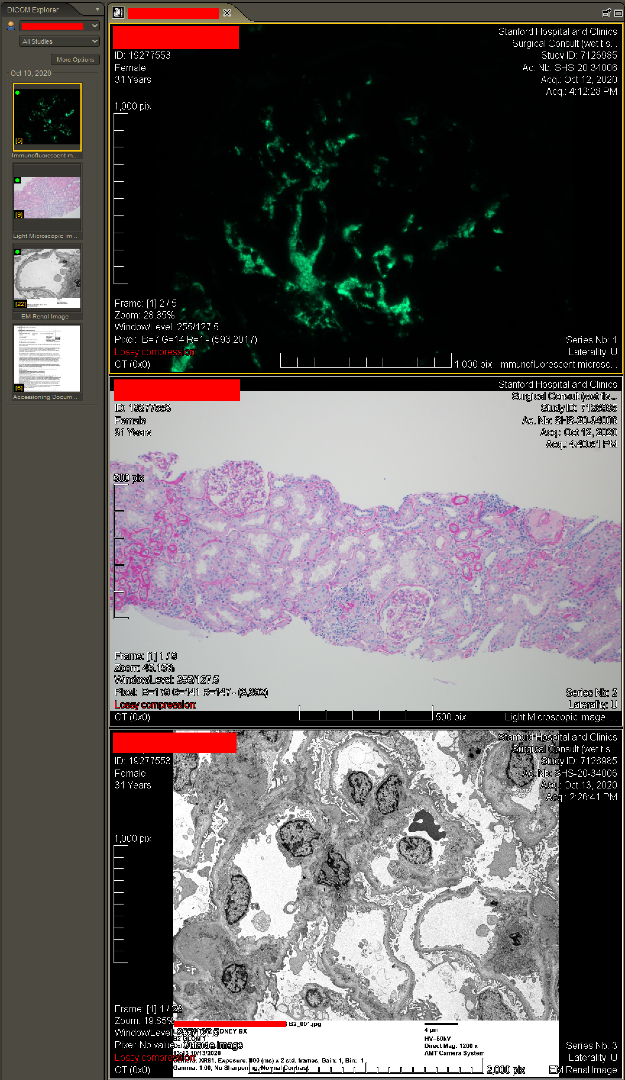
From APLIS to PACS
As DICOM
Original APLIS

Slide 18
From APLIS to PACS
As DICOM
Original APLIS
Link to Whole Slide Images Displayed in Secondary WSI Viewer

Slide 19
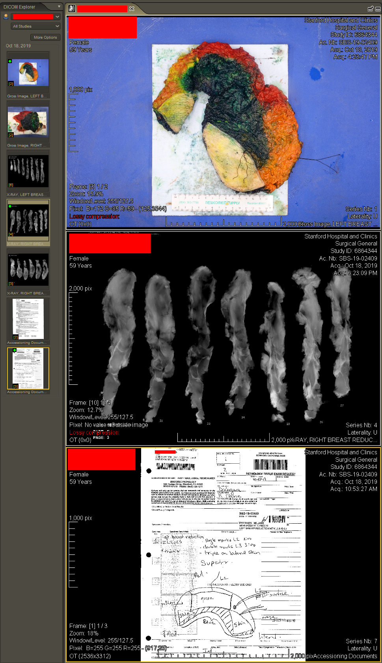
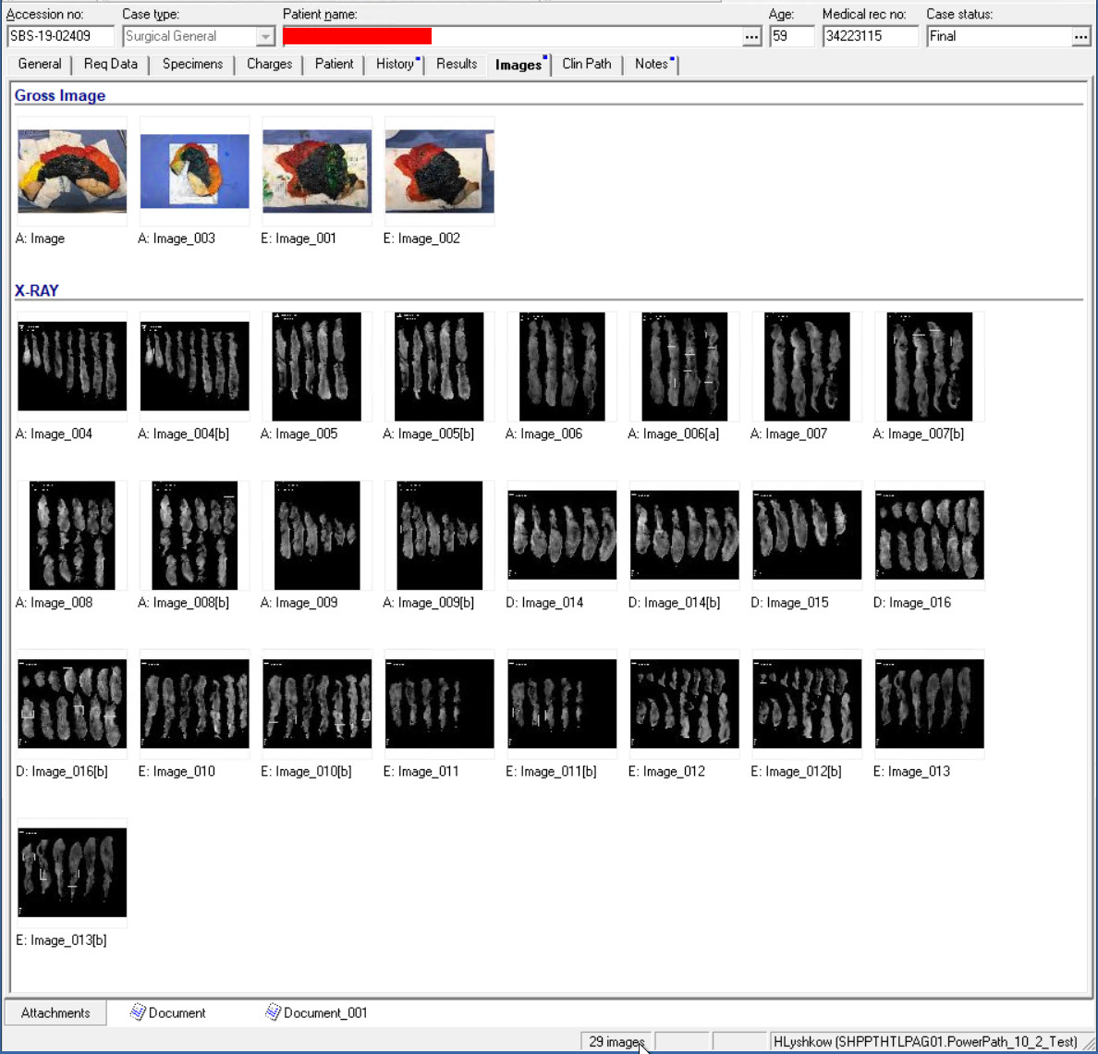
From APLIS to PACS
As DICOM
Original APLIS

Slide 20
From APLIS to PACS
As DICOM
Original APLIS
This is where documents are displayed, as tabs

Slide 21
APLIS Annotations
Another rich source of information is annotations, which were proprietary in the APLIS
This data can be converted to DICOM Grayscale/Color Softcopy Presentation States (GSPS/CSPS)
As a GSPS annotations will be displayed in PACS and can be used for Machine Learning

Slide 22
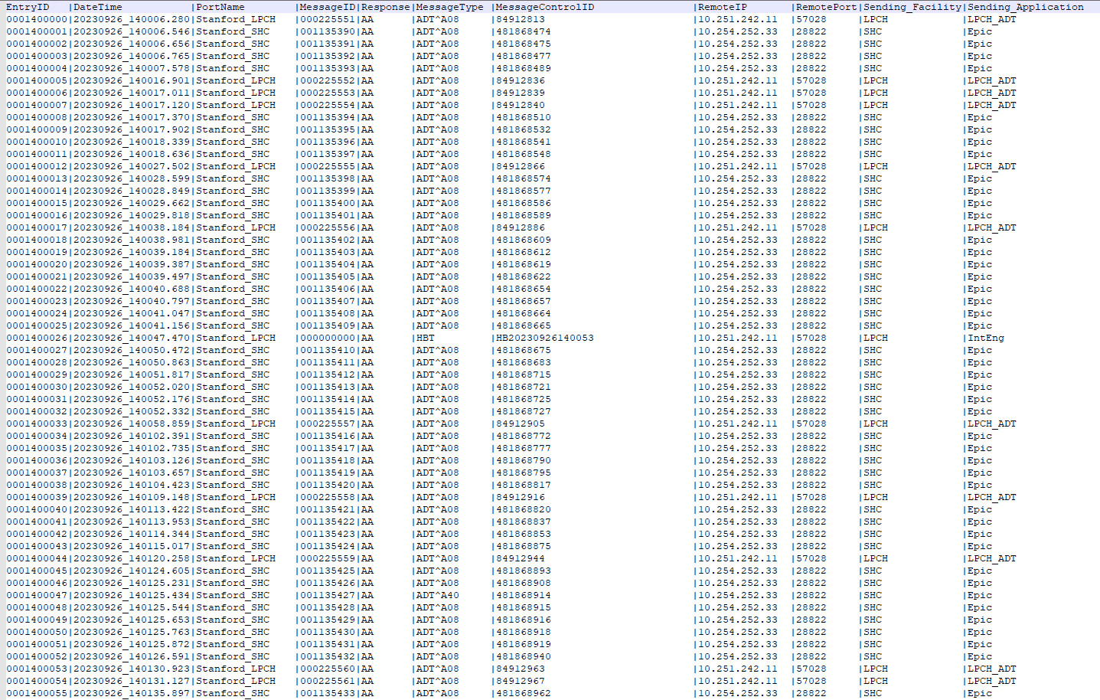
Keeping the Data Fresh and the HL7 Validation Process
Because the APLIS was live with an HL7 feed the migrated data required its own HL7 feed
Validation within the Stanford environment to receive an HL7 feed took months of testing and validation
Testing included patient demographic updates and patient merge message handling
There were multiple HL7 feeds making testing highly complex

Slide 23
The Enriched Patient Record
As the patient record moves forward to include Radiology, Pathology and Genomics data all forms of source patient data must be collected
The DICOM standard is a proven mechanism for storing, transferring and querying large amounts of data
AI and Machine Learning algorithms can utilize both image and PDF data from any APLIS if they are converted to DICOM format and saved into the PACS or VNA environment
APLIS systems that remain proprietary are silos that must be unlocked

Slide 24
Review of the Process
The “How” of Converting an APLIS to DICOM:
  Start simple – develop the simplest DICOM image skeleton that allows images to be viewed in a PACS viewer
  Roll up one’s sleeves and dig into the Database Schema of the APLIS in question
  Identifying which tables contain information required for building out a basic DICOM Secondary Capture (SC) image object
  Find the source image data, is it stored as a path to an external file or inside the database itself?
  We’ve found the data, what file format is it? Is it encrypted or compressed? How do we convert it to make it DICOM friendly?
  Mapping of database elements to DICOM elements, it is all in the table
  What other objects in the database, such as markups, are clinically relevant that should make it to the PACS/VNA?

Slide 25
Lessons Learned
Let the pathologists lead the project
  They do not see images the same way a Radiologists
Unless an APLIS can be fully converted buy-in for migration is difficult
Do not forget the time needed for validating mapping from a legacy silo into DICOM
The HL7 testing and validation period can take far longer than expected

Slide 26
Review of Objectives
Did we:
  Learn that pathology data encompasses more than just Whole Slide Imaging (WSI)?
  Show that non-WSI pathology images, documents and reports can form a rich dataset?
  Discovery how an entire silo of non-DICOM data can brought into the DICOM world?

Slide 27
Questions?

