Slide 1
DICOM Educational Conference
Chennai, India
October 9-11, 2023

Slide 2











Innovation with Integration and Interoperability
FHIR®
DICOMweb™
Call patients to remind them of appointments
Log all images with cancer to my notepad
When urgent images are stored, notify radiologist
Increase staff in ER during freezing rain forecasts
When results are available, call patient to inform them
E-mail patient their images after each visit

Slide 3
Flexible Imaging Workflows
Questions I might ask an imaging repository
  “Hey Server, what studies do you have for John Doe?”
  “Hey Server, I’d like to download John Doe’s study 1.2.x.”
  ”Hey Server, please store this bundle of pixel+metadata.”
DIMSE DICOM is critical for workflows where DICOM is directly created, consumed, and understood
To image-enable applications that don’t know DICOM, or to leverage DICOM in broader networks, we need a new paradigm : web access to DICOM

Slide 4
Why Web Services for Healthcare
Promotes interoperability beyond the data layer and prescribed data flows
Extensible building blocks to meet evolving, novel, and unique use cases
Integrates with cross-industry frameworks for data security, scalability and resilience
Augments services in place with proxying

Slide 5
DICOMweb: Medical Imaging on Web
HTTP-driven services for access to DICOM services, using REST architecture
Incremental capability enhancements for DICOM-enabled systems where necessary
  i.e., image-producing modalities don’t all need to be retrofitted to support DICOMweb – it is leveraged where it is needed
resource type
http://server.org/dicomweb/studies/1.2.345
endpoint
study UID
Learn more: https://www.dicomstandard.org/dicomweb/

Slide 6
Examples of DICOMweb In Practice
Web-enabled workflows
  E.g., web viewers, embedding inside other applications like EMRs
  Non-DICOM-centric applications
Networked workflows
  E.g., remote or foreign storage where firewall or VPN traversal occurs
In IHE Profiles
  Query and Retrieve in WIA (Web Image Access)
  Store (STOW) in WIC (Web Image Capture)
  UPS-RS in RRR-WF (Remote Reading Workflow) and AIW-I (AI Workflow for Imaging)

Slide 7
DICOMweb™ Services
Query
(QIDO-RS)
Retrieve
(WADO-RS)
Download full DICOM, thumbnails, headers, rendered images, and other data
Store
(STOW-RS)
Upload new instances into an image manager for storage
Tasks
(UPS-RS)
Unified procedure step to create work items and manage them through the lifecycle
Server Info
Capabilities Service that lists what a DICOMweb compliant server is capable of
Discover studies and their structure
List studies for a patient, for a procedure, for a modality, and more
Retrieve DICOM objects and their components
Add to existing studies or add new ones

Slide 8


Query (QIDO-RS)
What studies do you have for John Doe?
GET http://server.com/studies/?00100010=DOE^JOHN
Study | Date | Link
Abdomen CT | Jan. 17, 2014 | http://<url>
Chest CR | Mar. 23, 2015 | http://<url>
Key | Value | Description
{attributeID} | {value} | Query matching on supplied value
includefield | {attribute} | all | Include supplied DICOM header values in result
fuzzymatching | true | false | Whether query should use fuzzy matching
limit | {n} | Return only {n} results
offset | {n} | Skip {n} results
E.g.:
https://server/studies​?PatientID=12345678
https://server/studies​?PatientID=12345678​&StudyDate=20180101
https://server/studies​?00100010=DOE*​&00101002.00100020=12345678&limit=25

Slide 9
DICOMweb™ Structures
<DicomAttribute Tag="00080020" VR="DT" Keyword="StudyDate">
<Value number="1">20130409</value>
</DicomAttribute>
<DicomAttribute Tag="00080061" VR="CS" Keyword="ModalitiesInStudy">
<Value number="1">CT</value>
</DicomAttribute>
<DicomAttribute Tag="00100010" VR="PN" Keyword="PatientName">
<PersonName number="1">
<SingleByte>
<FamilyName>Doe</FamilyName>
<GivenName>John</GivenName>
</PersonName>
</DicomAttribute>
<DicomAttribute Tag="0020000D" VR="UI" Keyword="StudyInstanceUID">
<Value number="1">
1.2.392.200036.9116.2.2.2.1762893313.1029997326.945873
</Value>
</DicomAttribute>
"00080020": {
"vr": "DT", "Value": ["20130409"]
},
"00080061": {
"vr": "CS", "Value": ["CT"]
},
"00100010": {
"vr": "PN", "Value": [ {
"Alphabetic": {
"Family": ["Doe"], "Given": ["John"]
}
}]
},
"0020000D": {
"vr": "UI", "Value": [
"1.2.392.200036.9116.2.2.2.1762893313.1029997326.945873"
]
}
JSON
XML

Slide 10
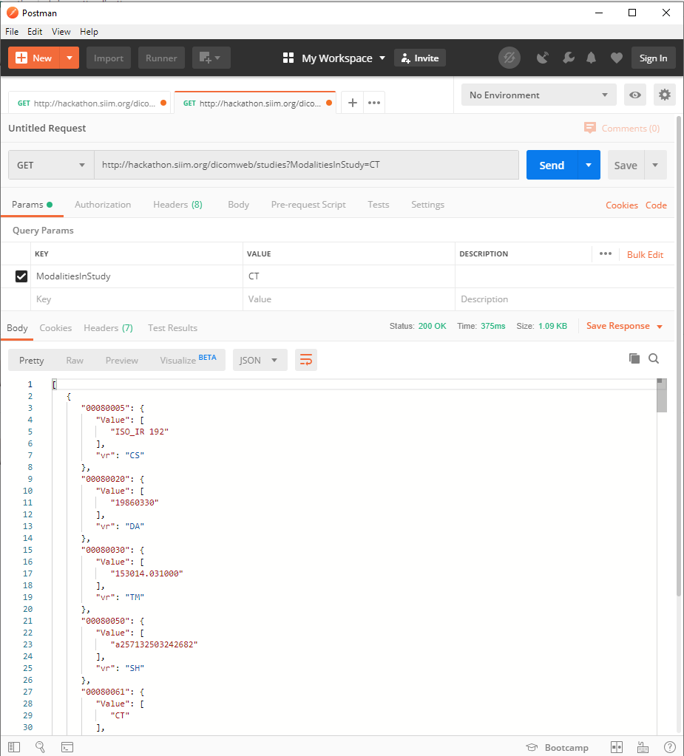
Query (QIDO-RS) on Postman

Slide 11
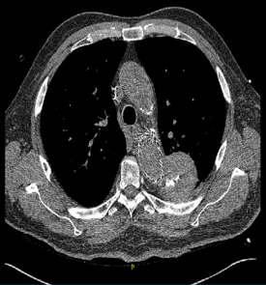
Retrieve (WADO-RS)
Show me images for the Abdomen CT
GET http://server.com/studies/1.2.3/series/4.5.6/
Key | Value | Description
annotation | “patient” / “technique” | Add burned-in demographics / procedure details
quality | {n} | Quality of image (lossy factor)
viewport | vw,vh / sx,sy,sw,sh | Width and height, or crop to specific region
window | centre,width,shape | Center of the range of gray scale in the image
Render Options:
Sub-resource | Description
(none) | Retrieve the DICOM objects in the requested format in the Accept header
/rendered | Retrieve a renderable version of the instances (e.g., JPG)
/metadata | Retrieve the DICOM headers in the requested format (JSON or XML)
/bulkdata | Retrieve the bulkdata items in the requested resource
/thumbnail | Retrieve a representative rendered image of the study

Slide 12
Media Types
Category | Media Type | Support
Single Frame Image | image/jpeg | default
 | image/gif | required
 | image/png | required
 | image/jp2 | optional
Multi-frame Image | image/gif | optional
Video | video/mpeg | optional
 | video/mp4 | optional
 | video/H265 | optional
Text | text/html | default
 | text/plain | required
 | text/xml | required
 | text/rtf | optional
 | application/pdf | optional
Source: Part 3.18 Table 6.1.1-3. Rendered Media Types by Resource Category

Slide 13
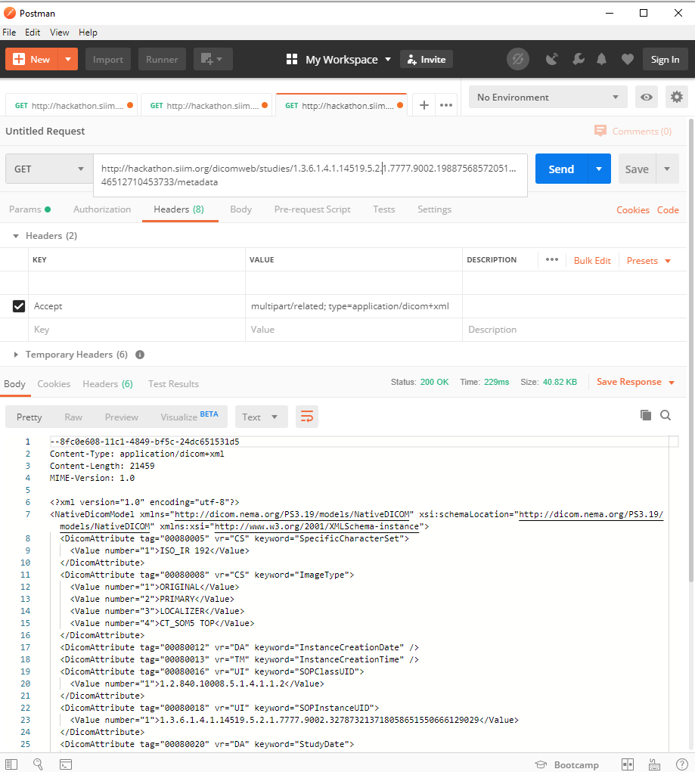
Postman: Retrieve Metadata

Slide 14
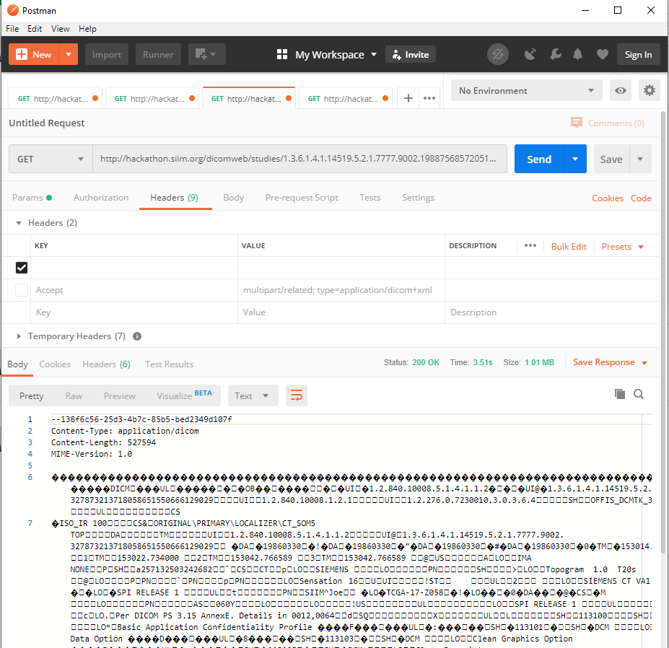
Postman: Retrieve DICOM Part 10

Slide 15

Store (STOW-RS)
Store this image
POST http://server.com/studies
Stored

Slide 16
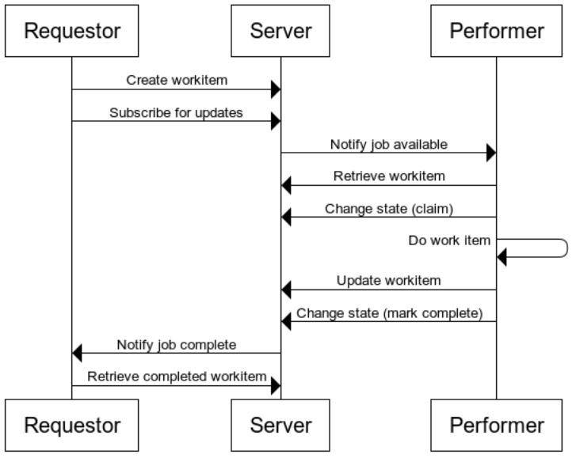
Tasks (UPS-RS)
What do I need to do today?
GET http://server.com/workitems/?00741202=BRADLIST
Study | Date | Link
Abdomen CT | Nov. 20, 2015 | http://<url>
Abdomen CT | Nov. 20, 2015 | http://<url>

Slide 17
Sample DICOMweb Tools
Open Source DICOMweb Servers
  Orthanc (https://www.orthanc-server.com/)
  DCM4CHEE (https://www.dcm4che.org/)
Medical Image Viewers
  OHIF (http://ohif.org/)
Public Servers
  SIIM (http://siim.org/hackathon) – key required
  Medical Connections (https://www.dicomserver.co.uk/Pages/Index/RESTful)
Working with REST
  Postman (https://www.getpostman.com/)

Slide 18
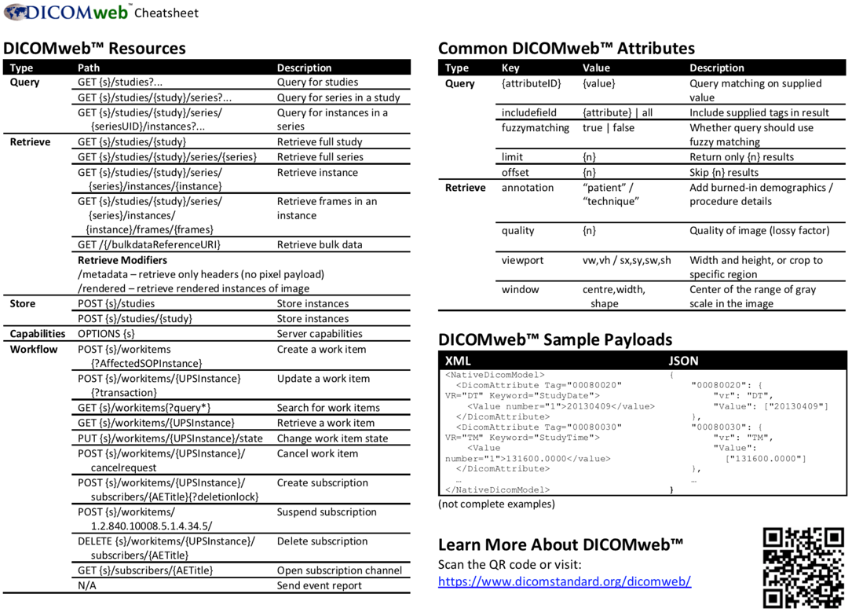

DICOMweb™ Cheatsheet
Learn more: https://www.dicomstandard.org/dicomweb-cheatsheet/

