Slide 1
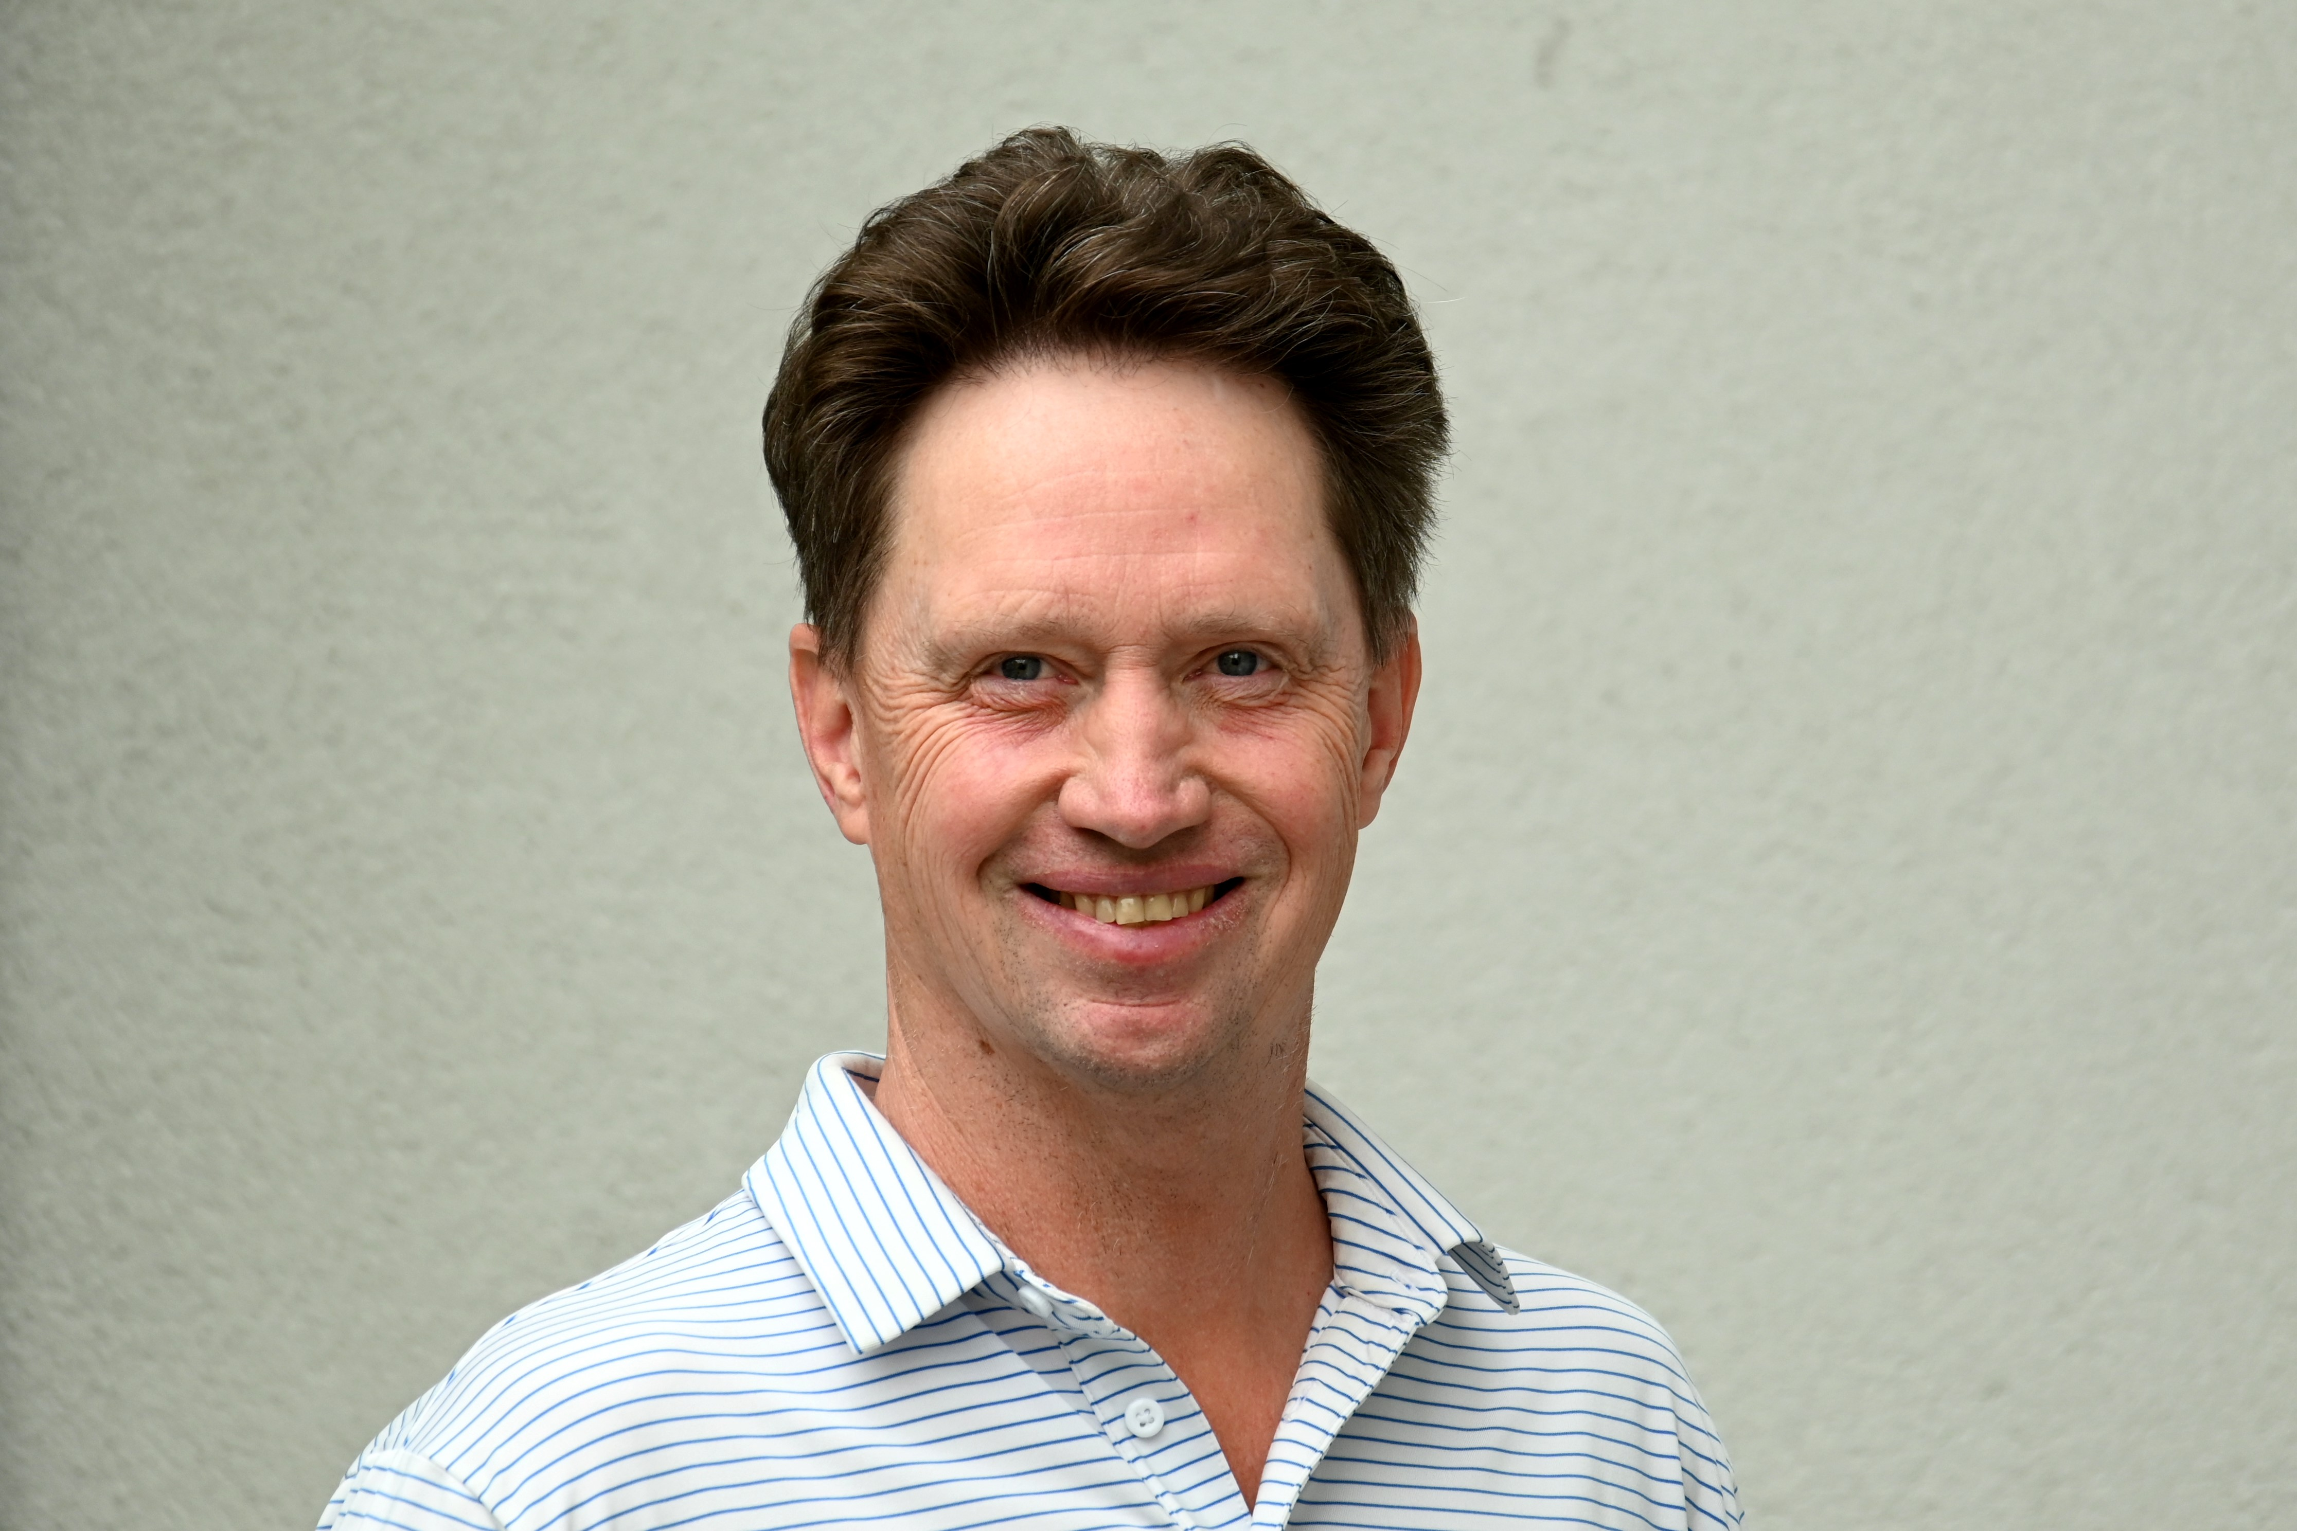
DICOM Educational Conference
Chennai, India
October 9-11, 2023

Slide 2
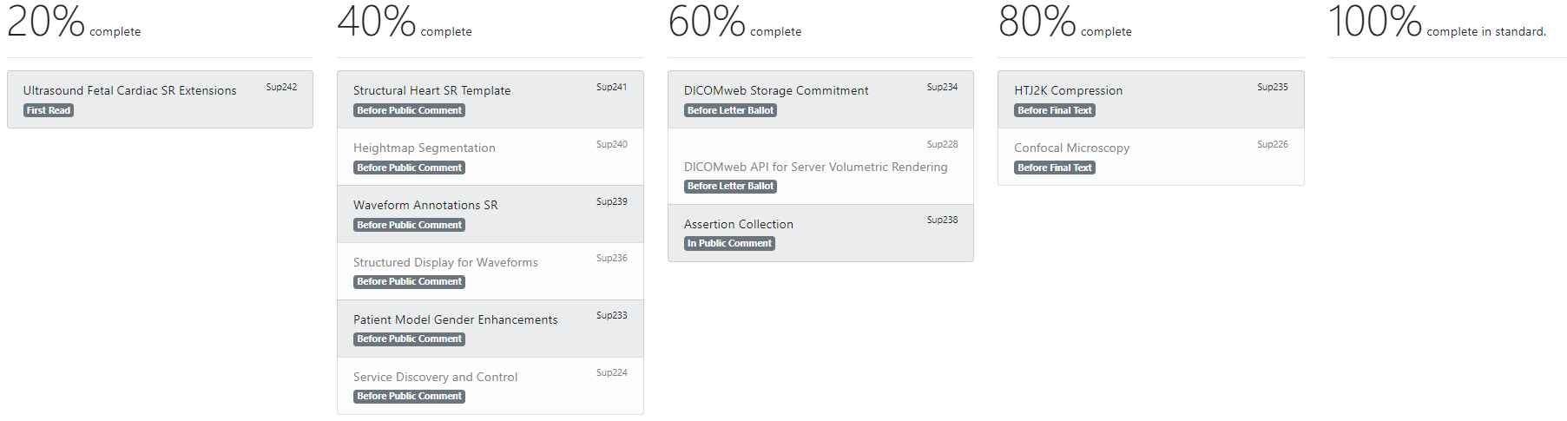
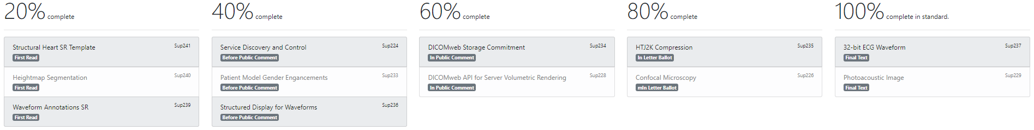
What is currently in development?
August 2023
June 2023

Slide 3
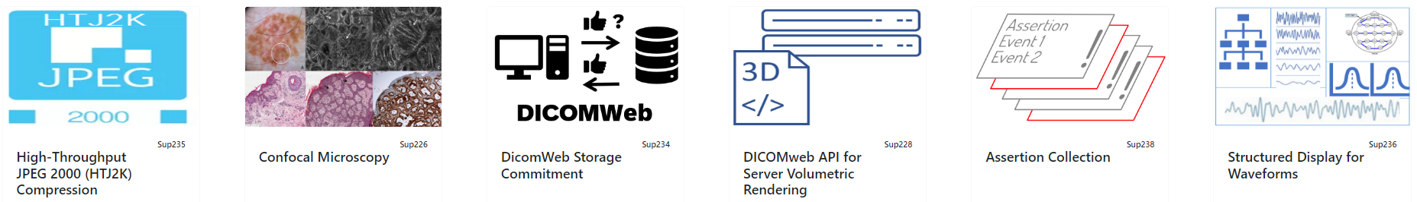
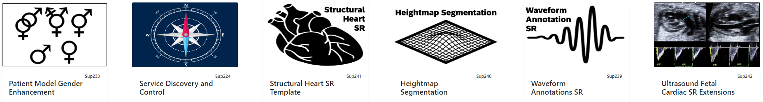
What is currently in development?

Slide 4
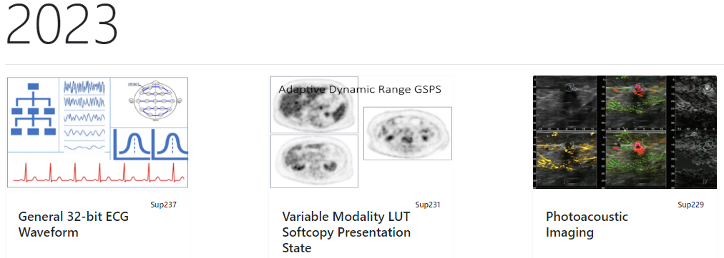
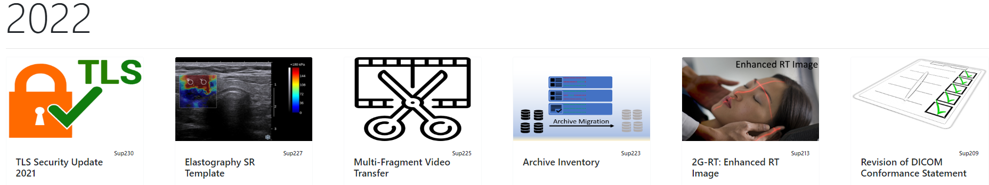
What made it into DICOM in the last years?

Slide 5
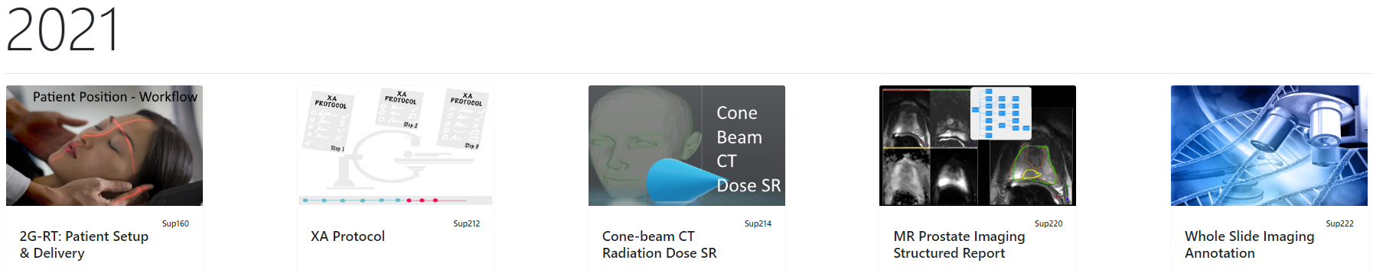
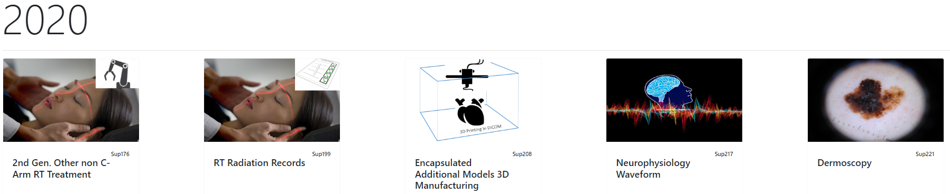
What made it into DICOM in the last years?

Slide 6
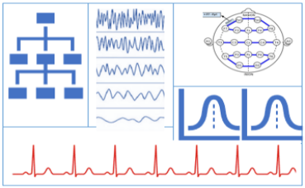
General 32-bit ECG Waveform ²⁰²³
ECG Waveform SOP Class (based on the existing General ECG SOP Class) with fewer constraints.
The High-Resolution SOP class permits 32 bits per sample. The already available General ECG SOP class can store waveform with 16 bits per sample.
In clinical neurophysiology it is common practice to acquire ECG data together with the routine scalp EEG or in case of a sleep study.

Slide 7
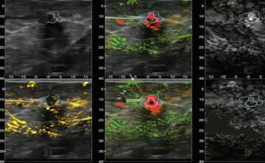
Photoacoustic Image ²⁰²³
Photoacoustic (PA) imaging enables optical absorption in biological tissues with acoustic resolution.
Photoacoustic Imaging is in widespread use in preclinical research labs and is currently being translated to clinical applications.
Frequently used in hybrid with pulse/echo ultrasound for anatomical information.
Contrast is generated through absorption by chromophores and nano-particles.
In principle, excitation at multiple wavelengths allows the modality to discriminate individual chromophores.

Slide 8

TLS Security Update ²⁰²²
Adds new Secure Transport Connection Profiles and retires older less secure ones.
BCP 195 RFC 8996 TLS Secure Transport Connection Profile
Servers shall support both TLS 1.2 and TLS 1.3. Clients shall support at least one of TLS 1.2 or TLS 1.3.
The IETF recently updated the Best Current Practice document called BCP-195. The new document no longer allows downgrading to TLS 1.0 or 1.1.

Slide 9

Multi-fragment Video ²⁰²²
Problem:
DICOM limits MPEG2 and H.264 Transfer Syntax encoding to 1 fragment
→ Limits total size to 4 GB
→ Vendors report surgical videos of 100 GB
Today: Multiple vendors ignore fragment limit
Solution:
Add a multiple fragment capability to video in DICOM.
Both sender and receiver need to support this to make it work.
• Add 64-bit combined fragment length field
• Supports odd length streams

Slide 10
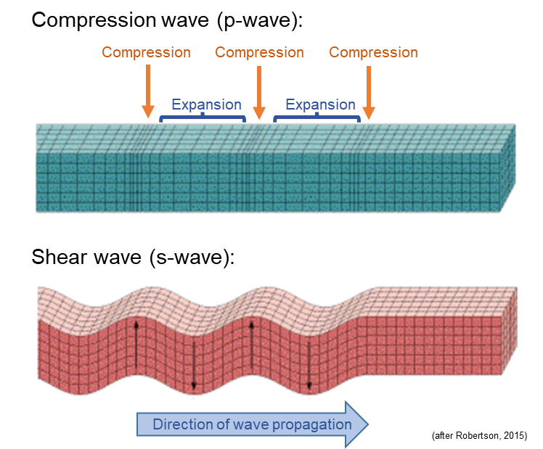
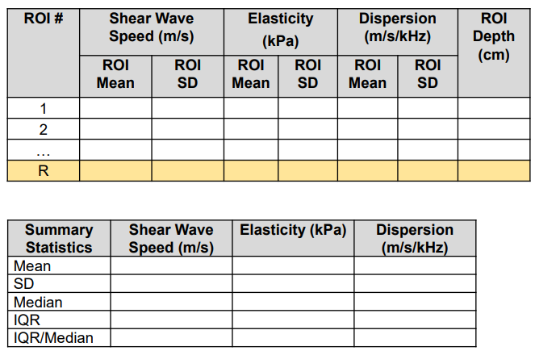
Elastography Structured Report Template ²⁰²²
An SR template for elastography of organs/tissues such as liver, breast, prostate.
Many solid tumors are known to differ mechanically from surrounding healthy tissues. Fibrosis associated with chronic liver diseases causes the liver to become stiffer.
Ultrasound can measure the speed at which an induced shear wave propagates through tissue.
Tissue stiffness can be converted into an estimated Elasticity in kPa.
Elastography involves drawing 3-12 ROIs at differing depths on the acquired images.
Report record: Mean and Standard Deviation for wave speed and elasticity within each ROI, and summary statistics.

Slide 11
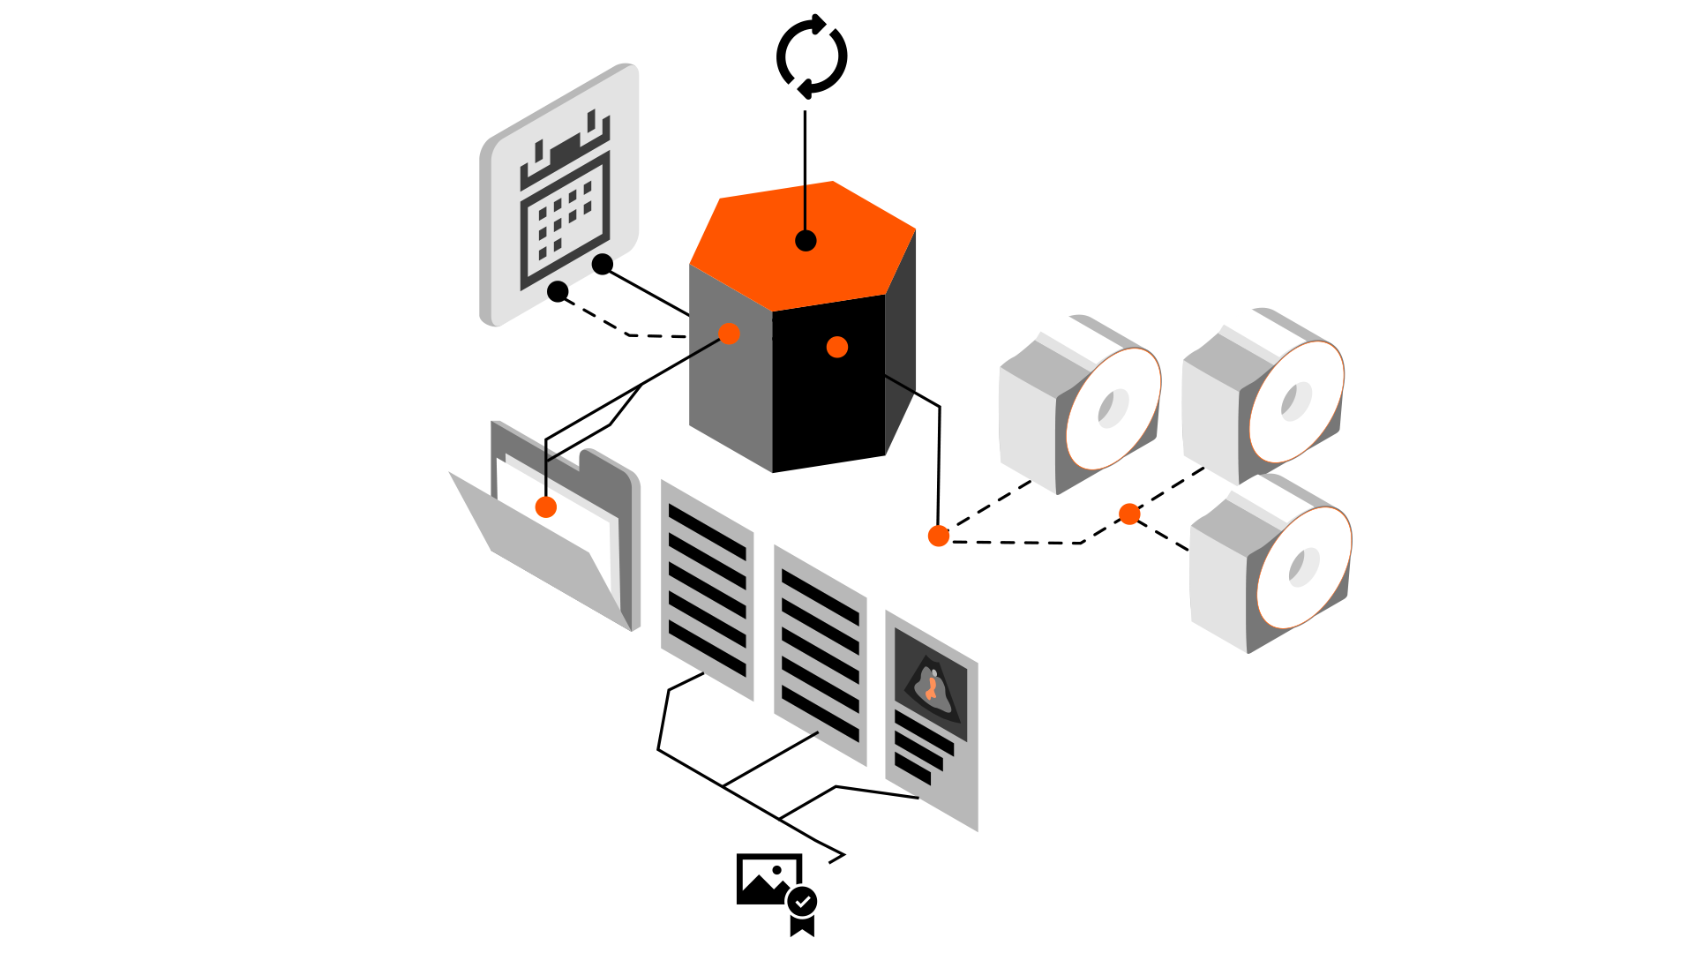
Archive Inventory ²⁰²²
Use Cases:
Migrating / Porting DICOM repositories from one image management system (PACS or VNA) to another.
Large scales, and handle both on-premises and remote (e.g., cloud-based) storage.
Migration usually during clinical operation.
Healthcare institutions merge separate repositories
into an enterprise repository.
Bulk access to the archive: Research use cases, including artificial intelligence and machine learning.
Two alternative inventory strategies:
Production model
of an archive inventory object = tree of all information in the archive.
Remote initiation
Asynchronous
Query Response model
A query response returns all matching objects as a tree of a complete archive, or a subset thereof as specified by key attributes.

Slide 12
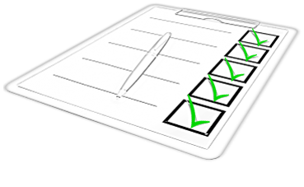
Revision of DICOM Conformance Statement ²⁰²²
Update to Part 2 - Conformance
To better meet the needs of all user groups, for example service, R&D, testing, sales, healthcare provider IT personnel. Comparability is better facilitated for different products' DICOM functionality by providing essential information in tables.
A detailed template is provided. Vendors are encouraged to populate this template for their products.

Slide 13
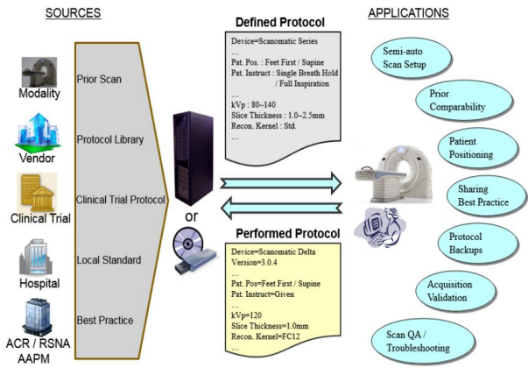
XA Protocol – based on the CT Protocol model ²⁰²¹
Use Cases:
Managing protocols site consistent
Record protocol details for follow up studies
Vendor trouble shooting image quality issues
Best practice sharing
Protocol life cycle management, Quality assurance
Protocol: Definition part
Prepare (define setup) of equipment for an Xray acquisition including:
Patient preparation & positioning
Equipment characteristics
Acquisition technique
Reconstruction technique
Preliminary image handling such as filtering, enhancement
Results data storage (auto-sending)
Protocol: Performed part
Record parameters used during the acquisition / procedure of the Xray equipment.

Slide 14
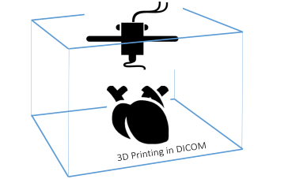
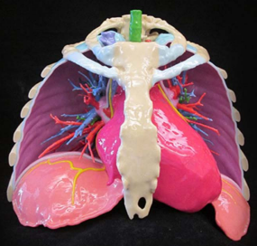
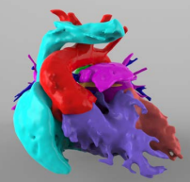
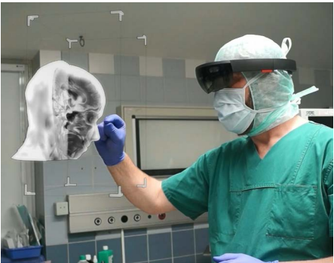
Encapsulated 3D objects – additional models ²⁰²⁰
Use Cases:
Allow store/query/retrieve 3D models, intended for 3D manufacturing
(and virtual reality), as DICOM objects
Address medical 3D manufacturing and uses of Virtual Reality,
Augmented Reality, and Mixed Reality.
New enriched capabilities beyond STL encapsulation:
Support for a new 3D model type: Object File (OBJ)
Identification of models for assembly into a larger object
Capturing a preferred color for manufacturing
or display of a model OBJ Encapsulation

Slide 15
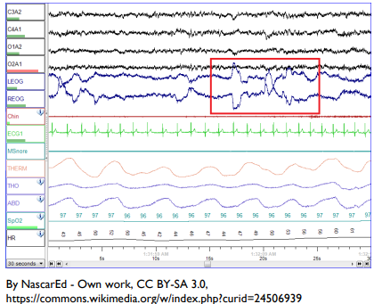
Neurophysiology Waveform ²⁰²⁰
Electrical activity of the brain: Routine electroencephalography (EEG) data recording collected on the skull.
Electrical activity of skeletal muscles: Electromyography (EMG) data recording.
Recording eye movement Electrooculography (EOG) data collected near the eyes.
Sleep study: Electroencephalography (EEG) for a polysomnography (PSG) study.
Respiratory data using more than a single channel.
Patient's position continuously.

Slide 16
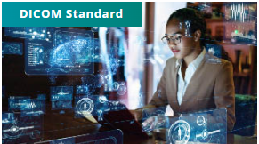
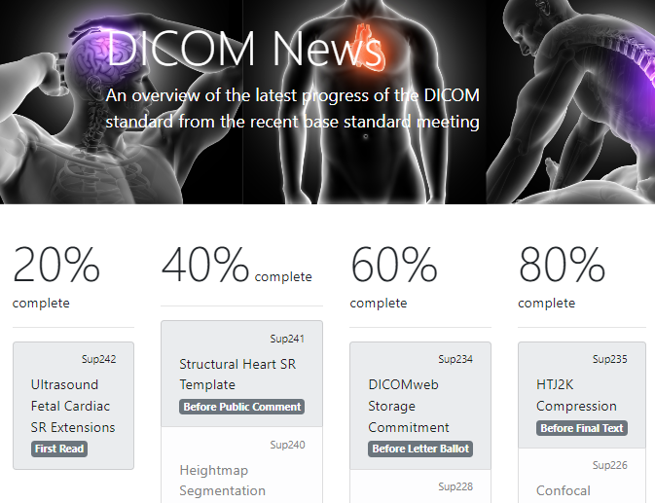
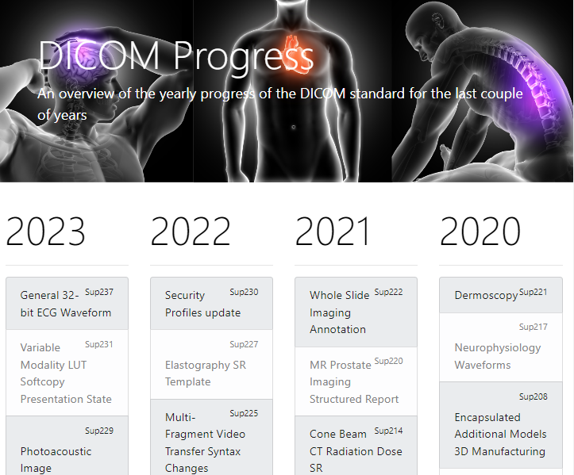
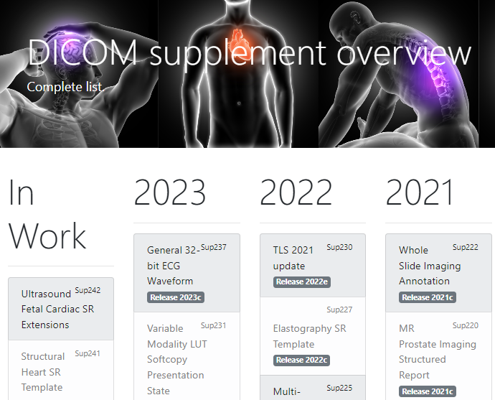
Where do you find DICOM News and progress?
The DICOM standard:
https://www.dicomstandard.org/current
DICOM News
https://www.dicomstandard.org/news
DICOM Progress
https://www.dicomstandard.org/
approved-supplements
DICOM by feature and year:
https://www.dicomstandard.org/
supplements

Slide 17
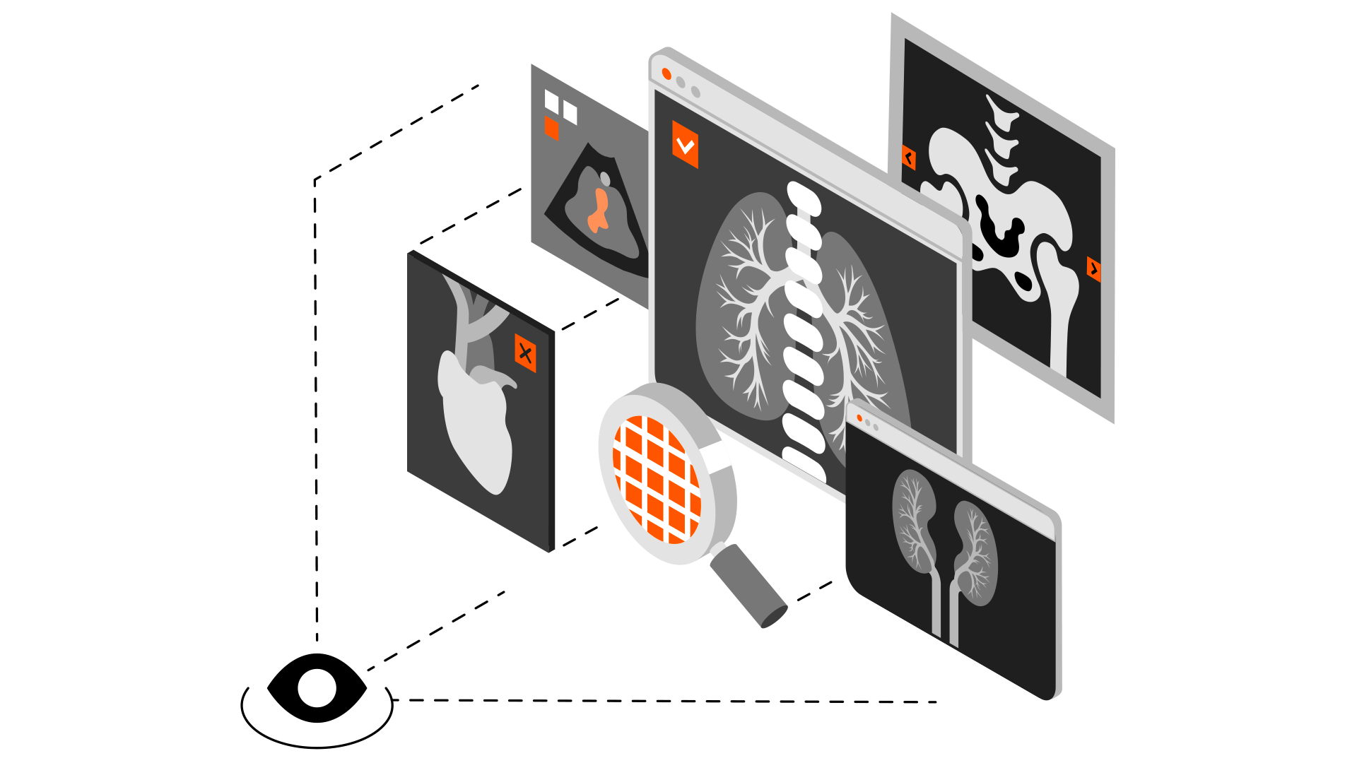
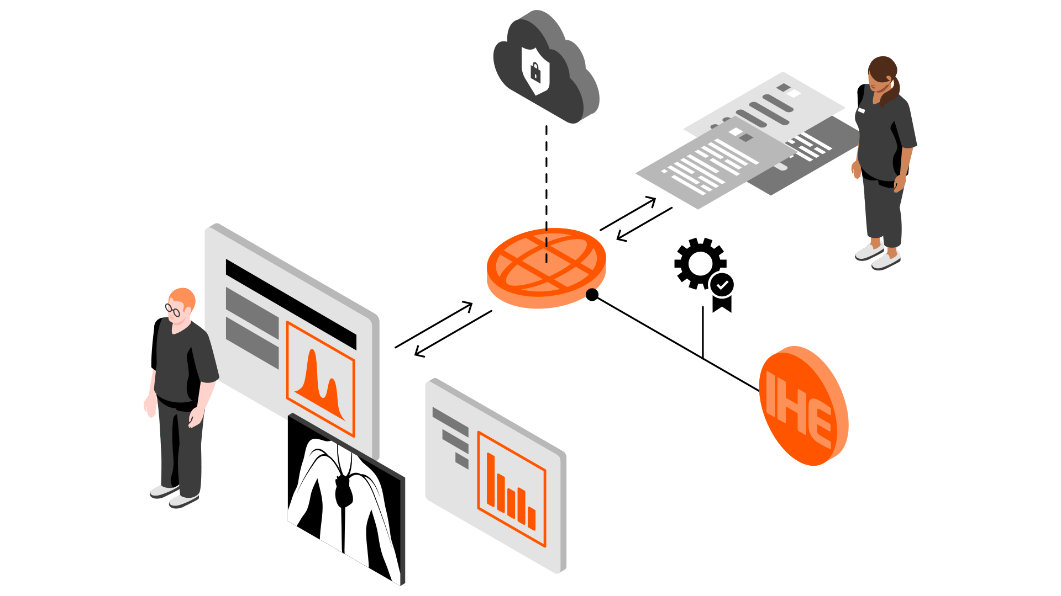
FHIR-DICOM Interop
ImageStudy resource:
Use case illustrations
EHR App FHIR-queries EHR Backend to retrieve DICOM Studies with images for a specific patient.
Images are displayed with Image Display App (IHE profile) from DICOM Thumbnails.
ImageStudy resource is used between primary care, echo lab, and Cathlab IHE XDS-I on demand retrieve.
ImageSelection resource:
frames, segments, 2D/3D region
Observation, measurement
Context sharing
Radiation Dose Summary
Summary of DICOM dose radiation
FHIR Observation
mapping from DICOM SR
Imaging ordering workflow in FHIR

Slide 18
Contacts for further information
DICOM Secretariat dicom@dicomstandard.org
Security, TLS
Robert Horn
Web Services
Dieter Krotz
Bill Wallace
Photoacoustic Image
Brian Bialecki
Gender Enhancement - Patient Model
Robert Horn
Greyscale Presentation State
Nicholas Bevins
Elastography SR
Kevin O'Donnell
X-ray
Francisco Sureda
HL7 DICOM Interop
Jonathan Whitby
Chris Lindop
Neurophysical Waveform
Silvia Winkler
Cone Beam CT
Nick Bevins
MR Prostate
Andrey Fedorov
Web Services
Bialecki, Brian
Physics
Nicholas Bevins
Brian Bialecki
Video, Compression
Bill Wallace
Realtime video
Emmanuel Cordonnier
Archive Inventory
Harry Solomon
DCS template
Antje Schroeder
Radiotherapy
Christof Schadt
Ulrich Busch
Jim Percy
Microscopy, Dermoscopy
Liam Caffery
Whole Slide Imaging
David Clunie
3D Manufacturing
Allan Noordvyk
Justin Ryan

Slide 19
Contact
Björn Nolte
bjoern.nolte@siemens-healthineers.com

