Slide 1
DICOM Educational Conference
Bangkok, Thailand
3-4 October 2019
Encounter-based Imaging workflow
EBIW
mayo Clinic
Ken Persons
Copyright DICOM® 2019 www.dicomstandard.org #DICOMConference2019 #DICOM @DICOMstandard

Slide 2
Encounter-based Imaging Workflow
EBIW
Topics:
What is Encounter-Based Imaging ?
IHE, Standards, and Encounter-Based Imaging Workflow
Metadata
Applying EBIW In The Real World
Summary and Resources

Slide 3
What is Encounter-Based Imaging?
EBI = imaging captured in the context of an encounter between a patient and a care-provider (typically without an imaging order)
Order-based Imaging
[CT, MR, PET, XA, MG, Echo]
(Radiology, Cardiology, etc.)
Encounter-based Imaging
[Tablets, Cameras, Point of Care US]
(Dermatology, Wound Care,
Burn Unit, ER, Sports Medicine,
etc., etc., etc.,
etc.)

Slide 4
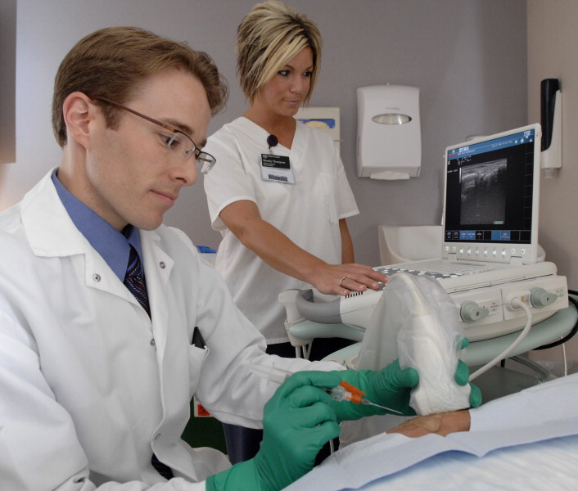

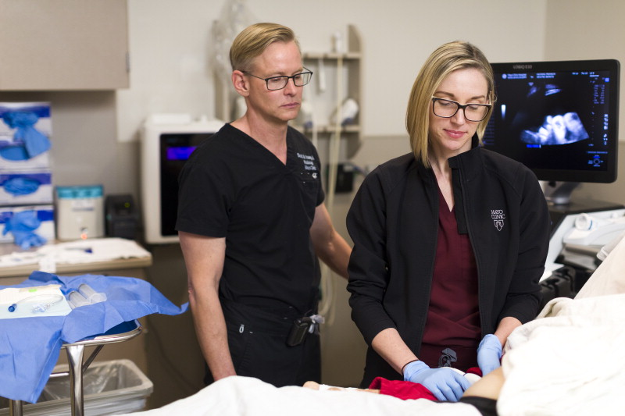

Example:
Point of Care Ultrasound

Slide 5
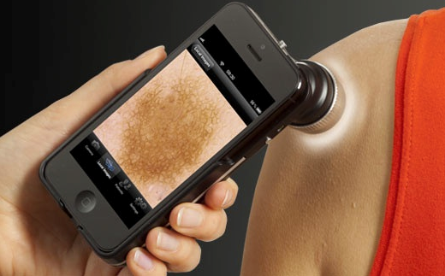
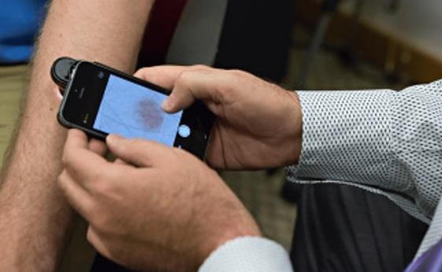
Example:
Medical Photos in Dermatology

Slide 6
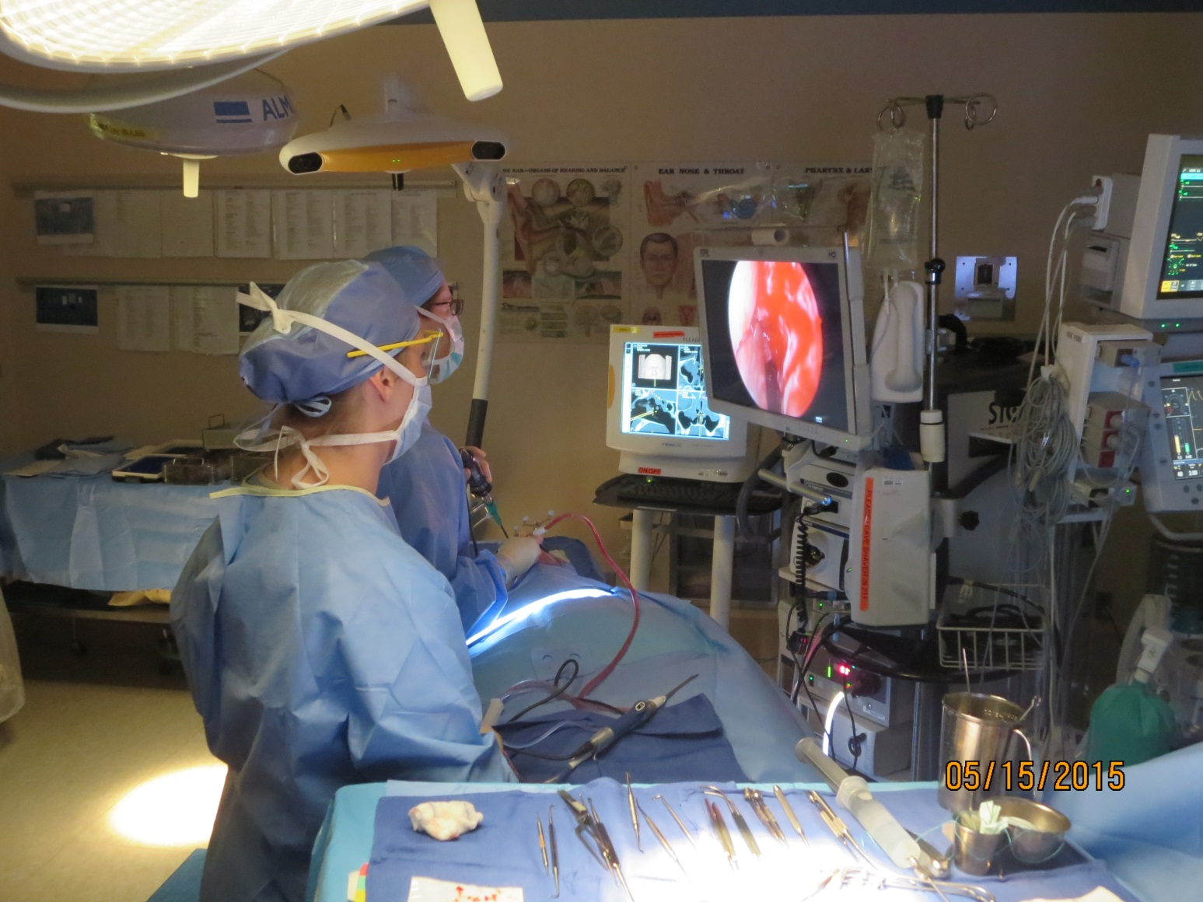
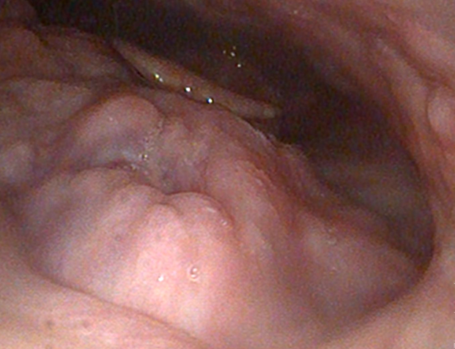
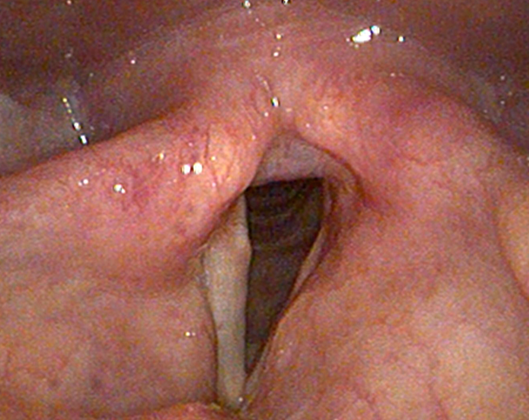
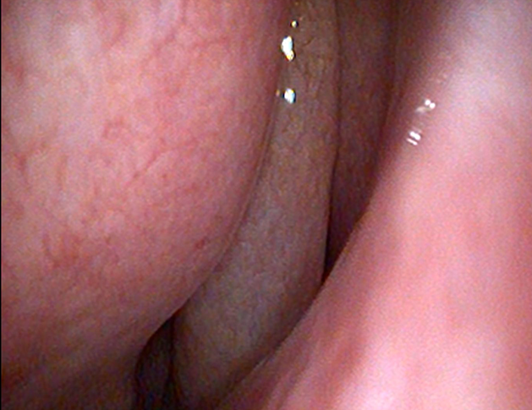
Example:
Surgical Procedures for ENT

Slide 7
Standardizing
Encounters-based Imaging Workflow
Goals:
Address medical imaging performed outside the context of an ordered procedure
Capture & record consistent, predictable, metadata
Minimize manual data entry and create efficient workflows
Utilize standards-based interfaces
    RESTful Web services where appropriate (lightweight devices)
Manage & access images as part of a well-knit medical record
Facilitate Analytics

Slide 8
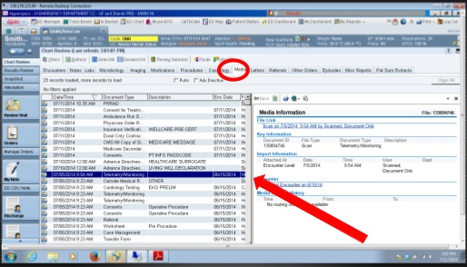


What’s the Harm ?
When acquisition is not integrated, complete and consistent, the quality and efficiency of care is negatively affected:
…Image
…Image
…Image
…Color Image
…Image
Patient’s imaging record fragmented across departments
Images printed and scanned into EMR without metadata
Images in the EMR are lumped under a “media tab” with little differentiation/navigation
  Not the fault of the EMR; it’s the acquisition process and data management
Sharing between affiliated hospitals is limited / non-existent
Images not readily available to the Care Team
Time lost to awkward workflow/data capture; lack of automation

Slide 9
Encounter-based Imaging Workflow
EBIW
Topics:
What is Encounter-Based Imaging ?
IHE, Standards, and Encounter-Based Imaging Workflow
Metadata
Applying EBIW In The Real World
Summary and Resources

Slide 10

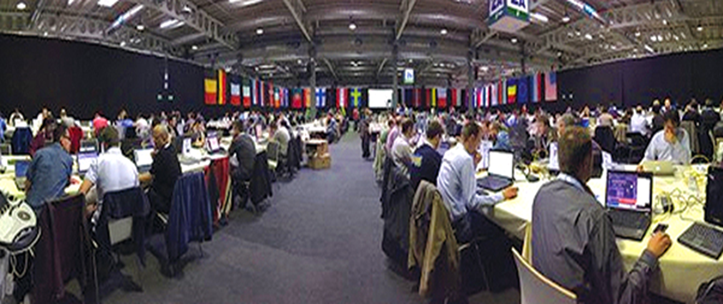
IHE
“IHE is an initiative by healthcare professionals and industry to improve the way computer systems in healthcare share information. IHE promotes the coordinated use of established standards such as DICOM and HL7 to address specific clinical needs in support of optimal patient care.”
IHE Secretariat: RSNA & HIMSS
  www.ihe.net
IHE Scope:
  Tailor and Test Standards
  Profile existing standards to address specific use cases in healthcare
  Organize Connectathon testing events

Slide 11
IHE
IHE Terms
  Integration Profile: an implementation guide for addressing a given use case
    An Integration Profile specifies the behavior of actors and the transactions between them
  Actor: a generalized real-world system or component thereof
  Transaction: a specified interaction between Actors
  Technical Framework: Includes all of the integration profiles, actors and transactions defined for a particular domain (e.g. Radiology Domain)

Slide 12
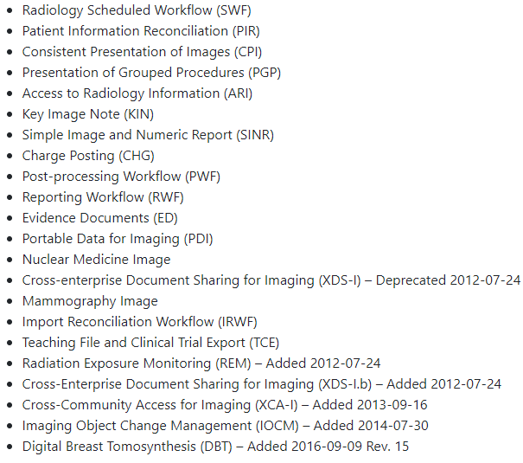
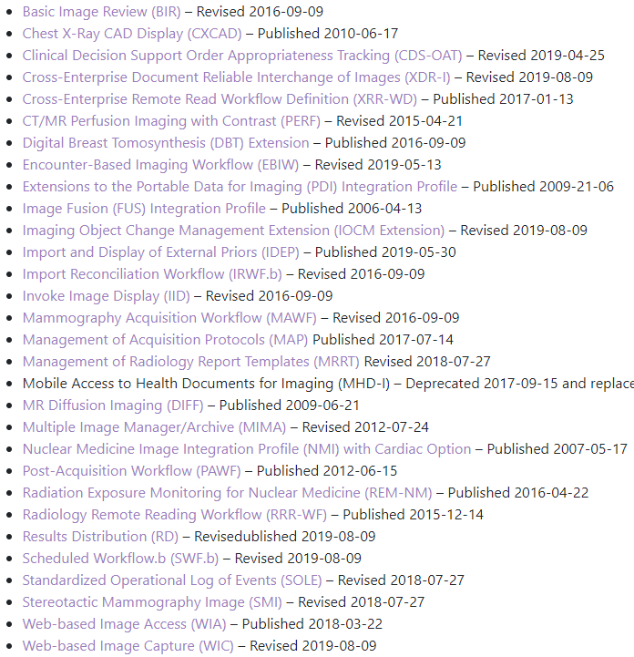
IHE
Radiology Domain
IHE Radiology Technical Framework – Integration Profiles
Approved Profiles
Supplementary Profiles (for trial)
Orders-based

Slide 13
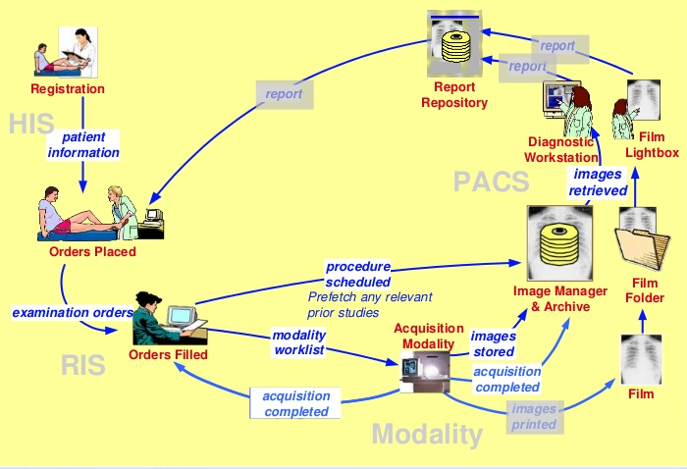
IHE
IHE Radiology Schedule Workflow Profile – orders-based workflow

Slide 14




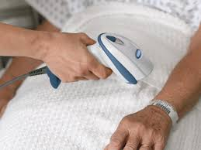
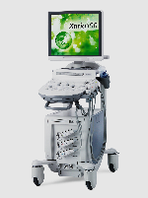
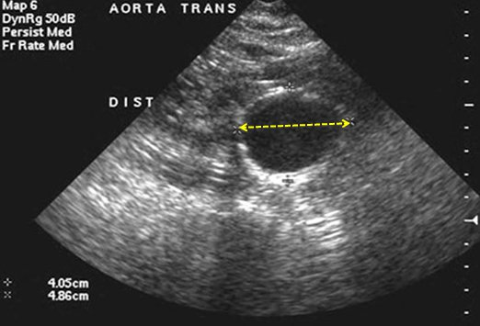

Encounter-based Imaging Workflow
Use Case #1: Point of Care Ultrasound
EMR, MPI, PAM, PDQ,
etc.
EMR
Patient Visit in ER
Decision to use US
Scan Patient Wrist Band
Get Encounter Information
Add Other Information
Scan Patient
Store Images
Notify Results
Result Aggregator
Encounter Manager
(Patient ID,
Notify Visit ID,
Imaging Acq. Time,
Result Procedure Code,
Accession #,
Body Part,
etc.)
Get
Imaging
Context
Store Images
PoC US
Image Manager/ Archive

Slide 15

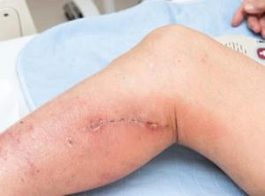
Encounter-based Imaging Workflow
Use Case #2: Lightweight Device
EMR, MPI, PAM, PDQ,
etc.
EMR
Result Aggregator
Encounter Manager
(Patient ID,
Notify Visit ID,
Imaging Acq. Time,
Result Procedure Code,
Accession #,
Body Part,
etc.)
Get
Imaging
Context
Store Images
Image Manager/ Archive

Slide 16
EBIW using DICOMweb
http://encountermanager.here.org/workitems?AdmissionID=987654
&ScheduledProcedureStepSequence.ScheduledStationAETitle=DermTab1
[ {
“PatientName”: {"vr": "PN", "Value": [{"Alphabetic": "SMITH^JOHN"}]},
“PatientID”: {"vr": "LO", "Value": ["66437748"]},
“IssuerOfPatientID”: {"vr": "LO", "Value": ["MyHospital"]},
“PatientBirthDate”: {"vr": "DT", "Value": ["19670701"]},
“PatientSex”: {"vr": "CS", "Value": ["M"]},
“InstitutionName”: {"vr": "LO", "Value": ["Metrocity General Hospital"]},
“InstitutionalDepartmentName”: {"vr": “LO", "Value": [“Dermatology"]},
…
Encounter Manager
Get
Imaging Context
http://mypacs.here.org/studies
Content-Type: application/dicom+json
[ {
“PatientName”: {"vr": "PN", "Value": [{"Alphabetic": "SMITH^JOHN"}]},
“PatientID”: {"vr": "LO", "Value": ["66437748"]},
“IssuerOfPatientID”: {"vr": "LO", "Value": ["MyHospital"]},
“PatientBirthDate”: {"vr": "DT", "Value": ["19670701"]},
…
“BodyPartExamined”: {"vr": "CS", "Value": [“CALF"]},
“Laterality”: {"vr": "CS", "Value": [“R"]},
…
Content-Type: image/jpeg
<the image>
Store Images
Image Manager/ Archive

Slide 17
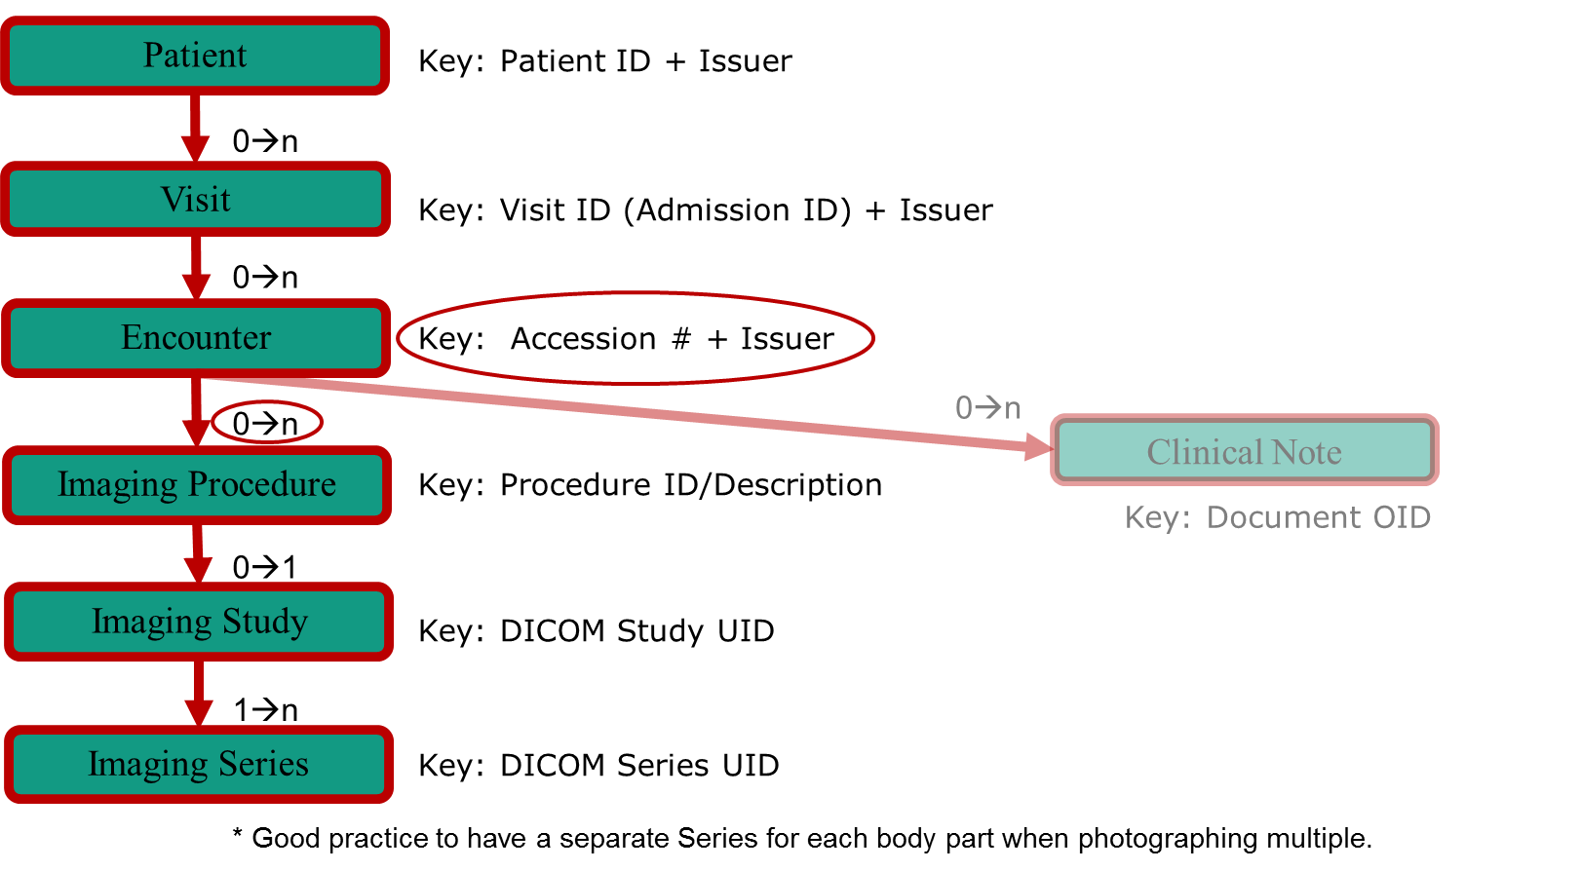
EBIW Information Model

Slide 18
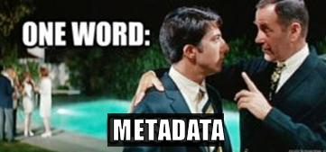
Encounter-based Imaging
So what’s the Key ?

Slide 19
Key Metadata
Patient Metadata
  Name, Date of Birth, Age, MRN, Other IDs, …
Encounter Metadata
  Department, Specialty, Physician, Referring Physician,
  Admission ID, Admission Date/Time, Reason for Admission, …
Procedure Metadata
  Modality, Imaging Procedure, Body Part, Reason for Imaging,
  Accession #, Acquisition Date/Time, Device, Operator, …
Pixel Metadata
  Rows, Columns, Bit Depth, Pixel Size, Encoding, ...
Why? To manage the images; to readily find them again & use them
To turn the JPEG into a medical document

Slide 20
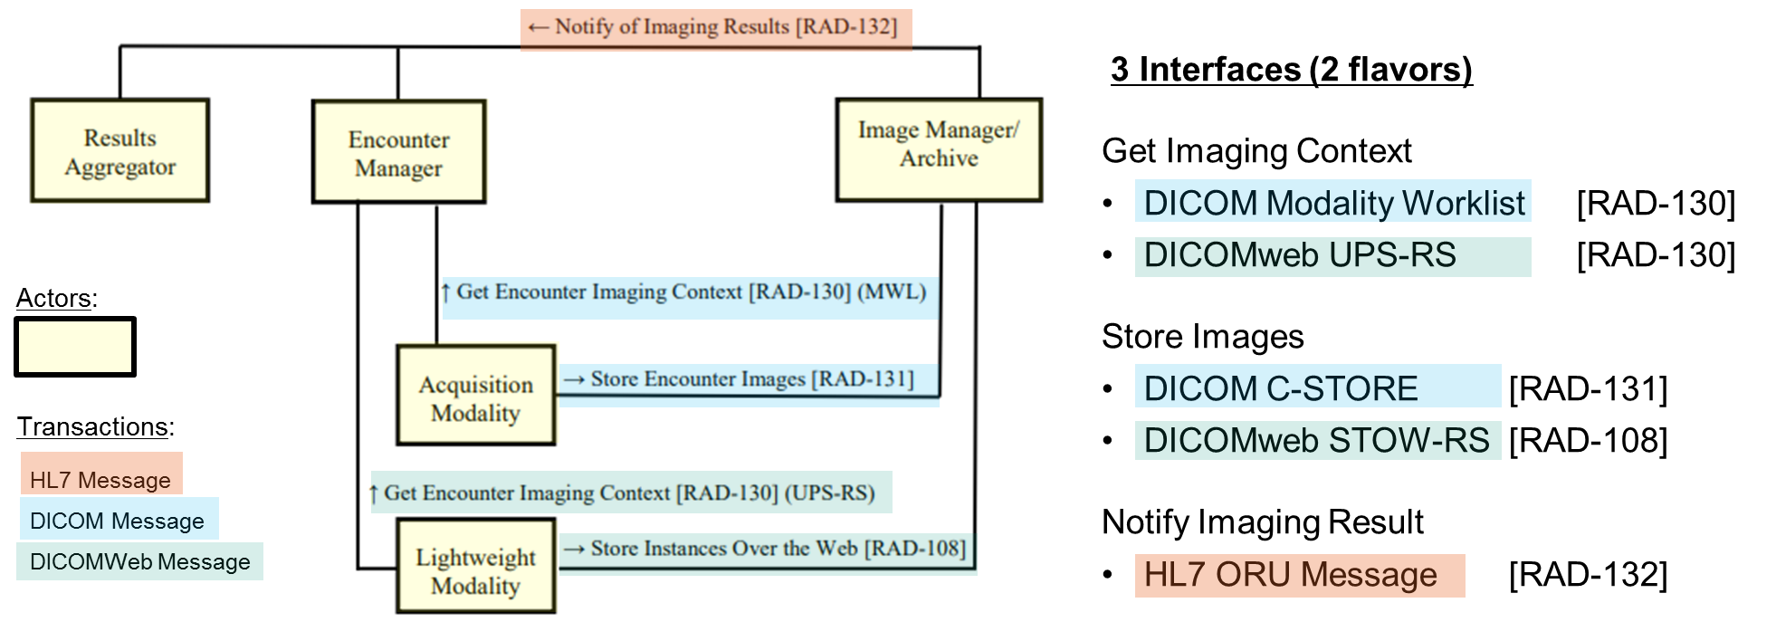
IHE EBIW Actor/Transaction Diagram

Slide 21
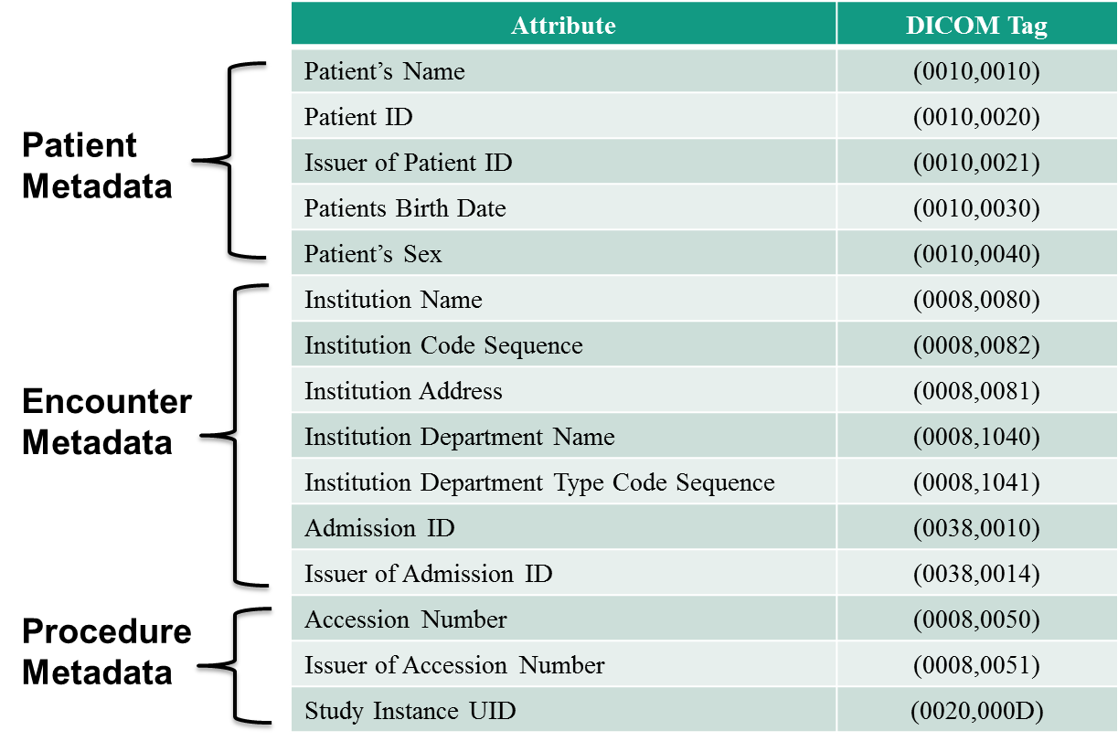
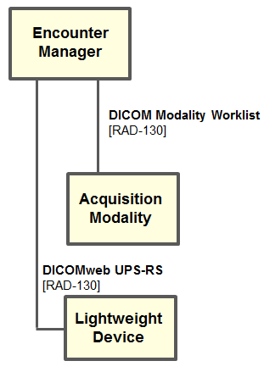
Key Values - Get Imaging Context

Slide 22
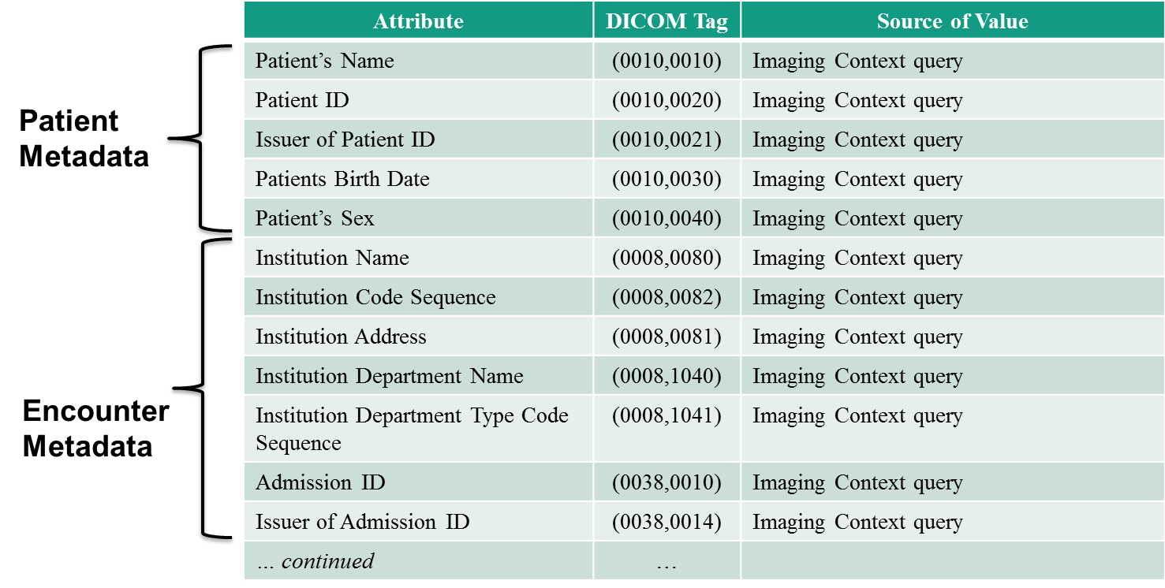
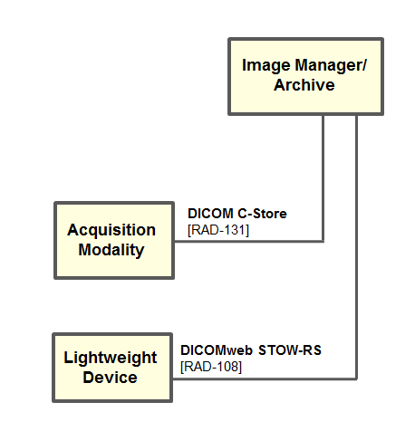
Key Values – Store Images

Slide 23
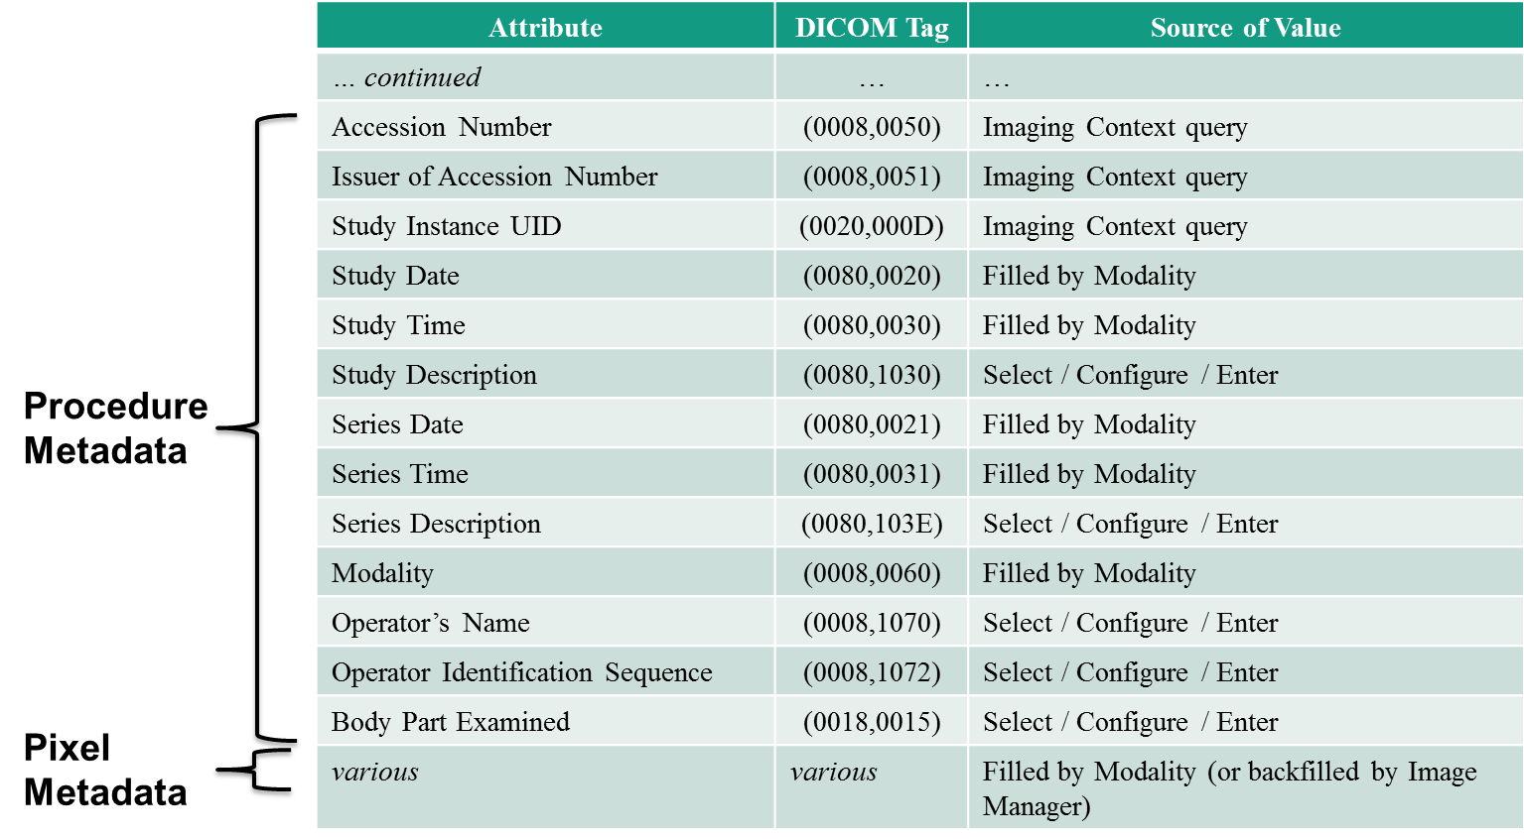
Key Values – Store Images

Slide 24
Encounter-based Imaging Workflow
EBIW
Topics:
What is Encounter-Based Imaging ?
IHE, Standards, and Encounter-Based Imaging Workflow
Metadata
Applying EBIW In The Real World
Summary and Resources

Slide 25
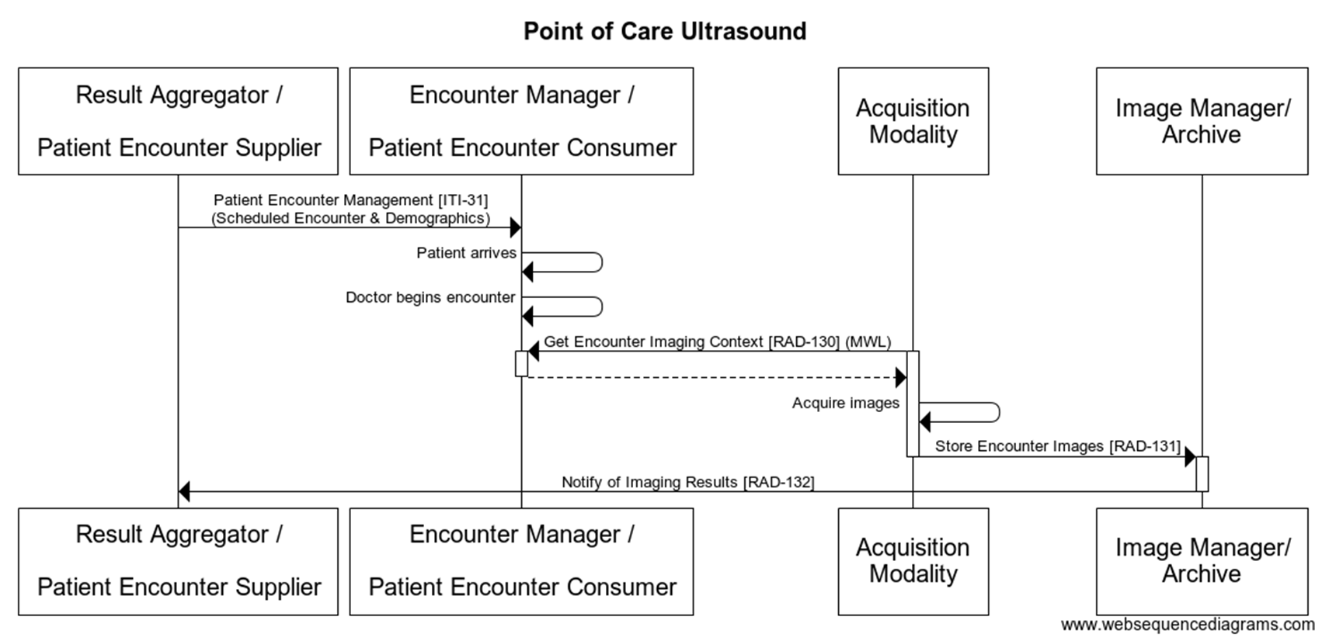
Applying EBIW in the Real World
Point of Care Ultrasound Process Flow

Slide 26
Applying EBIW in the Real World
Point of Care Ultrasound Process Flow
One of Several Real World Options
Actor Role:
EMR
Actor Role:
Encounter
Manager
Results
Aggregator
Notify Imaging Result
(HL7)
Get Imaging
Context
(DICOM)
Actor Role:
Image Manager
Ultrasound
or
Digital Capture
VNA
Actor Role:
Store Images
(DICOM)
Actor Role:
Acquisition
Modality
Image Archive

Slide 27
Applying EBIW in the Real World
Point of Care Ultrasound Process Flow
Another of Several Real World Options
Information
System
EMR
Actor Role:
Actor Role:
Encounter
Manager
Results
Aggregator
Get Imaging
Context
(DICOM)
Notify Imaging Result
(HL7)
Actor Role:
Ultrasound
or
Digital Capture
Image Manager
VNA
Actor Role:
Store Images
(DICOM)
Actor Role:
Acquisition
Modality
Image Archive

Slide 28
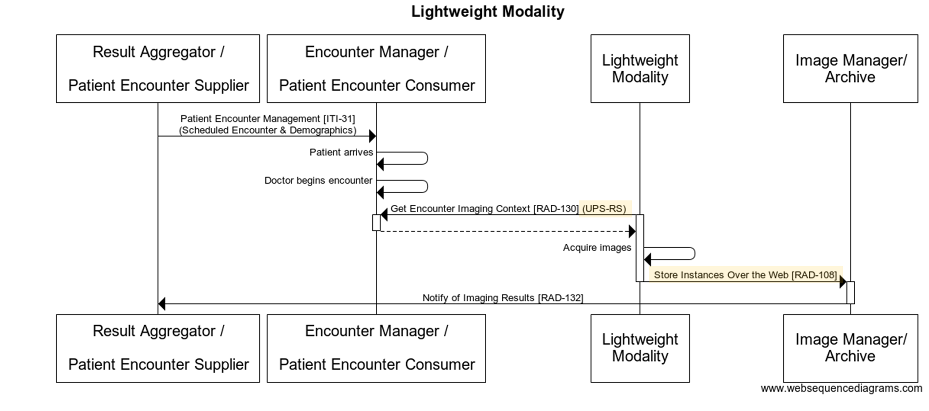
Applying EBIW in the Real World
Lightweight Modality Flow

Slide 29

Applying EBIW in the Real World
Lightweight Modality Flow
One of Several Real World Options
Actor Role:
EMR
Actor Role:
Encounter
Manager
Results
Aggregator
Get Imaging
Context
(DICOMweb)
Notify Imaging Result
(HL7)
Actor Role:
Image Manager
Photo Capture
Actor Role:
VNA
Light Weight
Device
Store Images
(DICOMweb)
Actor Role:
Image Archive

Slide 30
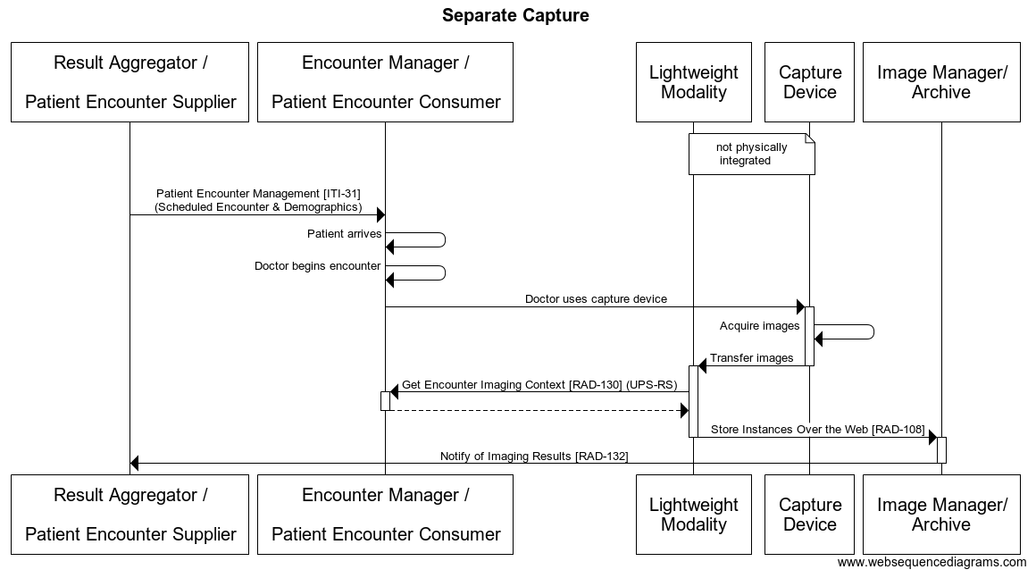
Applying EBIW in the Real World
Separate Capture and Import Flow

Slide 31
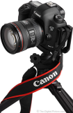
Applying EBIW in the Real World
Separate Capture and Import Flow
One of Several Real World Options
Information
System
EMR
Actor Role:
Actor Role:
Encounter
Manager
Results
Aggregator
Get Imaging
Context
(DICOM or DICOMweb)
Notify Imaging Result
(HL7)
Actor Role:
Image Manager
Image Import
Software
External
Camera
VNA
Transfer
Photos
Actor Role:
Store Images
(DICOM or DICOMweb)
Actor Role:
Lightweight
Modality
Image Archive

Slide 32
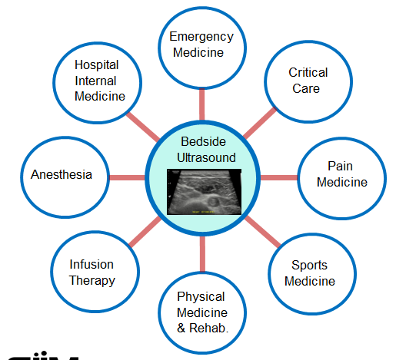
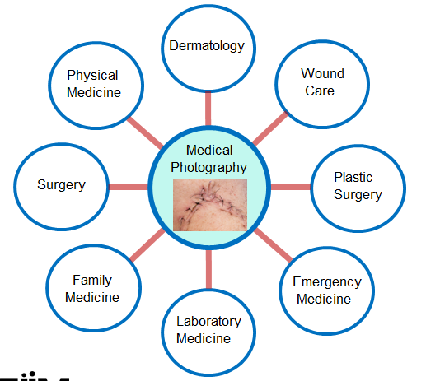
Image Acquisition
IHE Encounters-based Imaging Workflow
An IHE “standards-based” approach that addresses workflow for:
Non-order’s based imaging for
  Bedside Ultrasound
  Camera-based Acquisition (Lightweight Devices)

Slide 33


Enterprise Imaging
Example: Mature VNA Implementation
Electronic Health Record
Registration
Master Data
Orders
Results Management
Worklist
Services
Acquire/Store
Photos/Videos
EHR
Desktop
EHR
Mobile
Patient
Portal
Bedside Ultrasound Devices
Integration
DICOM, HL7 and Web Services
Interface Engine Services
Patient Imaging Registry
Vendor Neutral Archive
Clinical Image Viewing
Image Routing Services
DICOM and Web Services
DICOM Digital
Capture Devices
DICOM Wrap
Import Services
Outside Images
Import
Service
Mayo
Images
Export
Service
Cardiology
OB/Gyn
Ophthalmology
Orthopedics
Radiation Oncology
Urology
Vascular Medicine
Neurology
PMR
Sports Medicine
Pain Medicine
Infusion Therapy
Radiology
Anesthesiology
Dental & Oral Surgery
Emergency Department
Pulmonary/Bronchoscopy
Critical Care
Hospital Internal Medicine
Video Clip Import
GI Scopes
Others….
Others….
Medical Photo Import
Operating Rooms
Import API
ENT Scopes
Mayo Photo App
Stress Echo Videos
Electronic Import
CD/DVD Import
Electronic Export
Burn CD/DVD
Orders-based
Encounters-based

Slide 34

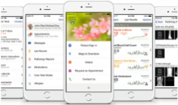
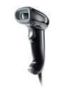



Example: Encounters-based Image Acquisition Workflow/Data flow with a VNA
Bedside Ultrasound Devices (speak DICOM)
Electronic Health Record
Patient Registration
Master Data Management
EHR
Desktop
EHR
Mobile
Patient
Portal
1
7
7
7
Create
and Result
Order
For
Imaging
Using
Known
Accession #,
Department,
PHI,
etc.
Get Patient Demographic Information
View Images
View Images
View Images
3rd Party Modality Worklist Server
Modality Worklist Query
1
1
1
1
Anes.
Sports Medicine
Critical
Care
Pulmonary
Bronchoscopy
Enterprise Clinical Image Viewer Optimized Environments
barcode
PID
1
4
DICOM
Images
DICOM
Images
DICOM
Images
DICOM
Images
With
Acc #
Institutional Image Management System
(IIMS)
(Patient Imaging Registry)
6
Notify Exam In Progress →
(PHI, Dept., Modality, Study UID…)
← Get Accession #
2
2
2
2
3
Gateway
3
4
Retrieve
Prior
Images
Notify IIMS
that images are available
(ORU)
DICOM
Images
with Acc #
Vendor Neutral Archive
Validate Images Against Patient Registration
6
5
Logical Storage Pools

Slide 35
Enterprise Imaging
Example: Mature VNA Implementation
Electronic Health Record
Registration
Master Data
Orders
Results Management
Worklist
Services
Acquire/Store
Photos/Videos
EHR
Desktop
EHR
Mobile
Patient
Portal
Bedside Ultrasound Devices
Integration
DICOM, HL7 and Web Services
Interface Engine Services
Patient Imaging Registry
Vendor Neutral Archive
Clinical Image Viewing
Image Routing Services
DICOM and Web Services
DICOM Digital
Capture Devices
DICOM Wrap
Import Services
Outside Images
Import
Service
Mayo
Images
Export
Service
Cardiology
OB/Gyn
Ophthalmology
Orthopedics
Radiation Oncology
Urology
Vascular Medicine
Neurology
PMR
Sports Medicine
Pain Medicine
Infusion Therapy
Radiology
Anesthesiology
Dental & Oral Surgery
Emergency Department
Pulmonary/Bronchoscopy
Critical Care
Hospital Internal Medicine
Video Clip Import
GI Scopes
Others….
Others….
Medical Photo Import
Operating Rooms
Import API
ENT Scopes
Mayo Photo App
Stress Echo Videos
Electronic Import
CD/DVD Import
Electronic Export
Burn CD/DVD
Orders-based
Encounters-based

Slide 36
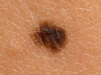




Example: Encounters-based Image Acquisition Workflow/Data flow with a VNA
Photography and Video Clip Acquisition and Import Services
Electronic Health Record
Registration
Master Data Management
EHR
Desktop
EHR
Mobile
Patient
Portal
1
1
7
7
7
Launch
To Patient
Context
Patient Lookup
Web Service
Import EHR Photos
Web Service
(future)
View Images
Create
Order
For
Imaging
Using
Known
Accession #,
Department,
PHI,
etc.
View Images
View Images
C
1
2
A
Medical
Photo/Video Import
Application
2
B
Enterprise Clinical Image Viewer Optimized Environments
2
4
Mobile
Photo/Video App
DICOM Images
and Video Clips
with Acc #
Institutional Image Management System
(IIMS)
(Patient Imaging Registry)
6
DICOM Encapsulate Web Service
Notify Photo Exam Info. →
(PHI, Dept., Photo Classification, …)
← Get Accession #
DICOM Encapsulation and Routing
3
4
Retrieve
Prior
Images
3
Notify IIMS
that images are available
(ORU)
DICOM Images
and Video Clips
with Acc #
Vendor Neutral Archive
Validate Images Against Patient Registration
6
5
Logical Storage Pools
Three Methods:
Medical Photos
Mobile Photo/Video App
Restricted Photos
A
B
Photo/Video Import Application
C
API – Import Web Service

Slide 37
Encounters-based Image Workflow – Standards-based Implementation
IHE EBIW Example Implementation Using a VNA (Real World Device / IHE Actor)
Electronic Health Record (IHE Results Aggregator Actor)
Patient Registration
Master Data Management
EHR
Desktop
EHR
Mobile
Patient
Portal
5
View Images
View Images
View Images
Institutional Image Management System
Modality Worklist Server
(IHE Encounter Manager Actor)
(IHE Image Manager Actor)
3 IHE Interfaces (2 flavors)
Get Imaging Context
DICOM Modality Worklist [RAD-130]
DICOMweb UPS-RS [RAD-130]
Store Images
DICOM C-STORE [RAD-131]
DICOMweb STOW-RS [RAD-108]
Notify Imaging Result
HL7 ORU Message [RAD-132]
1
2
Point of Care
Ultrasound
(IHE Acquisition Modality Actor)
Photo Acquisition App
1
2
Image Availability Notification
(IHE Lightweight Device Actor)
3
3
4
4
Gateway
DICOM Images
3
4
5
3
4
DICOM Images
Vendor Neutral Archive (IHE Image Archive Actor)

Slide 38
Encounter-based Imaging Workflow
EBIW
Topics:
What is Encounter-Based Imaging ?
IHE, Standards, and Encounter-Based Imaging Workflow
Metadata
Applying EBIW In The Real World
Summary and Resources

Slide 39
In Summary
As noted earlier, EBIW builds on SWF (Scheduled Workflow), taking advantage of DICOM Modality Worklist, well defined metadata in a well defined DICOM image header structure, the use of an accession number as a key, and the DICOM Store/Query-Retrieve services.
EBIW adds support for DICOMweb for lightweight devices.
Capturing and leveraging metadata properly depends on having a clear information model, query model, etc. By storing photos DICOM-wrapped, the pre-existing infrastructure that was used by orders-based DICOM imaging is inherited.

Slide 40
What to Ask For
Sample Language:
“Does the EMR implement the IHE Result Aggregator role in the EBIW Profile?”
  … to make sure the EMR can receive/process the ORU notifications
RFP: “Shall support the EBIW Profile as the Acquisition Modality Actor”
  … to require that your new PoCUS support encounter-based workflow
To confirm conformance
  IHE Integration Statements
  Connectathon Results

Slide 41
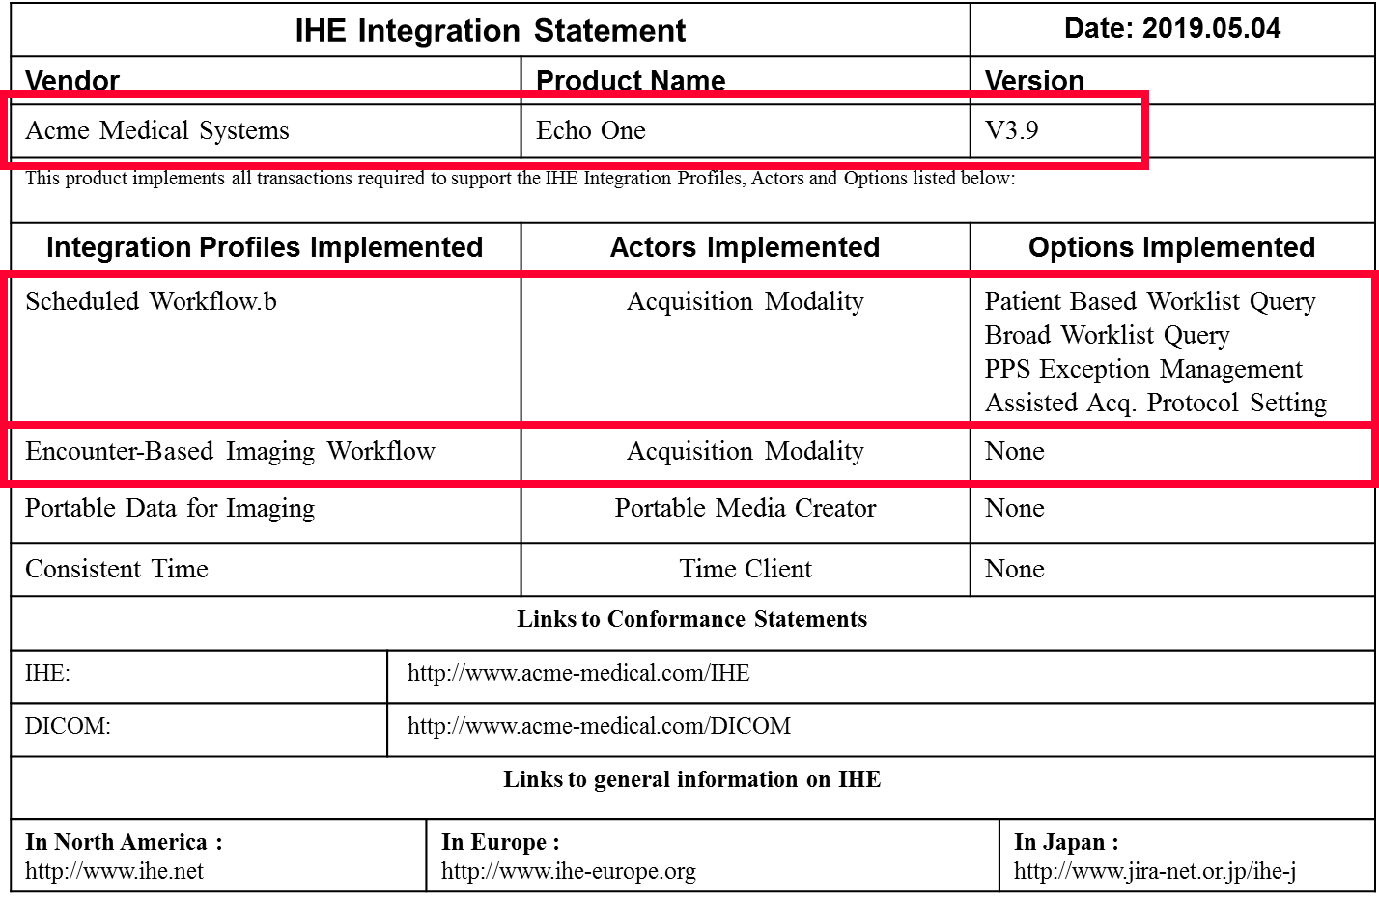
What to Ask For

Slide 42
IHE EBIW Profile: https://www.ihe.net/uploadedFiles/Documents/Radiology/IHE_RAD_Suppl_EBIW.pdf
EBIW ~ Further Reading
How to read the EBIW profile
  Consider starting with the Concepts Section (47.4.1.*)
  Actor Descriptions (47.1.1.*)
  Volume 3 transactions (4.130 ~ 4.132)
  Don’t overlook Cross-Profile Considerations (47.6)
How to find integration statements
  product-registry.ihe.net
  connectathon-results.ihe.net
  Search vendor websites
  Google
  Ask Salespeople
  (if we don’t have it, that’s how profiles get on product roadmaps)

Slide 43
Presenter’s contact information
Thank you –
You are welcome to contact me if you have questions or want to discuss any of these topics further.
  Kenneth Persons
  krpersons@mayo.edu
  Mayo Clinic,
  200 First St. SW Pb 2-58
  Rochester, MN, USA 55902

