Slide 1
DICOM Educational Conference Bangkok, Thailand
3-4 October 2019
DICOM Real-time video
Emmanuel CORDONNIER, b<>com
Co-chair dicom WG13
Copyright DICOM® 2019 www.dicomstandard.org #DICOMConference2019 #DICOM @DICOMstandard

Slide 2
Technology Background
Video over IP for TV studios

Slide 3
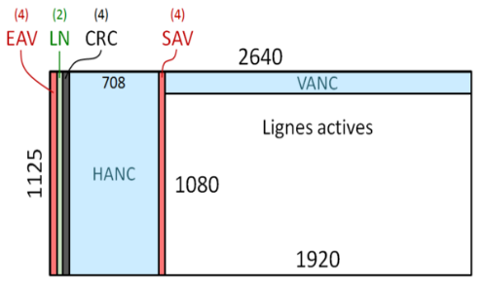
Multiplexed Video Over IP
Mimics coaxial cable by multiplexing all information in the same stream
Audio and ancillary data (subtitles…) are embedded in the hidden parts of the video
That is neither efficient (latency…) nor flexible
Addresses audio-video synchronization, but not video-video
Active lines
SAV: Start of Active Video
EAV: End of Active Video
LN: Line Number
CRC: Cyclic redundancy check
VANC: Vertical Ancillary data
HANC: Horizontal Ancillary data

Slide 4
Maze of SMPTE IP Video Standards

Slide 5
Convergence on SMPTE ST2110

Slide 6
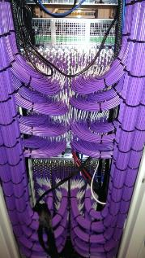
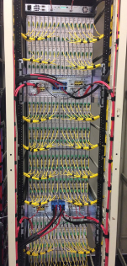
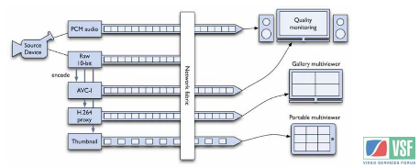
Professional AV world (R)evolution
From 1998 to 2012:
Migration of pro AV transport from coax infrastructure to networking technologies: Ethernet (IP), first for long haul, then for intra-studio applications (ProMPEG, VSF, SMPTE, IETF, ISO).
2013-2017: « There is more to be done with IP than merely replacing a cable with another »
Using SDN technologies for open control of networking gear along the path of AV streams.
Re-visiting the essence exchange and transport model.
Focus of the Joint Task Force for New Media (EBU/VSF/SMPTE): VSF-TR03 & TR04 Tech.
TR03 resulting standards: SMPTE ST 2110-*
Throughput: ~ x 15
Price : ~ ÷ 2

Slide 7
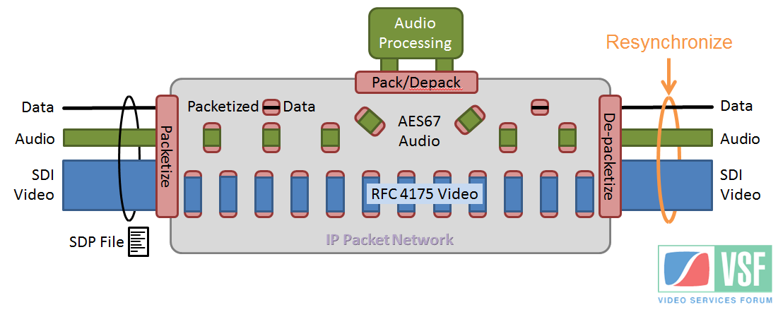
VSF-TR03/ST 2110-10 (audio) in a nutshell
Example: live audio processing
Reference system clock
SDP: Session Description Protocol

Slide 8
Video in DICOM
FROM Video Study STORAGE to … Real-Time video (Sup202)

Slide 9
Existing DICOM Video Storage
For example, Operating Room to EHR via PACS
Not real-time
Patient information in video metadata
DICOM Q/R
or WADO
DICOM Wlist /
HL7 ORM / FHIR
DICOM Store
EMR
Video Source* &
Temporary storage
EHR
PACS
Operating Room
*over head camera, endoscope, microscope …

Slide 10
Video Interoperability in Operating Room(s)
The OR is core to health businesses
20% of hospital expenditures, 6% of health costs
50 million procedures per year (U.S.)
Important risks
300,000 preventable severe adverse events / year (U.S.)
only ¼ of which are related to surgeon gesture itself
Need to improve
OR infrastructure mainly based on proprietary solutions
prohibitive purchase & operation costs
no shared resources among rooms

Slide 11
Users of Real-Time Video
Varied video sources (not just visible light)
Endoscopy (gastroenterology, orthopedic surgery, ENT)
Laparoscopy
Microscopy
Fluoroscopy
Ultrasound
Angiography
Ophthalmology
General surgery: overhead camera
Dental surgery
HIT displays (patient vital monitors, chart…)

Slide 12
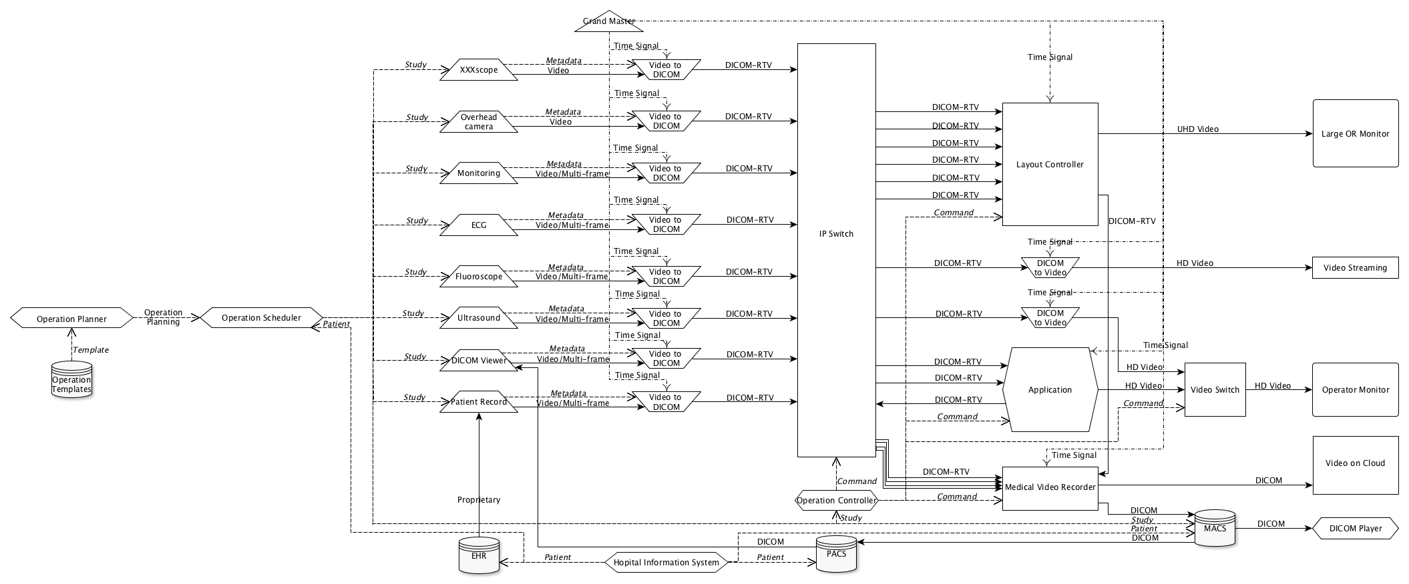
Use Cases: Global Picture
Synchronization
Visible light
Display
Monitoring
Switching
Medical imaging
Distribution
Scheduling
Supporting data
Image processing
Management
Storage

Slide 13
Duplicate video on multiple monitors
Two operators contributing to a procedure
a surgeon performing the operation
an assistant controlling the imaging system
Latency between monitors should be compatible with collaborative activity on surgery
Implementation either in the device or as a converter

Slide 14
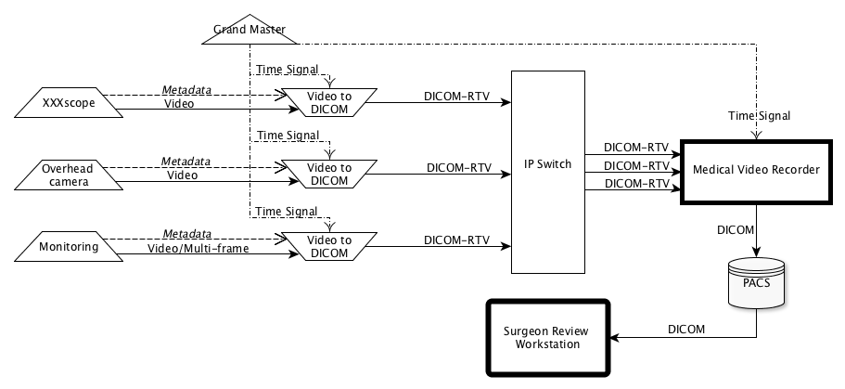
Post-procedure Review
Senior surgeon watches a recorded procedure
Reviews to understand what happened
Decides if the procedure is a success or need to re-operate
Need good quality recording of all video (endoscopy, monitors, …) and associated metadata
Need accurate time synchronization between channels

Slide 15
Automated OR Displays
“Multi-displays” tile multiple videos on one monitor
Tiling/Layout depends on the procedure step
Need automated layout set-up (“hanging protocol”)
Metadata drives layout automation

Slide 16
Augmented Reality
Image-guidance improves interventional procedures
Real-time display may be current feed(s), or combined with reference imaging (e.g., PET tumor location)
Need real-time video, metadata, and good synch
Minimizing latency improves safety and efficacy

Slide 17
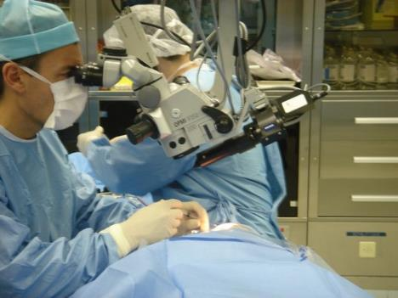
Example: Cataract surgery
Overlay plane
Surgeon view

Slide 18
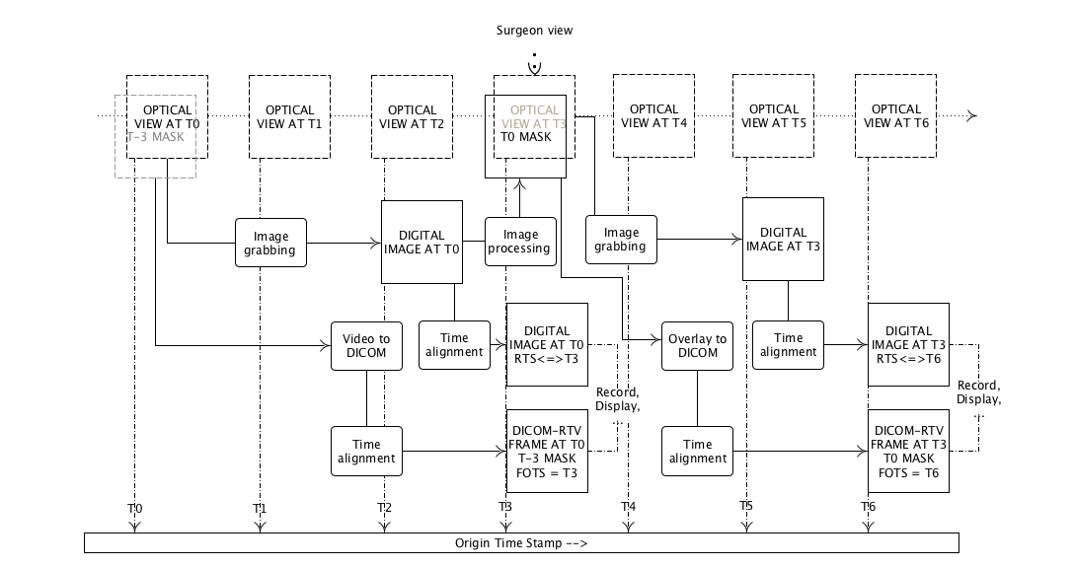
Example: Implementation

Slide 19
Real-Time Video Principles
Real-time data is comprised of video, audio and associated metadata essences
Each essence is carried as a flow over a multicast IP-based infrastructure
A flow broadcast by one source device may be consumed by any number of devices
A Flow is transmitted as a sequence of Grains (each may be one or more packets)
Grains (frames) are synchronized/”aligned” via PTP (Precision Time Protocol)
Packets of video (V) will be more frequent than audio (A) and metadata (M)

Slide 20
Real-Time Session Description
SMPTE ST 2110-10 requires an SDP object describing a set of flows
Nature of the flow (video, audio, DICOM-RTV metadata…)
one IP port per flow
Video characteristics
Source identification
…
DICOM metadata also incorporates the main SDP content
DICOM Conformance Statements describe how SDP objects are accessed
SDP
object

Slide 21
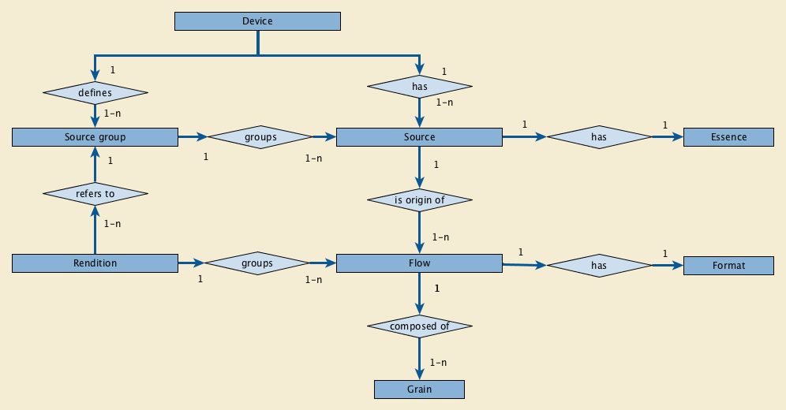
Real World Model
A Device can provide and/or consume content
A producing Device has one or more Sources
A Source is the origin of one or more Flows (same content)
A Flow corresponds to a SOP Instance (with a UID & transfer syntax)
A Rendition links multiple Flows (e.g., video and audio)

Slide 22
Metadata Flow (for video)
Video Flow contains only Bulk Data (no metadata)
Metadata Flow references the Video Flow (similar to JPIP) but contains no Pixel data
Metadata Flow describes the Video Flow using (modified) modules from existing video IODs
Static payload (sent at least every 1 second)
Every frame
Real-Time
Video Endoscopic
Video Endoscopic Image IOD
Synchronization Module
Real-Time Bulk Data Flow Module
Current Frame Functional Groups Module
Image Pixels, Multi-frame and Cine modules
=
+
+
+
-
Pixels replaced by a reference

Slide 23
Metadata Flow (for audio)
Audio Flow contains only Bulk Data (no metadata)
Metadata Flow references the Audio Flow but contains no waveform samples
Metadata Flow describes the Audio Flow using (modified) modules from existing audio IODs
Static payload (sent at least every 1 second)
Every sample
Real-Time
Audio Waveform
Audio Waveform
IOD
Synchronization Module
Real-Time Bulk Data Flow Module
Current Frame Functional Groups Module
Waveform Module
=
+
+
+
-
Waveforms replaced by a reference

Slide 24
Metadata Packet Structure
RTP Header
Main
Extension
RTP Payload
RTV Meta Info
Details of encoding
RTV Dynamic Frequently changing
RTV Static Unchanging but resent every second to sync up newly connected consumer
Notes:
The communication is expressed as RTP packets with the synchronization done through RTP timestamp (which is reset to 0 every 13 hours), the actual time of the frame being stored in the RTP Extension (Origin Timestamp which is corresponding to the actual the frame was produced – also stored in the DICOM RTV Metadata Dynamic Payload - and the Sync Timestamp which is the time aligned on the synchronization instants). The payload contains a DICOM dataset comprising the Meta Information – similar to Part 10 – containing the information that only make sense for the real-time communication, the dynamic payload that contains the information that change or may change every frame (or sample) and, optionally, the static payload that contains the information that is the same for every frame.

Slide 25
RTV (File) Information Header
For compliance with pending Standard Fast Metadata Payload Header (SMPTE ST 2110-41)
Attribute Name | Tag | Type | Attribute Description
Header Preamble | No Tag or Length Fields | 1 | A fixed 128 byte field available for Application Profile or implementation specified use. If not used by an Application Profile or a specific implementation, all bytes shall be set to 00H. Receivers shall not rely on the content of this Preamble to determine that this payload is or is not a DICOM payload.
DICOM Prefix | No Tag or Length Fields | 1 | Four bytes containing the character string "DICM". This Prefix is intended to be used to recognize that this payload is or is not a DICOM payload.
File Meta Information Group Length | (0002,0000) | 1 | Number of bytes following this RTV Meta Element (end of the Value field) up to and including the last RTV Meta Element of the Group 2 RTV Meta Information
Transfer Syntax UID | (0002,0010) | 1 | Uniquely identifies the Transfer Syntax used to encode the referred bulk-data Flow. This Transfer Syntax does not apply to the RTV Metadata which is encoded using the Explicit VR Little Endian Transfer Syntax.
RTV Meta Information Version | (0002,0031) | 1 | This is a two byte field where each bit identifies a version of this RTV Meta Information header. In version 1 the first byte value is 00H and the second byte value is 01H.
RTV Communication SOP Class UID | (0002,0032) | 1 | Uniquely identifies the SOP Class associated with the Data Set. SOP Class UIDs allowed for RTV Communication are specified in section 7.2 STANDARD SOP CLASSES.
RTV Communication SOP Instance UID | (0002,0033) | 1 | Uniquely identifies the SOP Instance associated with the Data Set placed in the RTP Payload and following the RTV Meta Information.
RTV Source Identifier | (0002,0035) | 1 | The UUID of the RTP source that sends the RTV Metadata Flow.
RTV Flow Identifier | (0002,0036) | 1 | The UUID of the RTV Metadata Flow.
RTP Flow Sampling Rate | (0002,0037) | 1C | The rate of the dynamic part of the RTV Metadata Flow, the same as the bulk-data Flow rate. Required if RTV Metadata Flow includes a dynamic part.
RTV Flow Actual Frame Duration | (00020038) | 3 | Duration of image capture in msec.
Private Information Creator UID | (0002,0100) | 3 | The UID of the creator of the private information (0002,0102).
Private Information | (0002,0102) | 1C | Contains Private Information placed in the RTV Meta Information. The creator shall be identified in (0002,0100). Required if Private Information Creator UID (0002,0100) is present.

Slide 26
IOD Modules
IE | Module | Reference | Usage
Patient | Patient | C.7.1.1 | M
 | Clinical Trial Subject | C.7.1.3 | U
Study | General Study | C.7.2.1 | M
 | Patient Study | C.7.2.2 | U
 | Clinical Trial Study | C.7.2.3 | U
Series | General Series | C.7.3.1 | M
 | Clinical Trial Series | C.7.3.2 | U
Equipment | General Equipment | C.7.5.1 | M
Frame of Reference | Frame of Reference | C.7.4.1 | U
 | Synchronization | C.7.4.2 | M
Image | General Image | C.7.6.1 | M
 | General Reference | C.12.4 | U
 | Real-Time Bulk Data Flow | C.7.6.26 | M
 | Acquisition Context | C.7.6.14 | M
 | Device | C.7.6.12 | U
 | Specimen | C.7.6.22 | C - Required if the Imaging Subject is a Specimen
 | VL Image | C.8.12.1 | M
 | ICC Profile | C.11.15 | U
 | SOP Common | C.12.1 | M
 | Common Instance Reference | C.12.2 | U
 | Real-Time Acquisition | C.7.6.28 | C - Required if this flow contains a stereoscopic pair
 | Current Frame Functional Groups | C.7.6.X2 | M
Reference to PTP (vs. NTP)
---------RTV Static Payload-------------
--RTV Dynamic Payload--

Slide 27
Current Frame Functional Groups Module
This Module is placed in every frame, in the RTV Dynamic Payload
Attribute Name | Tag | Type | Attribute Description
Current Frame Functional Groups Sequence | (0006,0001) | 1 | Sequence that contains the Functional Group Sequence Attributes corresponding to the current frame or audio sample. Only one Item shall be included in this Sequence.
>Include one or more Functional Group Macros that are contained in every frame. |  |  | For each IOD that includes this module, a table is defined in which the permitted Functional Group Macros and their usage is specified.

Slide 28
Time of Frame Macro
This Module is placed in every frame, in the RTV Dynamic Payload
Attribute Name | Tag | Type | Attribute Description
Time of Frame Group Sequence | (0034,000D) | 1 | Time characteristics of the current frame or audio sample. Only one Item shall be included in this Sequence.
>Frame Origin Timestamp | (0034,007) | 1 | This timestamp contains the capture time of the payload content for this frame or audio sample. It is in TAI, not UTC.

Slide 29
Example of Functional Group Macro
Attribute Name | Tag | Type | Attribute Description
Frame Usefulness Group Sequence | (0034,0009) | 3 | Sequence that contains the Functional Groups Sequence Attributes corresponding to the current frame or audio sample. Only a single Item shall be included in this Sequence.
>Includes Information | (00034,000C) | 3 | Whether or not the current frame includes useful information, i.e. not noise nor void Enumerated value: YES NO
>Includes Imaging Subject | (0034,0008) | 3 | Whether or not the current frame includes the imaging subject. Enumerated value: YES NO
Real-Time Video Microscopic Image Functional Group Macro

Slide 30
New IODs and SOP Classes
Information Object Definition | Type | Part
Real-Time Video Endoscopic Image IOD | Composite | PS3.3
Real-Time Video Photographic Image IOD | Composite | PS3.3
Real-Time Audio Waveform IOD | Composite | PS3.3
Rendition Document IOD | Composite | PS3.3
UID Value | UID Name | UID Type | Part
1.2.840.10008.10.1 | Video Endoscopic Image Real-Time Communication | SOP Class | PS3.22
1.2.840.10008.10.2 | Video Photographic Image Real-Time Communication | SOP Class | PS3.22
1.2.840.10008.10.3 | Audio Waveform Real-Time Communication | SOP Class | PS3.22
1.2.840.10008.10.4 | Rendition Document Real-Time Communication | SOP Class | PS3.22

Slide 31
Transfer Syntaxes
Transfer Syntax describes the encoding of the bulk data (video or audio) conveyed in the ST 2110-xx Flow referenced in the DICOM RTV Metadata Flow
Initially, only uncompressed video is supported
Will consider compression as pending ST 2110-22 is finalized
ST 2110-22 (Compressed Video Formats) is in the process of adoption
UID Value | UID Name | UID Type | Part
1.2.840.10008.1.2.7.1 | SMPTE ST 2110-20 Uncompressed Progressive Active Video | Transfer Syntax | PS3.5
1.2.840.10008.1.2.7.2 | SMPTE ST 2110-20 Uncompressed Interlaced Active Video | Transfer Syntax | PS3.5
1.2.840.10008.1.2.7.3 | SMPTE ST 2110-30 PCM Digital Audio | Transfer Syntax | PS3.5

Slide 32
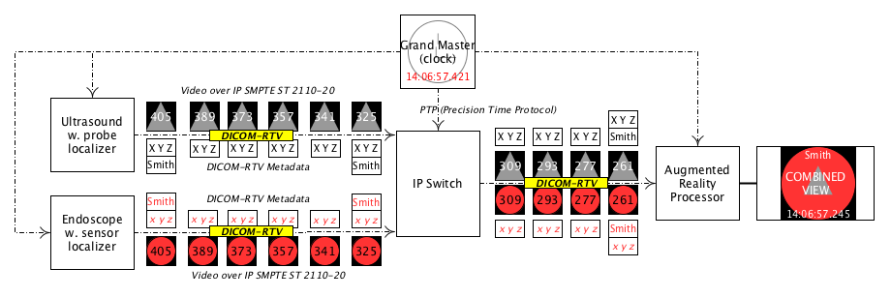
Summary: Example of Endoscopy/Ultrasound AR
Grand Master Clock
Time in ms
14:06:57:421
Processing
Display
Alternate video and metadata frames on the destination network
Acquisition
Video and metadata frames on the sources to switch networks

Slide 33
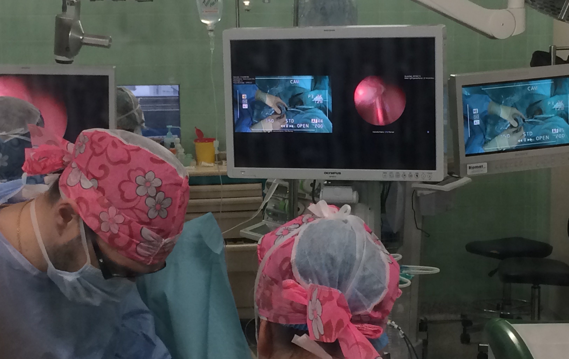
Example of implementation (1) – Multiple Display
World 1ère
Jan. 16th, 2019
CHU de Rennes, France
5 Prostate Procedures
Dr. Sebastien Vincendeau
Endoscopic and surgeon’s hands views perfectly synchronized ready for remote mentoring
Perfect time synchronization between two real-time video sources

Slide 34
Example of implementation (II) – Augmented Reality
IRCAD / IHU Strasbourg with b<>com
Presentation at CARS 2019, Rennes, France, June 2019
Registration error drastically reduced thanks to correct time synchronization via DICOM-RTV
Comparison of SDI based vs. DICOM-RTV based Augmented Reality

Slide 35
Perspectives and Publications
Extension to Angiography / Fluoroscopy (DICOM WG02)
Extension to Ultrasounds (DICOM WG12)
Extension to compressed images (compliance with SMPTE ST 2110-22)
Compatibility with Fast Metadata Payload (SMPTE ST 2110-41)
Extension to Wireless communication (see 5G-TOURS European Project)
World first retransmission of medical images in an operating room via DICOM-RTV: technical details, COMPSAC Workshop 2019, Saad El Jaouhari, et al.
Introduction to DICOM-RTV: a new standard for real-time video communication in hospitals, IEEE Healthcom 2019 Saad El Jaouhari et al.
Streaming DICOM Real-Time Video and Metadata Flows Outside The Operating Room IEEE GLOBECOM 2019, Saad El Jaouhari et al.
On-the-fly DICOM-RTV Metadata Pseudonymization during a Real-Time Streaming, ICOIN 2020, Saad El Jaouhari et al. (submitted)

Slide 36
Author Contacts
Emmanuel Cordonnier
emmanuel.cordonnier@b-com.com
b<>com 1219 avenue des Champs Blancs 35510 Cesson-Sévigné France
Presentation re-using material from Philippe Lemonnier (b<>com & VSF/SMPTE)
This presentation has received funding from the European Union’s Horizon 2020 research and innovation program under grant agreement No 856950
Thank you for your attention!

