Slide 1
DICOM Educational Conference Bangkok, Thailand
3-4 October 2019
Artificial Intelligence Overview
University of Arkansas for Medical Sciences
Lawrence Tarbox Ph.D
User Co-Chair, DICOM Standards Committee and WG 14, 23, and 29
Copyright DICOM® 2019 www.dicomstandard.org #DICOMConference2019 #DICOM @DICOMstandard

Slide 2
Acknowledgements
Many thanks to Gianluca Paladini of Siemens Healtheneers for providing many of the slides in this presentation
Many thanks to participants in DICOM WG-23 “Artificial Intelligence / Application Hosting” for their work, which is represented in this presentation.

Slide 3
AI Use Cases Taxonomy: Impact Level and Data Integration Complexity
Data Integration Complexity
Level 1
Level 2
Level 3
Level 4
Scanning,
Data Creation
Post-Processing,
Reading
Patient Centric
Precision Medicine
Population, Patient Cohort
Scan automation, positioning, iso-centering, optimal dose
Reconstruction, artifact correction, de-noising
Automated detection of abnormality; patient triage
Workflow automation; Detect, diagnose and report generation
Contouring, labeling, measurement, characterization, quantification
Clinical pathways, decision support, multiscale/multi-modal
Predict, plan, prescribe
Virtual patient avatar, treatment simulation
Interventional navigation, fusion
Population health management
Outcome analysis
Quality care, Meaningful Use
Biomarker discovery

Slide 4
AI Use Cases Taxonomy: Levels of AI Automation Complexity
AI Automation Complexity
Level 1
Level 2
Level 3
Level 4
Level 5
AI Auto-Adjusts
Static Presets
AI Responds To Specific Adjustments
AI Semi- Autonomously Acquires Data
AI Autonomously Processes Scanned Data
AI Is Fully Autonomous, Connected, Learning
Operator performs fine-adjustment
Physician reads all images
Operator triggers adjustment
Physician reads selected data
Operator takes control in emergency
Physician reads selected data
Physician reviews selected data & pre-analyzed information
Physician is only needed for complex cases

Slide 5
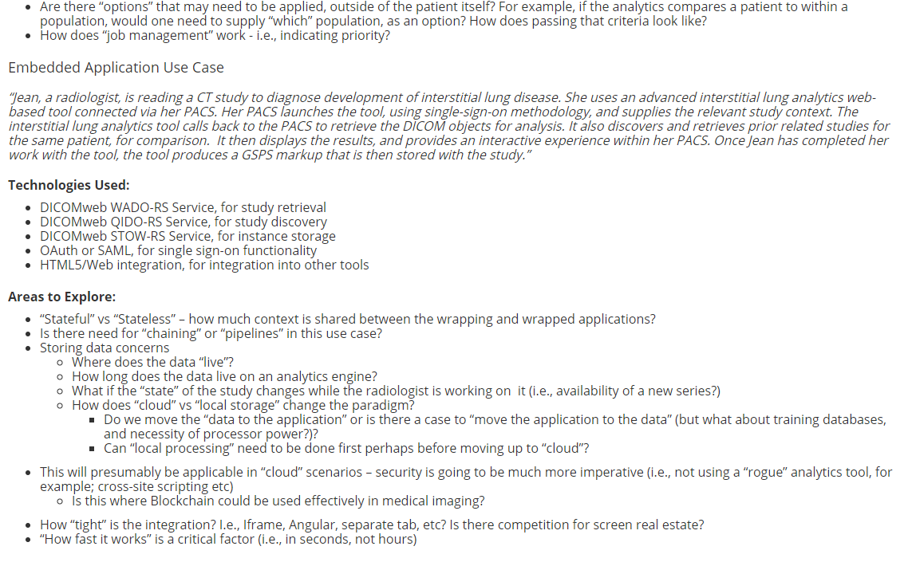
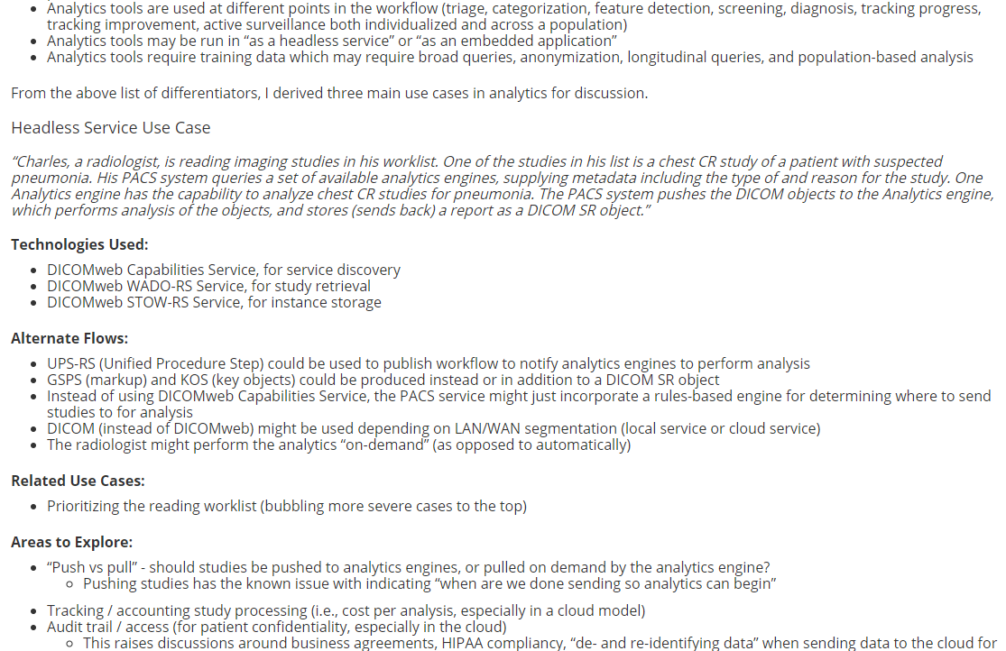
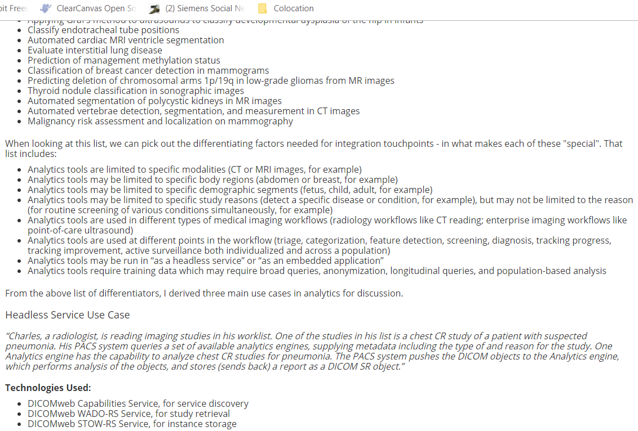
Coordinated Effort in WG-23
Use Case Gathering
Grouping, Taxonomies
Requirements, Refined Categories
Gap Analysis
Proposed
Specification
MITA
IHE
DICOM
WG-20
ACC
DICOM
WG-23
AAPM
ACR
ADA
…
What are the procedure steps/workflows involved?
What input information is needed?
What new output information is being generated?
…
What is the AI technology impact level?
What classes of data need to be integrated?
Which groups focused on applicable standards need to be involved?
…
What information needs to be stored, queried, retrieved, communicated, presented?
…
Are the requirements supported by existing standards?
If so, are existing standard adequate or can they be improved?
If not, what additions or modifications are recommended?
…
How is new information defined, categorized, described?
How is new information stored, queried, retrieved, communicated, presented?
…

Slide 6
Existing Work Item
“Extending Application Hosting With Dicom Web Services for Remote Image Analysis Services”
Create an informative annex for Part 17 illustrating how to use existing mechanisms within DICOM, IHE, or the web in general to trigger an external analysis service
Corollary effort – gap analysis
Could be triggered from a workstation or from a workflow engine
Could be interactive or in the background
AI was the driving impetus for creating the work item
Work Item first presented to DSC in April 2017, withdrawn after heavy discussion, reworked, and the revised work item approved by the DSC in September 2017 with significantly reduced scope
Reduced scope does not preclude future work

Slide 7
Focused on two ‘easy’ use cases
Passing Discrete Data in the Image Generation Workflow
Passing Discrete Data in the Reading Workflow
Continuous background analysis as image data is generated or stored
Prepare data for the reading workflow
Extract statistics from data
Analysis on demand while viewing or reading studies
Considered two options:
Unified Procedure Step (similar to IHE PAWF)
Something similar to IHE Invoke Image Display

Slide 8
Gap Analysis Thus Far
Existing DICOM, IHE or web-based mechanisms likely can support the simple use cases/scenarios currently under consideration
Confirmation requires fleshing out the use cases further
Need consistency in results reporting
Worry is that more complex use cases cannot be covered with existing mechanisms
Such use cases may be out of scope for the current work item
But could be considered for future work items
Querying for, gathering training data sets

Slide 9
AI and importance of Big Data: Run-time classification error
Classification Error
40%
30%
20%
Emergence of AI unveils the
benefits of training with Big Data
10%
Traditional Machine Learning
0%
Deep Learning / AI
10
100
1000
10000
100000
1000000
Number of Training Datasets

Slide 10
Next Steps
Working jointly with the IHE Radiology Technology Committee, merge and flesh out the two simple use cases
End goal is an IHE profile
IHE decided on the UPS approach, leveraging the PAWF & other work
Launched a new work item to deal with results reporting, to be coordinated with a new IHE profile
Continue gathering examples of data to be reported
Consider additional, potentially more complex use cases
Use the taxonomy and process previously described
Sketch out plans for next work items

Slide 11
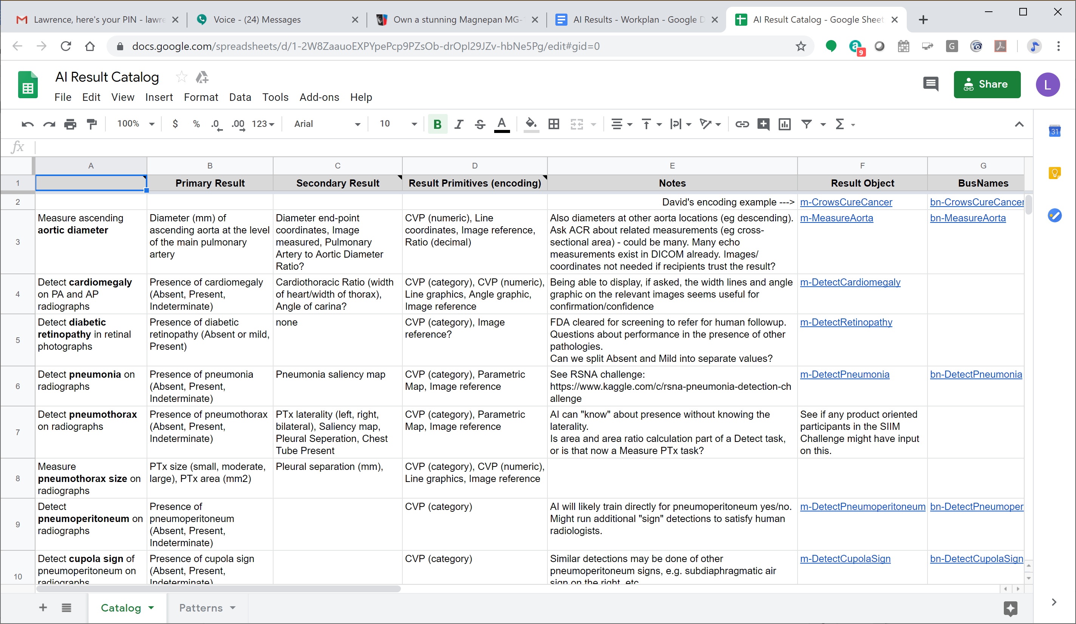
AI Result Catalog

Slide 12
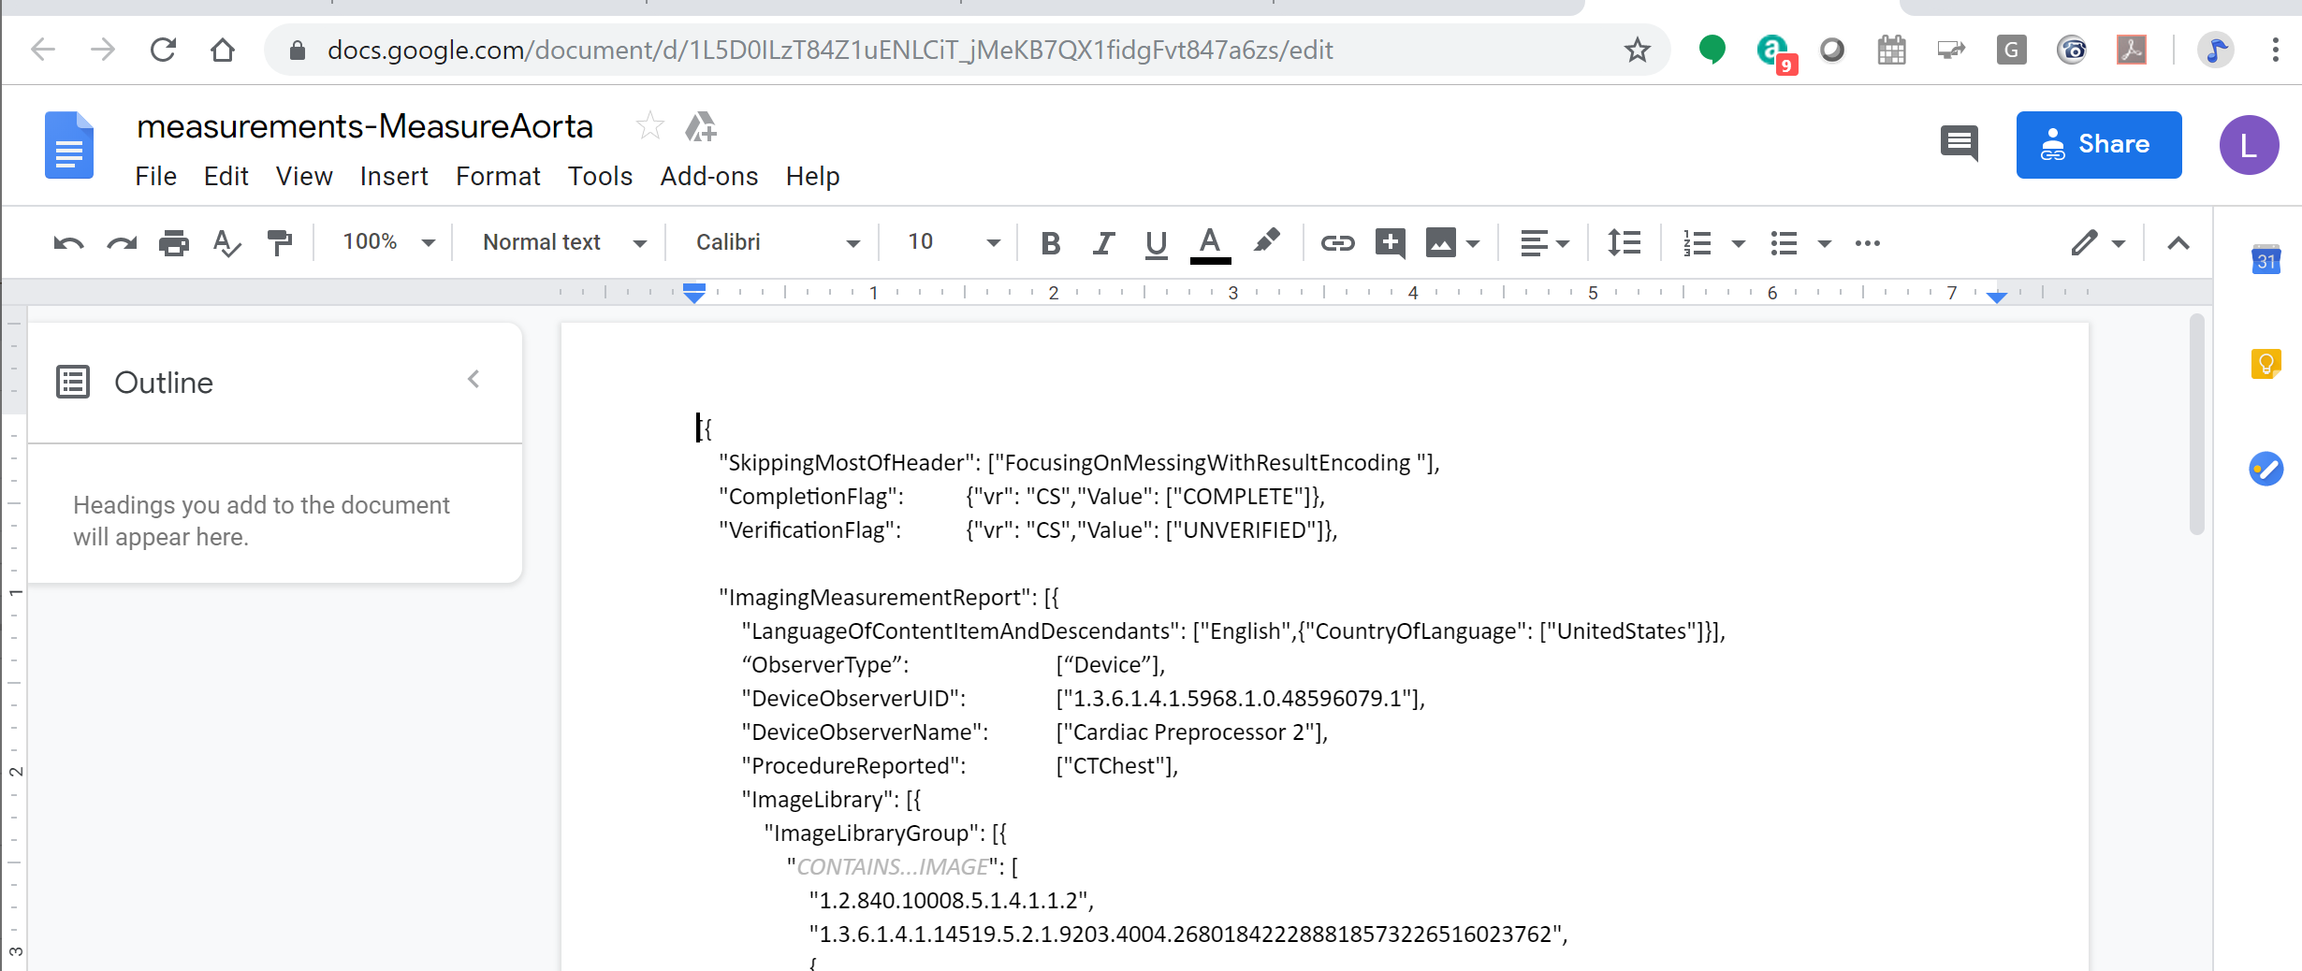
Example Result Object

Slide 13
Miscellaneous Discussion Points
Standardized results interchange
Integrated access to other clinical data (e.g. EMR/HIS/LIS)
Advanced De-Identification topics for AI, e.g.:
Co-anonymization of other clinical data and reports
Re-identification of anonymized data;
AI job management / orchestration;
‘App Store’ related: subscriptions; metering of resources/service use and cost; monetization;
Mechanisms for training/test data discovery

Slide 14
Open Questions
Are the 2 current use cases/scenarios sufficient for the current work item? Or should we include additional use cases?
How do we coordinate with ACR, RSNA, SIIM, AAPM, and other orgs?
Informal cross participation is working for the moment
Should we formalize relationship?
Volunteers to
Flesh out use cases and examples
Be supplement editors
Is the frequency and time of t-cons – currently bi-weekly – sufficient?
Could we use face-to-face meeting to speed things up, and if yes, when?

Slide 15
Contributing To WG-23 Initiatives
Anyone is welcome to join Working Group 23!!!
Share and discuss AI use cases
Identify where DICOM lacks support for AI
Propose ideas to add AI requirements in DICOM

