Slide 1
DICOM Educational Conference Bangkok, Thailand
3-4 October 2019
Dicomweb™ and FHIR®
Change Healthcare
Elliot Silver, M.SC. Past Co-Chair of HL7 Imaging Integration & DICOM WG-20
Copyright DICOM® 2019 www.dicomstandard.org #DICOMConference2019 #DICOM @DICOMstandard

Slide 2
Formalities
DICOM® is a registered trademark of NEMA; DICOMweb™ is a trademark of NEMA.
FHIR® and the FLAME DESIGN are registered trademarks of HL7 and used with the permission of HL7.

Slide 3
What is the HL7 FHIR Standard?
Result of HL7 Fresh Look task force
“What would healthcare exchange look like if we started from scratch using modern approaches?”
Addresses perceived deficiencies in existing HL7 standards
V2: Product of a by-gone era
V3: Too complex, little traction
CDA: Too much variability
FHIR targets
Broader sharing across organizations
Mobile, web, cloud environments
Integration in days, not months
Notes:
So, what is HL7 FHIR?
FHIR came out of an effort by HL7 to answer the question “what would healthcare exchange look like, if we started from scratch using modern approaches?”
They looked at their earlier standards.
HL7 V2 is firmly rooted in its time.
Designed with minimal security for static networks: small number of well-known, always present, trusted systems
New systems only came online as part of a major purchase, so the fact it took some cost and effort to get it to talk to everything else, well, that’s expected of a complex procurement.
HL7 V3 is a more modern approach, but it has a steep learning curve.
Too abstract, required local implementation guides. Those implementation guides result in incompatible local dialects.
To develop implementation guides and promote their use, essentially requires the resources and leverage of a government agency.
Clinical Data Architecture documents are more widely adopted than rest of V3.
still lots of inconsistency
Starting fresh, HL7 wanted to address the requirements of today’s healthcare environment.
A standard to enable more interoperability and information sharing between organizations
A standard ready for the needs of mobile and web clients, and for cloud computing
And, because mobile clients join and leave the network all the time, and because we expect to be connecting to many other organizations, the standard needs to enable quick and simple integrations.

Slide 4
What is HL7 FHIR?
Fast
Focus on design and implementation efficiency
Healthcare
Don’t try to cover other domains
Interoperable
Systems should just work together
Resources
Fundamental building blocks
<Patient xmlns="http://hl7.org/fhir">
<id value="31415"/>
<identifier>
<use value="usual"/>
<label value="MRN"/>
<system value="http://www.goodhealth.org/ids/mrs"/>
<value value="123456"/>
</identifier>
<name>
<family value="Levin"/>
<given value="Henry"/>
</name>
<gender value="male"/>
<birthDate value="1932-09-24"/>
<careProvider>
<reference value="Organization/2"/>
<display value="Good Health Clinic"/>
</careProvider>
<active value="true"/>
</Patient>
Notes:
FHIR stands for Fast Healthcare Interoperable Resources.
Fast
Focus on design and implementation efficiency.
The healthcare information content is exchanged with minimal overhead.
As we’ve seen at the hackathon this week, developers can get started and productive quickly, using tools they are already familiar with.
Healthcare
FHIR addresses healthcare information exchange, and that’s HL7’s core competency
FHIR recognizes that there are other standards out there and doesn’t try to cover all information domains within a hospital.
There exist good solutions to problems like web security, so we don’t need to invent a custom approach, instead FHIR leverages existing standards.
Interoperable
Systems should just work together with the minimum of manual configuration and maximum of understanding.
And Resources
The resource is the basic unit of transaction.
It is a discrete, self-contained bundle of information.
In FHIR, all information is in resources that are accessed or updated.
The closest equivalent to resources in HL7 v2 is the segment.
Here we see a partial Patient resource expressed as XML– with an MRN, first and last names, gender, date of birth, and so on
There are FHIR resources defined for Patients, Providers, Medications, Procedures, reports, Appointments, Clinical impressions, etc.

Slide 5
How HL7 V2 Works
Application wants to graph a patient’s blood pressure over the last year.
MSH | ^ ~\& |VSM001 |MIRTH_CONNECT |HIS001 |MIRTH_CONNECT |20100511220525 | |ORU ^R01 |MSG0000001 |P |2.5 | | |NE |NE |CO |8859/1 |ES-CO
PID | |6537077 |6537077 ^ ^ ^ ^CC | |ANDRES FELIPE ^FERNANDEZ CORTES | |19860705 |M
OBR |1 | |VS12340000 |28562-7 ^Vital Signs ^LN
OBX |1 |NM |271649006 ^Systolic blood pressure ^SNOMED-CT | |132 |mm[Hg] |90-120 |H | | |F | | |20100511220525
OBX |2 |NM |271650006 ^Diastolic blood pressure ^SNOMED-CT | |86 |mm[Hg] |60-80 |H | | |F | | |20100511220525
OBX |3 |NM |6797001 ^Mean blood pressure ^SNOMED-CT | |94 |mm[Hg] |92-96 |N | | |F | | |20100511220525
OBX |4 |NM |386725007 ^Body temperature ^SNOMED-CT | |37 |C |37 |N | | |F | | |20100511220525
OBX |5 |NM |78564009 ^Pulse rate ^SNOMED-CT | |80 |bpm |60-100 |N | | |F | | |20100511220525
OBX |6 |NM |431314004 ^SpO2 ^SNOMED-CT | |90 |% |94-100 |L | | |F | | |20100511220525

Slide 6
How HL7 V2 Works
Application wants to graph a patient Dylan Doe’s blood pressure over the last year.
EMR
Have a BP reading for MRN 87345125.
User Application
Have a BP reading for MRN 94672543.
MSH | ^ ~\& |VSM001 |MIRTH_CONNECT |HIS001 |MIRTH_CONNECT |20100511220525 | |ORU ^R01 |MSG0000001 |P |2.5 | | |NE |NE |CO |8859/1 |ES-CO
PID | |6537077 |6537077 ^ ^ ^ ^CC | |ANDRES FELIPE ^FERNANDEZ CORTES | |19860705 |M
OBR |1 | |VS12340000 |28562-7 ^Vital Signs ^LN
OBX |1 |NM |271649006 ^Systolic blood pressure ^SNOMED-CT | |132 |mm[Hg] |90-120 |H | | |F | | |20100511220525
OBX |2 |NM |271650006 ^Diastolic blood pressure ^SNOMED-CT | |86 |mm[Hg] |60-80 |H | | |F | | |20100511220525
OBX |3 |NM |6797001 ^Mean blood pressure ^SNOMED-CT | |94 |mm[Hg] |92-96 |N | | |F | | |20100511220525
OBX |4 |NM |386725007 ^Body temperature ^SNOMED-CT | |37 |C |37 |N | | |F | | |20100511220525
OBX |5 |NM |78564009 ^Pulse rate ^SNOMED-CT | |80 |bpm |60-100 |N | | |F | | |20100511220525
OBX |6 |NM |431314004 ^SpO2 ^SNOMED-CT | |90 |% |94-100 |L | | |F | | |20100511220525
Help me!
MSH | ^ ~\& |VSM002 |MIRTH_CONNECT |HIS001 |MIRTH_CONNECT |20100511220725 | |ORU ^R01 |MSG0000003 |P |2.5 | | |NE |NE |CO |8859/1 |ES-CO
PID | |94672543 |94672543 ^ ^ ^ ^CC | |ALEXANDRA ^ROJAS RINCON | |19890507 |F
OBR |1 | |VS12360000 |28562-7 ^Vital Signs ^LN
OBX |1 |NM |271649006 ^Systolic blood pressure ^SNOMED-CT | |100 |mm[Hg] |90-120 |N | | |F | | |20100511220725
OBX |2 |NM |271650006 ^Diastolic blood pressure ^SNOMED-CT | |68 |mm[Hg] |60-80 |N | | |F | | |20100511220725
OBX |3 |NM |6797001 ^Mean blood pressure ^SNOMED-CT | |92 |mm[Hg] |92-96 |N | | |F | | |20100511220725
OBX |4 |NM |386725007 ^Body temperature ^SNOMED-CT | |37 |C |37 |N | | |F | | |20100511220725
OBX |5 |NM |78564009 ^Pulse rate ^SNOMED-CT | |120 |bpm |60-100 |H | | |F | | |20100511220725
OBX |6 |NM |431314004 ^SpO2 ^SNOMED-CT | |98 |% |94-100 |N | | |F | | |20100511220725
MSH | ^ ~\& |VSM001 |MIRTH_CONNECT |HIS001 |MIRTH_CONNECT |20100511220525 | |ORU ^R01 |MSG0000001 |P |2.5 | | |NE |NE |CO |8859/1 |ES-CO
PID | |6537077 |6537077 ^ ^ ^ ^CC | |ANDRES FELIPE ^FERNANDEZ CORTES | |19860705 |M
OBR |1 | |VS12340000 |28562-7 ^Vital Signs ^LN
OBX |1 |NM |271649006 ^Systolic blood pressure ^SNOMED-CT | |132 |mm[Hg] |90-120 |H | | |F | | |20100511220525
OBX |2 |NM |271650006 ^Diastolic blood pressure ^SNOMED-CT | |86 |mm[Hg] |60-80 |H | | |F | | |20100511220525
OBX |3 |NM |6797001 ^Mean blood pressure ^SNOMED-CT | |94 |mm[Hg] |92-96 |N | | |F | | |20100511220525
OBX |4 |NM |386725007 ^Body temperature ^SNOMED-CT | |37 |C |37 |N | | |F | | |20100511220525
OBX |5 |NM |78564009 ^Pulse rate ^SNOMED-CT | |80 |bpm |60-100 |N | | |F | | |20100511220525
OBX |6 |NM |431314004 ^SpO2 ^SNOMED-CT | |90 |% |94-100 |L | | |F | | |20100511220525
(I hope D. Doe has come by since we were connected.)
OK.
I don’t know who that is, but I’ll keep it in case anyone ever wants it.

Slide 7
How HL7 V2 Works
Application wants to graph a patient Dylan Doe’s blood pressure over the last year.
Do you have BP measurements for D. Doe from the last year?
EMR
Sure. Here you go.
User Application
http://bigemr.com/Observation?subject:Patient.name=Doe&date=gt20191002&category=http://loinc.org|85354-9&_include:Observation:subject
{
"resourceType": "Bundle",
"id": "7dce9b29-314a-4753-bb32-1e16422846ff",
"meta": { "lastUpdated": "2019-10-01T19:58:54.503+00:00" },
…
}

Slide 8
An Emerging Standard
Targeting releases every ~18 months
Release 4
Partial normative components: XML/JSON; REST API; Infrastructure; Patient, Observation resources
Remainder: Standard for Trial Use (i.e. no normative content)
Resources assigned a FHIR Maturity Model level
FMM 0 (draft) through 5 (normative candidate)
Release | Publication Date
Draft 1 | 2012/05
DSTU 1 | 2014/09
DSTU 2 | 2015/10
STU 3 | 2017/03
Release 4 | 2019/01
Release 5 | 2021/01?
Notes:
After many years of incubation, parts of FHIR are finally a standard.
We’ve had several draft releases, labelled “for trial use”.
Release 4 was published at the start of 2019. Release 4 made some parts of FHIR standardized and locked down things like the XML and JSON representation, and some key resources
Now, we’re working towards Release 5 which is expected to start balloting in spring of 2020, and expected publication in early 2021. From here on in, each release stardardizes additional content, and will likely introduce new draft content.
What does “for trial use” mean to you? Be prepared for a more-challenging-than-usual upgrade process, and higher chances of compatibility issues between products based on different releases.
With so much of FHIR still in draft, am I suggesting that you stay away? No. Government bodies and other organizations worldwide are recommending or requiring FHIR, and the still shakey parts are in many ways better than earlier efforts, so…. There is no need to stay away from FHIR, or not put FHIR into production use—especially since, it is out there and is being used now—I’m just saying that early adopters should expect some bumps in the road.

Slide 9
Why DICOM and FHIR?
Increasing need for integration of the imaging and information system workflows
Patient-centered care
Cross-institutional care
Enterprise imaging
Machine Learning/Artificial Intelligence

Slide 10
Using FHIR
http://server/Patient?family=Menace&given=Dennis&_revinclude=ImagingStudy.patient
Return all patients with given name Dennis, family name Menace, and any ImagingStudy resources referring to those patients
http://server/ImagingStudy?patient=998015&modality=CT&started=gt2008
Return all ImagingStudy for a specific patient of CT modality started in 2008 or later

Slide 11
Imaging-related Resources
Resource | Description
ImagingStudy | Main DICOM Study/Series/Instance information; DICOMweb endpoints
Media | Non-DICOM clinical image/audio/video; DICOMweb renderings (merged with DocumentReference in release 5)
Procedure | Planned or performed procedure details
ServiceRequest | Planned or actual order
Observation | Measurements, simple assertions
DiagnosticReport | Coded and textual findings and interpretation
Communication | Information exchange, e.g. critical results notification
Endpoint | Network endpoint, e.g., DICOMweb server
Notes:
What are some of the resources that you’ll run into when using FHIR for Imaging?
ImagingStudy represents study, series, and instance-level information, that is about equivalent to what you’d get back in a C-FIND result.
There are additional resources too that you’re likely to run into: Procedure, Observation, DiagnosticReport, and more.

Slide 12
FHIR ImagingStudy Design
Goals:
DICOM for imaging
FHIR for the non-imaging medical record
Clear division of responsibilities/minimize overlap
Enable use of imaging information by non-DICOM systems
Encourage web access (DICOMweb)
Assumptions:
Images reside on a DICOM archive
Images accessed through WADO-RS or WADO-URI
Key use cases:
“Simple” image display
Analytics and summary information
Enable advanced uses (QIDO-RS)
Notes:
Rather than going to go into the details of the various resources, I want to talk briefly about the approach the HL7 imaging workgroup took designing ImagingStudy.
First, there was no intention to replace DICOM with FHIR. DICOM will continue to be the standard of choice for medical imaging. FHIR is the emerging choice for information-centric parts of the medical record.
What we tried to do was make available a reasonable amount of information to systems that don’t knowing DICOM networking or the DICOM information model. We tried to anticipate what an EMR or workflow analytics product might find useful. But we also tried to limit information duplication, and said beyond this point, use DICOM QIDO-RS or WADO-RS.
Nothing we did should change that DICOM images will continue to be stored on a PACS or VNA –although the archive may gain a FHIR interface.
The information in FHIR imaging resources should make so-called “basic” image display easy for non-imaging-centric applications, and enable new workflow and analytics applications. And for FHIR-based applications with more advanced imaging needs, the imaging resources contain the information needed to switch over to DICOMweb.
Again, we don’t see this as either-or FHIR or DICOM. We intend the two to complement each other.

Slide 13
FHIR ImagingStudy Structure

Slide 14
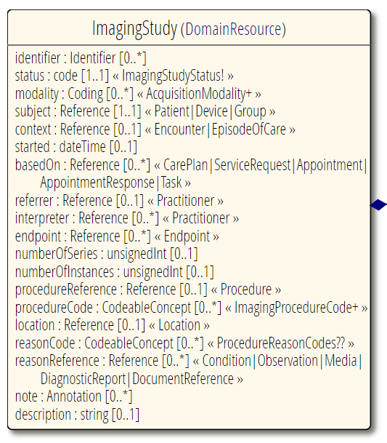
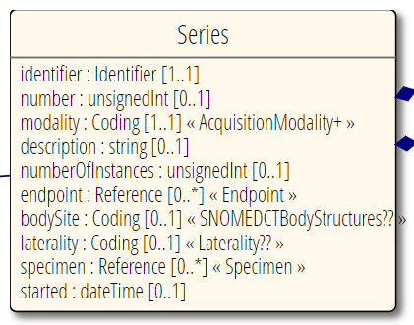
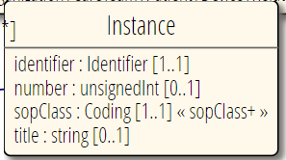
FHIR ImagingStudy Structure
Notes:
Can take the base URL information in the endpoint resource, combine it with the Study, series and instance UIDs, and perform a WADO-RS retrieve

Slide 15
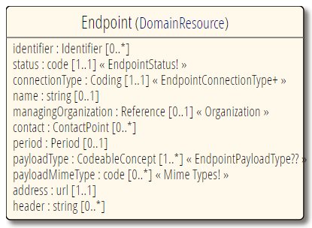
Endpoint Resource
Imaging Types:
dicom-wado-uri
dicom-wado-rs
dicom-qido-rs
Based on the type, the base URL can be combined with the UIDs to form a request for retrieval
http://server.org/wadors/studies/1.2.3/series/4.5.6/instances/7.8.9

Slide 16
Potential DICOMweb and FHIR Workflow
User application queries FHIR server for patients matching criteria; server responds with matching patients.
User Application queries FHIR server for ImagingResources belonging to selected patients; server responds.
User Application retrieves relevant Endpoint resources from FHIR server.
User Application retrieves imaging from DICOMweb Server.
Application may issue additional queries to FHIR server for related resources: DiagnosticReport, Procedure, ServiceRequest, Observation; etc.

Slide 17
SMART-on-FHIR
FHIR standardizes (EMR) data access
SMART-on-FHIR adds:
UI plug-in model
Authentication and launch context
Enables:
App stores
Best of breed
Narrow market solutions (e.g. specialist, departmental)
Intermountain Healthcare “Bilirubin Chart” App. Image credit: SMARTHealthIT.org
Notes:
So far we’ve been focusing on FHIR and basic data exchange. Now I want to talk about the user experience, and the SMART initiative.
SMART defines a interface plug-in model, so that a clinical interface can be written once, and can run in multiple environments.
Here, we see one of Boston Children’s Hospital’s apps running in a frame inside an EMR product.
The EMR supplies the patient information at the top, and the list of available apps down the side. The user has selected the “Pediatric growth chart” app, which is displayed in the central white area. Using the patient context provided by the EMR, the app can query a FHIR server for the growth measurements (which are Observation resources), and then draw them in the provided frame.
This same growth chart app, without code change, should be able to run in any EMR vendor’s product. Since the clinical information is communicated via FHIR, applications can be granted write as well as read access.
This opens up all kinds of opportunities.
I’ve heard “EMR vendors don’t do departmental apps well” or “it’s too costly to customize for my site or my department.”
Don’t like your vendor’s offering? Go shopping for the best-of-breed interface for your department’s needs (or just your needs).
New vendors will pop up providing interfaces for some subspecialty that no-one knew existed, let alone had different needs. And if they write it once, it will work across multiple platforms.
EMR vendors will be able to focus on their core competencies without being accused of underserving certain classes of users.
I see imaging or reporting applications plugging into the EMRs as first class citizens, more than just launch-in-context.
Or consider if your imaging workstation were able to host SMART-on-FHIR imaging apps – maybe your 3-d printing segmentation app, an imaging-specific relevant patient history, or a study-specific literature search. You select a third-party app from the SMART app store, and suddenly, it’s right there, part of your imaging environment.
We’ve been dealing with the deconstruction of PACS for several years now. Is this the deconstruction of the EMR? Consider:
Start with a FHIR storage layer from one vendor
Add a workflow engine from another vendor, to watch resources and orchestrate behavior. Maybe add two.
And finally add your favorite, best-of-breed UI applications from a smattering of vendors, large and small.
The combination of FHIR and SMART may be leading to the vendor-neutral EMR.

Slide 18
SMART-on-FHIR
Boston Children’s Hospital “Pediatric Growth Chart” App. Image credit: Cerner
Notes:
So far we’ve been focusing on FHIR and basic data exchange. Now I want to talk about the user experience, and the SMART initiative.
SMART defines a interface plug-in model, so that a clinical interface can be written once, and can run in multiple environments.
Here, we see one of Boston Children’s Hospital’s apps running in a frame inside an EMR product.
The EMR supplies the patient information at the top, and the list of available apps down the side. The user has selected the “Pediatric growth chart” app, which is displayed in the central white area. Using the patient context provided by the EMR, the app can query a FHIR server for the growth measurements (which are Observation resources), and then draw them in the provided frame.
This same growth chart app, without code change, should be able to run in any EMR vendor’s product. Since the clinical information is communicated via FHIR, applications can be granted write as well as read access.
This opens up all kinds of opportunities.
I’ve heard “EMR vendors don’t do departmental apps well” or “it’s too costly to customize for my site or my department.”
Don’t like your vendor’s offering? Go shopping for the best-of-breed interface for your department’s needs (or just your needs).
New vendors will pop up providing interfaces for some subspecialty that no-one knew existed, let alone had different needs. And if they write it once, it will work across multiple platforms.
EMR vendors will be able to focus on their core competencies without being accused of underserving certain classes of users.
I see imaging or reporting applications plugging into the EMRs as first class citizens, more than just launch-in-context.
Or consider if your imaging workstation were able to host SMART-on-FHIR imaging apps – maybe your 3-d printing segmentation app, an imaging-specific relevant patient history, or a study-specific literature search. You select an third-party app from the SMART app store, and suddenly, it’s right there, part of your imaging environment.
We’ve been dealing with the deconstruction of PACS for several years now. Is this the deconstruction of the EMR? Consider:
Start with a FHIR storage layer from one vendor
Add a workflow engine from another vendor, to watch resources and orchestrate behavior. Maybe add two.
And finally add your favorite, best-of-breed UI applications from a smattering of vendors, large and small.
The combination of FHIR and SMART may be leading to the vendor-neutral EMR.

Slide 19
FHIRcast
Simplified, web-aware context switching
Reduces need for per application pair integration APIs.
Applications use FHIR subscriptions to receive notification of context switch
Open context events list
Basic context events defined, including switch-imaging-study
Improvements on alternatives:
SMART-on-FHIR | Only supports launch, not follow context
HL7 CCOW | Requires separate Context Manager; two-phase commit

Slide 20
Evolution of HL7 Standards vs. DICOM
HL7 FHIR | DICOMweb
HL7 V2, V3 does not address evolving environment | Traditional DICOM networking (DIMSE) does not address evolving environment
Add new REST-based capabilities | Add new REST-based capabilities
New modern data model | Maintain existing data model
Potential information loss of on round-tripping between standards | Full fidelity on round-tripping
Questionable access to historical data | Full access to historical data
Complex to add FHIR interfaces to existing systems | Simpler to add DICOMweb interfaces to existing systems
Revolution | Evolution

Slide 21
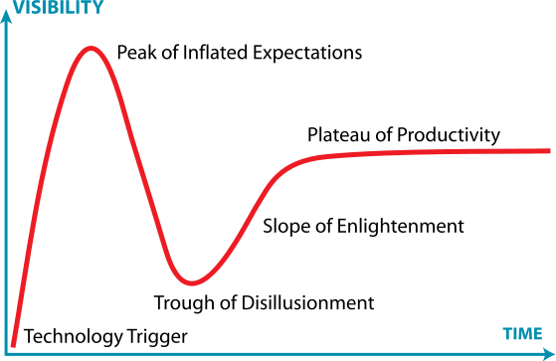
Great Expectations
Gartner Hype Cycle. Image credit: Wikipedia
Notes:
Now that I’ve made you a believer in the power of FHIR, I want to insert a word of caution.
This is a graph that has been used by Graham Grieve, HL7’s FHIR director.
FHIR won’t solve all our interoperability problems. It will address many of the pain points of previous efforts. However, it will uncover new pain points that we’re going to have to work through.
We’re approaching the peak. Soon we’ll start to get feedback from actual implementations and reality will set in, and people will talk about how over-hyped FHIR is.
We’ll get a better idea of what FHIR is, and isn’t, good at; and what patterns do, and don’t, work. Then we’ll settle into something better than where we were without FHIR.
And, remember, no matter how easy FHIR makes data exchange, nothing is going to solve interoperability if the involved parties just don’t want to share.

Slide 22
Conclusion
FHIR is the new standard from HL7
DICOM and HL7 are working together
Bringing imaging information to the widest audience
Respecting each other’s strengths
DICOM used for imaging-centric activities
FHIR used for information-centric activities
FHIR enables new capabilities
Greater range of devices
Query model
Greater interoperability
SMART-on-FHIR
CDS Hooks
FHIRCast
Notes:
What do I want you to take away from this?
You now know the broad brushstrokes of FHIR. And can respond without embarrassing yourself when your CIO asks about the FURRY standard. You know that it has potential, but you should exhibit some healthy skepticism too.
You also know that DICOM and HL7 are working together to bring imaging information to the widest set of users, and that FHIR and DICOMweb work hand-in-hand, each with specific strengths.
I want to you think about how FHIR can change about how we all work.
What does better support for mobile clients; bed-side devices; or patient- or provider-portals mean?
What does access to any part of the patient record, instantly, change in terms of context for decision making, or for analytics?
What does improved interoperability mean when treating a referred patient or someone requiring treatment while on vacation?
And what do opportunities for specialized interfaces do for your clinicians’ productivity or quality?
As you consider all of that, I hope you’ve found this worthwhile, and I thank you for your time and attention.

Slide 23
Questions?
Contact Information
Elliot Silver, M.Sc. Vancouver, Canada
elliot.silver@changehealthcare.com
@elliot_silver
Resources
HL7® FHIR® http://hl7.org/fhir/
DICOMweb™ Standard http://diciomstandard.org/current/output/html/part18.html

