Slide 1
DICOM Educational Conference Bangkok, Thailand
3-4 October 2019
DICOMweb PRINCIPLES
b<>com
Emmanuel CORDONNIER
WG13 CO-Chair
Copyright DICOM® 2019 www.dicomstandard.org #DICOMConference2019 #DICOM @DICOMstandard

Slide 2
Need for additional DICOM flavor
DICOM was initially developed/optimized for intra-radiology communications
Designed in 1993, it used “modern” technologies (IP, Service/Objects)
Extremely robust and efficient, it has been largely deployed as DICOM “worlds”
New contexts of use (enterprise, cross-enterprise, smartphone/tablets…) and new users (surgeons, clinicians, patients…) introduce new requirements
In parallel, imaging information is more crucial (diagnosis, therapy, follow-up…)
So, more and more industrial / research actors need to access images
Thanks to recent technologies, desire to propose complementary communication

Slide 3
Easy EHR Access to Imaging Information
© Alert
QIDO+WADO
EHR
PACS
QIDO: Query by ID to DICOM Object
WADO: Web Access to DICOM Object

Slide 4
Zero Footprint DICOM Viewer
WADO
Reference
© b<>com

Slide 5
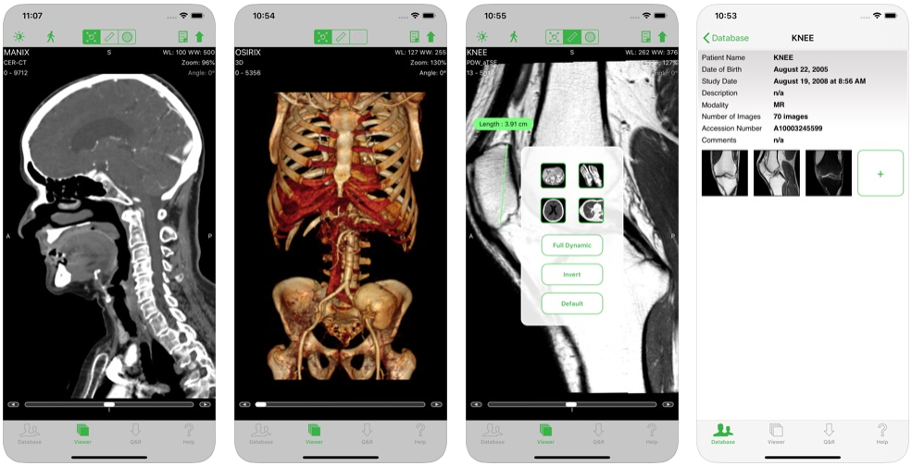
DICOM Viewers on Tablets and Smart Phones
© Osirix

Slide 6
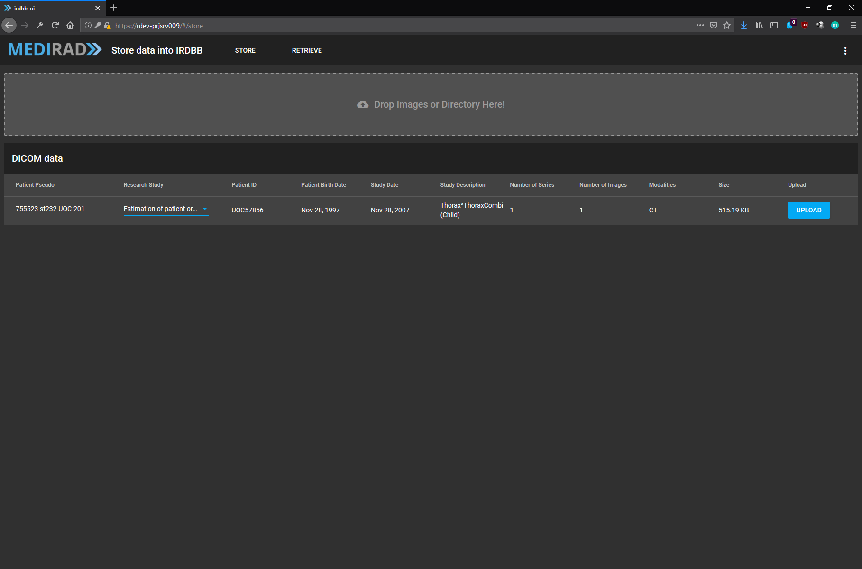
Zero Footprint Medical Imaging Study Upload
STOW
Action
STOW: Store Over the Web
© b<>com

Slide 7
DICOMweb™ Origin
DICOM communication was restricted to run over network with static addresses
For medical imaging to go beyond radiology department, it has been necessary to enable DICOM instances to pass thru non-DICOM world, e.g., the web
In 2003, WADO URI has been defined for retrieving DICOM Instance via http
In 2011, WADO has been extended to RESTful syntax, initiating DICOMweb™
DICOM «world»
DICOM «object»
DICOM «world»
Non-DICOM world

Slide 8
DICOM® (DIMSE) vs DICOMweb™
TCP/IP
DICOM (DIMSE)
Image Data
metadata
Image Data
metadata
Image Data
metadata
metadata
metadata
metadata
HTTP
DICOMweb
Image Data
Image Data
Image Data

Slide 9
Dual Mode Requirement for Easy Deployment
Medical Imaging Equipement
Web Client System
DIMSE
DICOMweb
DIMSE Gateway
Web Gateway
DICOMweb
DIMSE Interface
Web Interface
DIMSE Interface
DICOM Objects
Database
DICOM Objects Database
Flexibility for the client
to be implemented either
as new system
or on existing system
Medical Imaging Equipment
Medical Imaging Equipment
9

Slide 10
Key Concepts
Transaction
composed of request/response message pair
always initiated by a user agent request
completed by an origin server behavior followed by a response.
Resource
A resource is an abstract thing or concept that is reified by a representation, which is a data object contained in an octet-stream.
Representation
A representation is a data object contained in an octet-stream that represents a resource.
Media Type
A media type defines the format and algorithms needed for encoding and decoding resources into representations.

Slide 11
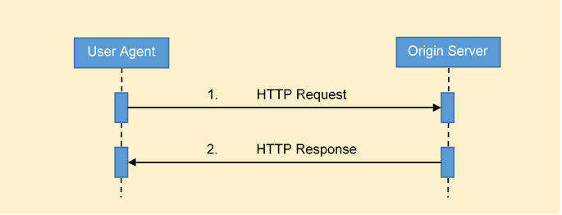
HTTP Transactions
A Transaction is composed of request/response message pair
Transactions are always initiated by a user agent request
They are completed by an origin server behavior and response
Behavior

Slide 12
HTTP Messages
A sequence of bytes (octet-string)
Message formats are specified using ABNF [RFC5234]
US-ASCII Symbols (7-bit)
No data types – that happens at another level

Slide 13
Anatomy of Transaction HTTP Message
First line -> | request-line / response-line
Metadata -> | header-fields
Separator -> | CRLF
Content -> | [payload]
Where request-line = method SP /{+resource}{?parameter*} SP version header-fields = *( header-field CRLF ) / alternatives – either request-line or response-line but not both CRLF = %x13%x10 ASCII carriage return followed by linefeed – separates lines [] optional expression, may or may not be present SP = %x20 ASCII space character - used as term separator

Slide 14
Anatomy of a Request Method
method SP /{+resource}{?parameter*} SP version CRLF
*(header-field CRLF)
CRLF
[payload]
Method | Description
CONNECT | Connect to a server
DELETE | Delete a resource
GET | Retrieve a representation
HEAD | Retrieve metadata
OPTIONS | Retrieve capabilities
POST | Action with a payload, e.g. store, search…
PUT | Replace a representation

Slide 15
Anatomy of a Request Target Resource
method SP /{+resource}{?parameter*} SP version CRLF
*(header-field CRLF)
CRLF
[payload]
The target resource is a URL composed of three components:
/ Origin Server Root Path
{+resource} Target Resource
{?parameter*} Query Parameters

Slide 16
Target Resource Template
/{+resource}{?parameter*}
Specified using URI Templates [RFC6570]
{ } enclose components
+ indicates that reserved characters may be used
? Indicates a query component parameter
* Indicate zero of more instances of the parameter (& separator)
… and several other operators

Slide 17
WADO (jpeg) Request resource & parameter Examples resource / parameter Action Result
/studies/{study}/…?
Select the object
presentationUID&… or windowCenter…
Apply the presentation
&region
Select a region
Build the pixel area
CT WC-800 WW200
&rows…&columns…
&annotation
Burn the annotations
DOE 2003-9-22
&contentType
Generate the MIME type
Content-Type: image/jpeg;
name="Image.jpg"
Content-Transfer-Encoding: base64
Content-Disposition: attachment;
filename="Image.jpg"
/9j/4AAQSkZJRgABAQEASABIAAD/2wBDAAYEBQYFBAYGBQYHBwYIChAKCgkJChQODwwQFxQYGBcU
FhYaHSUfGhsjHBYWICwgIyYnKSopGR8tMC0oMCUoKSj/2wBDAQcHBwoIChMKChMoGhYaKCgoKCgo
KCgoKCgoKCgoKCgoKCgoKCgoKCgoKCgoKCgoKCgoKCgoKCgoKCgoKCgoKCj/wgARCABkAGQDASIA
AhEBAxEB/8QAGwABAQEBAQEBAQAAAAAAAAAAAAUEAwECBgf/xAAYAQEAAwEAAAAAAAAAAAAAAAAA

Slide 18
Anatomy of a Request Version
method SP /{+resource}{?parameter*} SP version CRLF
*(header-field CRLF)
CRLF
[payload]
”HTTP/1.1” or “HTTPS/1.1” (secure)
:Some day soon… “HTTP/2” or “HTTPS/2”

Slide 19
Anatomy of a Request Header Fields (1)
method SP /{+resource}{?parameter*} SP version CRLF
*(header-field CRLF)
CRLF
[payload]
Content Negotiation Header Fields
Header Field | Usage* | Description
Accept | M | All requests that may receive a response that includes a payload shall contain an Accept header field.
Accept-Charset | O | Indicates what charsets are acceptable in textual response content.
Accept-Encoding | O | The Accept-Encoding header field is used to indicate the transfer coding opions that are acceptable in the response.
Accept-Language | O | Indicate the set of natural languages that are preferred in the response
*Specifies user agent support requirement. All header fields are mandatory for origin server

Slide 20
Anatomy of a Request Header Fields (2)
method SP /{+resource}{?parameter*} SP version CRLF
*(header-field CRLF)
CRLF
[payload]
Payload Header Fields
Header Field | Usage | Description
Content-Length | MC | Specifies the decimal number of octets in the payload. It shall not be present if the message has a Content-Encoding header field. It should be present otherwise, even is the size of the payload is zero. If the response message has a payload, and does not have a Content-Encoding header field, it shall have a Content-Length header field specifying the length in octets (bytes) of the payload.
Content-Range | MC | Specifies the range of a partial representation contained in a payload.
Trailer | MC | See [RFC7230, Section 4.4 <https://tools.ietf.org/html/rfc7230#section-4.4>].
Transfer-Encoding | MC | See [RFC7230, Section 3.3.1 <https://tools.ietf.org/html/rfc7230#section-3.3.1>].

Slide 21
Anatomy of a Request Header Fields (3)
method SP /{+resource}{?parameter*} SP version CRLF
*(header-field CRLF)
CRLF
[payload]
Content Representation Header Fields
Header Field | Usage | Requirement
Content-Type | M | Specifies the media type of the representation contained in the payload. If a message has a payload, it shall have a Content-Type header field.
Content-Encoding | C | Specifies any content encodings applied to the representation and thus what decoding to apply to obtain a representation in the media type specified by the Content-Type. Content-Encodings allow compression, encryption, and/or authentication of representations.
Content-Language | O | Specifies the natural language(s) of the intended audience used in representation.
Content-Location | C | Contains a URL that references the specific resource corresponding to the representation in the payload. It should be present in any message that has a payload containing a representation of a resource.

Slide 22
Anatomy of a Request Payload
method SP /{+resource}{?parameter*} SP version CRLF
*(header-field CRLF)
CRLF
[payload]
An octet-string containing one or more representations

Slide 23
RESTful Studies Service (RS)

Slide 24
Studies Service Resources
Service
Studies
Study
Study
Study 1
Series 1
Series N
Instance 1
Instance N
Instance 1
Instance N
Frame 1
Frame N
Frame 1
Frame N

Slide 25
Study Service Resources, URI Templates and Descriptions
Resource | URI Template and Description
Studies Service | /
All Studies | /studies
Study | /studies/{study}
Study Metadata | /studies/{study}/metadata
Study’s Series | /studies/{study}/series
Study’s Instances | /studies/{study}/instances
All Series | /series
Series | /studies/{study}/series/{series}
Series Metadata | /studies/{study}/series/{series}/metadata
Series’ Instances | /studies/{study}/series/{series}/instances
All Instances | /instances
Instance | /studies/{study}/series/{series}/instances/{instance}
Instance Metadata | /studies/{study}/series/{series}/instances/{instance}/metadata
Frame List | /studies/{study}/series/{series}/instances/{instance}/frames/{frame_list}
Bulkdata | /{+bulkdata}

Slide 26
Study Service Resources
URI Template
/studies/{study}/series/{series}/instances/{instance}
URL
/studies/1.2.3/series/4.5.6/instances/7.8.9
UID

Slide 27
RESTful Studies Service Overview
Resources
Studies, Series, Instance, Frames, Metadata, Bulkdata
Transactions
Retrieve DICOM or rendered representation (WADO-RS)
Store DICOM representations (STOW-RS)
Search for DICOM resources (QIDO-RS) enabling fuzzy matching (patient’s name…)
Manage Worklist (UPS-RS WL)
Media Types
Application/dicom, Application/dicom+xml, Application/json

Slide 28
DICOM Media Types for WADO (URI vs. RS)
Media Type | Default Charset | URI | RS
application/dicom | US-ASCII | default | default
application/dicom+xml | UTF-8 | n/a | required
application/dicom+json | UTF-8 | n/a | required
application/octet-stream | undefined | n/a | required

Slide 29
Rendered Media Types for WADO (URI vs. RS)
Resource Class | Transfer Syntax Name | URI | RS
Single Frame Image | image/jpeg | default | default
 | image/gif | optional | required
 | image/png | optional | required
 | image/jp2 | optional | optional
Multi-Frame Image | image/gif | optional | optional
Video | video/mpeg | optional | optional
 | video/mp4 | optional | optional
 | video/H265 | optional | optional
Text | text/html | default | default
 | text/plain | required | required
 | text/xml | optional | required
 | text/rtf | optional | optional
 | application/pdf | optional | optional

Slide 30
Studies Service Other Services (UPS-RS WL and NPI-RS)
UPS-RS Worklist Service
DICOMweb version of DICOM Worklist
RS Non-patient Instance (NPI) Storage
For storing information that is not related to one particular patient (palettes, protocols, templates…)

Slide 31
DICOMweb™ Specifications
DICOM Part 18 : DICOMweb Services
DICOM Part 2 (Annex I): Conformance
Will be re-documented through pending Sup183

Slide 32
Questions?

Slide 33
Presenter’s contact information
Emmanuel Cordonnier
emmanuel.cordonnier@b-com.com
b<>com 1219 avenue des Champs Blancs 35510 Cesson-Sévigné France www.b-com.com
Presentation content initiated by James Philbin (ACR, DICOM WG27 User Co-chair)
Thank You

