Slide 1
DICOM Educational Conference Bangkok, Thailand
3-4 October 2019
What is a secretariat and what does it do?
Office of the DICOM secretariat
Medical Imaging Technology Association (MITA)
Lisa Spellman DICOM General Secretary
Copyright DICOM® 2019 www.dicomstandard.org #DICOMConference2019 #DICOM @DICOMstandard

Slide 2
Overview
About
Medical Imaging & Technology Alliance (MITA)
DICOM Secretariat
Staff
Roles & responsibilities
Initiatives
DICOM Collaboration Activities
DICOM Communications & Outreach
Please join us!
Copyright DICOM® 2019 www.dicomstandard.org #DICOMConference2019 #DICOM @DICOMstandard

Slide 3
Medical Imaging Technology Association (MITA)
Is a division of the National Electrical Manufacturers Association (NEMA)
Collective voice of manufacturers, innovators, and product developers in medical imaging and radiopharmaceuticals
Represents companies whose sales make up more than 90 percent of the global market for advanced imaging technologies
MITA hosts DICOM Secretariat
We collaborate often
2019 initiatives include:
Adopt Uniform Standards for Medical Imaging Service Providers
Ensure Patient Access to Medical Imaging
Promote Cybersecurity for Medical Imaging
Improve Regulatory Environment to Promote Growth and Innovation
Remove Barriers and Reduce Costs in Markets Worldwide
Copyright DICOM® 2019 www.dicomstandard.org #DICOMConference2019 #DICOM @DICOMstandard
Notes:
MITA is an operational steward and strong supporter of DICOM and in the other parts of MITA there are initiatives that may be of interest to users and vendors in the medical imaging space.
We collaborate often, examples include: Cybersecurity with MITA MII and Ultrasound Committees

Slide 4
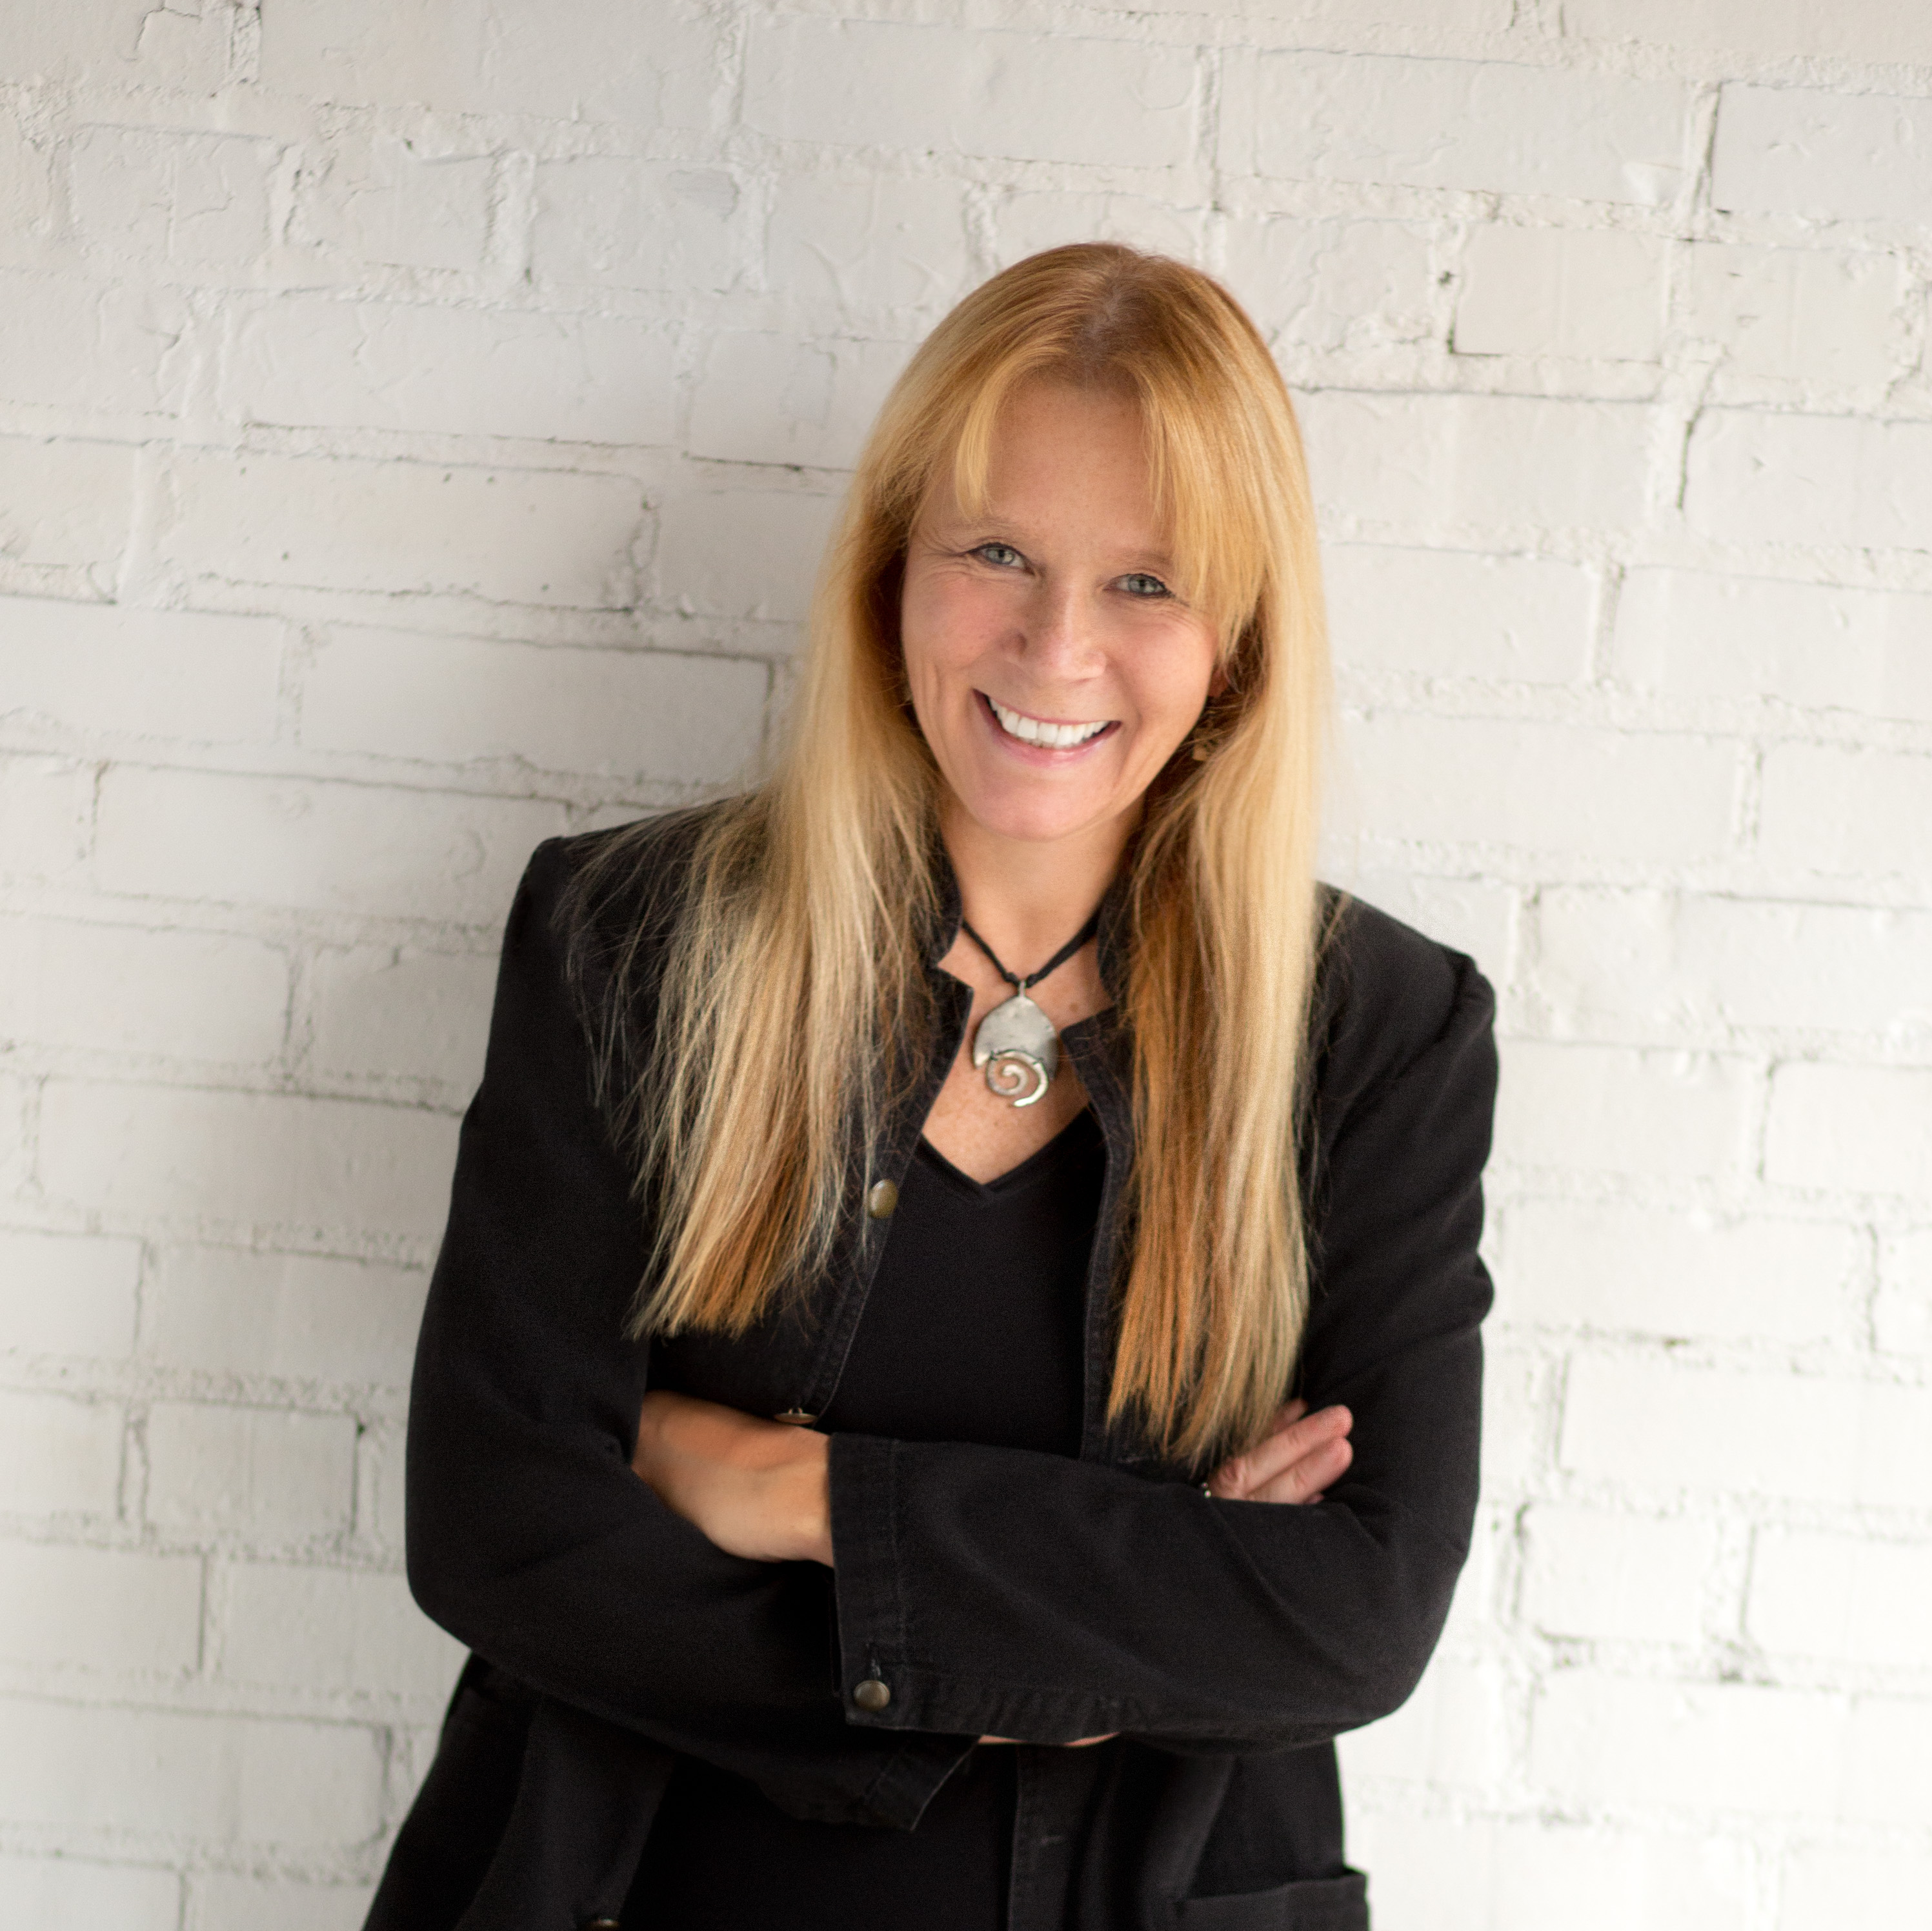
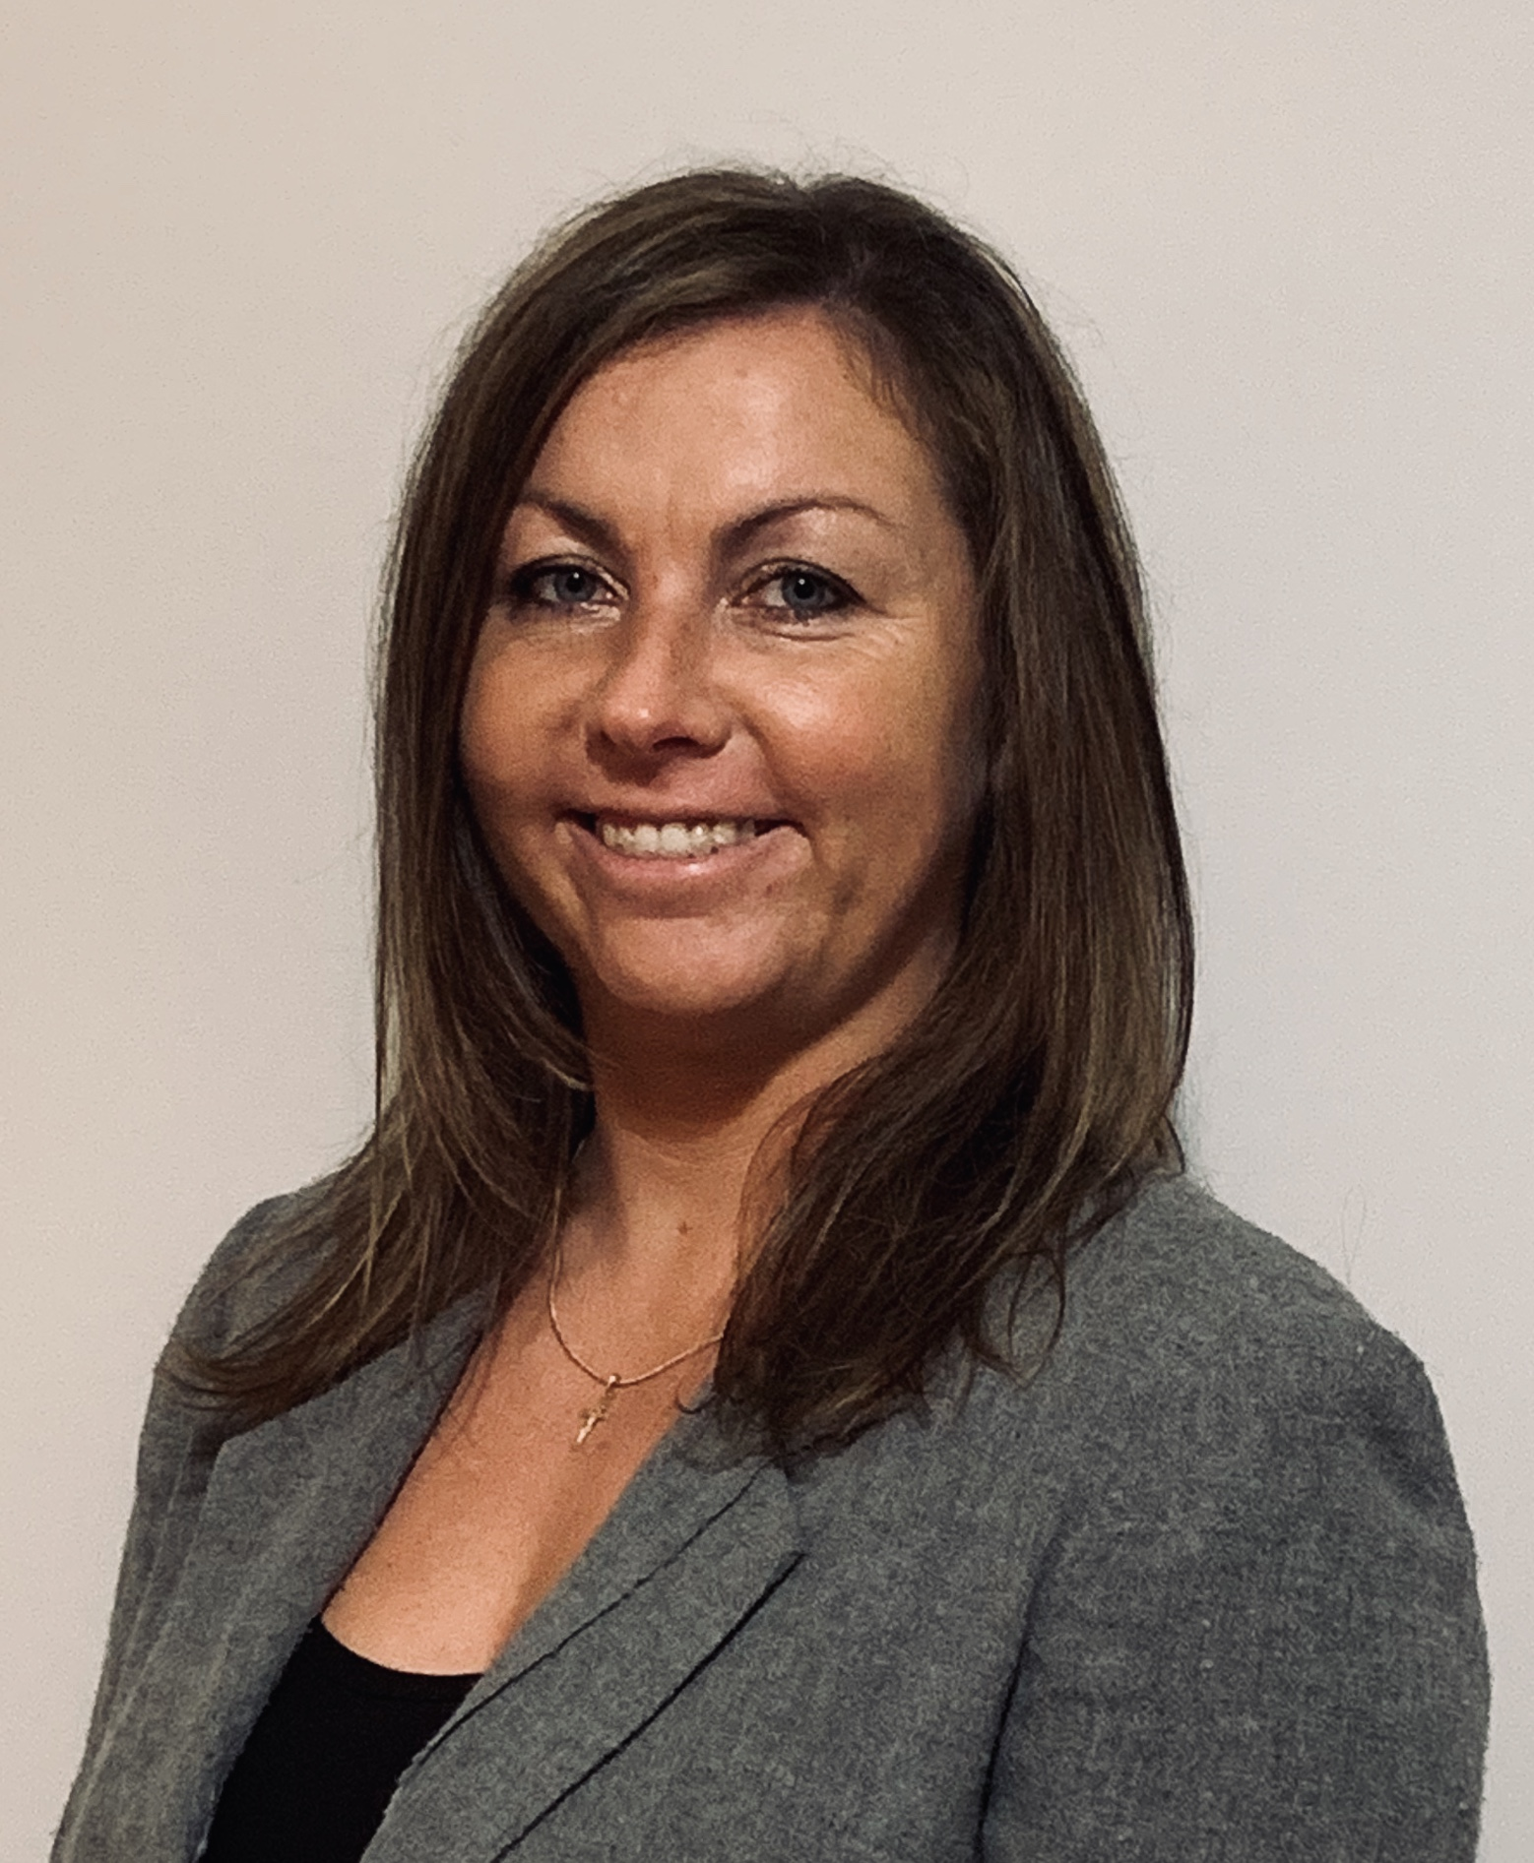
DICOM Secretariat Staff
Lisa Spellman
DICOM General Secretary
LSpellman@dicomstandard.org
Luiza Kowalczyk
Senior Manager, DICOM Operations
LKowalczyk@dicomstandard.org
Copyright DICOM® 2019 www.dicomstandard.org #DICOMConference2019 #DICOM @DICOMstandard

Slide 5
DICOM Secretariat Roles & Responsibilities
DICOM Operations and Strategy
In collaboration with all DICOM WGs, including DICOM Standard Committee (DSC), WG-10 Strategy, WG-29 Education Communication & Outreach
DICOM Work Group Support
Divided WGs ~ 50/50, we support all WGs with administrative services
A few WGs are facilitated by other associations such as the International Federation of Clinical Neurophysiology (IFCN)
DICOM Member Services
Add new members, updating, respond to information requests

Slide 6
DICOM Secretariat Initiatives
Website updates
www.dicomstandard.org had a major update ~ two years ago
NEMA, MITA & DICOM site updates in early 2020
DICOM navigation largely unchanged, improving visual
Continue to expand DICOM communications & outreach
Restarted DICOM Twitter account so please tweet!
@DICOMstandard #DICOM # DICOMConference2019
Infrastructure review
Look to improve collaboration & action tracking tools
Investigating JIRA, Confluence
What do you need? Please tell us.
Copyright DICOM® 2019 www.dicomstandard.org #DICOMConference2019 #DICOM @DICOMstandard

Slide 7
DICOM Collaboration Activities
We support & facilitate outreach, collaboration
Internally within NEMA, and MITA
White paper collaboration with MITA Medical Imaging Informatics (MII) & MITA Cybersecurity on white papers, information sharing and more
Externally w/other organizations, such as:
Society for Imaging Informatics (SIIM) doing Webinars, cross-attending meetings
Standards Development Organizations (SDOs) such as ISO/TC215, HL7 & others
DICOM WG-10 meets jointly w/TC215 & HL7 Jan/Feb @HL7
DICOM 12052, Reference Standards Portfolio
Peer organizations, including COCIR, JIRA and many others
COCIR & JIRA were DICOM co-founders – members of these organizations get a discount on membership to DICOM Standard Committee (DSC)
Copyright DICOM® 2019 www.dicomstandard.org #DICOMConference2019 #DICOM @DICOMstandard

Slide 8
DICOM Communications & Outreach
DICOM members & stakeholders can get information from:
WG mailing lists: Agendas, notification of minute posting, release of voting packets, reminders & other announcements
WG members may use list to send relevant info & questions to other WG members
Want to check your status on any WG mailing list? Please contact me or Luiza
DICOM News
WG-06 updates: Bjorn will cover more on this tomorrow
DICOM in the News
Press releases
Copyright DICOM® 2019 www.dicomstandard.org #DICOMConference2019 #DICOM @DICOMstandard

Slide 9
DICOM Enhancing social media presence
Enhancing social media presence
DICOM Twitter Handle - https://twitter.com/DICOMstandard
Hash tags:
#DICOM #DICOMweb
Copyright DICOM® 2019 www.dicomstandard.org #DICOMConference2019 #DICOM @DICOMstandard

Slide 10
Please join us! Joining DICOM is easy!
About Joining any DICOM WG
No fee to join any DICOM WG
Can start as an Observer
Observers can participate in all WG activities, except voting
Want to be able to vote?
Sign IP Agreement (link below)
DICOM WGs typically meet 1-2x/month by telco – some meet more, some meet less, and some go dormant as work is completed
About Joining the DICOM Standard Committee (DSC)
Can join as an Observer
To join as voting and help guide the future of DICOM
If already a member of MITA, COCIR or JIRA
$1,850/year
If not a member
$9.850/year
https://www.dicomstandard.org/participate/
Copyright DICOM® 2019 www.dicomstandard.org #DICOMConference2019 #DICOM @DICOMstandard

Slide 11
Thank you!
Lisa Spellman
DICOM General Secretary
LSpellman@dicomstandard.org
+1-703-841-3237
Luiza Kowalczyk
Senior Manager, DICOM Operations
LKowalczyk@dicomstandard.org
+1-703-841-3259
Secretariat Resource Links
DICOM Secretariat General Mailbox: dicom@dicomstandard.org
DICOM Website: www.dicomstandard.org
MITA Website: www.medicalimaging.org
NEMA Website: www.nema.org
Copyright DICOM® 2019 www.dicomstandard.org #DICOMConference2019 #DICOM @DICOMstandard

