Slide 1
DICOM Educational Conference
Bangkok, Thailand
3-4 October 2019
Fundamentals of DICOM
Kevin O’Donnell
Canon Medical Research USA
Co-Chair DICOM WG-10 (Strategy)
Past-Chair DICOM Standards Committee
Copyright DICOM® 2019 www.dicomstandard.org #DICOMConference2019 #DICOM @DICOMstandard

Slide 2
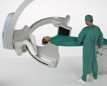
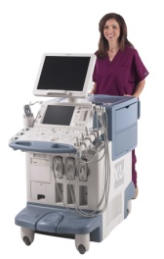

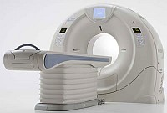
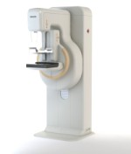
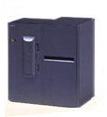
DICOM : A Family of Protocols
Protocol
  Specifies how two systems exchange information
Many kinds of Systems:
    Modalities, PACS, RIS, Workstations, EMR,…
Many kinds of Information:
    Images, worklists, measurements, surfaces, audit logs, …
Notes:
DICOM is for Systems talking to each other about imaging
Many protocols in the family – related but independent

Slide 3
Routine Clinical Practice
Scheduling Exams
Distributing Images
Acquiring Images
Reporting Images
Medical Imaging
Managing Images
Displaying Images
Processing Images
Notes:
The bulk of the things we’ll look at are attempts to address PRAGMATIC needs of routine radiology/cardiology practice; rather than, research, etc. Usable for other purposes but DESIGNED for clinical practice.

Slide 4
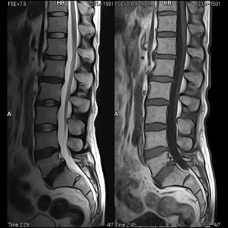
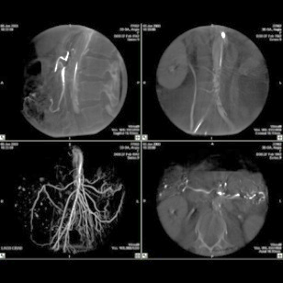


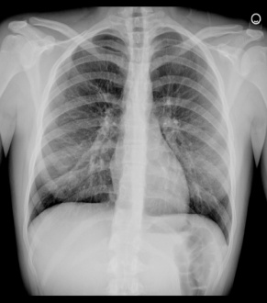


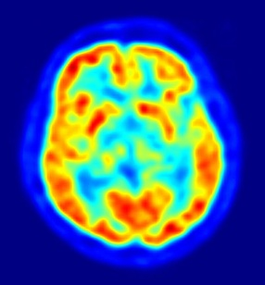
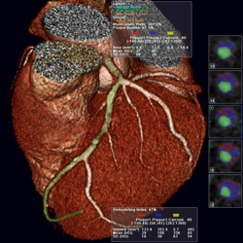
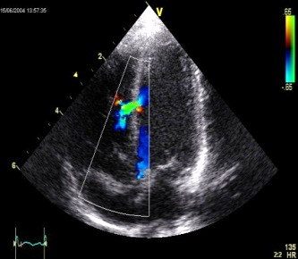
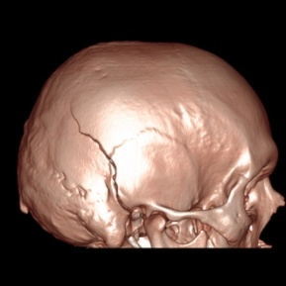
Store Images
DICOM stores your images
All kinds of images
CT, MR, X-Ray, Ultrasound, Angiography, PET, … Ophthalmology, Scanned Documents
Single & Multiframe; Volumes & Cines;
B&W & Color; Original & Processed
DICOM helps manage your Images
Not just pixels; Significant meta-data
Patient identification & demographics, the order, equipment, acquisition, workflow, …
PACS = database; DICOM = machine readable
Can query/sort/autoroute/manage

Slide 5
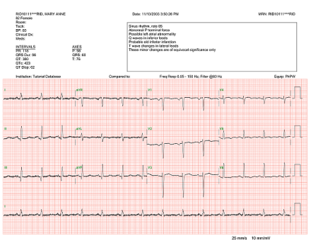
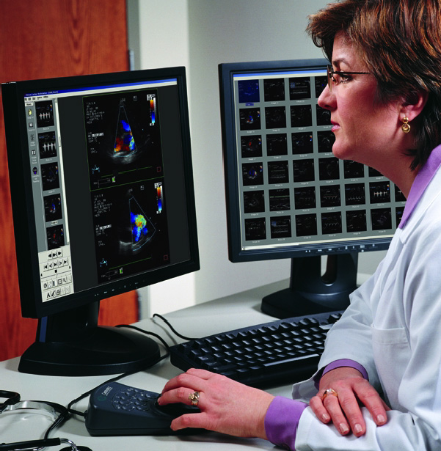
Other DICOM Components
Store (Imaging) Data
  fetal growth, cardiac output, tumor size,
  CAD findings, ECG Waveforms
Manage (Imaging) Workflow
  Modality Worklists, Progress updates, Storage Commitment
  Display Images
  Screen calibration, annotations, layouts,
  key image flagging

Slide 6

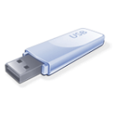
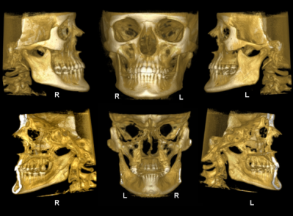
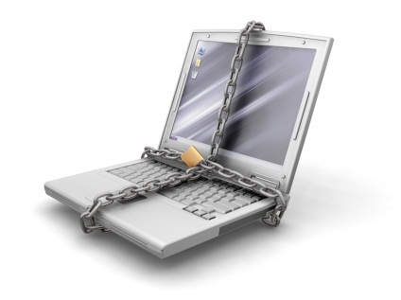
Other DICOM Components
Distribute Images
  Network push/pull,
  Media Transfer (CD, USB, Bluray…),
  Email Attachments,
  Web Protocols
  Store Analysis Results
  Registrations, Segmentations, Image Markup, 3D Print Models, …
  Security
  Audit Trails, De-identification Schemas, Encryption, TLS

Slide 7
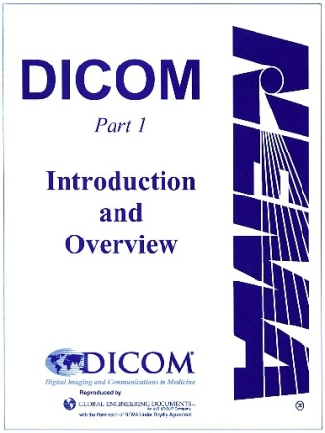
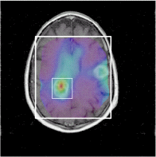
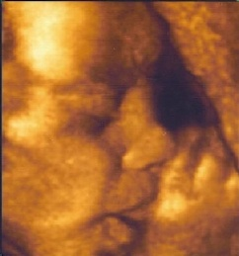
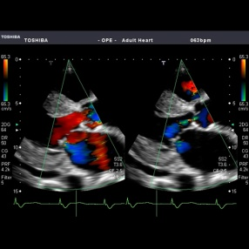
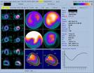
DICOM is not Static
DICOM first published in 1993.
Extended regularly to meet the
expanding needs of Medical Imaging:
  Multi-slice CT
  3D Ultrasound
  Web-based PACS
  USB Memory Sticks
  Clinical Measurements
  Radiation Dose Reporting
  Image Registration & Segmentation
  Computer Aided Detection/Diagnosis
  and Many, Many More . . .
Notes:
DICOM has been evolving for over 20 years; new modalities continue to emerge.
Large hospitals are creating millions of frames per year.
The field of medical imaging has changed quite a lot in the last 20 years – and DICOM is keeping pace with the needs of the field.
Whether it is new technology in the modalities, or new clinical applications, or the use of general IT and internet capabilities for the medical imaging world, DICOM is the standard for assuring interoperability for radiology and other imaging specialties.
This presentation is about how DICOM keeps up with the evolving world, and how you can keep up with DICOM.

Slide 8
DICOM Change Process
Supplements for major changes
  New object types, new services, new compression schemes
  About 10 / year
  Developed by Working Groups
  Require Work Item approved by DICOM Standards Committee
Change Proposals for minor corrections
  About 100 / year
  Anybody can submit
  Backward Compatibility: Avoid changes that break existing implementations
Continuous maintenance process
  WG-06 (“Architecture Review Board”) meets five times per year
  All documents published for open Public Comment;
  later formal vote by Letter Ballot
Notes:
There are two major mechanisms for updating DICOM - Supplements and Change Proposals. Supplements are used for major increments of functionality within the Standard, such as new types of image objects, new services, or new compression schemes. Change Proposals are used for clarification of the text of the Standard, or minor additions to existing functionality, such as new optional data elements within an image object definition.
A Supplement requires a formal Work Item approved by the DICOM Standards Committee. The Work Item assures that the scope of the proposed change is consistent with the strategic direction of DICOM, and the task is assigned to one of the DICOM Working Groups
A Change Proposal may be submitted by any user of the DICOM Standard at any time. All CPs are carefully reviewed to assure backward compatibility.
Changes are officially valid as soon as the final text of the supplement or CP is approved. A revised edition of the Standard with all the changes is published free on the DICOM web site. However, it is the responsibility of equipment vendors to keep up with the standard.

Slide 9
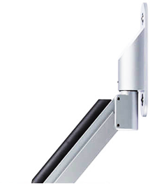
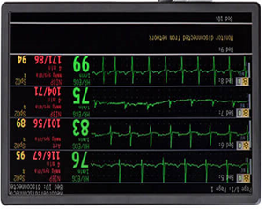

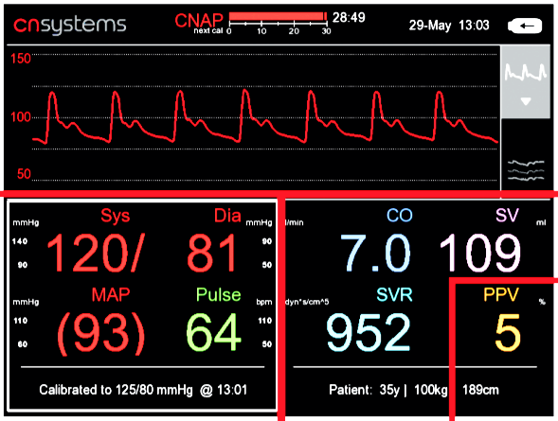
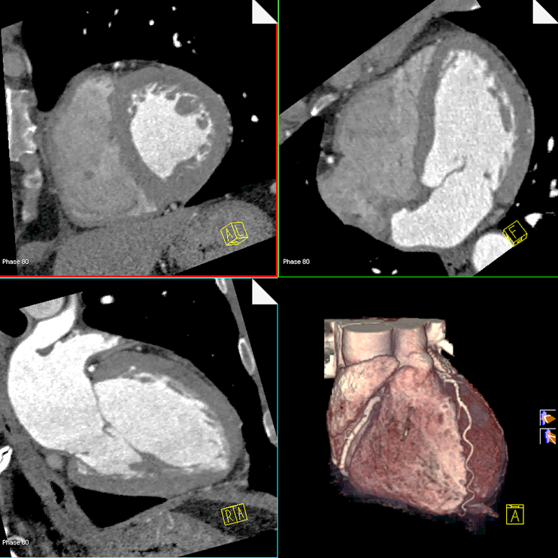

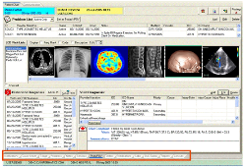
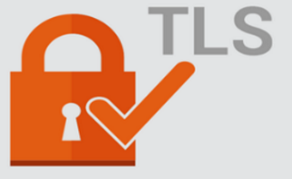
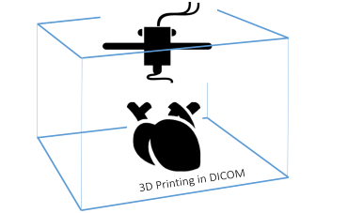
Some Recent Supplements
Sup 202 Real Time Video
Sup 203 DICOMweb: Thumbnail Service
Sup 204 TLS Security Update
Sup 205 STL Encapsulation for 3D Manufacturing
…
Sup 219 Simplified SR in JSON for AI
Notes:
204 = (mostly) Use TLS 1.2, originally added TLS around 2001

Slide 10
Working Groups
Modality, clinical domain, or function specific teams,
assigned to develop Supplements or Change Proposals
WG-01: Cardiac and Vascular Information | WG-17: 3D
WG-02: Projection Radiography/Angiography | WG-18: Clinical Trials and Education
WG-03: Nuclear Medicine | WG-19: Dermatology
WG-04: Compression | WG-20: Integration of Imaging and Info Systems
WG-05: Exchange Media | WG-21: Computed Tomography
WG-06: Base Standard | WG-22: Dentistry
WG-07: Radiotherapy | WG-23: Application Hosting
WG-08: Structured Reporting | WG-24: Surgery
WG-09: Ophthalmology | WG-25: Veterinary Medicine
WG-10: Strategic Advisory | WG-26: Pathology
WG-11: Display Function Standard | WG-27: Web Technology for DICOM
WG-12: Ultrasound | WG-28: Physics
WG-13: Visible Light | WG-29: Education, Communication & Outreach
WG-14: Security WG-15: Digital Mammography and CAD | WG-30: Small Animal Imaging WG-31: Conformance
WG-16: Magnetic Resonance | WG-32: Neurophysiology Data
Notes:
Working Groups can be established to develop the standard for a particular modality, for a particular clinical domain, or for a particular functional capability.
Working Group 6, the Base Standard working group, is the architecture review board – it is responsible for ensuring the coherence, clarity, and quality of the DICOM Standard. All changes are reviewed several times by Working Group 6

Slide 11
Maintaining Stability
No “Versioning”
  It’s just “DICOM”
  Not “DICOM 3.1”, “3.2”, “2015b”, etc.
Notes:
The SOP Class-based Compliance Model- how DICOM has expanded its capabilities over 20 years while maintaining backward compatibility"

Slide 12

DICOM SOP Class
Service + Object = Service Object Pair
(Storage + MR Image = MR Image Storage)
MR Image Storage SOP Class
SCU
SCP
SCU – Service Class User
the system that uses the service (client)
SCP – Service Class Provider
the system that provides the service (server)
Notes:
TODO – Animate
A bit of jargon terms that might come up in subsequent presentations or encounters with DICOM – you’re now a DICOM geek.
SOP Classes are key to DICOM. They form the context for any given communication so both sides know the rules.
Compliance is by SOP Class. If we need new rules, it’s easy to do inside a new SOP Class.

Slide 13
Some Other SOP Examples
SOP Class = service and object
  Store a CT image
  Store an XR image
  Find the studies for a patient
  Find the worklist items for a modality
  Move a set of images
  Create an image print job
Notes:
TODO – Pair of Lego bricks?

Slide 14
Maintaining Stability
No “Versioning”
  It’s just “DICOM”
  Not “DICOM 3.1”, “3.2”, “2015b”, etc.
DICOM evolves by adding new “SOP Classes”
  New SOP Classes are added
  Old SOP Classes don’t “break”
  Most applications continue to support older SOP Classes
  when supporting new ones
Notes:
Unlike other standards, such as HL7, DICOM evolves by adding extensions, not by creating a new version of an existing capability. Those capabilities – to which an implementation claims conformance – are “SOP Classes”. Once a SOP Class is defined, any changes to it are minor, and are fully forward- and backward-compatible.
So there is no DICOM version 3.0, 3.1, etc. – it’s just DICOM.
With the Supplement process, as just described, new features can be added to DICOM, but these are typically new SOP Classes, and they do not replace existing capabilities, they add new capabilities to which a product can claim conformance.
So a product can support multiple capabilities at the same time. And DICOM products determine exactly how they can interoperate every time the establish a connection, by negotiating the SOP Classes that they support.
And every DICOM conformant product comes with a Conformance Statement, so that humans can also see whether two systems will interoperate – which capabilities (that is, SOP Classes) it supports, and how the system uses those capabilities.

Slide 15

Stability and Maintenance
Don’t break existing implementations
  In existing SOP Classes:
  Clarify but don’t change meaning
  Add new codes, attributes, or behaviors BUT
  products don’t have to support them and
  can ignore them safely.
  Exception: fix something that is already broken
The Caveat
  Vendors are still responsible to monitor CPs
  and fix their products when they are deficient

Slide 16
Publication vs Conformance
DICOM Conformance is to SOP Classes
– not to a version of the Standard
New DICOM editions are published (e.g. 2019c)
  SOP Classes are added but not changed incompatibly
Each SOP Class is stable
  forward and backward compatible across all editions
  any new data elements are optional
Products conforming to the same SOP Class interoperate
  Humans compare DICOM Conformance Statements (DCS)
  Machines do Association Negotiation
Notes:
The SOP Class-based Compliance Model- how DICOM has expanded its capabilities over 20 years while maintaining backward compatibility"

Slide 17
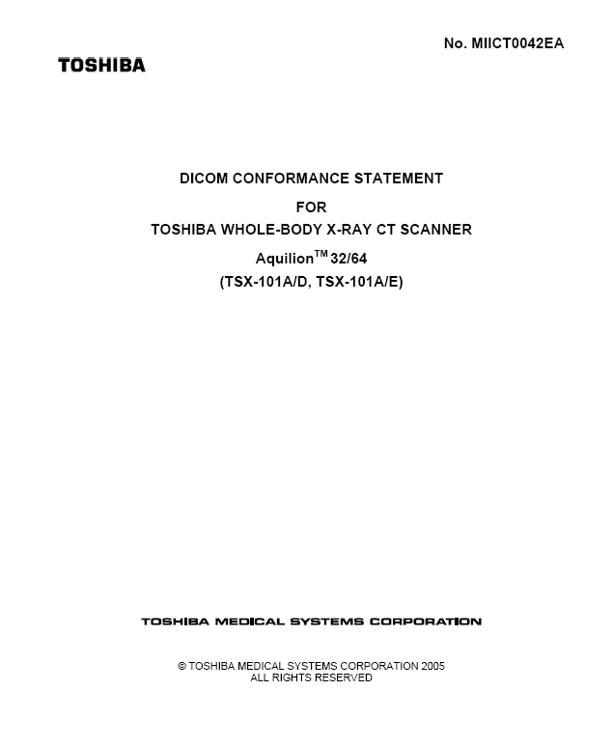

Documented Assertion of Product Conformance
DICOM Conformance Statement
  Required for every compliant product –
  pro-forma in DICOM Part 2
  Lists the SOP Classes & roles supported by a product
  Allows user organization (or system integrator) to determine
  components that should work together
  Also describes product implementation details and behaviors
Notes:
This product supports this list of SOP Classes; here are some details about how the SOP Classes have been implemented and how the system behaves when it uses them”

Slide 18
Machine Negotiation of Conformant Capabilities
Before two systems perform a DICOM transaction they first agree:
  what SOP Class they will use (e.g. MR Image Storage)
  who will be the SCU (client role), who will be the SCP (server role)
  what compression will be used (e.g. JPEG Lossless)
This process is called Association Negotiation
AE_TITLE1
Association Negotiation
AE_TITLE2
<Request>
<Response>
MR Image Storage
Notes:
Association Negotiation
Software can determine if two systems are compatible
Happens each time two DICOM systems open an association (connection)
They negotiate which SOP Classes will be used, and how (e.g. Transfer Syntax)
Based on what each system supports and/or prefers

Slide 19
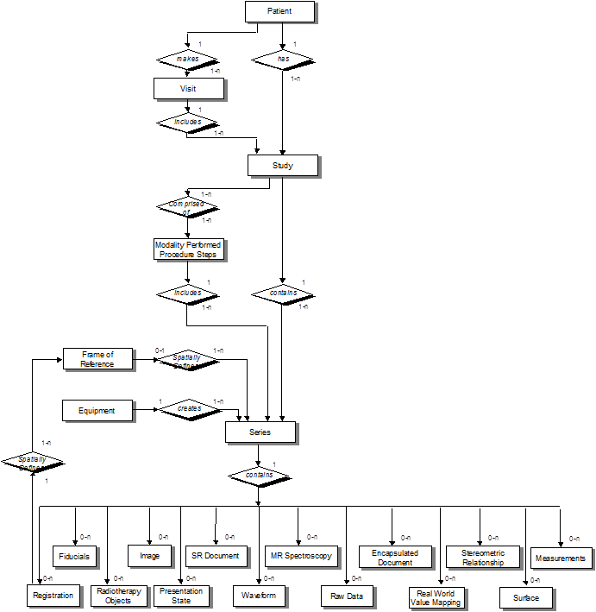
Information Model Stability
New Objects conform to existing information/real-world model
Allows reuse in implementation
  Leverage standard modules in toolkits
  PACS can handle new objects with minimal change
Avoid temptation to “improve”
Notes:
When we design new Services and SOP Classes, it is important to maintain the information model so you can proxy between old services and new and continue to combine new objects and old. New ophtalmology retinal maps can be easily stored on old PACS and burned by old CD burners.
We struggle mightily to restrain ourselves sometimes. But usually the cute feature is not worth orphaning billions of existing images.

Slide 20
The Information Model
Patient
Information
Simplified model of real world concepts and activities
  Study ≈ ordered procedure;
  Series ≈ performed protocol
  Sufficient for pragmatic needs of routine radiology
1..n
Study
Information
1..n
Series
Information
1..n
Image
(Instance)
Information

Slide 21
DICOM Model Elements
An Image (or other IODs) holds acquired data
A Series may group closely related Images from the same PPS, same protocol, & same piece of Equipment
A Study groups all Series for a given Req. Procedure
A Patient may have many Studies
Instances are actual data created based on an object definition
DICOM uses Unique Identifiers (UIDs) to identify:
  specific Instances
  specific SOP Classes
  specific Study / Series
  . . . and many other things
Notes:
The information model represents the data created and managed in DICOM.
Note multiple series may be created for a single PPS, protocol, equipment
Note UIDs are intended for machines to read, not humans (UIDs long strings of numbers that are inconvenient for humans)

Slide 22
Starting from the bottom ...
MR Storage SOP Class
Storage Service
Service
Class
User
Service
Class
Provider
+
MR Object
Module
Module
Module
Attribute
Attribute
Attribute
Notes:
When you read you begin with A-B-C
With DICOM you begin with two AE’s
… Hmmmm
Let’s see if we can make it a bit easier:
Att-ribute to hold the stuff
Tag – to flag it with a code
VR – the kind of stuff it is
VM – how many things it holds
Macro – a way to copy tags
Module – looks just like a macro
IOD – the object that it makes
And a Service makes it go (go, go, go)
…
Tag, SOP, SOP, UCUM Code, Service Class, parent node…

Slide 23
DICOM Terms: Attribute
DICOM Data Stream = …00100010Smith^John^^^…
Tag | Attribute Name | VR | VM | Value
(0010,0010) | Patient Name | PN | 1 | Smith^John^^^
(See DICOM Part 6: Data Dictionary)
Tag (Group #, Element #):
to identify an attribute/data element
Value Representation (VR):
data type used to encode the value(s)
Value Multiplicity (VM):
how many values can be in the attribute
Notes:
0010,0020 Patient ID
CS, FL, DT
Parts 5, 7, & 8 get into the byte details of how exactly the datastream is encoded. Mostly handled by toolkits/libraries.

Slide 24
DICOM Terms: Module
Patient Module
Attribute | Tag | Type | Attribute Description
Patient Name | (0010,0010) | 2 | Patient’s Full Name
Patient ID | (0010,0020) | 2 | Primary hospital identification number or code for the patient
Issuer of Patient ID | (0010,0021) | 3 | Identifier of the Assigning Authority that issued the Patient ID
…
(See DICOM Part 3: Information Object Definitions)
Module: an architectural convenience;
a logical group of attributes about a common topic
Macro: purely an editing convenience;
a table of attributes that can be easily copied into modules
Type: (1) Required (2) May Be Empty if Unknown (3) Optional
(1C or 2C) Conditional

Slide 25
DICOM Terms: Object (IOD)
Enhanced CT Object
IE | Module | Reference | Usage
Patient | Patient | C.7.1.1 | M
…
Equipment | General Equipment | C.7.5.1 | M
Image | General Image | C.7.6.1 | M
 | Contrast/Bolus | C.7.6.4 | C – Required if contrast media was used in this image
 | CT Image | C.8.2.1 | M
(See DICOM Part 3: Information Object Definitions)
Information Entity (IE): a group of modules representing a Real-World object
Reference: a Section in Part 3 where it is defined
Usage: (M) Mandatory; (C) Conditional; (U) Optional

Slide 26
DICOM Services
Print – Printing Objects to a DICOM Printer
Storage – Storing Objects, e.g. to a PACS
Query/ – Getting Objects, e.g. from a PACS
Retrieve
MWM – Getting Scheduled Patients, e.g. from RIS (Modality Worklist Management)
MPPS – Status (Started, Completed) back to RIS
(Modality Performed Procedure Step)
. . .
(See DICOM Part 4: Service Class Specifications)
Notes:
We’ve almost climbed all the way back up to the top of that tree at the beginning

Slide 27
XML / Web publication
DICOM Standard is maintained in DocBook XML and
published free on the Web in multiple formats:
  PDF - the official version
  XML - for automatic update of tools
  HTML - for easy use with hyperlinks to references
  MS Word - for extraction into project documentation
Re-published several times per year
to incorporate all approved Supplements and Change Proposals
http://dicomstandard.org/current

Slide 28


The DICOM Standard
Administered and Published by:
  NEMA (National Electrical Manufacturers Association)
  and it’s medical imaging division:
  MITA (Medical Imaging Technology Alliance)
Intellectual Property
  DICOM Trademark and Copyright is held by NEMA
  No license required to use the DICOM Standard in products
dicom.nema.org
  Download free electronic copies of all 20 Parts of the Standard
  Plans and activities are publicly posted
  ISO publishes Part 1 of the Standard as ISO 12052

Slide 29


Presenter’s contact information
Kevin O’Donnell, MASc.
kodonnell@mru.medical.canon
Pacifica, California, USA
https://global.medical.canon/
Thank you
For
Your Attention!

