Slide 1
Supplement 250 2D Total Body Photography
WG-19 dermatology
Public comment
July 2026

Slide 2
Work items – WG19
Work Item: 2022-12-B originally Total Body Photography Supplement
  2D Total Body Photography
  3D Total Body Photography
Structured Reports
  Skin Lesion Tracking (2026-03-A) - Link- individual skin lesion (dermoscopy)- 3D, dermoscopy-2D, 3D to 3D, 3D to 2D
  Skin Lesion Assessment (Proposed)
Supplement 250 (history)
  First Read June 2025
  Draft Public Comment November 2025
  Draft Public Comment January 2026
  Draft Public Comment March 2026
  Draft Public Comment June 2026

Slide 3
Supplement 250 2D TBP – New
TBP Regional Image IOD
  Photogrammetry Calibration Module
  TBP Regional Image Module

Slide 4
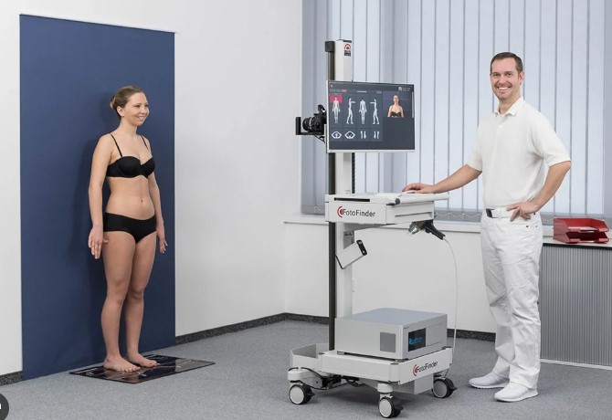
Scope -2D Total Body Imaging
DSLR Camera

Slide 5
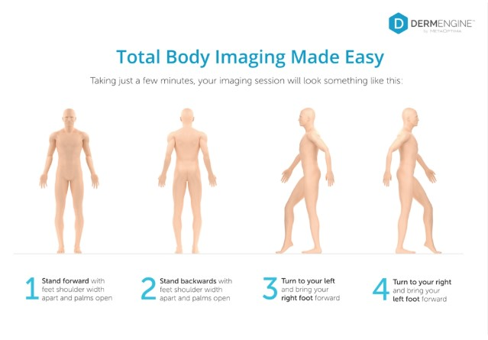
Scope -2D Total Body Imaging

Slide 6
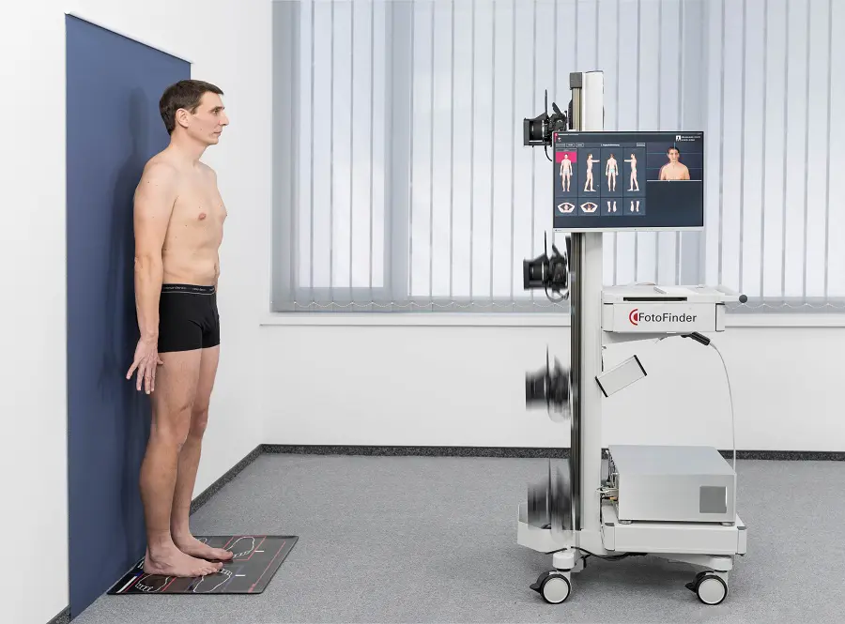
2D Total Body Photography
Camera positions – automated movement
Vertical movement only

Slide 7
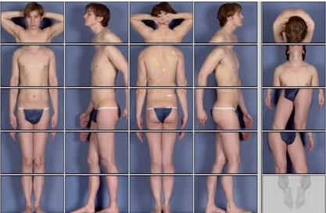
Scope -2D Total Body Imaging
Acquisition template

Slide 8
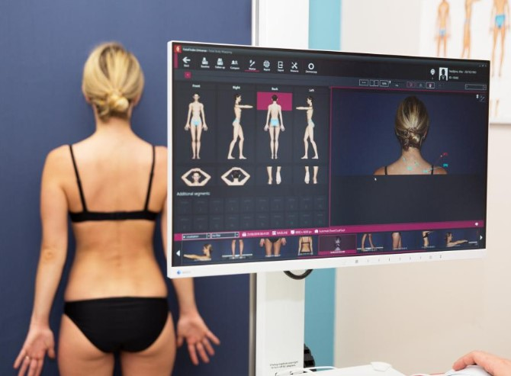
2D Total Body Photography
Acquisition template

Slide 9
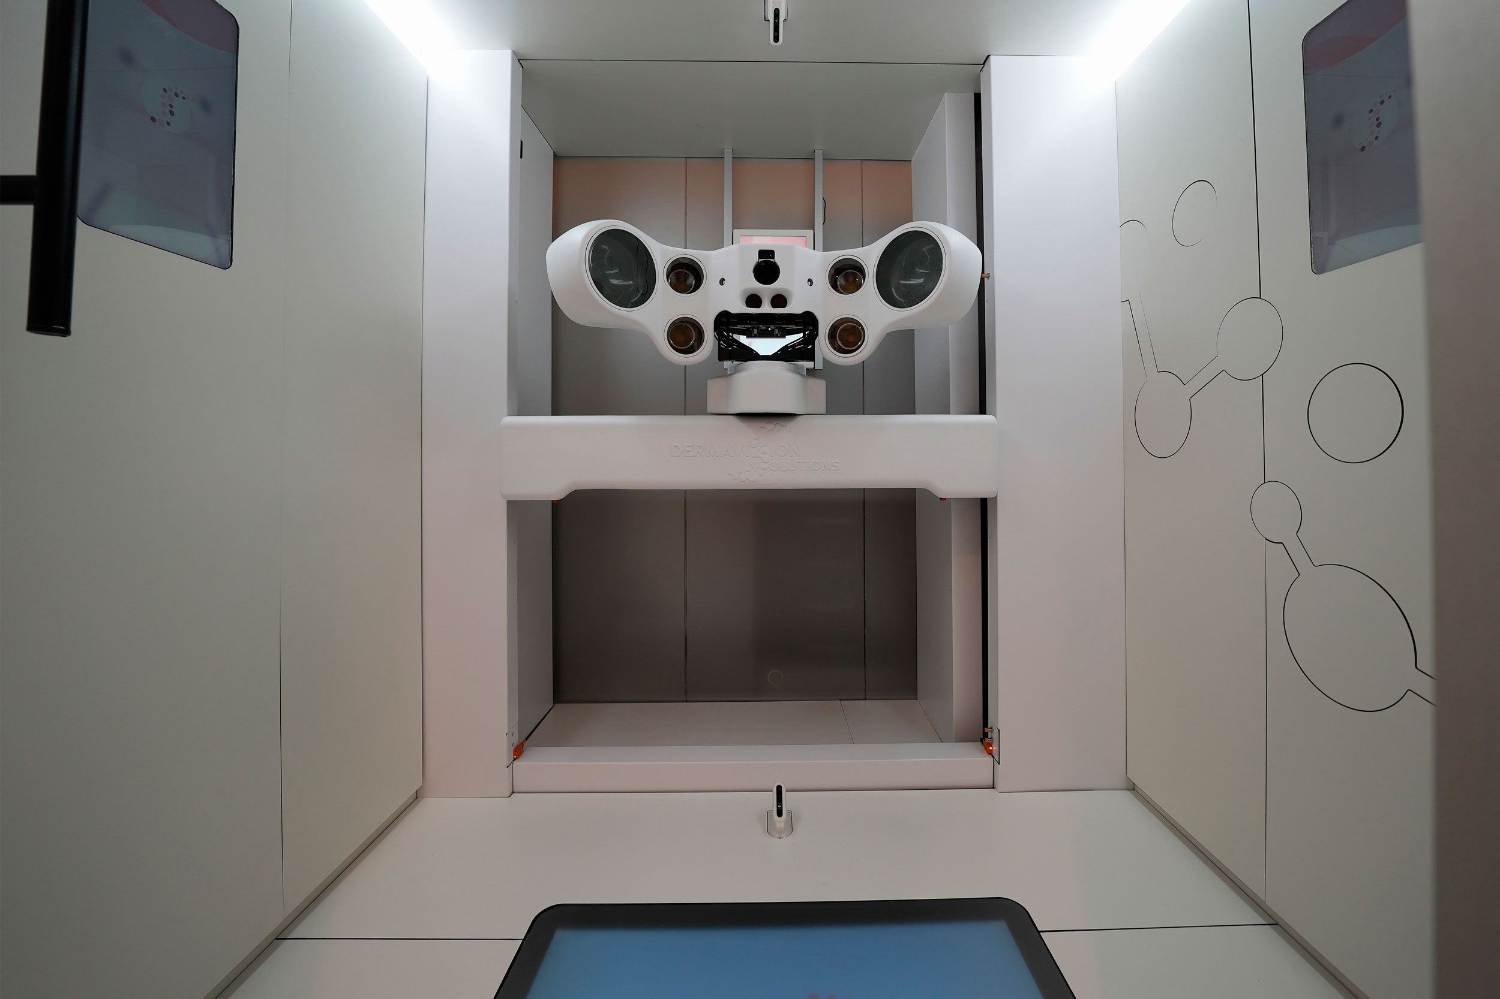
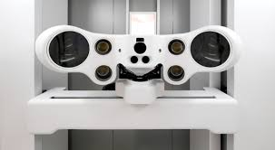
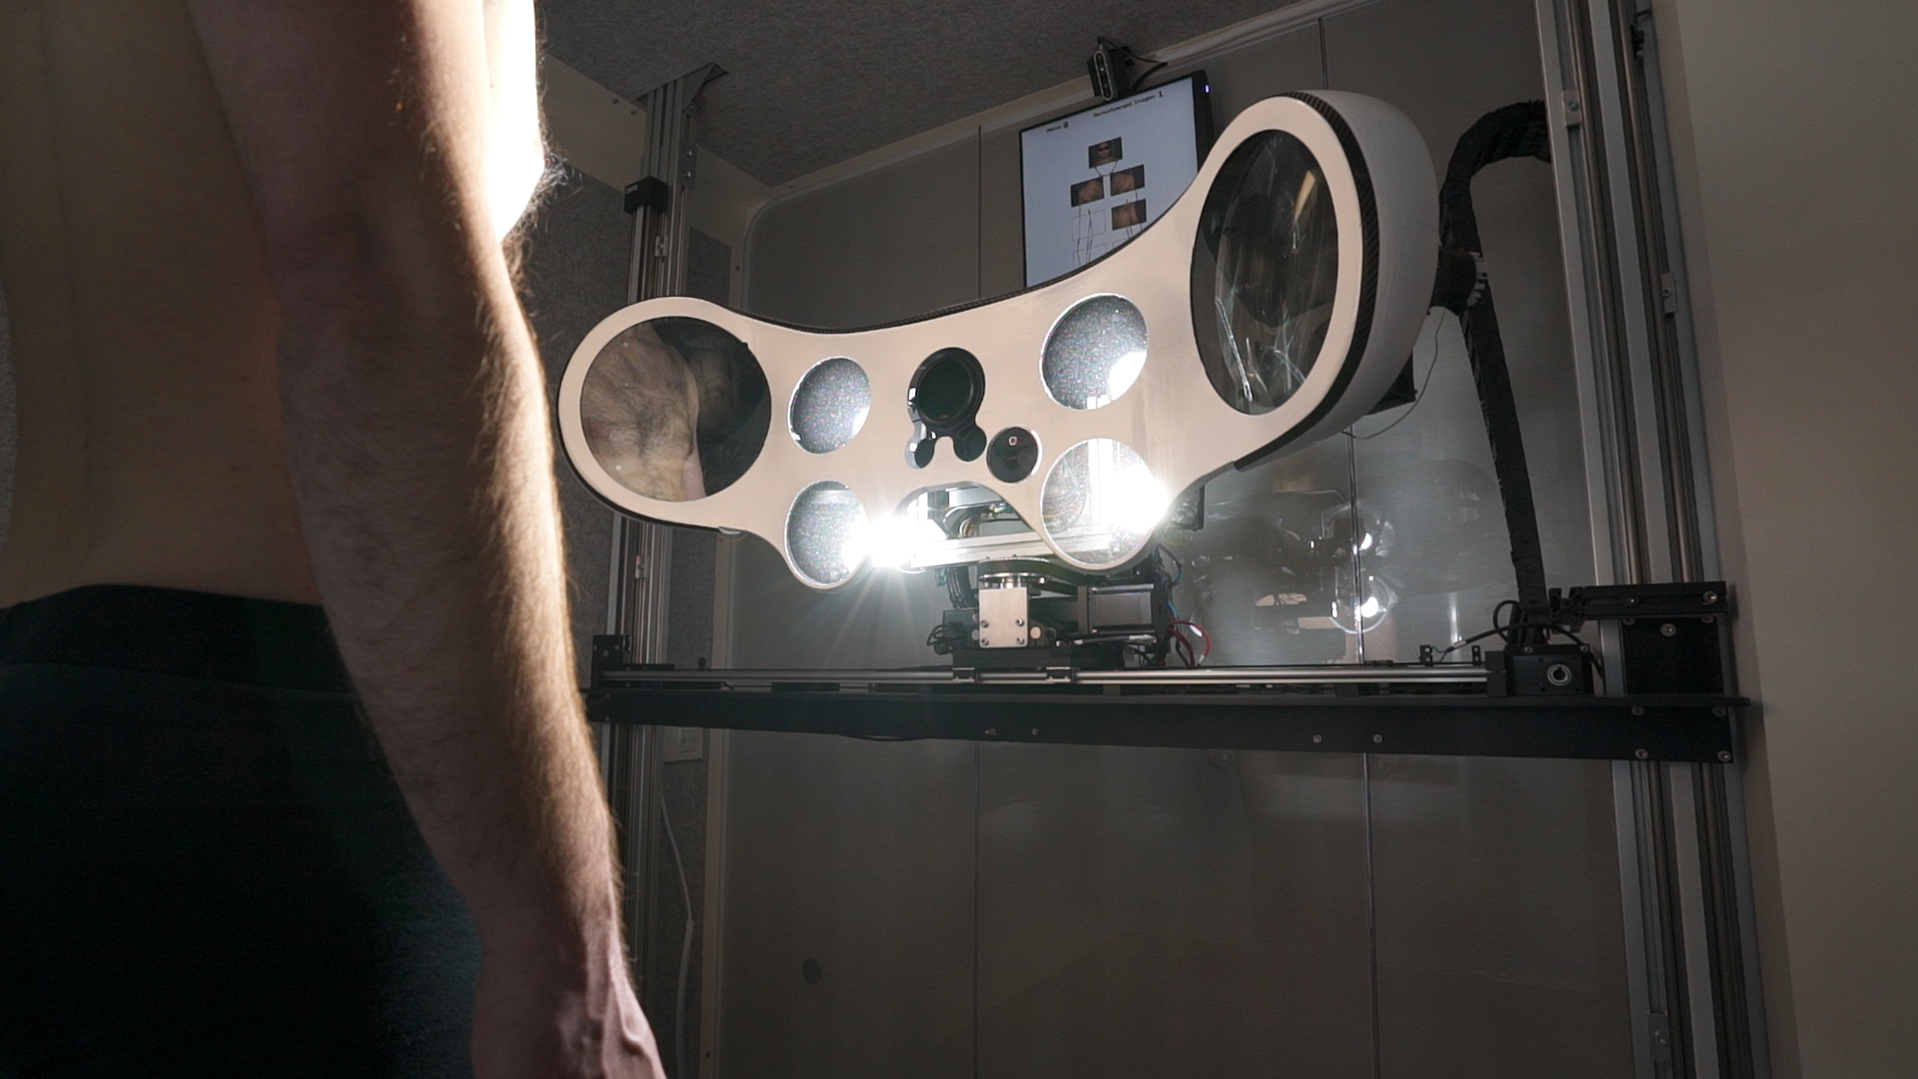
Multiple axis camera movement

Slide 10
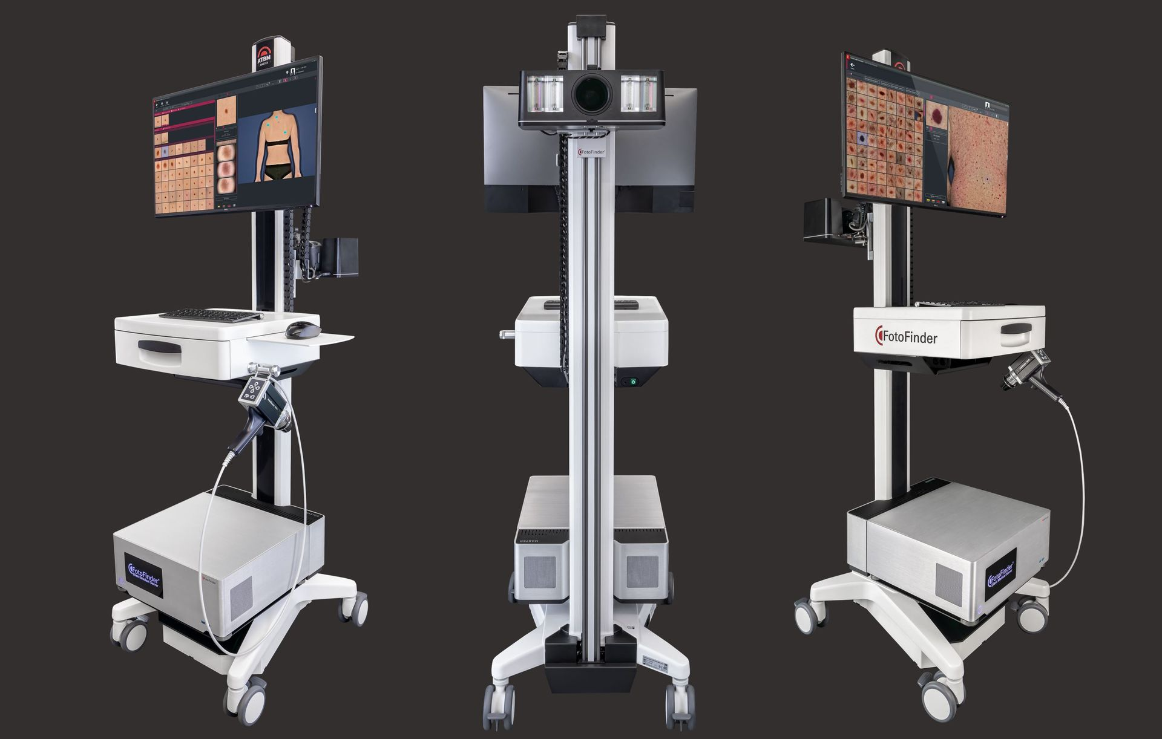
Dermoscopy
Dermatoscope

Slide 11
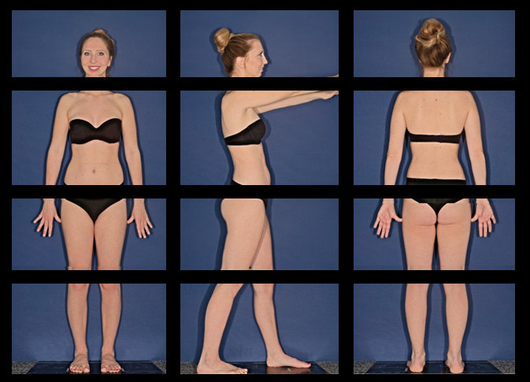
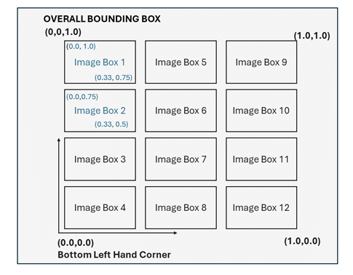
Basic Structured Display IOD for visualisation

