Slide 1
Supplement 249:
Ultrasound Fetal Anatomical Survey Structured Report Extensions
Public Comment Draft
WG-1/12
17 June 2025

Slide 2
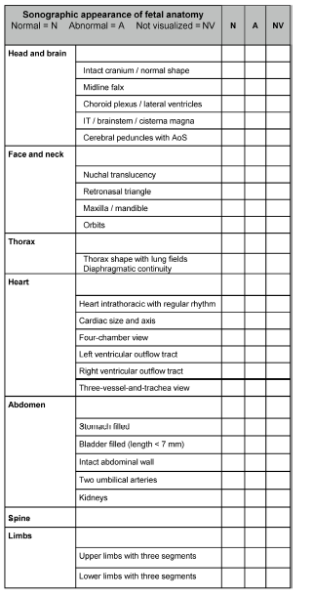
Background
Various clinical guidelines call for a survey of fetal anatomy in the first, second, and third trimesters to identify structural anomalies (e.g. from ISUOG or JSUM).
Those guidelines identify specific lists of anatomy to consider.
Assessments are qualitative (Normal, Abnormal, Not Visualized) not quantitative.

Slide 3
Overview
Scope:
A sub-template for Fetal Anatomical Survey is added to TID 5000 (OB-GYN Ultrasound Procedure Report)
A new CID provides codes for relevant anatomy of interest (drawn from the various guidelines)

