Slide 1
Supplement 248 – DICOMweb Send
WG27
Public Comment
April 2026

Slide 2
Content
Work Item
  Summary of C-MOVE
Performing sub-operations – protocol cross-over
  Use cases
Design considerations
Diagrams
  C-MOVE | Send
  Example
  Proxies

Slide 3
Work item 2025-05-B – DICOMweb Move¹ Transaction
Introduction
The DICOM Standard defines the C-MOVE operation for pushing instances, complementing the C-GET operation that pulls instances. The C-MOVE triggers C-STORE sub-operations, with the C-MOVE SCP acting as the C-STORE SCU. This allows a third party to initiate a push between systems without being directly involved in the transfer.
Limitations of Current Standard
There is no DICOMweb equivalent for the C-MOVE operation. This limits both the adoption of DICOMweb for specific use cases and the implementation of push transactions within a web-based ecosystem.
It is possible to achieve something like a third party move by having the initiator use WADO to get the applicable instances from the source and then use STOW to send these to the recipient, but that is cumbersome, inefficient, and a waste of resources.
Description of Proposal
Add a move¹ transaction to DICOMweb, more specifically to both the Studies service (PS3.18, Section 10) and the Non-Patient Instances service (PS3.18, Section 12), as to remove the current limitations.
¹ Although ‘move’ is the traditional DICOM name for the operation, it is in essence a request to send DICOM objects.

Slide 4
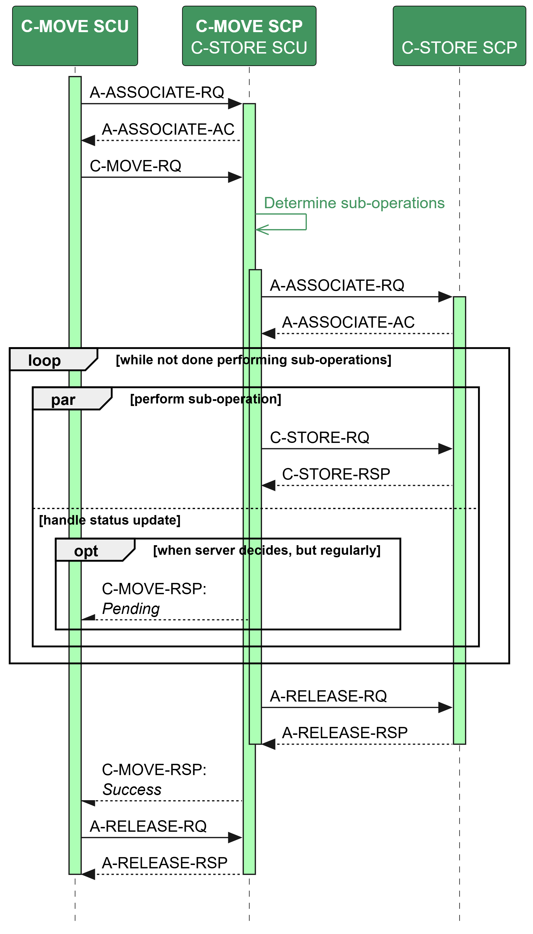
Diagram shows a conceptual
overview of DIMSE’s C-MOVE
operation, including the sub-
operations the SCP is requested
to perform by the SCU.
This workitem is about creating
DICOMweb transactions that
define the interaction of the
user agent and the origin server
to achieve the same.
Interaction between SCP or origin
server and destination is within scope
of this work item, as to enable full
flexible solutions for hybrid environ-
ments.
Some notes
When a connection is closed before all
is done, the server decides on its own
behavior (it can continue, it can stop, it can …) and the client has no way to
get the results.
Cancellation – which is part of the C-MOVE operation and initiated by the
Client – is not shown in the diagram.
protocol request
protocol response
internal activity

Slide 5
Performing Sub-Operations – Protocol Cross-over
Currently, performing C-MOVE implies performing C-STORE sub-operations.
Similarly, it could be defined that performing DICOMweb Send implies performing DICOMweb Store transactions.
For hybrid environments, i.e. with DIMSE and DICOMweb systems, supporting protocol cross-over for sub-operations could be very useful; this would
allow a DICOMweb Send Origin Server to use C-STORE sub-operations to perform its task, hereby acting as an SCU;
allow a C-MOVE SCP to use DICOMweb Store transactions to perform its task, hereby acting as a user agent.
Protocol cross-over would require mappings.
Going from DICOMweb to DIMSE requires a mapping from URLs to AE Titles.
Going from DIMSE to DICOMweb requires a mapping from AE Titles to URLs.

Slide 6
Performing Sub-Operations – Protocol Cross-over
Use cases comprise
A DICOMweb enabled PACS handling the Send Request sending to a DIMSE-only VNA (destination), just by switching protocols. (In a way translating destination “https://generalHospitalVNA.local” to destination “VNA-AETitle”.)
Regional cooperating hospitals that allow DIMSE exchange within each of them but block DIMSE between them (as a firewall rule) could make use of DICOMweb to provide an easy way out.
A medical institution that wants to support easy access to studies for second opinions could use cloud buckets. However, medical cloud storage services typically only support DICOMweb, which at that case would be needed to provide this service.
A C-MOVE SCP to DICOMweb Send user agent proxy translating C-MOVE operations to equivalent DICOMweb Send transactions, as to enable gradual evolution to a DICOMweb eco-system.
The C-MOVE SCP and DICOMweb Send origin server determine whether they cross-over or not. So, the interface for the SCU and the user agent does not change.

Slide 7
Design Considerations for DICOMweb’s Send Transaction
Clarity – It should be named properly
  Although DIMSE has baptized the equivalent operation C-MOVE, it is a send request, and should be named as such
Long-running Transactions – It should be able to deal with potential HTTP time-outs
  As a send request might take a long time to complete, it should be able to be handled asynchronously
Multiplicity – It should be capable to handle multiple responses, as DIMSE also allows for multiple (progress) responses
Consistency – It should follow existing DICOMweb interface patterns
  As sending involves searching, the Transaction should be like the Search Transaction. For the Studies resources this means that both the SOP Class UID (0000,0002) holding the Query/Retrieve Information Model and the Query/Retrieve Level (0008,0052) should be handled as they are handled in the Search Transaction, i.e. by defining multiple resources
  As sending may involve asynchronicity, it should follow DICOMweb’s Storage Commitment pattern for that, i.e. by defining two Transactions, one to initiate the activity, and one to check for the result(s).

Slide 8
Multiple Responses of the Send Transaction
There are several ways we can deal with multiple responses.
Combine them – This follows the pattern used in the Search transaction
  When a proxy of an origin server would convert a Send transaction to a C-MOVE operation on an SCP, the pending all results would need to be combined into one response.
  Disadvantage: when applied to the send transaction there would be no way to monitor progress, as all are received at once.
Enforce multipart responses – This exploits a technical option in HTTP
  When a proxy of an origin server would convert a Send transaction to a C-MOVE operation on an SCP, each pending result would need to be transformed into a part of the multi-part response, and a success/warning/failure result would yield the final part.
  Disadvantages: does not follow existing DICOMweb interface patterns; does not solve the time-out issue; requires a somewhat more complex user agent, handling multiple HTTP parts separately instead of handling one HTTP payload.

Slide 9
Multiple Responses (continued)
Notify the Client with a Response – This follows a technical option that is available in PS3.18
  When a proxy of an origin server would convert a Send Transaction to a C-MOVE, it would need to provide a subscription service for notifying the user agent, incl. extending the send transaction interface with a transaction UID.
  Disadvantage: requires subscription service by origin server, subscription by user agent, handling of multiple protocols by both parties
Long polling for responses – This follows a pattern described in RFC6202
  When a proxy of an origin sever would convert a Send Transaction to a C-MOVE, it would keep the connection to the user agent open until the (first) status message that arrives is sent to the user agent, after which this – in case not all sub-operations are yet done – requests a new status.
  Disadvantage: yet another pattern in PS3.18 to deal with multiple messages from an SCP; seems to be old-fashioned; requires specific handling of time-outs (which are more likely)

Slide 10
Multiple Responses (continued)
Poll for responses – This follows the ‘short-polling’ pattern used in the Storage Commitment service
  When a proxy of an origin server would convert a Forward transaction to a C-MOVE operation on an SCP, the last Pending result needs to be kept until the user agent asks for the response; at that time, a converted response can be returned.
  A difference with Storage Commitment is that there would be a payload (progress status) at every poll request, while Storage Commitment only provides a payload when done.
  Disadvantage: monitoring progress is by request of the user agent, while in DIMSE it is determined by the SCP
Proposed approach
Multiple responses are handled by polling for responses, as this best follows-the existing DICOMweb interface patterns.
Furthermore, this approach provides a solution to the HTTP time-out issue, avoids multi-part responses, does not require other protocol implementations.

Slide 11
To Cancel or Not To Cancel
Within DIMSE, it is possible to cancel C-MOVE, and the other basic operations C-FIND and C-GET
  Using the C-operation-CANCEL-RQ
This has not been mimicked to DICOMweb: currently no Transaction can be cancelled
  UPS-RS allows for cancelling a workitem, but that is at application level, and does not cancel a Transaction
Proposed approach
The cancellation of the send request transaction will, for now, not be supported
When the need arises, a New Work Item Proposal for cancelling Transactions can be created
  This would need to comprise cancelling Searching, Retrieving, Sending, and Committing Storage

Slide 12
Destination of the Send Transaction
In DIMSE, the destination of a C-MOVE is an AE Title, so in DICOMweb it would make sense to use an HTTP endpoint (the base URI of a DICOMweb Studies service that supports the Store Transaction)
Another option is to allow for either an endpoint or an AE Title as destination
  That, however, give the user agent the option and/or responsibility to choose, while the origin server is better positioned to do that. The chosen protocol of the sub-operation should be irrelevant to the user agent.
Proposed approach: use endpoint as destination.

Slide 13
Security
Usually, DICOM regards security rightfully as an orthogonal aspect for its services
However, as more than two logical parties play a role in forwarding data sets, the DSC urged to discuss this with WG14: how Security should play a role here
  “Since the move recipient will see this [a move] as an unsolicited incoming data transfer, that may challenge some web security models. WG27 will consult with WG14 about security models since that might affect design choices and parameters of this supplement.”
WG14 advised to add security considerations according to RFC3552 (Guidelines for Writing RFC Text on Security Considerations). Further discussions resulted in the conclusion a separate supplement is to be created to describe security mechanisms and considerations.

Slide 14
Send Transaction Resources – Studies Service
Based on Table 10.6.1-1. Search Transaction Resources
Resource | URI Template | Native | Proxy | Query Type
All Studies’ Send Requests | /studies/send/{transactionUID}?destination={aetitle} {&search*} | M | M | hierarchical
Study's Series’ Send Requests | /studies/{study}/series/send-requests/{transactionUID}?destination={aetitle} {&search*} | M | M | hierarchical
Study's Instances’ Send Requests | /studies/{study}/instances/send-requests/{transactionUID}?destination={aetitle} {&search*} | M | O | relational
All Series’ Send Requests | /series/send-requests/{transactionUID}?destination={aetitle} {&search*} | M | O | relational
Study Series' Instances’ Send Requests | /studies/{study}/series/{series}/instances/send-requests/{transactionUID}?destination={aetitle} {&search*} | M | M | hierarchical
All Instances’ Send Requests | /instances/send-requests/{transactionUID}?destination {&search*} | M | O | relational

Slide 15
SEND Transaction Resources – NPI Service
Table based on Table 12.6.1-1. Search Transaction Resources
Resource | URI Template | Description
All Instances | /{npi-name}/send-requests?{transactionUID} | Searches a collection of NPI Instances and forwards or starts to forward these to another server.
Where
npi-name = "color-palettes"
/ "defined-procedure-protocols"
/ "hanging-protocols"
/ "implant-templates"
/ "inventories“
/ "protocol-approvals"
transactionUID ; is the Unique Identifier of a send request transaction

Slide 16
Send Transaction – Request and Response
POST SP "/" {resource} "/send-requests/" {transactionUID} "?" {destination} {&search*} SP version CRLF
Accept: 1#media-type CRLF
*(header-field CRLF)
CRLF
where destination = "destination" "=" {destination}
providing the Application Entity Title of the destination of the send request.
version SP status-code SP reason-phrase CRLF
Content-Type: media-type CRLF
*(header-field CRLF)
CRLF
[payload]
200 and 202 success response payloads shall contain a Send Request Response Module indicating what has been achieved to this point. Other responses may contain a status report.

Slide 17
Check Send Result Transaction – Request and Response
Request
GET SP "/" {/resource} "/send-requests/{transactionUID} SP version CRLF
Accept: 1#media-type CRLF
*(header-field CRLF)
CRLF
Response
version SP status-code SP reason-phrase CRLF
Content-Type: media-type CRLF
*(header-field CRLF)
CRLF
[payload]
200 and 202 success response payloads shall contain a Send Request Response Module indicating what has been achieved to this point. Other responses may contain a status report.

Slide 18
Send Request Response Module
Based on C.4.2.1 C-MOVE Service Parameters (PS3.4) for name, type, and description, and Table 9.3-10. C-MOVE-RSP Message Fields (PS3.7) for tag.
Attribute Name | Tag | Type | Attribute Description
Status | (0000,0900) | 1 | The status of the associated sub-operations performed to this point. The status value shall be populated as described in PS3.4, Section C.4.2.3.1, using values as defined in PS3.4, Section C.4.2.1.5. Note: DICOMweb Send does not support Cancel.
Number of Remaining Sub-operations | (0000,1020) | 1C | The number of store sub-operations associated with this Send Request that are remaining. Required when the Status (0000,0900) is Pending.
Number of Completed Sub-operations | (0000,1021) | 1 | The number of store sub-operations associated with this Send Request that yielded Success.
Number of Failed Sub-operations | (0000,1022) | 1 | The number of store sub-operations associated with this Send Request that yielded Failure.
Number of Warning Sub-operations | (0000,1023) | 1 | The number of store sub-operations associated with this Send Request that yielded Warning.
Failed SOP Instance UID List | (0008,0058) | 1C | The list of UIDs of SOP Instances for which the associated sub-operation yielded Failure. Required when the Status (0000,0900) is not Pending and Number of Failed Sub-operations (0000,1022) is not zero.
The Number of Completed, Failed, and Warning Sub-operations should always be present. See PS3.4, Section C.4.2.3.1, third and fourth bullet. As cancelling is excluded, there are just four statuses possible: Pending, Success, Failed, and Warning.

Slide 19
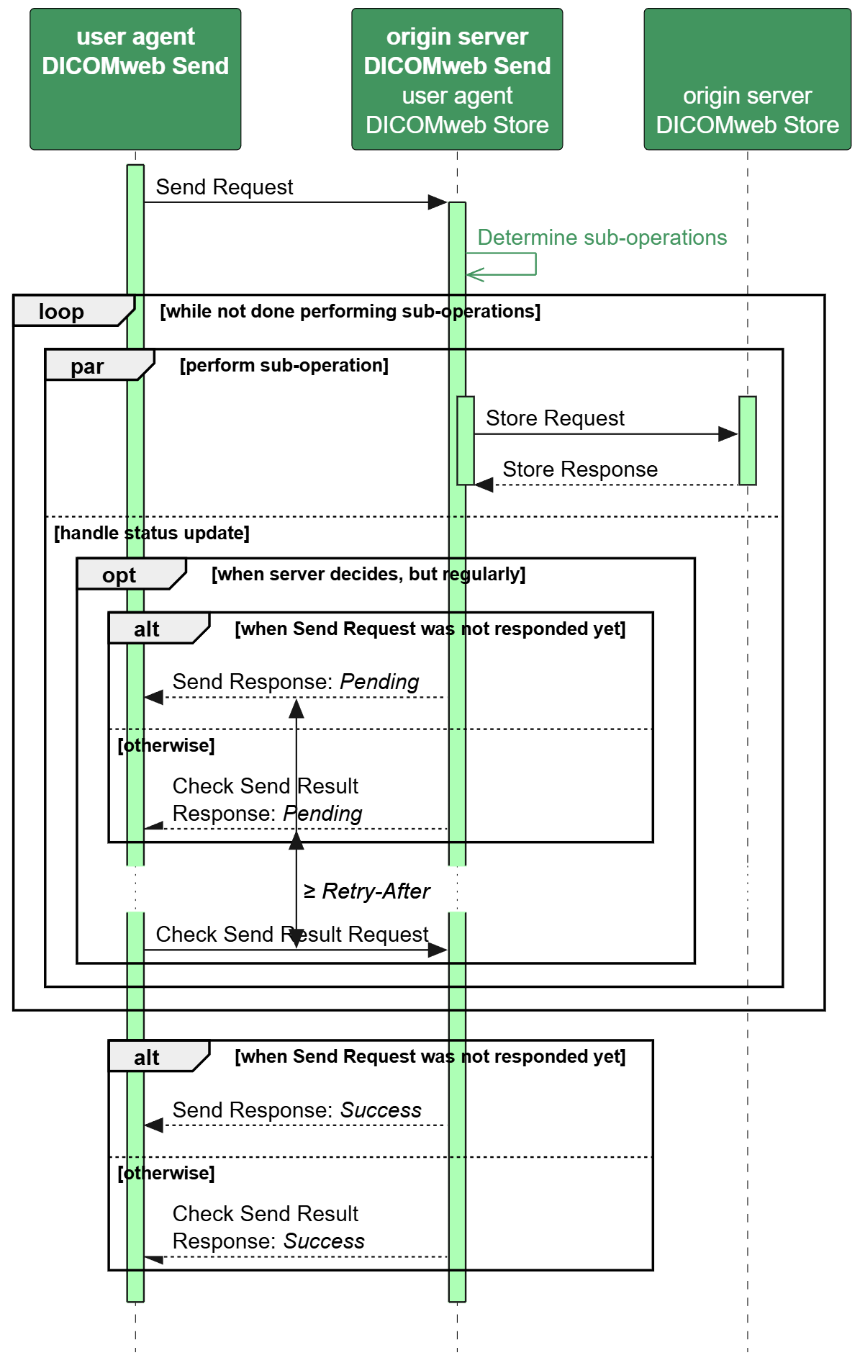
DIMSE’s C-MOVE
DICOMweb’s Send
short polling-oriented
Improved drawing
loop
par
opt
alt

Slide 20
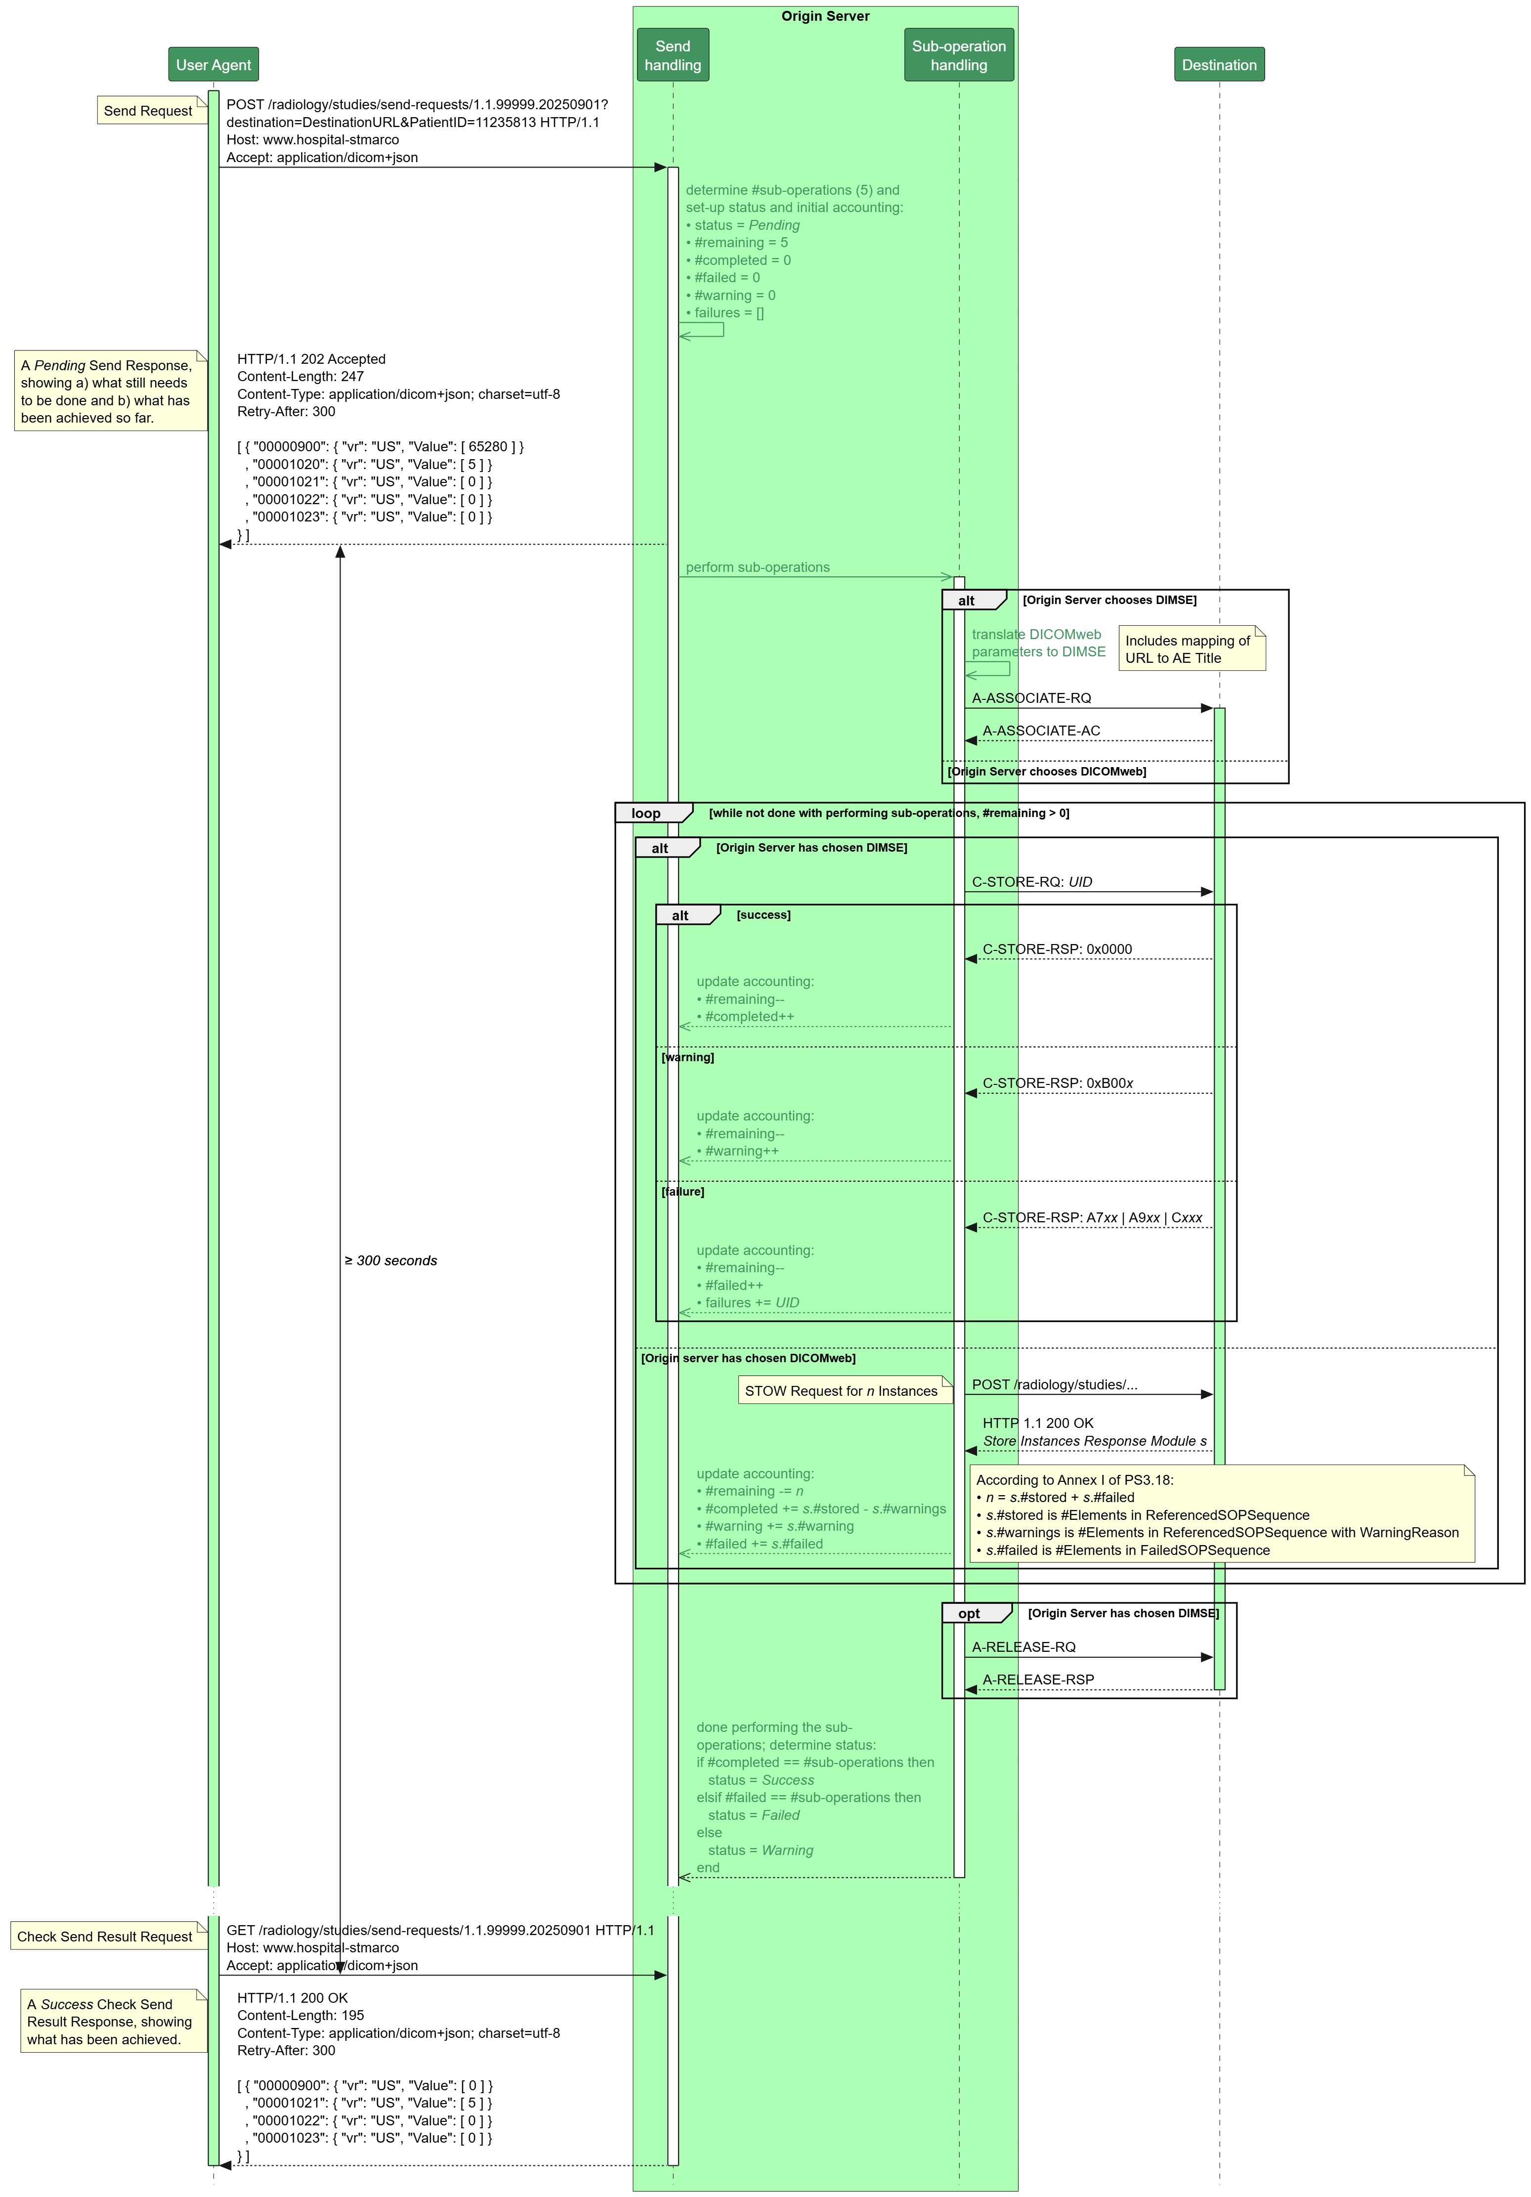
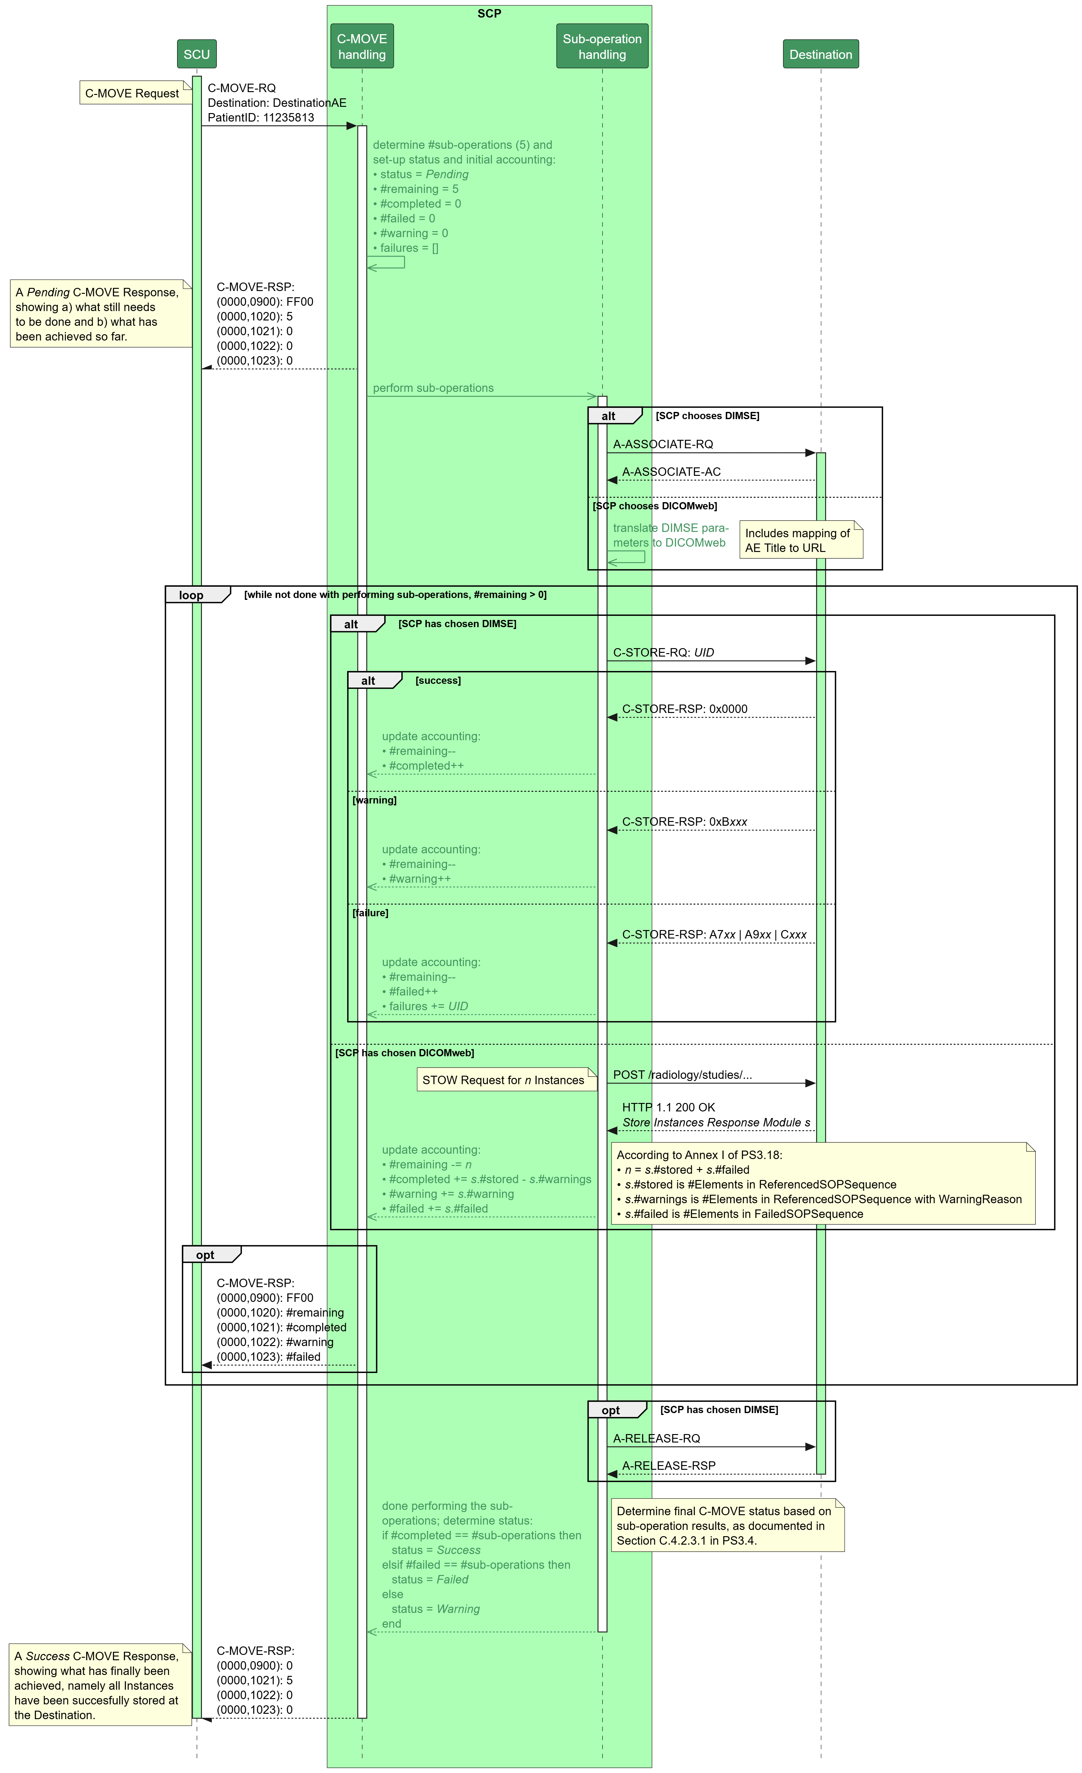
The diagram shows:
Expanded origin server
Example messages
Single and multiple responses
Sub-operation alternatives
Detailed logic for status
and counter
The second diagram shows:
Expanded SCP
Same flow, minor differences

Slide 21
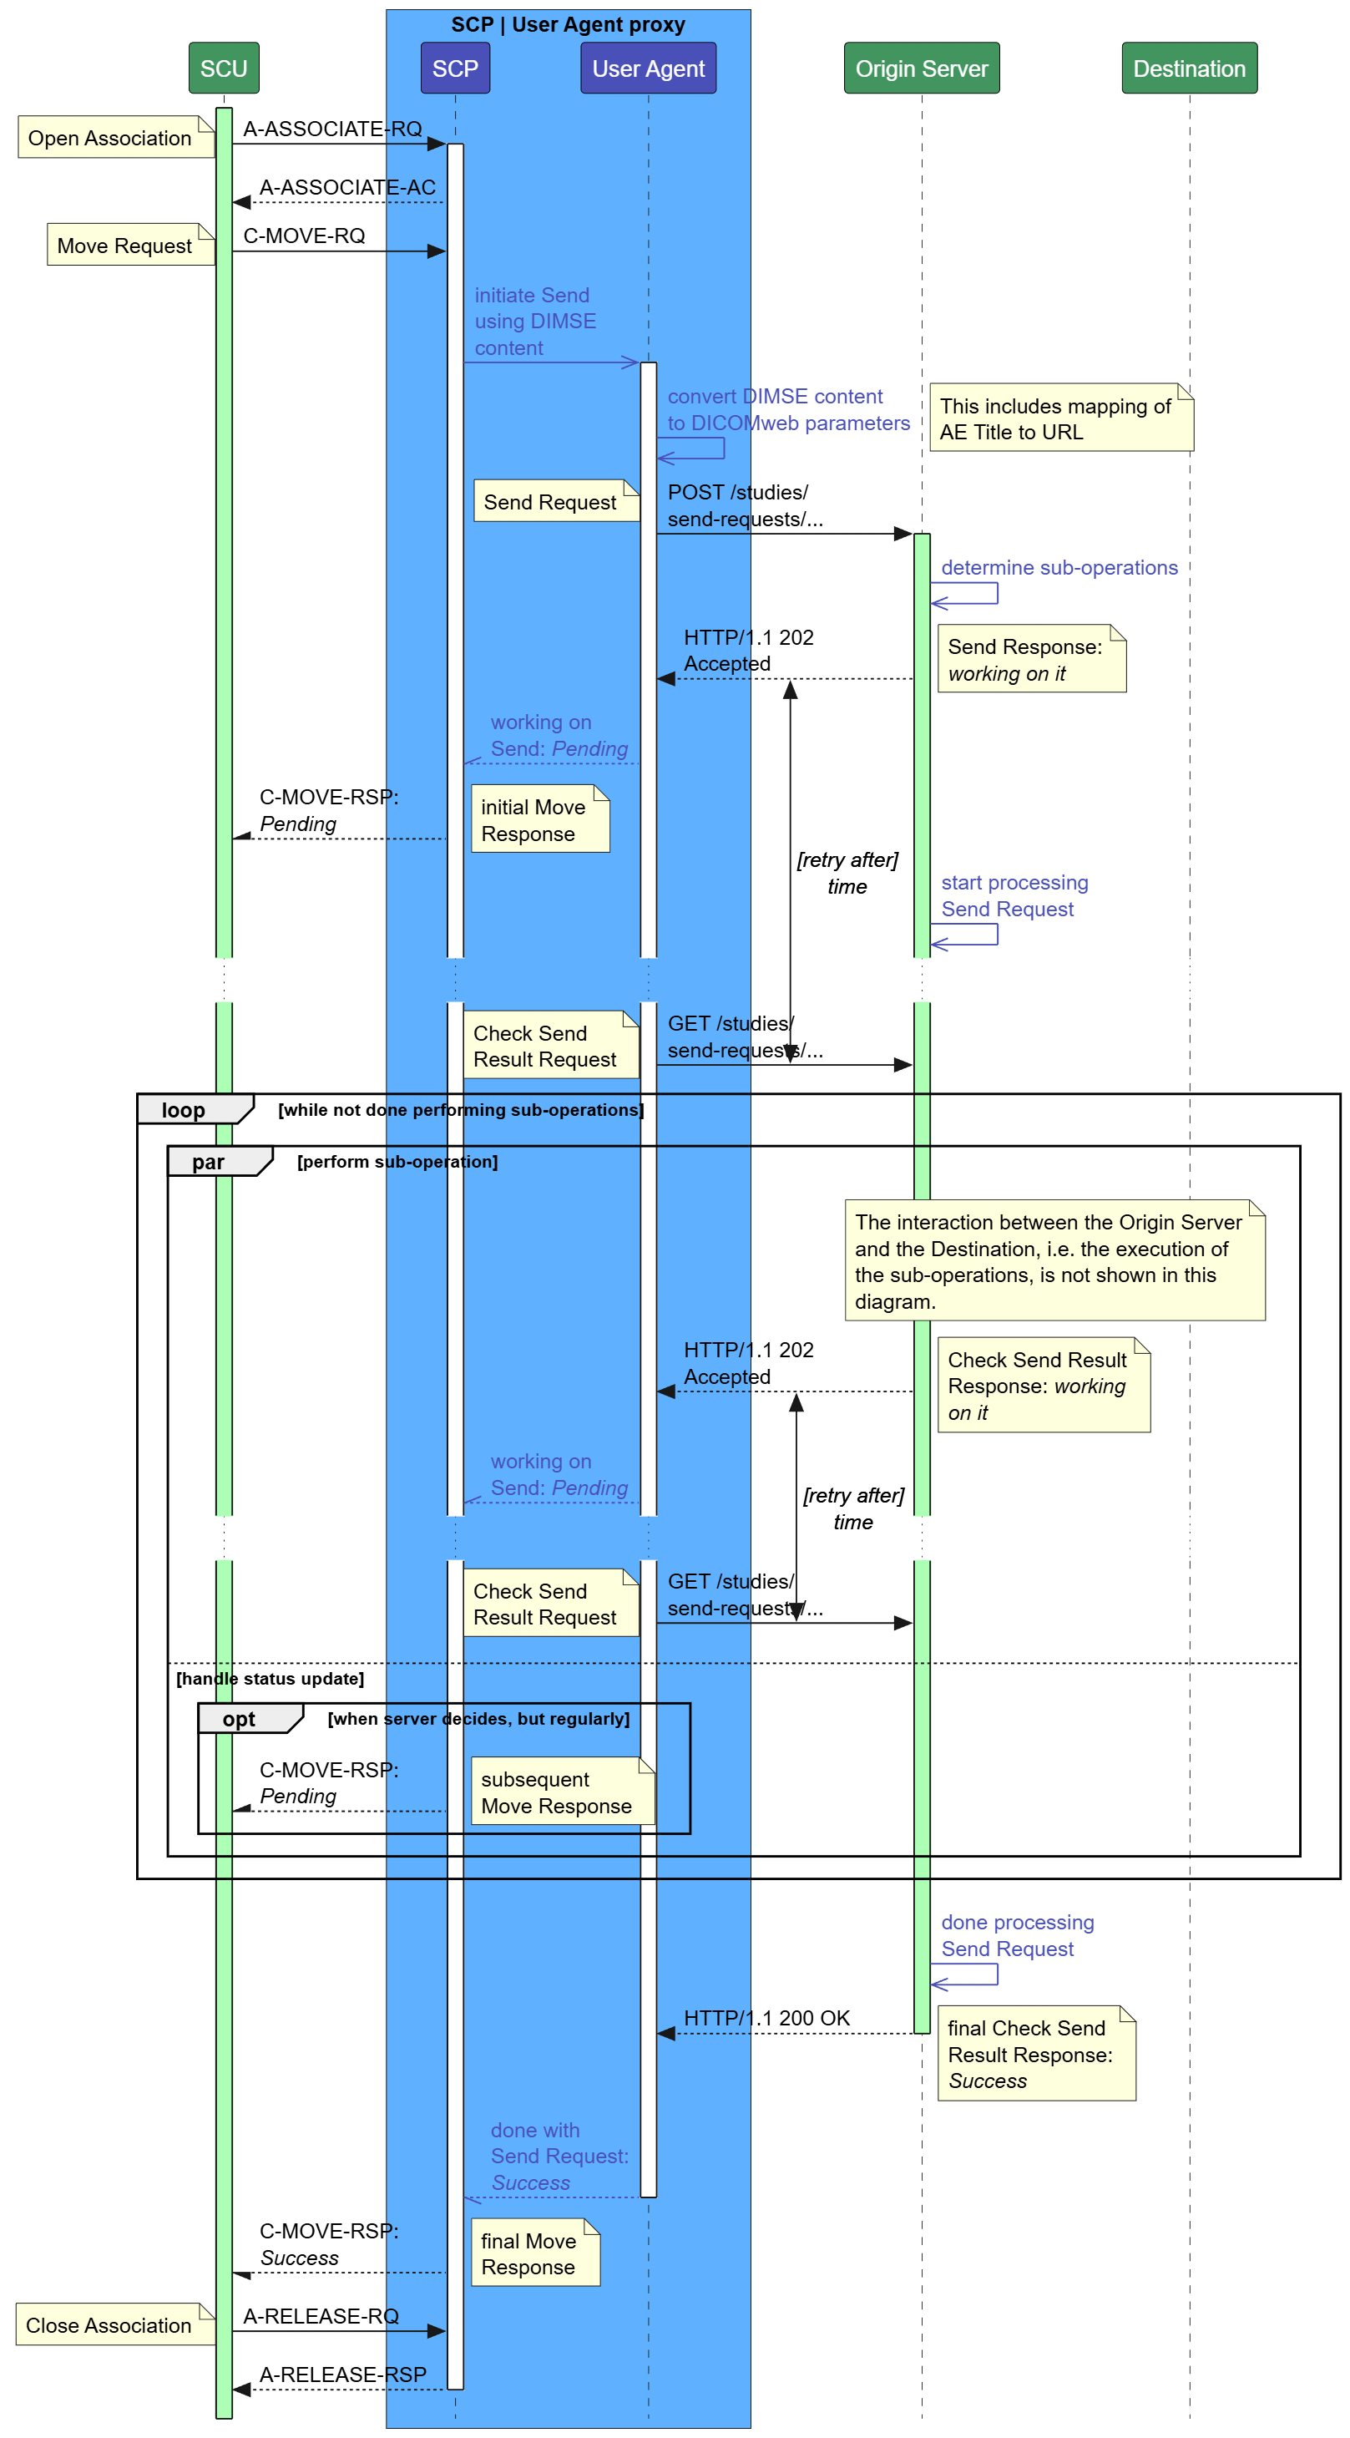
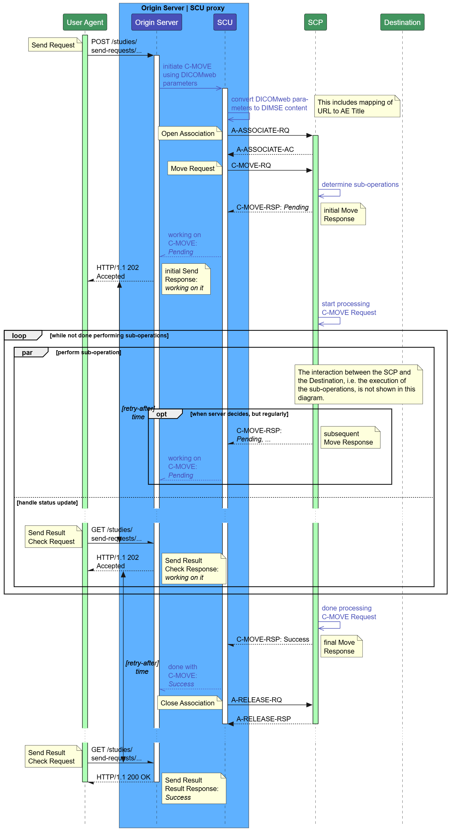
Bi-directional Proxies
On the left, a proxy that allows an SCU to get a C-MOVE done using an Origin Server.
On the right, a proxy that allows a User Agent to get a Send done using an SCP.

Slide 22
End of Presentation

