Slide 1
Supplement 247: Eyecare Measurement Templates
DICOM Working group 9 Ophthalmology Public Comment
February 2025

Slide 2
Purpose
Add templates, context groups, and coded vocabulary for key eyecare measurements
Ophthalmic study reports typically produced as Encapsulated PDF
Need to record key measurements as discrete data for clinical summary (e.g., in EHR)
Focus on key clinical measurements, not a comprehensive list of measurements (e.g., for research)

Slide 3
Prior work
IHE Eyecare - Key Measurements in DICOM Encapsulated PDF, for Trial Implementation (2019) [https://www.ihe.net/uploadedFiles/Documents/Eye_Care/IHE_EyeCare_Suppl_Key_Measurement_PDF.pdf]
Content option under Unified Eye Care Workflow
Templates for SR-like content in Encapsulated PDF
AAO recommendation of discrete data exchange (in association with displayable PDF) (2021) [https://www.aaojournal.org/article/S0161-6420(21)00164-0/fulltext]

Slide 4
Sup247 Approach
Templates defined for use in either SR or SR-like content in Encapsulated PDF
Separate template for each category of measurement
Visual Field
Optic Disc
Retinal Nerve Fiber Layer
Macula Thickness
Ganglion Cell Layer
Corneal Topography
Endothelial Cell Count
Ophthalmic Image ROI

Slide 5
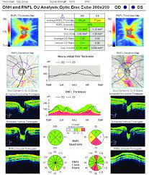
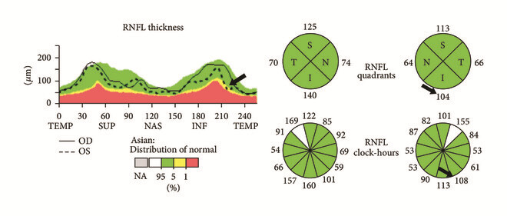
Example: Retinal nerve fiber layer
Table CID 42x3 RNFL Key Measurements
Coding Scheme Designator | Code Value | Code Meaning
DCM | nnn400 | Retinal nerve fiber layer average thickness
DCM | nnn401 | Retinal nerve fiber layer inferior thickness
DCM | nnn402 | Retinal nerve fiber layer superior thickness
DCM | nnn403 | Retinal nerve fiber layer temporal thickness
DCM | nnn404 | Retinal nerve fiber layer nasal thickness
DCM | nnn411 | RNFL clockface position 1 thickness
DCM | nnn412 | RNFL clockface position 2 thickness
DCM | nnn413 | RNFL clockface position 3 thickness
DCM | nnn414 | RNFL clockface position 4 thickness
DCM | nnn415 | RNFL clockface position 5 thickness
DCM | nnn416 | RNFL clockface position 6 thickness
DCM | nnn417 | RNFL clockface position 7 thickness
DCM | nnn418 | RNFL clockface position 8 thickness
DCM | nnn419 | RNFL clockface position 8 thickness
DCM | nnn420 | RNFL clockface position 10 thickness
DCM | nnn421 | RNFL clockface position 11 thickness
DCM | nnn422 | RNFL clockface position 12 thickness
DCM | nnn406 | Retinal ROI radius

Slide 6
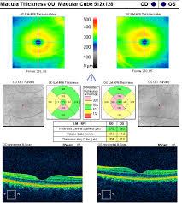
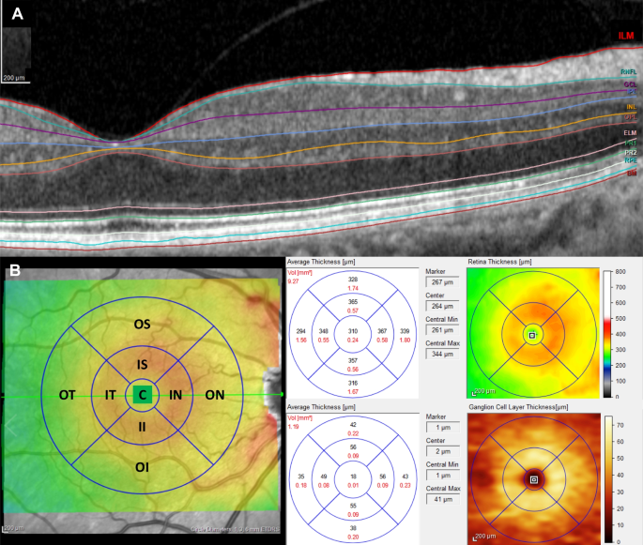
Example: Macular Thickness
Table CID 42x4 Macular Thickness Key Measurements
Coding Scheme Designator | Code Value | Code Meaning
LN | 57108-3 | Macular grid.center point thickness by OCT
LN | 57109-1 | Macular grid.center subfield thickness by OCT
LN | 57110-9 | Macular grid.inner superior subfield thickness by OCT
LN | 57111-7 | Macular grid.inner nasal subfield thickness by OCT
LN | 57112-5 | Macular grid.inner inferior subfield thickness by OCT
LN | 57113-3 | Macular grid.inner temporal subfield thickness by OCT
LN | 57114-1 | Macular grid.outer superior subfield thickness by OCT
LN | 57115-8 | Macular grid.outer nasal subfield thickness by OCT
LN | 57116-6 | Macular grid.outer inferior subfield thickness by OCT
LN | 57117-4 | Macular grid.outer temporal subfield thickness by OCT
LN | 57118-2 | Macular grid.total volume by OCT
DCM | nnn250 | Average macular thickness

Slide 7
Key Measurements are Mandatory
Table TID 60x1. Ophthalmology Measurements Group
 | NL | Rel with Parent | VT | Concept Name | VM | Req Type | Condition | Value Set Constraint
1 |  | CONTAINS | CONTAINER | EV (125007, DCM, "Measurement Group") | 1 | M
8 | > | CONTAINS | INCLUDE | DTID 300 “Measurement” | 1-n | MC | IFF Template is invoked with a non-empty $Measurement parameter (see Content Item Description) | $Measurement = $Measurement
9 | > | CONTAINS | CODE | $QualType | 1-n | MC | IFF Template is invoked with a non-empty $QualType parameter (see Content Item Description) | $QualValue
10 | > | CONTAINS | INCLUDE | DTID 300 “Measurement” | 1-n | U |  | $Measurement = $OptMeasure
Row 8 | Mandatory numeric findings of the measurement group. Each Concept specified in the Value Set Constraints (i.e., as specified in the invoking Template $Measurement parameter) shall be encoded in a NUM Content Item. Note that the NUM Content Item allows an absent value with an associated reason code per CID 42, e.g., (114007, DCM, “Measurement not attempted”). TID 300 Measurement defines an optional capability to specify properties of a measurement via TID 310 Measurement Properties. TID 310 supports properties such as normality, statistical properties (through subsidiary TID 311), normal ranges (subsidiary TID 312), level of significance and more. Normality flags are highly useful and commonly provided by implementations.
Row 9 | Mandatory qualitative findings of the measurement group. Each Concept specified in the Value Set Constraints (i.e., as specified in the invoking Template $QualType parameter) shall be encoded in a CODE Content Item.
Row 10 | Optional numeric measurements of the measurement group.

Slide 8
Example invocation of measurement group
 | NL | Rel with Parent | VT | Concept Name | VM | Req Type | Condition | Value Set Constraint
1 |  |  | CONTAINER | EV (nnn100, DCM, “Visual Field Key Measurements”) | 1 | M
2 | > | HAS CONCEPT MOD | INCLUDE | DTID 1204 “Language of Content Item and Descendants” | 1 | U
3 | > | HAS OBS CONTEXT | INCLUDE | DTID 1002 “Observer Context” | 1-n | U
4 | > | HAS OBS CONTEXT | INCLUDE | DTID 4019 Algorithm Identification | 1 | U
5 | > | CONTAINS | INCLUDE | DTID 60x1 “Ophthalmology Measurements Group” | 1-2 | M | invoked once per eye measured | $Method = DCID 4250. Visual Field Static Perimetry Test Pattern $Measurement = DCID 42x1 Visual Field Key Measurements $QualType = EV (111855, DCM, "Glaucoma Hemifield Test Analysis") $QualValue = DCID 4254. Visual Field Static Perimetry Test Analysis Result

