Slide 1
Ultrasound Fetal Cardiac Structured Report Extensions
Public Comment Draft
WG-1/12
4 April 2024

Slide 2
Background
Fetal Cardiac Assessment using Ultrasound has evolved since Sup78 was published in 2010
Practice now includes many more measurements beyond visual assessment, such as:
  measurements of the ventricles, atria, septa and valves,
  measurements of fetal arrhythmia and hemodynamics,
  assessment of the fetal cardiovascular profile score (CVPS)
Many measurements initially specified for pediatric echo are also potentially applicable to late stage fetal development and should be available in the TID.

Slide 3
Overview
Scope:
TID 5220 and its sub-templates are extended for fetal echo
Many new requested measurements (and many similar measurements) are supported by the addition of TID 5302 for fully post-coordinated echo measurements
  Several new Properties, Anatomical Locations, and Measurements are added to existing CIDs.
  Guidance on how to use TID 5302 to encode many new fetal measurement examples is provided
A CID for Fetal Echocardiography Image Views is added
A new report section for Fetal Cardiovascular Profile Score (CVPS) is added

Slide 4
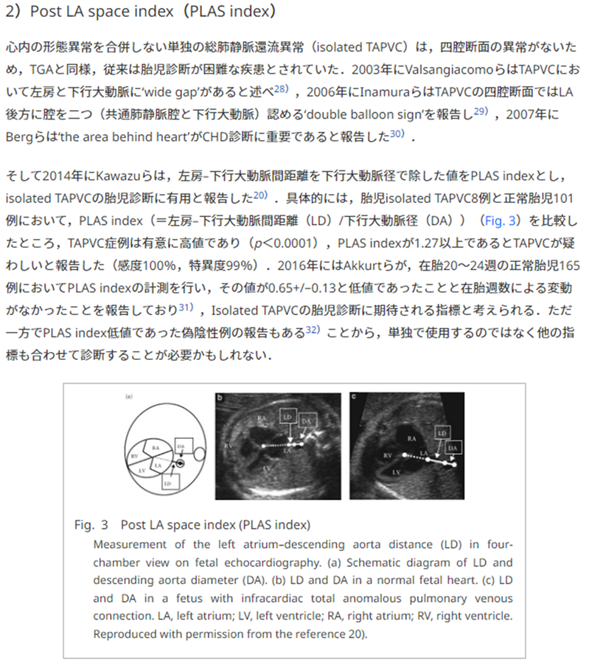
Post LA space (PLAS) index & LD

Slide 5
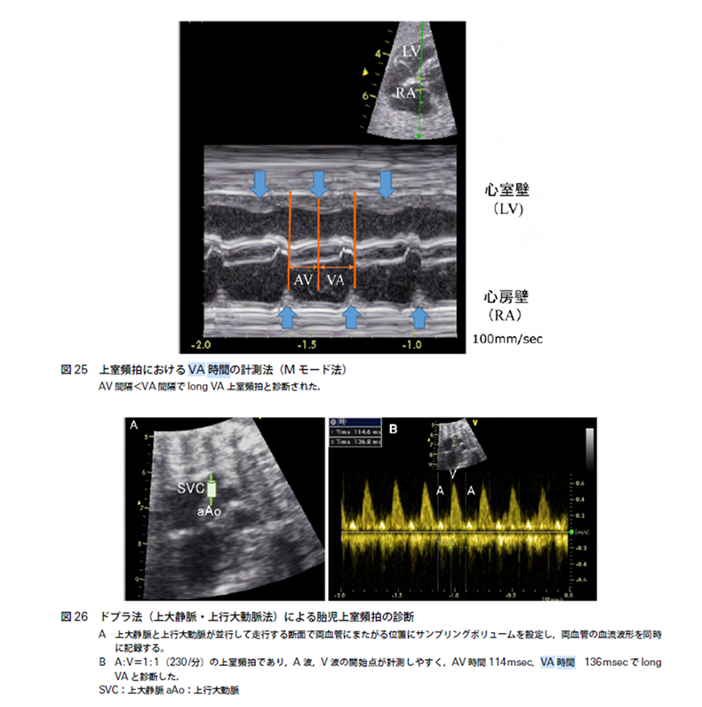
Fetal Arrhythmia Assessments
Fetal Echo Guideline Japan (Second edition) 2021
  Figure showing the atrioventricular (AV) and ventriculoatrial (VA) intervals used in assessment of fetal arrhythmia

