Slide 1
Supplement 236
Waveform Presentation State
DICOM Working group 32
public comment
Silvia Winkler
2024-05-30

Slide 2
Purpose of Waveform Presentation State
A Waveform Presentation State …
provides display properties separate from the waveform object
preserves display settings in order to be able to re-create a specific view
aligns a display view and the presentation of annotations stored in a separate object
refers to waveform objects and specific channels within these
defines color, shading and scaling

Slide 3
Existing Waveform Presentation
DICOM Waveform Module PS3.3 C.10.9 contains display information
Stored within the waveform object (this means: at recording time)
Referencing channels in the current object
Grouping of channels with same display properties
Just defines color, shading and scaling

Slide 4
Existing Waveform Presentation
Attribute Name | Attribute Description
Waveform Data Display Scale | The recommended time-based waveform data display scale in units​ of mm/s
Waveform Display Background CIELab Value | A color triplet value recommended for rendering the waveform​ display background on a color display.
Waveform Presentation Group SQ | Sequence of Items, each Item describing a Presentation Group of​ one or more waveform channels to be displayed together
> Presentation Group Number | A number that identifies the Presentation Group
> Channel Display SQ | Sequence of Items, each Item describing a channel to be displayed​ in the Presentation Group.
>> Referenced Waveform Channels | Identifier of the displayed channel, specified as a pair of values​ (Multiplex Group item no. in SQ), Channel item no. in SQ)
>> Channel Offset | The offset in seconds from the beginning of the channel waveform​ data to the first sample to be used for presentation

Slide 5
Existing Waveform Presentation
Attribute Name | Attribute Description
>> Channel Recommended Display CIELab Value | A color triplet value recommended for rendering the channel on a​ color display.
>> Channel Position | Position of the Channel within the Presentation Group display area
>> Display Shading Flag | Specifies display area shading between the displayed waveform​ channel and another line. Enumerated Values:​ NONE​ BASELINE​ ABSOLUTE​ DIFFERENCE​
>> Fractional Channel Display Scale | Fraction of the Presentation Group vertical display dimension​ assigned to the unit quantity (least significant bit) of the Channel​ samples
>> Absolute Channel Display Scale | Nominal vertical display height in mm assigned to the unit quantity​ (least significant bit) of the Channel samples

Slide 6
Use Cases
Which information should be stored and exchanged in which situation

Slide 7
Use Case: Recording
A technologist performs an EEG recording. From time to time, the technologist changes the filter settings and viewing montages, in order to check the quality of the recording.
The filter settings and viewing montages convey to selected channels
These channels may come from more than one instance (e.g. the EEG instance and the ECG instance)
Question: could this also affect channels from elder recordings (might be a prior examination or just a short time ago)? Answer: No, changes to the montage only affect the current recording.

Slide 8
Use Case: Recording cont.
The EEG technologist may note power line noise on a particular channel and physically manipulate the scalp and EEG electrode of that channel to improve impedance (or if the notch filter is employed incorrectly they may fail to note quality problems on some channel). If abnormalities occur or if external circumstances change that could be of importance for the evaluation of the recording, the technologist adds event annotations at various timepoints in the recording.
In addition to the annotations, the recording system also saves any changes to the display filter settings and the montage selected for the display throughout the recording.

Slide 9
Use Case: Recording cont.
Information that shall be preserved and exchanged:
Annotations added by the technologist
Time, Text, and Originator
Changes to Display Filter Settings
Changes to Display Montages

Slide 10
Use Case: post-hoc Review
A physician or technologist acting as a post-hoc reviewer looks through a completed EEG recording and marks potential epileptic patterns. The annotations added by the technologist during the recording are shown.
The physician has the option of using the settings for display filters and montage stored in the presentation state object generated during recording (so that the reviewer can view the EEG recording in the same manner as it was viewed by the technologist who made the recording).
If the physician or technologist reviewer adds annotations, these are stored as well.

Slide 11
Use Case: post-hoc Review
Changes to display settings are only stored based on user interaction/request.
Reviewer annotations are always stored.
Reviewer Annotations do not necessarily have a relationship to filters / montages.

Slide 12
Cardio Use Case: Home Performed Holter
A patient wears a 24 h ECG recorder for 1 week. Afterwards the data are sent/uploaded to a holter monitoring station.
A holter technician annotates the waveforms and highlights areas of interest. Then these data are sent to some kind of information system.
A cardiologist reviews the data and may change diagnosis or may send back to technician. Finally she signs the report in the information system and sends it to the EMR (probably as a PDF as well)

Slide 13
Cardio Use Case: Home Performed Holter
Patient provided wearable event recorder
Patient wears recorder 24h-1 week
Patient mails recorder back to clinic
Clinic uploads data to holter monitoring station
Patient
Holter technician
Holter technician
Annotates waveforms
Highlights areas of interest
Holter tech pushes data to a waveform information system
Cardiologist
Cardiologist reviews
May change diagnosis
May send back to holter tech
Cardiologist signs report in waveform information system
Waveform information system sends PDF or report link to EMR
2024-05-30

Slide 14
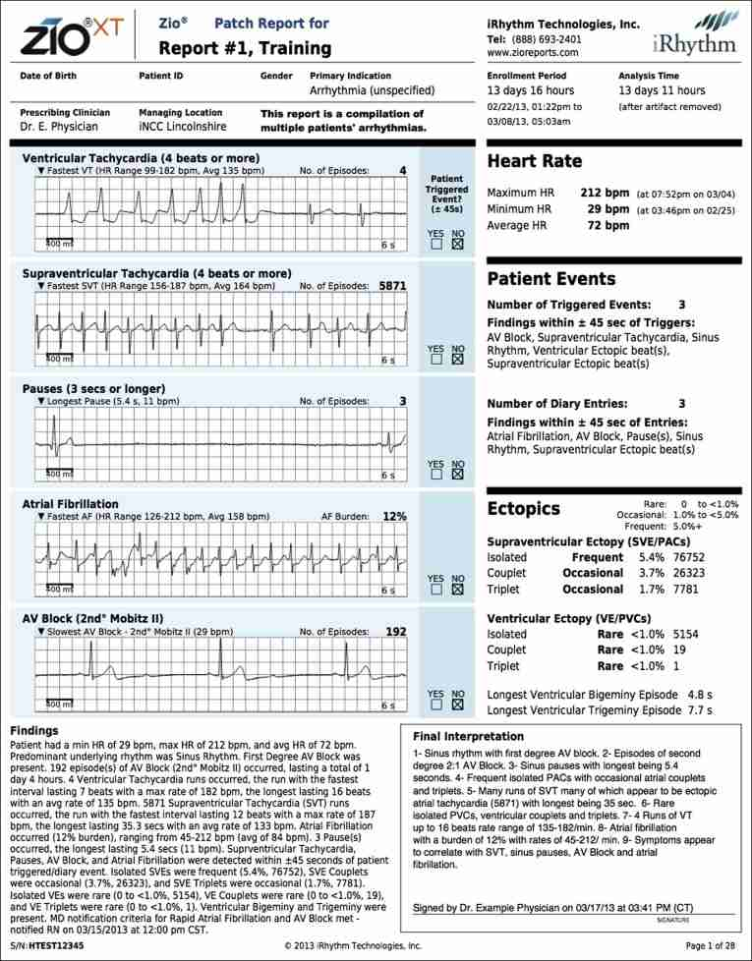
SR context
Presentation state
SR tables
SR narrative
https://www.researchgate.net/figure/iRhythm-Technologies-Inc-sample-Zio-Patch-report-format_fig1_259503800

Slide 15
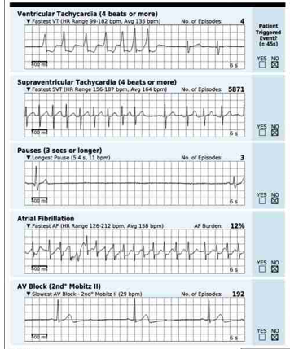
Cardio Use Case
Annotations:
If determined in real-time on the recording device: Annotation Module in the Waveform Object
If determined afterwards (after creation of the ECG Waveform): probably
Presentations State (anchored to a point on the strip) or
Structured Report
Segment („6s“): Presentation State („Segment of Interest“ - with defined color)

Slide 16
SR context
SR table
Presentation state
SR narrative
https://nurseslabs.com/wp-content/uploads/2019/02/HOLTER-MONITOR-REPORT-SUMMARY-Holter.jpg

Slide 17
Use Case: Electronic Health Record
A patient receives care in a new hospital system from a new neurologist which uses neurophysiology review workstations built by a OEM which is different from the OEM which made the equipment which recorded the patient’s previous video-EEG recordings.
The new neurologist receives the DICOM data from the patient’s previous video-EEG recordings made with the equipment of one OEM and is able to view this data using the review station made by a different OEM. The neurologist is able to view the:
video-EEG data using the montages used by the technologist who made the recordings
video-EEG data using his or own personal montages.
Annotations made by the technologist during the video-EEG recording
Annotations made by the neurologist who created the clinical report during the review process.
This involves review of data encoded with existing waveform IODs (EEG IOD, ECG IOD, video IOD) and also the Annotations IOD and the Presentation State IOD

Slide 18
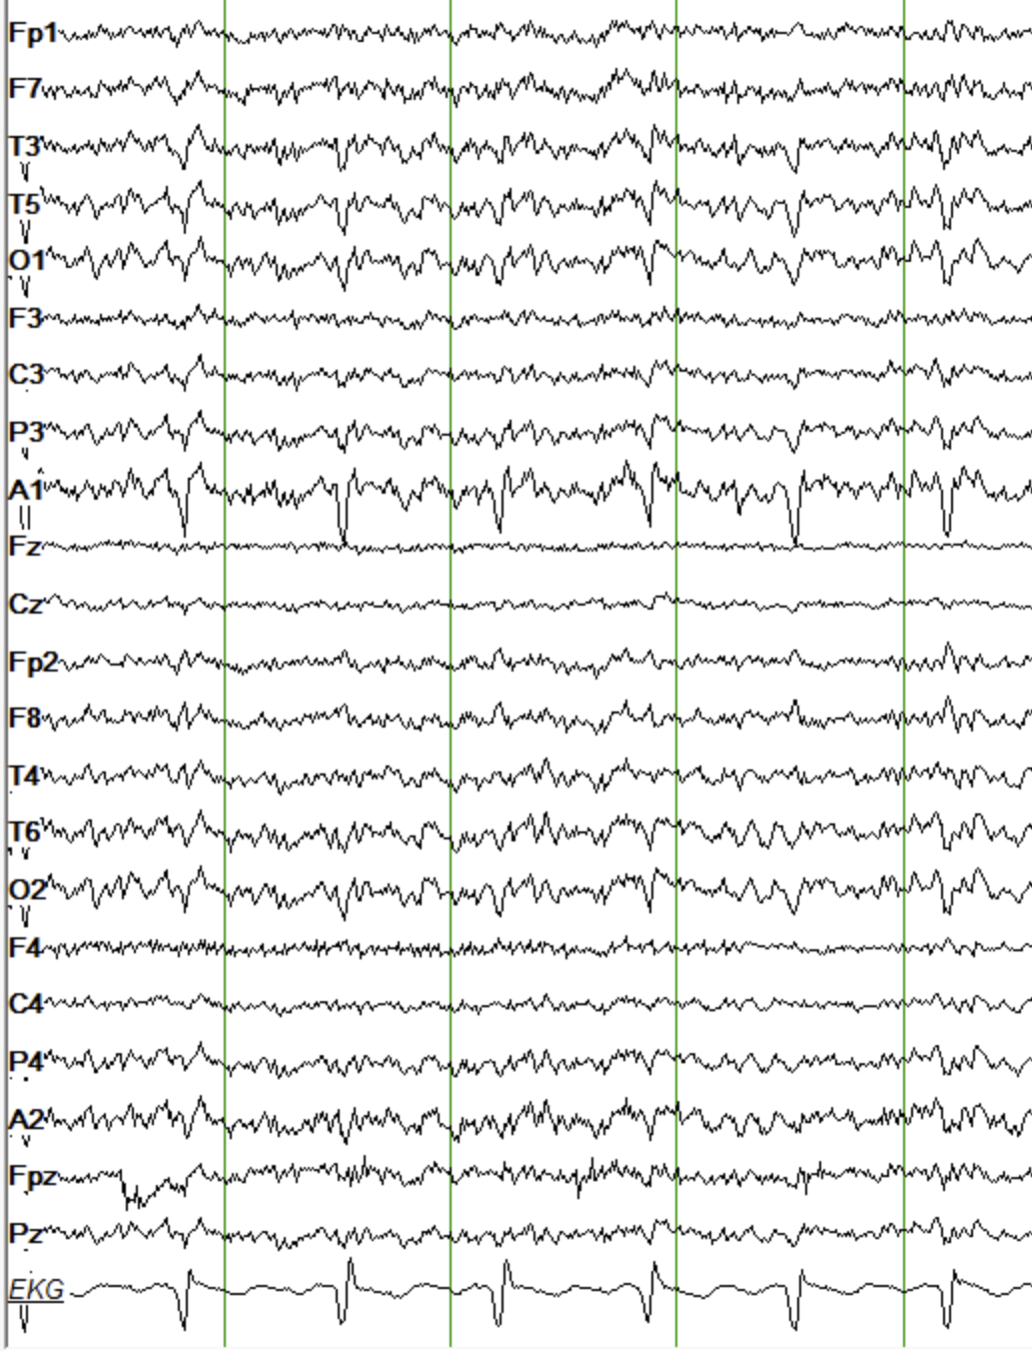
Definition of “Montage” in Neurophysiology
Each channel of EEG records the potential difference between multiple electrodes and a single common digital reference electrode.
Technically, “montage” defines a list of original channel sources and the method for their mathematical (linear) recombination to create a new “remontaged” list of channels for visualization of the data.
In clinical practice, the term “montage” includes the above in addition to other attributes of each “remontaged” channel including visualization filters, color, inter-channel vertical spacing, channel group number, and channel polarity
2024-05-30

Slide 19
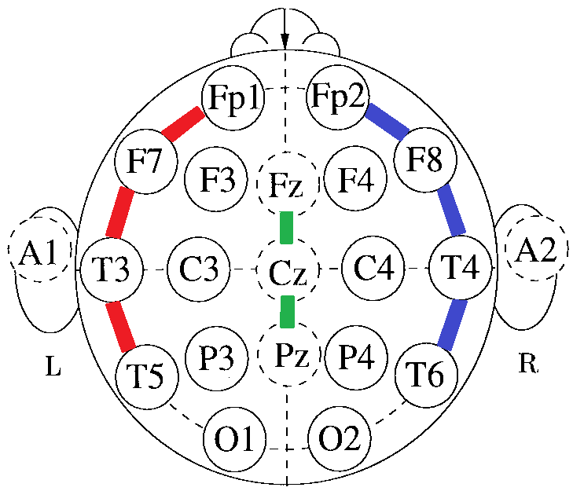
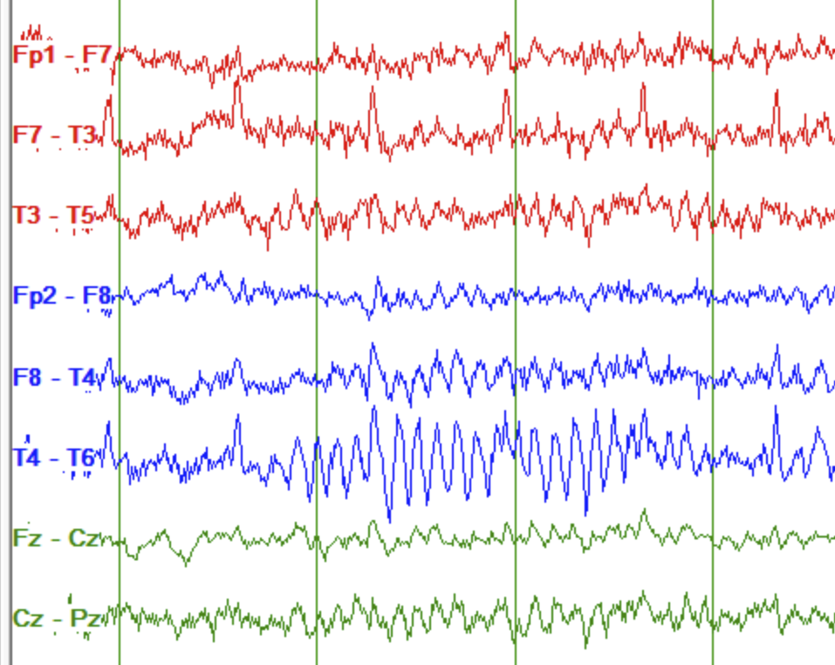
Montages
Display | Recorded
Channel 1 | Fp1, F7
Channel 2 | F7, T3
Channel 3 | T3, T5
Channel 4 | Fp2, F8
Channel 5 | F8, T4
Channel 6 | T4, T6
Channel 7 | Fz, Cz
Channel 8 | Cz, Pz

Slide 20
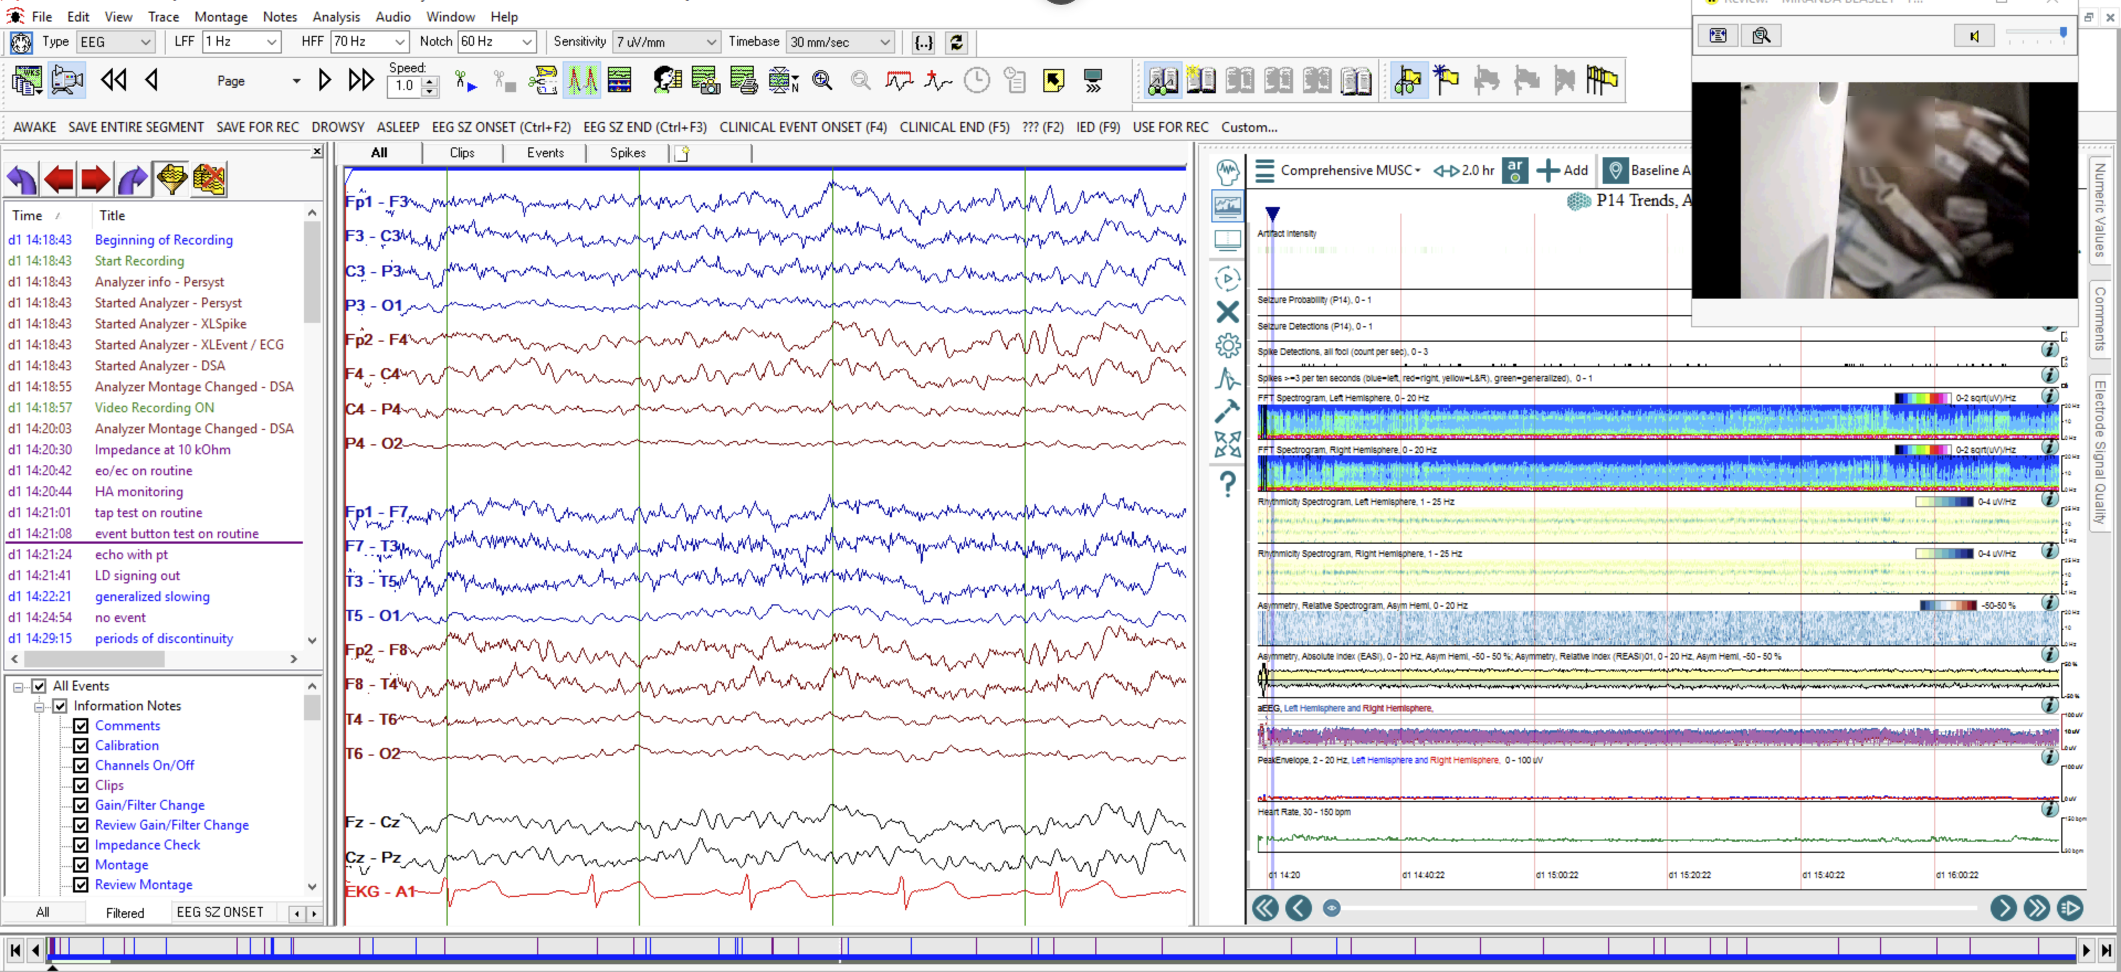
Montages
2024-05-30

