Slide 1
Supplement 233
Patient Model Gender Enhancements
WG-06
29 May 2024

Slide 2
DICOM Summary
Add optional attributes to the Patient Study Module and to various normalized services.
Updates and adds CID code lists. New codes are defined by DICOM for SPCU.
Updates TID 1007 Subject Context, Patient.
Clarifies use of Patient’s Sex (0010,0040) to match the HL7v2.9.1 definition.
Provides examples of use.

Slide 3
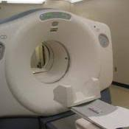
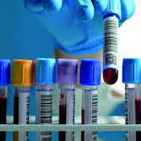

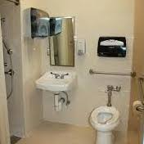
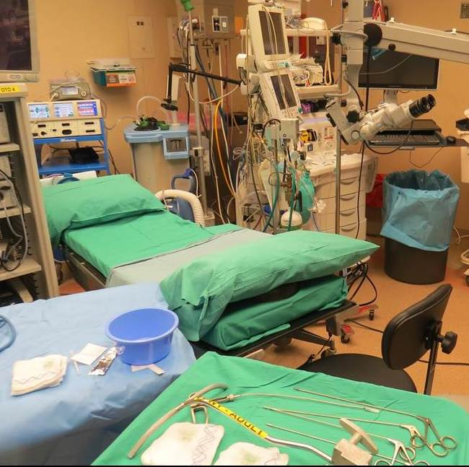
Use Case
Transgender patient presents for imaging and admit.
Anatomic Female but undergoing hormone transition to male.
Female
Anatomy
        Gender Identity = M
      Sex for Imaging = F
      Sex for Lab = M or more complicated
Sex for other clinical devices = F
Female & Male
Hormones
Female
& Male
Birth sex, administrative sex, sex, gender identity are not consistently used or understood.
Female
Set-up

Slide 4
Background
HL7 Gender Harmony Project begun
Supplement 233
Public Comment
Issued
Informative HL7 Specification
JAMIA publication
Spring 2019
Aug 2021
Oct 2021
Jan 2024
June 2024
HL7 Cross Paradigm IG: Gender Harmony
Informative HL7 Specification
  Describes logical model for sex and gender identity data representation
  Participation included SDOs (HL7, DICOM, IEEE, NCPDP), US, Canadian & Australian governments, LGBTQIA+ Advocates, EHR vendors (Epic, Allscripts), AMA, ACP, ACLA.
JAMIA publication - https://academic.oup.com/jamia/article/29/2/354/6382238
HL7 Cross Paradigm IG: Gender Harmony - Sex and Gender Representation (covers HL7 V2, CDA, and FHIR normative updates)
Notes:
Note that the JAMIA article is open access, and that there is a correction link in the article to correct some important typos.

Slide 5
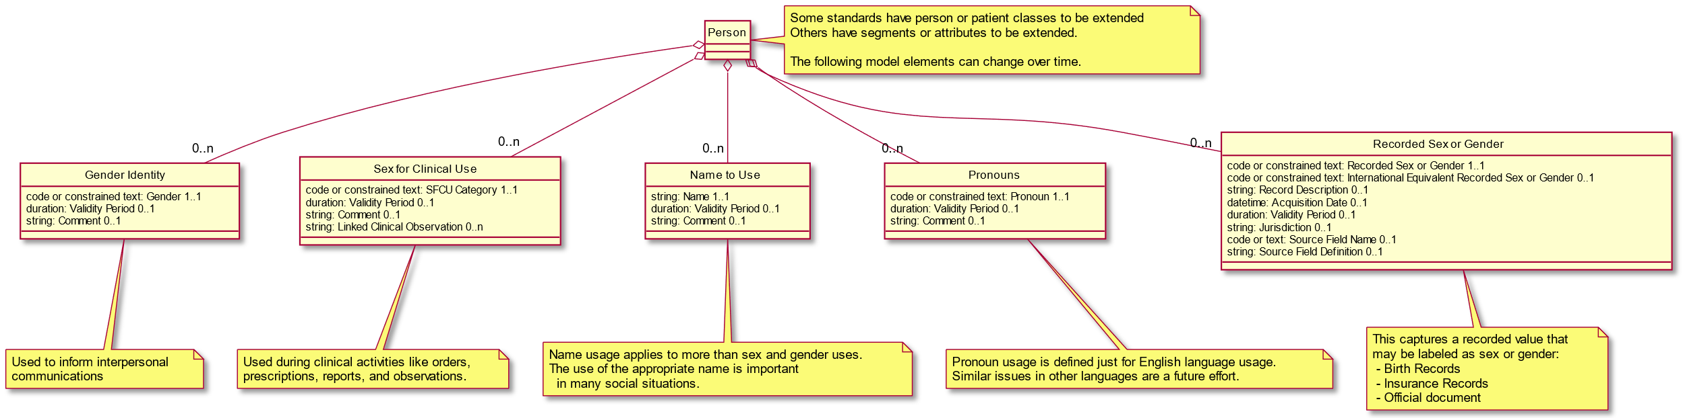
Gender Harmony Logical Model
This is an abstract class model that each standard will need to map into the specific concrete classes used

Slide 6
Gender Harmony Elements
Gender Identity (GI)
Source:
  Patient only
Optional Attributes
May change between studies
Used for guiding patient clinician interactions.
Sex Parameters for Clinical Use (SPCU)
Source:
  Clinician
  Clinical rules system
  Clinical observations
Optional Attributes
May change between studies
Used for machine setup, analysis, and interpretation.

Slide 7
GH Element Specifics-3
Name to Use (NtU)
Source:
  Patient
May change between studies
Optional Attributes
Used for guiding patient clinician interactions.
Pronouns
Source:
  Patient
May change between studies
Optional Attributes
Used for guiding patient clinician interactions.

Slide 8
Proposed HL7 Minimum Value Sets
Sex Parameters for Clinical Use (SPCU)
Gender Identity
Term | Definition
Female | Identifies as female gender. SNOMED 446141000124107
Male | Identifies as male gender. SNOMED 446151000124109
Nonbinary | Identifies as nonbinary gender. SNOMED 33791000087105
Term | Definition
Female-typical | Available data indicates that diagnostics, analytics, and treatments should consider best practices associated with female reference populations.
Male-typical | Available data indicates that diagnostics, analytics, and treatments should consider best practices associated with male reference populations.
Specified | Available data indicates that diagnostics, analytics, and treatment best practices may be undefined or not aligned with sex-derived reference populations. Additional information (usually, but not always, in the form of comments and/or observations) is available, but it does not align with typical male or female parameters, reference ranges, etc.
Expect local extensions. E.g., Canada has a national SNOMED extension for “two spirit”.
UMLS and SNOMED codes have been established.
DICOM CID xxx1 Person Gender Identity uses SNOMED
SPCU of “Specified” will often be accompanied by comments and/or URI to provide the specified ranges to used, procedures to follow, etc. URIs may reference clinical reports, hospital policies, etc.
DICOM CIDxxx2 Sex Parameters for Clinical Use uses DCM codes.

Slide 9
Proposed HL7 Minimum Value Sets
Pronouns
Term | Definition
He, Him, His, Himself | English personal pronouns, typically associated with masculinity, that are requested by a person to be used by them.
She, Her, Hers, Herself | English personal pronouns, typically associated with femininity, that are requested by a person to be used by them.
They, Them, Their, Theirs, Themself | English personal pronouns, typically not associated with masculinity or femininity, that are requested by a person to be used by them.
Based on LOINC answer list for Personal Pronouns - Reported, LL5144-2 Personal pronouns / Answers: 10; Scale: Nom; Code: -; Score: -.
DICOM CIDxxx4 Third Person Pronouns uses LOINC

Slide 10
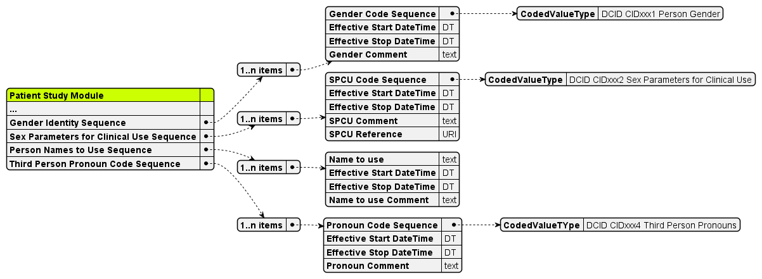

Slide 11
Modules Modified
The optional sex and gender attributes are added to the following modules:
  Patient Demographics Module (Normalized)
  Performed Procedure Step Relationship (Normalized)
  Patient Study Module (Composite)
  Unified Procedure Step Relationship Module (Normalized)
The definition of Patient’s Sex (0010,0040) is updated.
  The original definition only specified the enumerated codes to be used. It is updated to match HL7 v2.9.1 PID-8 updates. This attribute is set according to hospital policy.

Slide 12
Services Modified
The modified modules result in updates to the following services:
  Study Root SOP Class Group (C-FIND)
  Modality Performed Procedure Step
  Modality Worklist
  Relevant Patient Information Model
  Substance Approval Query
  Unified Procedure Step

Slide 13
Other Modifications
Application level confidentiality profiles updated
Updated TID 1007 Subject Context, Patient
New and updated CID
  CID 7455 Sex
  New CID Person Gender Identity
  New CID Sex Parameters for Clinical Use (SPCU)
  New CID Third Person Pronouns
New DICOM codes for SPCU

