Slide 1
Heightmap Segmentation
To accompany Sup240 Public Comment

Slide 2
Topics
Heightmap
Classic segmentation in DICOM (background information)
Heightmap segmentation
  1D and 2D
Notes and clarifications
Heightmap use in derived En Face Images

Slide 3
Heightmap definition
(computer graphics) A two-dimensional raster image used to store surface elevations that can later be applied to a three-dimensional object. https://en.wiktionary.org/wiki/heightmap

Slide 4
Heightmap in DICOM
Use case: identify surface in a 3D volume
  Restricted to single height (z) at any baseline location (x,y)
  Initial primary use for retinal layer surfaces in ophthalmic tomography (OPT)
  Degenerate case - intersection of surface with single image plane (1D raster for 2D object)
Mechanism: Heightmap Segmentation IOD
  Modeled on Segmentation IOD
  Simplified alternative to Surface Segmentation IOD, which allows arbitrary (folded, volume) surfaces

Slide 5
Segmentation (general background)
Important analytic task is identifying the different anatomical features in an image
  Bones, organs, tumors, blood
  Brain areas that are active with stimulus (functional MRI)
Segmentation classifies areas, volumes, or surfaces in categories
Segments can feed into imaging display pipelines
  As overlay or blending with source image (e.g., with Blending Softcopy Presentation State)
  Virtual removal of background or segmented anatomy from display of source (e.g., with Volumetric Presentation State)
Segments can feed into quantitative measurements

Slide 6
DICOM “classic” (pixel/voxel) segmentation
Modality = “SEG”
Derived image object using
enhanced multi-frame image paradigm
Multiple segments per object, each having a property (categorization)
Segments linked to one or more frames, pixels show presence of property at pixel location
Two disparate methods in single SOP Class – planar and volumetric

Slide 7
Planar (pixel) segmentation
For segmentation of projection or other single plane images
  Possibly including each slice in a CT or MR volume (multi-frame, or series of single frames)
Indicated by absence of Frame of Reference UID
Each segmentation frame references its corresponding source single frame
  AKA “derivation image”
Segmentation frame pixels are 1:1 with source
  Same pixel matrix size, spacing

Slide 8
Volumetric (voxel) segmentation
Segmentation object uses same Frame of Reference as source image(s)
Extent of SEG frames may differ from extent of source, may use different spatial resolution, different orientation
  Frame location in Frame of Reference specified by Pixel Measures, Plane Position (Patient), and Plane Orientation (Patient) functional groups
Segmented volume identified by Frame of Reference UID may correspond to multiple single frame objects in a source series
  E.g., for classical CT or MR SOP Instances
  Single Segmentation object may reference such multiple source images
Note: similar approach NOT used in Heightmap Segmentation

Slide 9
Segmentation data structure
Segment Sequence:
Catalog of properties
Functional Group Sequence: Attributes and classification of each frame
Pixel Data:
Stream of multiple frames

Slide 10
Segment Sequence (0062,0002)
Catalog of segmentation properties
  Identifier, label, description
  Algorithm used
  Property category (e.g., anatomy, physical object, functional locus) - CID 7150
  Specific property (e.g., liver, pacemaker, perfusion) – CID 7151
  Preferred display color

Slide 11
Heightmap segmentation
Locates a surface intersecting an
image plane or volume by its height (distance) from a baseline
Reuses planar segmentation data mechanism
  Enhanced multi-frame image paradigm
  Multiple segments per object, each having a property
  Each segmentation frame references its corresponding source
  Pixel spacing is 1:1 with source

Slide 12
Derivation (Source) Image
Heightmap is specified in the volumetric space (Frame of Reference) of referenced Derivation Image(s)
  Identified in Derivation Image Functional Group
  Derivation Code Sequence (113076, DCM, "Segmentation"); Purpose of Reference (121322, DCM, "Source Image for Image Processing Operation")
  For consistency with Segmentation IOD planar segmentation codes

Slide 13
2D and 1D Heightmaps
Heightmap for a 3D volume is a 2D plane
Heightmap for a 2D plane is a 1D raster (row)
Heightmap Segmentation IOD supports 1D or 2D frames
Heightmap follows DICOM convention of measuring pixel offsets from top of frame (TLHC)

Slide 14
Heightmap segmentation 1D frame
Each Heightmap 1D frame is one row with number of columns the same as corresponding source (Derivation Image) frame
Heightmap stored pixel values represent distance from top in source image in units of pixel rows (sub-pixel resolution)
  Upper edge of top pixel is 0.0, center of top pixel is 0.5
columns in both Derivation Image and Heightmap
top center of top pixel in column (heightmap value 0.0)
heightmap value (fractional vertical pixels in Derivation Image)
center of top pixel in column (heightmap value 0.5)
bottom center of top pixel in column (heightmap value 1.0)
rows in Derivation Image
bottom center of last pixel in column (heightmap value equals # rows in Derivation Image)

Slide 15
Heightmap 1D frames for various OPT scan patterns
Multi-frame Ophthalmic Tomography (OPT) image may have b-scans at varying plane orientations
  E.g., radial scan pattern, circular scan pattern
One Heightmap 1D frame for each segmented layer in each source b-scan frame
3
4
5
1
2
2
6
1
3
4
OPT radial scan frame orientations relative to OP retinal image
5
6

Slide 16
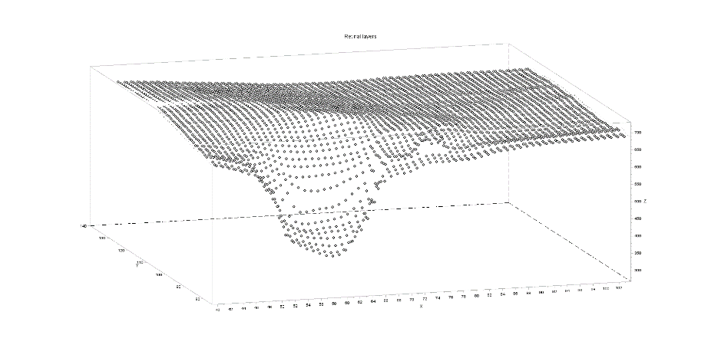
Heightmap 2D frames for volumetric OPT scan patterns
OPT image may have b-scans at constant plane orientation and regular plane spacing
  E.g., cube scan pattern
One Heightmap 2D frame for each segmented layer covers all source B-scan frames
  Pixel Data same as stream of 1D Heightmap rows for each source frame
  Column spacing same as source column
  spacing, row spacing same as
  source frame spacing
heightmap 2D frame values rendered as offsets into a 3D volume

Slide 17
Heightmap 2D frame pixel values rendered as offsets into a Derivation Image 3D volume
Heightmap columns
Heightmap rows
Derivation
Image
rows
Derivation
Image frames
Derivation Image columns

Slide 18
Heightmap pixel matrix spacing based on Derivation Image spacing
Heightmap segmentation
Heightmap row spacing equals Derivation image frame spacing
Heightmap column spacing equals Derivation image column spacing
(x₁,y₁,z₁)
(x₂,y₂,z₂)
Derivation image frame spacing derived from differences in Image Position (Patient)
Derivation image
Derivation image column spacing

Slide 19
2D Heightmap Frame Row Spacing
Equal to slice spacing in referenced derivation image
  Spacing Between Slices (0018,0088) might not be present in OPT images
  Slice Thickness (0018,0050) is technically an incorrect substitute – even though it is commonly used as it is a required attribute
Correctly should be computed from differences in Image Position (Patient) (0020,0032) in referenced Derivation Image

Slide 20
Heightmap position and orientation based on Derivation Image
Heightmap segmentation
H_{R} = (cos α_{R},cos β_{R},cos γ_{R})
(x,y,z)
Heightmap plane position (x,y,z) equals Derivation image 1st plane position (x₁,y₁,z₁)
H_{C} =
(cos α_{C},cos β_{C},cos γ_{C})
D_{R} = (cos α_{R},cos β_{R},cos γ_{R})
Heightmap plane row orientation H_{R}
equals Derivation image plane row orientation D_{R}
(x₁,y₁,z₁)
D_{C} =
(cos α_{C},cos β_{C},cos γ_{C})
Heightmap plane column orientation H_{C} equals cross product of Derivation image plane column orientation and row orientation D_{C} X D_{R}
Derivation image

Slide 21
Referenced images
Heightmap is specified in the volumetric space (Frame of Reference) of a referenced Derivation Image
  Identified in Derivation Image Functional Group
  Frame of Reference Coordinate System may be deformed – see CP2347 “Clarify OPT Frame of Reference Coordinate System”
Heightmap may be computed from a different object (e.g., Raw Data) identified in Referenced Image Functional Group

Slide 22

OPT Acquisition and Display
Frame of Reference Coordinate System
Typical 6x6mm scan area
Deformation is small, and measurements in image are corrected by (proprietary) algorithms
CP2347 clarifies that it is nominally in the Patient-based Coordinate System, with caveat for possible deformation
Heightmap follows OPT frame location in space and coordinate system, including for circular or other non-linear scans

Slide 23
N::M Relationship between OPT and SEG Instances
Heightmap SOP Instance can record multiple layers (segments)
One Heightmap SOP Instance can be applied to multiple OPT SOP Instances (e.g., if OPTs are one frame per instance)
  All OPTs (and Heightmap) must have same Frame of Reference UID
Multiple Heightmap SOP Instances can be applied to single OPT SOP Instances (e.g., one layer per Heightmap instance)

Slide 24
Pixel Values
Heightmap pixel data values use 32-bit floating point VR for sub-pixel resolution of position in anatomic image
Absence of segment in a column indicated by value in range specified by Float Pixel Padding Value (0028,0122) and Float Pixel Padding Range Limit (0028,0124)
CP2352 in process to clarify whether IEEE 754 NaN (Not a Number) values are legal (e.g., for padding)

Slide 25
Use in non-OPT contexts
Initial use case for segmenting retinal layers in OPT
No ophthalmic-specific vocabulary or constructs
Major constraint is geometric assumptions
  Derivation image frames perpendicular to heightmap baseline plane
  Rows of heightmap data correspond to the top rows of Derivation Image frames
  Columns of the Heightmap Segmentation correspond to the frames of the Derivation Image

Slide 26
Heightmap in En Face Image
Ophthalmic OCT En Face Image presents a cross-sectional slab of OPT or OPT Volume Analysis multi-frame image as a planar image
A surface of the slab may be specified using one segmented surface, or an interpolation of two segmented surfaces, or a fixed offset above/below a segmented surface
Revision of En Face IOD allows segmented surface to be Heightmap, Surface Segmentation, or any other SOP Class
  Previously, En Face IOD allowed only Surface Segmentation
Purpose is to show traceability, not to enable receiving app to reproduce slab

Slide 27
Relationship of OCT-A related SOP Instances
same Frame of Reference
Ophth OCT En Face Image SOP Instance
Source Image
Source Image
Frame Location Referenced Image
Referenced Segmentation
Ophth OCT B-Scan Volume Analysis SOP Instance
Frame Location Referenced Image
Derivation Image
[Heightmap, Surface] Segmentation SOP Instance
Derivation Image
OPT Image SOP Instance (structural)
Frame Location Referenced Image
Derivation Image
Raw Data SOP Instance
Ophth Photography Image SOP Instance (localizer)

Slide 28
Non-Backward Compatible Changes to En Face Image IOD
Allowing segmentation other than Surface Segmentation SOP Class
General change to segmentation object references
Adding mandatory reference to localizer (ophthalmic photography) image

