Slide 1
Supplement 234
DICOMweb Storage Commitment Service
WG27 – Web services for DICOM
Public Comment
Dieter Krotz & Jeroen Medema
June 2023

Slide 2
Work Item 2022-04-A
Limitations of Current Standard
DICOMweb covers the classic DICOM Storage and Query/Retrieve services with the same semantics: data is being copied. For DICOMweb the need to be able to rely on the fact that other systems will safely keep copied data safely is also applicable. However, there is no Storage Commitment service in DICOMweb to achieve that; there is an inconsistent set of services in DICOMweb compared to classic DICOM. Solutions will have to fall back to other mechanisms to achieve safekeeping.
Description of the proposal
Define the Storage Commitment service in DICOMweb given the described safekeeping need.
It needs to be determined what mechanisms are to be defined/selected for achieving this functionality. Even though Storage Commitment in classic DICOM supports both synchronous and asynchronous approaches, where the latter seems to be deployed more often, this does not necessarily need to be the way this is to be done in a RESTful way. Security aspects and existing non-standard solutions will play a role in determining how to achieve this functionality.
Approved by the DICOM Standards Committee, April 2022; work item 2022-04-A.

Slide 3
Summary (1 of 2)
Supplement 234 – DICOMweb Storage Commitment
adds one top-level resource for storage commitment: /commitment-requests;
  This mimics the approach taken by DIMSE.
allows for both synchronous and asynchronous communication utilizing polling;
  Storage commitment is often a long running process (e.g., a PACS is delegating storage commitment to a VNA and waits for the confirmation of the VNA before agreeing to storage commitment by itself).
  [See Discussion – Flow.]
allows for bi-directional proxyability;
  Enables hybrid solutions, with both legacy and state-of-the-art systems.
  [See Discussion – Proxyability.]
allows for adding study and series context to the referenced instances;
  This speeds up finding these instances at the server side.

Slide 4
Summary (2 of 2)
allows for specifying a ‘retry-after time’ by the Origin Server;
  Enables regulated polling, as to manage server load.
respects the (informal) semantics of HTTP POST and GET.
  Fits the cloud/RESTful approaches.
Next to the above, it also
defines how to document adherence to DICOMweb Storage Commitment in a DICOM Conformance Statement;
defines two new attributes/tags (both SQ);
comes with some examples.

Slide 5
Discussion
Flow

Slide 6

Flow of DICOMweb Storage Commitment Service
200 OK
Getting a result does not warrant that everything went
as requested, so that result still needs to be checked.
When checking the result, the Working … loop may be
skipped at the discretion of the origin server.
Done
Handle result
Done
202 Accepted
POST
Working…
Prepare request
Request
OK?
Working…
Prepare result check
Result check
Ready?
Issue with server
Issue with request
Transaction in use
GET
Issue with server
Transaction not known
Handle error
Handle error
400 Bad Request
409 Conflict
404 Not Found
user agent
origin server
When the transaction is not known, this means that either a
wrong Transaction UID is passed, or that the user agent waited
too long with the result check, and the origin server has deleted
the applicable results.
The conformance statement of the origin server shall specify
its typical retainment time of the result in number of hours
after finishing the request.
503 Service Unavailable
Notes:
The happy flows are shown first (synchronous and asynchronous); retrying and errors after that.

Slide 7
Flow of DICOMweb Storage Commitment Service
Done
Handle result
Done
Working…
Prepare request
Request
OK?
Working…
Prepare result check
Result check
Ready?
Issue with server
Issue with request
Transaction in use
Issue with server
Transaction not known
Handle error
Handle error
user agent
origin server
Notes:
The happy flows are shown first (synchronous and asynchronous); retrying and errors after that.

Slide 8
Discussion
Bi-Directional Proxyability

Slide 9
Bi-Directional Proxyability – Introduction
The DICOMweb Storage Commitment Service may be deployed in a hybrid context, i.e. a context in which both DICOMweb and DIMSE are used.
Therefore, bi-directional proxyability is important as to support whatever configuration of DICOM nodes.
Next slide shows how to proxy from a DIMSE SCU to a DICOMweb Origin Server and from a DICOMweb User Agent to a DIMSE SCP.

Slide 10
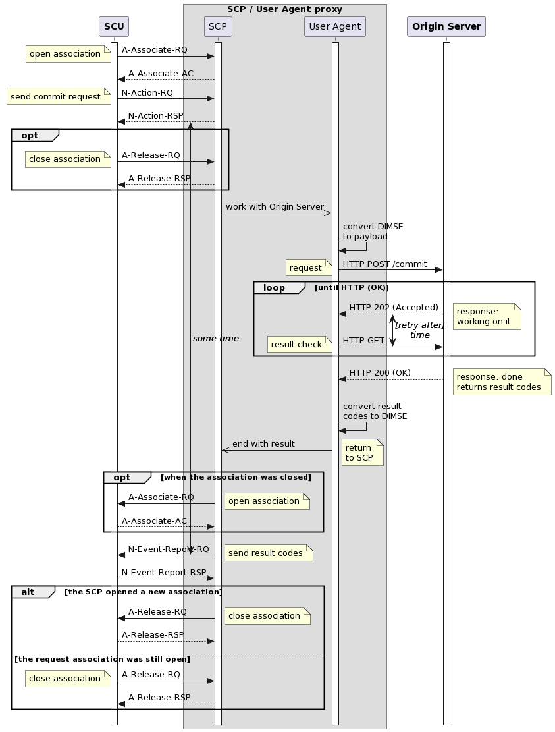
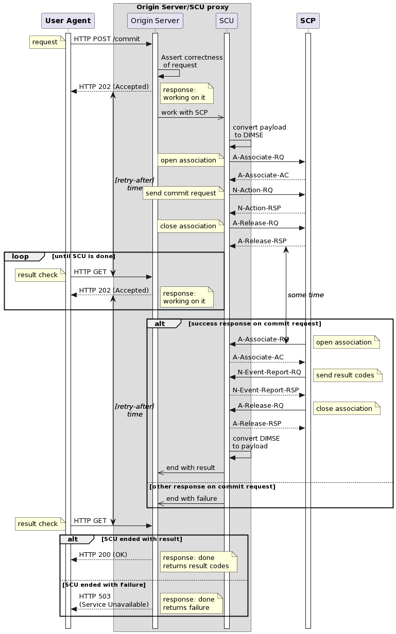
DIMSE to DICOMweb
DICOMweb to DIMSE

Slide 11
END OF PRESENTATION

