Slide 1
DICOM Educational Conference
Chennai, India
October 9-11, 2023
DICOM, Past, Present and Future
Herman Oosterwijk

Slide 2
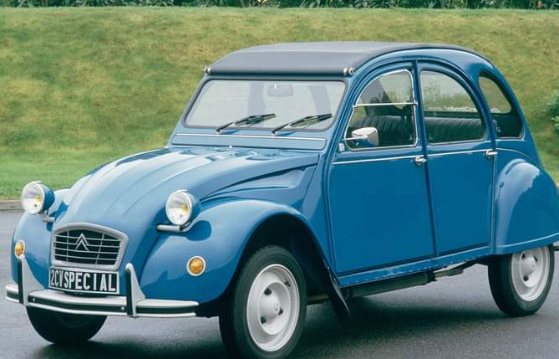

DICOM, Past, Present, and Future
Herman Oosterwijk, MSc, MBA
Background/disclaimers:
Involved with DICOM since 1980’s
Taught DICOM for 25+ yrs
Contributed to professional DICOM certification
Consultant for connectivity and business development
SIIM trainer and ambassador
Contact info: linkedin.com/in/hermanoosterwijk/
435cc, 24 hp

Slide 3

Agenda
Historical perspective
Where are we today
Where are we going
Discussion
This Photo by Unknown Author is licensed under CC BY-SA

Slide 4
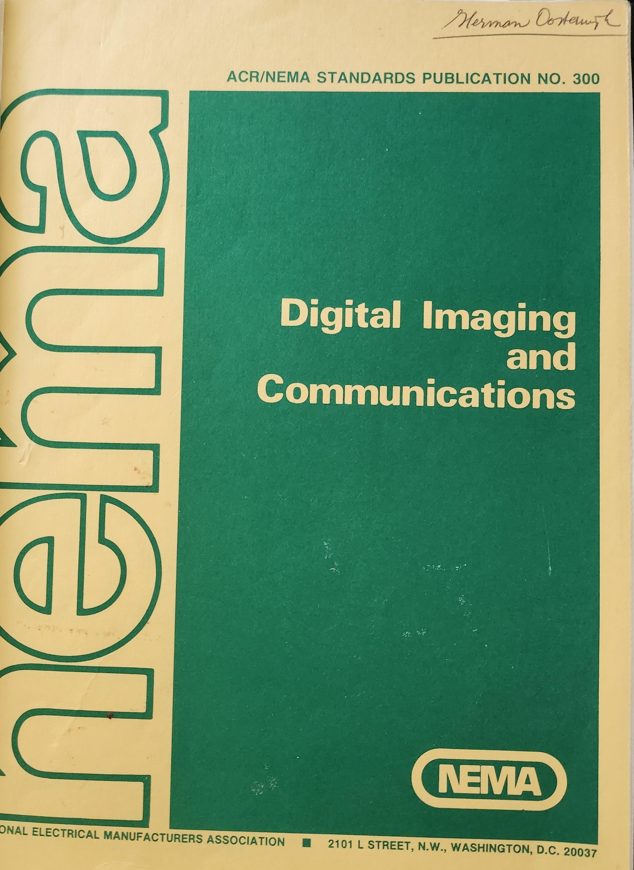
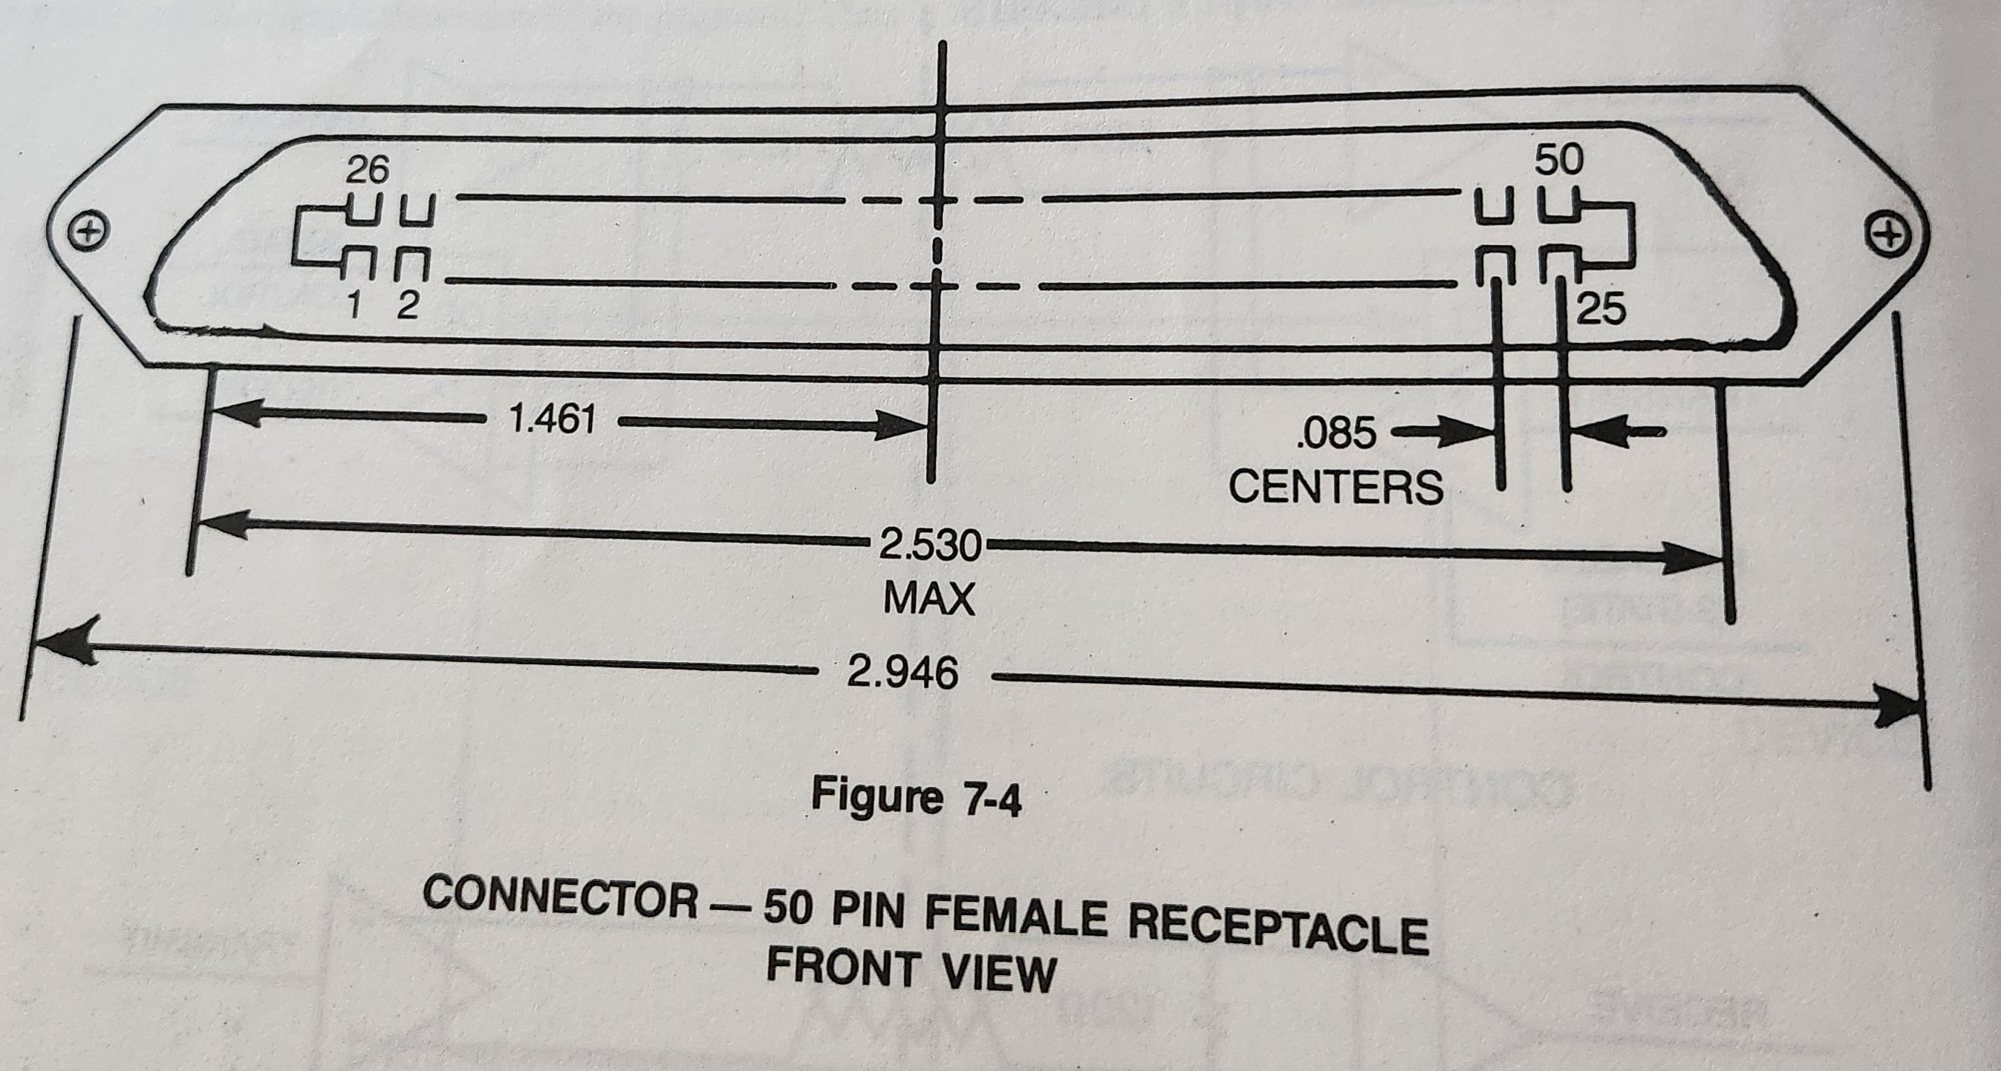
Before there was DICOM 3.0:
Custom built interfaces
Libraries of different vendor formats
ACR/NEMA 2.0: 50 pin connector 1988

Slide 5

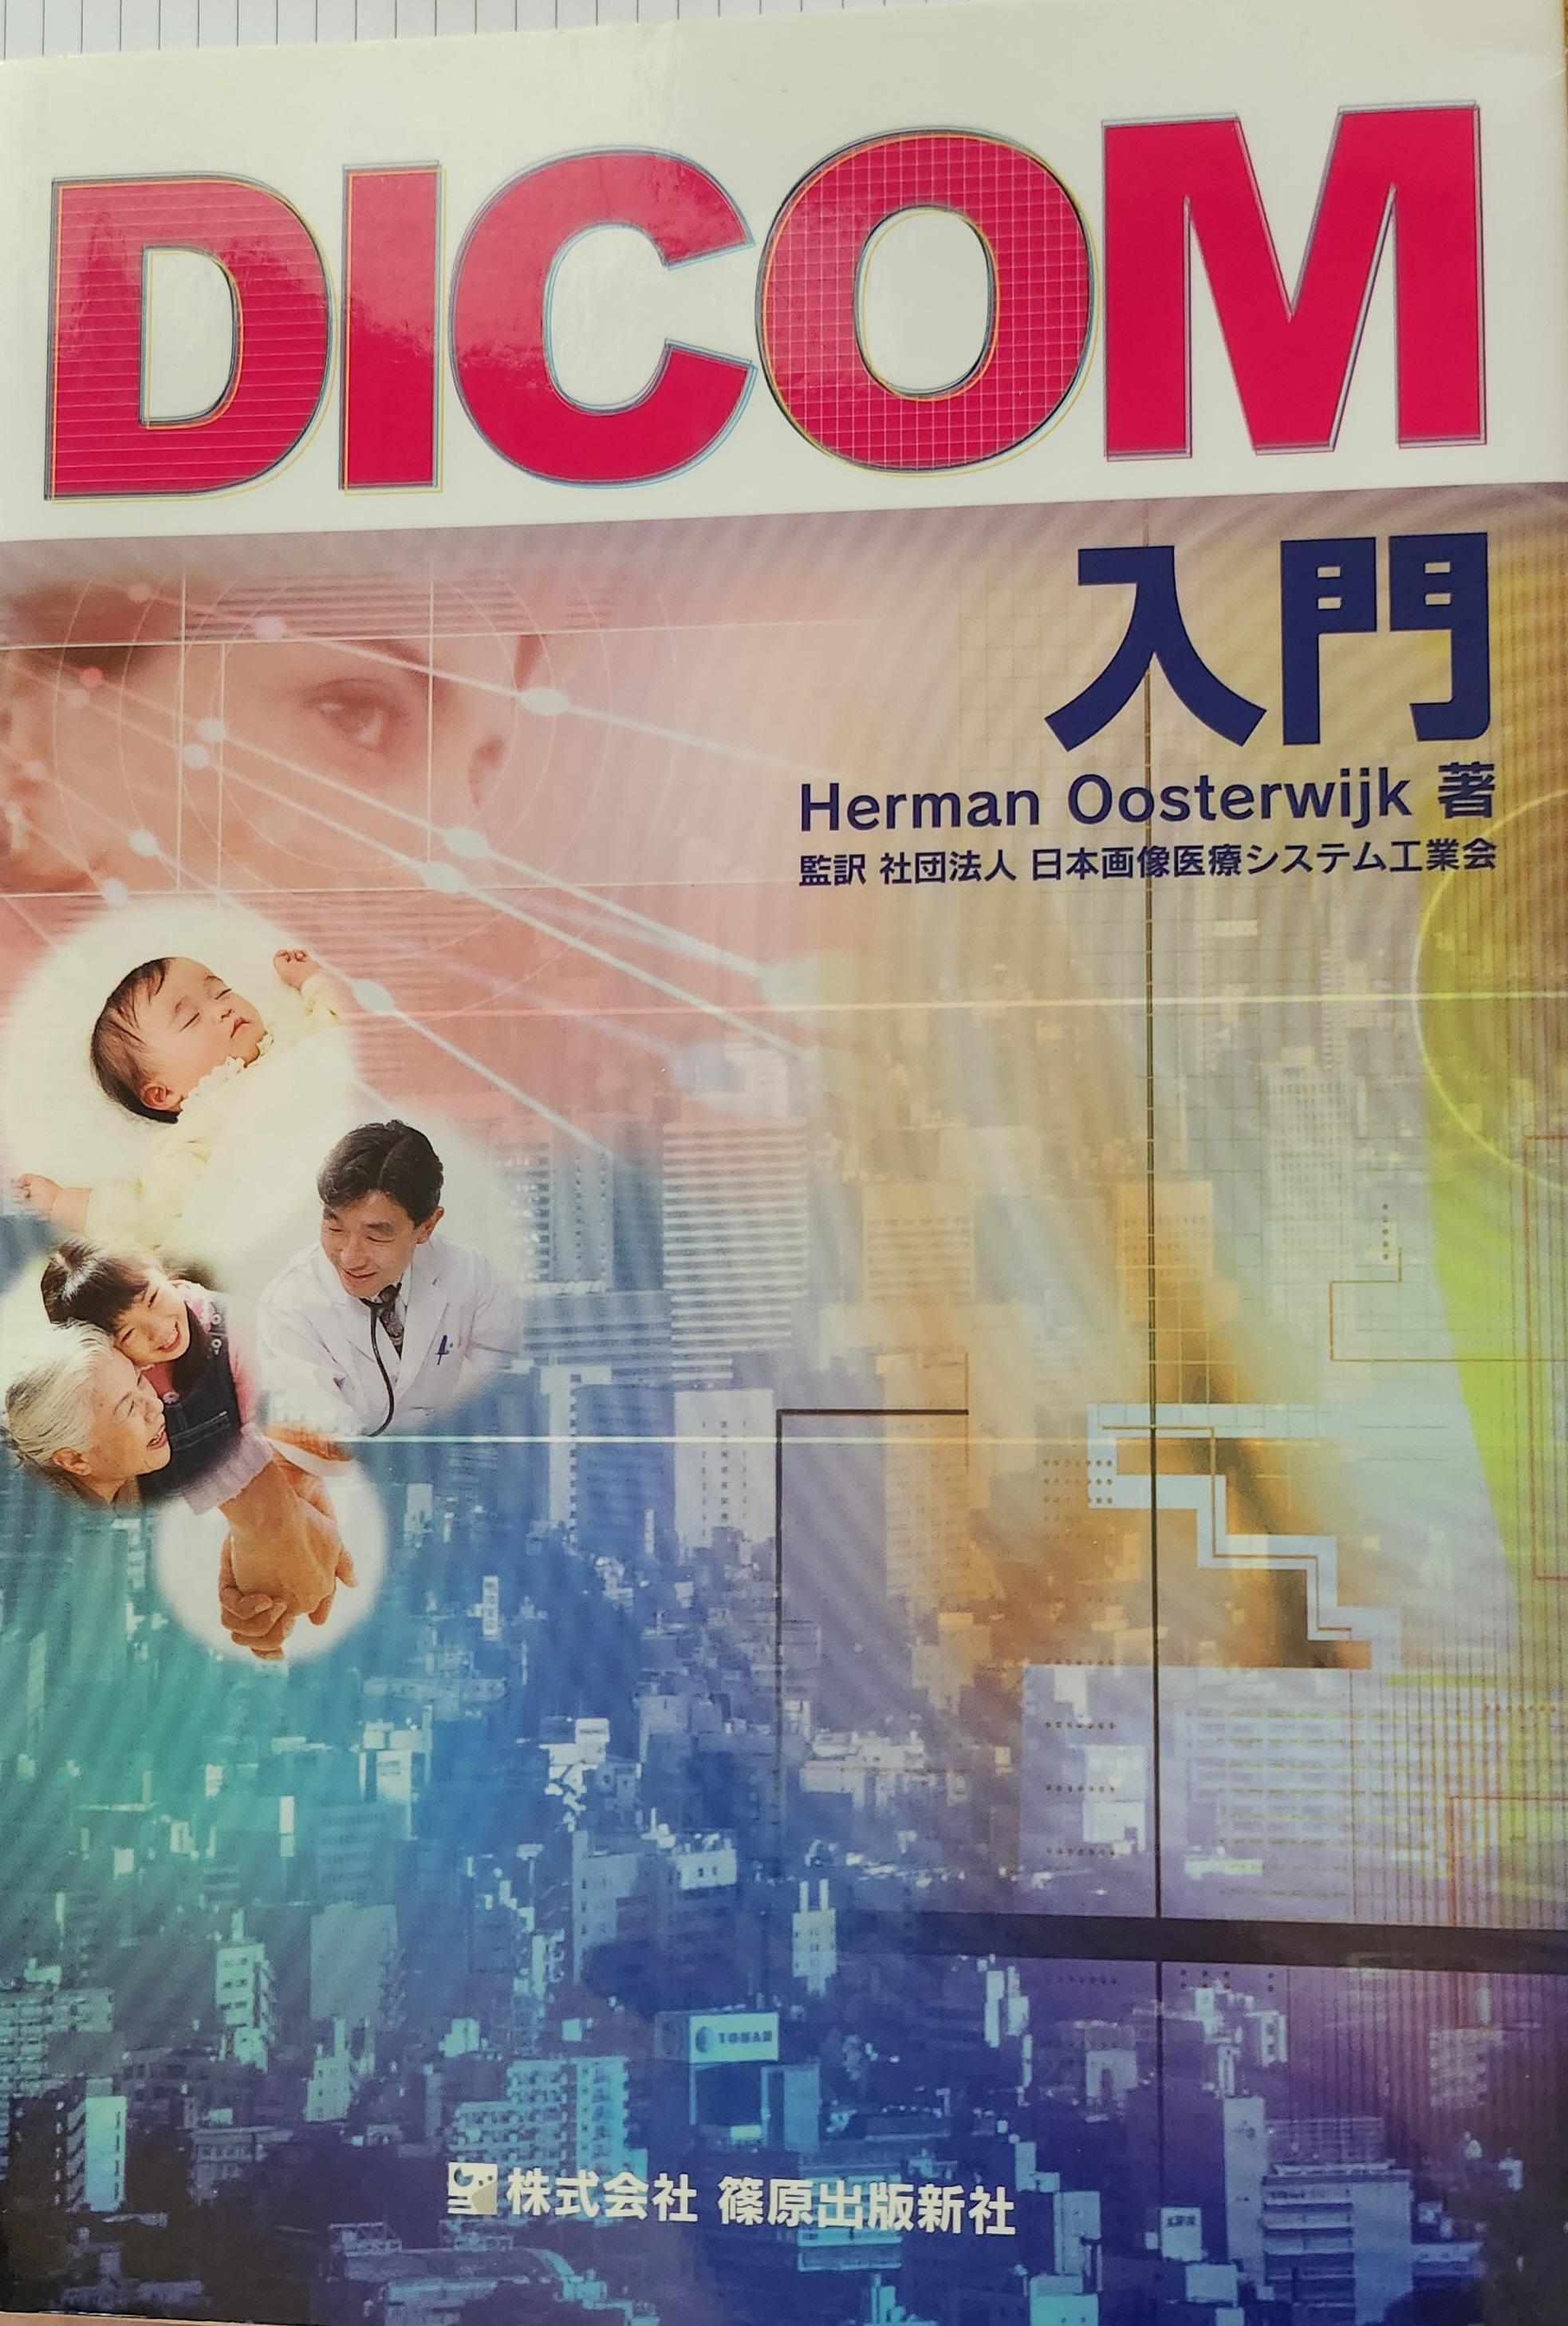
Historic perspective of DICOM
  Based on 1990’s technology:
    Fixed IP/port
    Tag structure (prior to XML/json)
    Quirky: even length records, implicit/explicit VR…
    DIMSE protocol based on OSI (negotiation)
    Somewhat of a barrier for novices
  But:
  Very robust
  Powerful data dictionary
  Initial worries about performance overhead are gone
  Plenty of toolkits
  Broad knowledge base
  Truly worldwide standard
To be discovered
1600cc, 50 hp

Slide 6

Evolution of DICOM:
  Image Communication
    Protocol DIMSE → DICOMWeb (uri, WS and RS)
    File formats/SOP Classes expanded and from traditional to Enhanced SOP Classes: stricter type 1,2, coding, multi frame, bulk xfer
  Workflow
    Study Component services retired, replaced with MWL (client-server)
    MPPS, STC, IA
  Image integration
    SR for measurements, KO: computer-to-computer communication
  Image Quality and Image Presentation
    GSDF
    Presentation State family: person-to-person communication
  Security
    Anonymization and Secure protocol
To be discovered

Slide 7
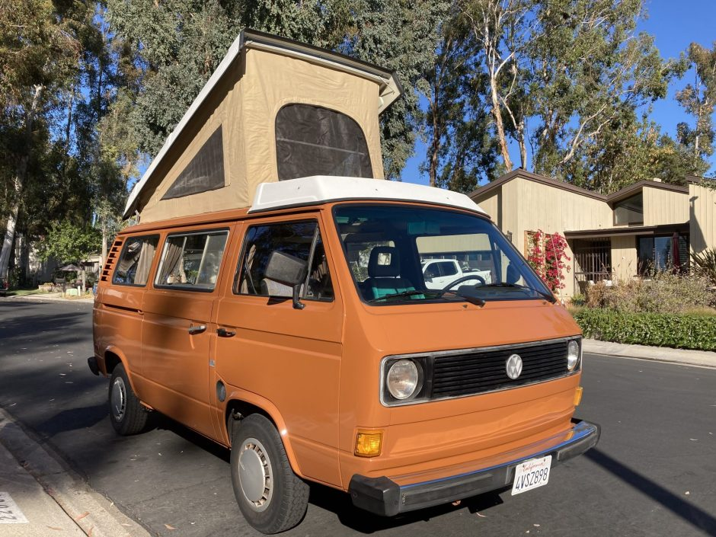
Past/present:
  Multiple specialties and domains came on board:
    Radiology, Cardiology, Oncology, Ophthalmology, Dentistry, Dermatology, Pathology, neurophysiological data
    Veterinary, DICONDE (NDT), DICOS (screening)
  Protocol aligned with FHIR (web services)
  AI is making an impact
To be discovered
2100 cc, 95 hp

Slide 8
Standard Deployment
Periphery
Part of MPPS, retired SOP Classes,
C_GET
STC push,
Big Endian
Many compression schemes
Periphery: unusable, retired
Enhanced SOP Classes
IAN
Digital pathology
MPPS and STC
Secure comm.
Dose mgt using SR
Contrast mgt
waveforms
To be discovered
Core
Deployed
Mature
DIMSE
Most traditional SOP Classes

Slide 9
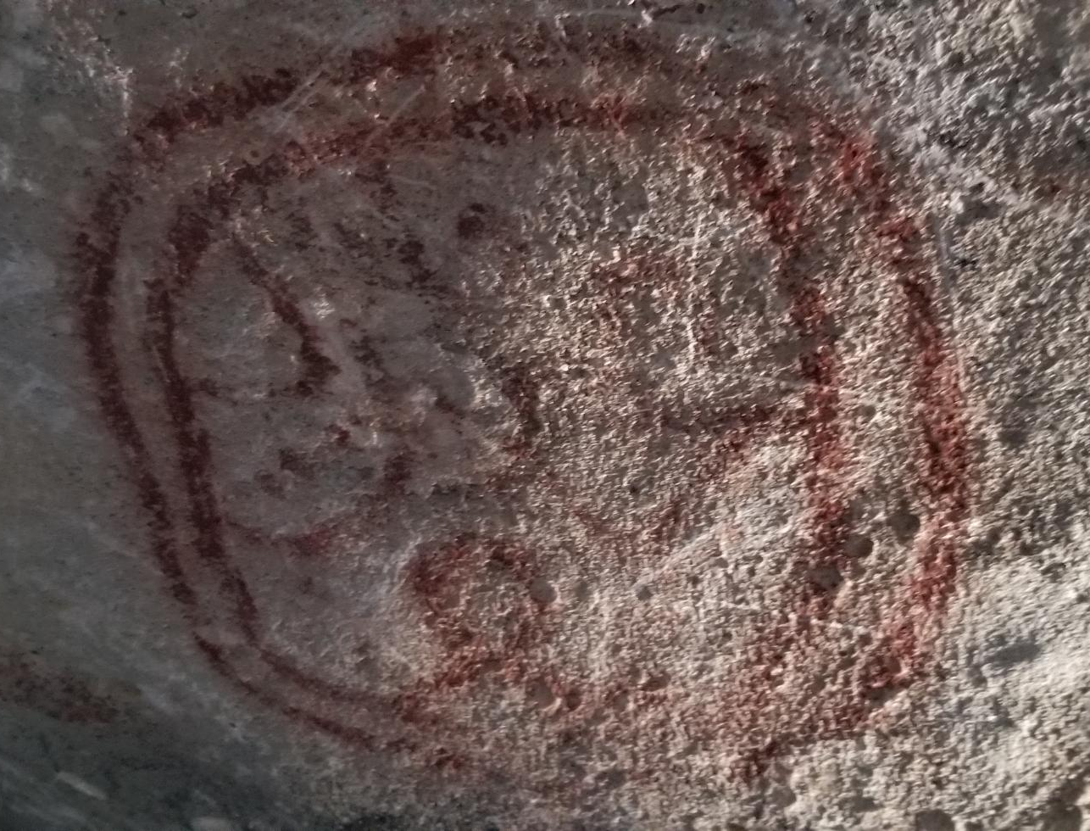
The choice on what standard or what part of the standard to use is often not clear:
Documents: a piece of written, printed, or electronic matter that provides information or evidence or that serves as an official record
  DICOM text SR
  HL7 ORU/MDM
  CDA
  Encapsulated CDA
  PDF
  Encapsulated PDF
  FHIR documents
  And then there is jpeg, tiff…..
  Random poll looking at CD’s: html, rtf, txt, pdf, DICOM SR’s, all often imported as SC’s (least common denominator, especially for VNAs)
To be discovered

Slide 10
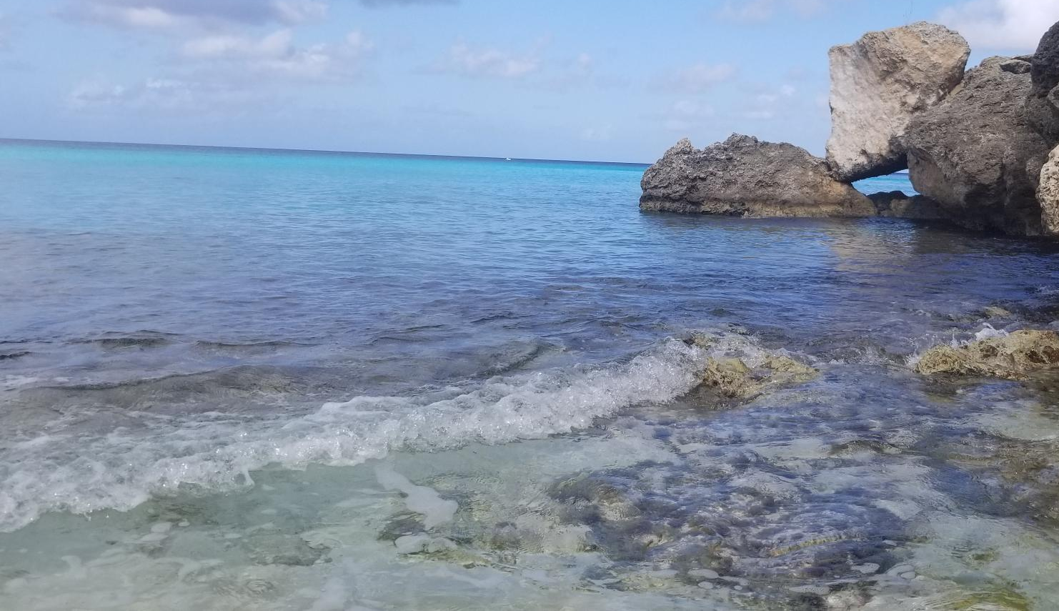
Point in case: EKG’s:
DICOM waveform
XML
PDF both native and encapsulated DICOM
HL7
To be discovered

Slide 11

What is driving DICOM:
REGUL
TECHN
IHE,
HL7,
Coding,
FHIR (maturity is issue)
To be discovered
VET
NDT
SEC
STDS
DOMAINS
WEB Svcs
Cloud, AI
TECHN
SPEC
RAD, OP
Path, RT
…

Slide 12
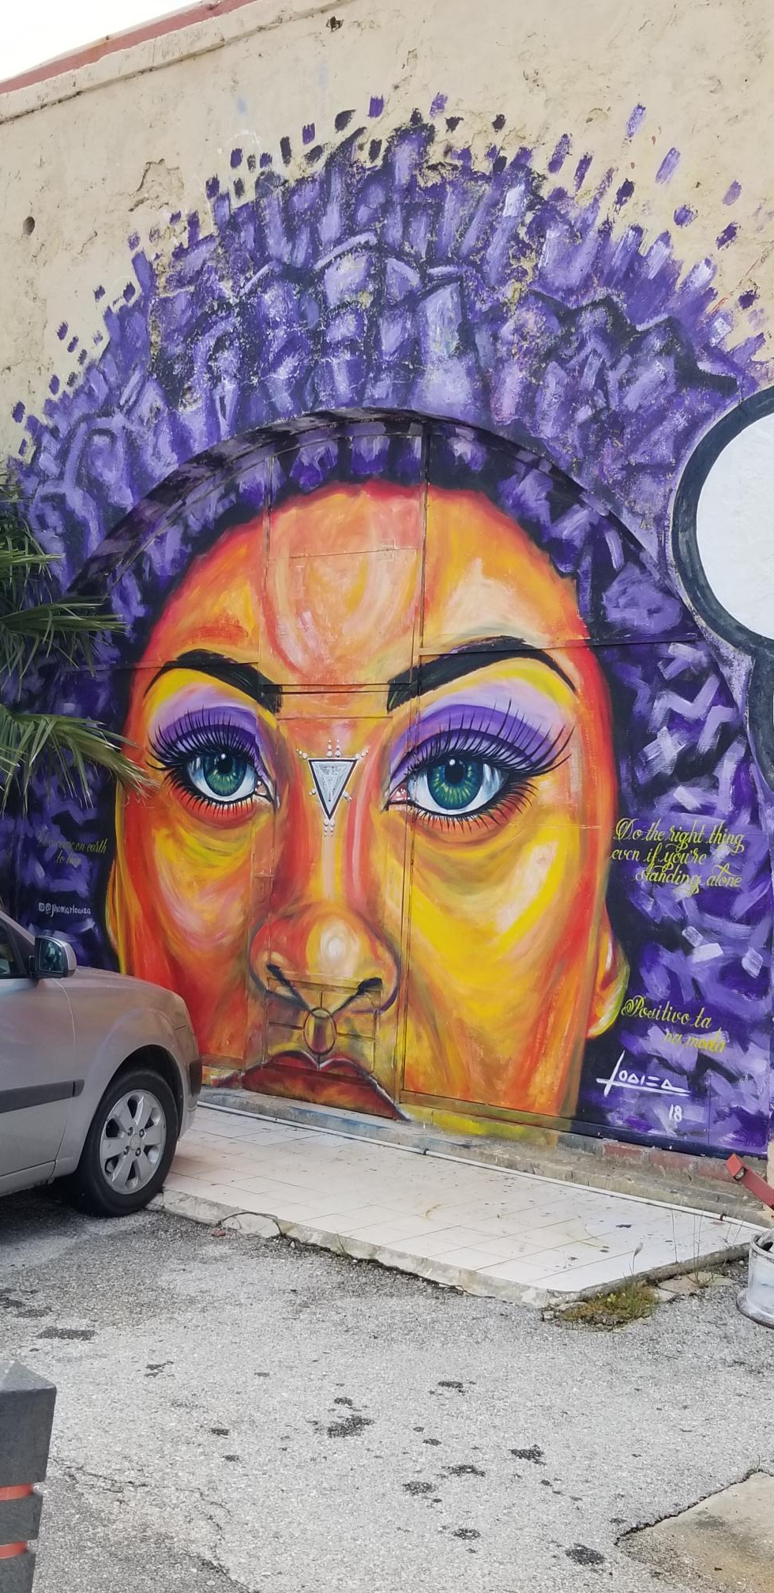
Future of DICOM?
Extrapolate current trends:
  Patient-centric access (PACS, RIS, EMR driven)
  Patient portals, integration of multiple portals: “Amazon” concept
  Enterprise imaging
    Inter- (new specialties/VNA)
    Extra- (other institutions)
  AI
  Web services, cloud vs on-prem
  POC devices: imaging will become ubiquitous
Security issues – ransomware, zero trust
New, disruptive technologies:
  VR (replace 3-D print?)
To be discovered

Slide 13
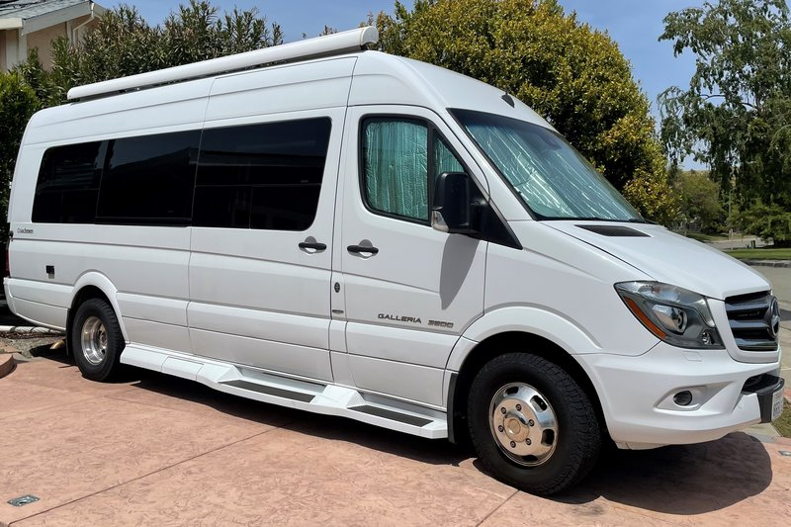
Case in point: AI
Presentation State (for people)
SEG’s
SR (for computers)
Notifications: HL7, DICOM, FHIR
PDF, stand alone or encapsulated
Unfortunately, still lots of SC’s and API’s
IHE is a great help (AIR, AIW, white paper)
To be discovered
3.0L V6, 188 hp

Slide 14
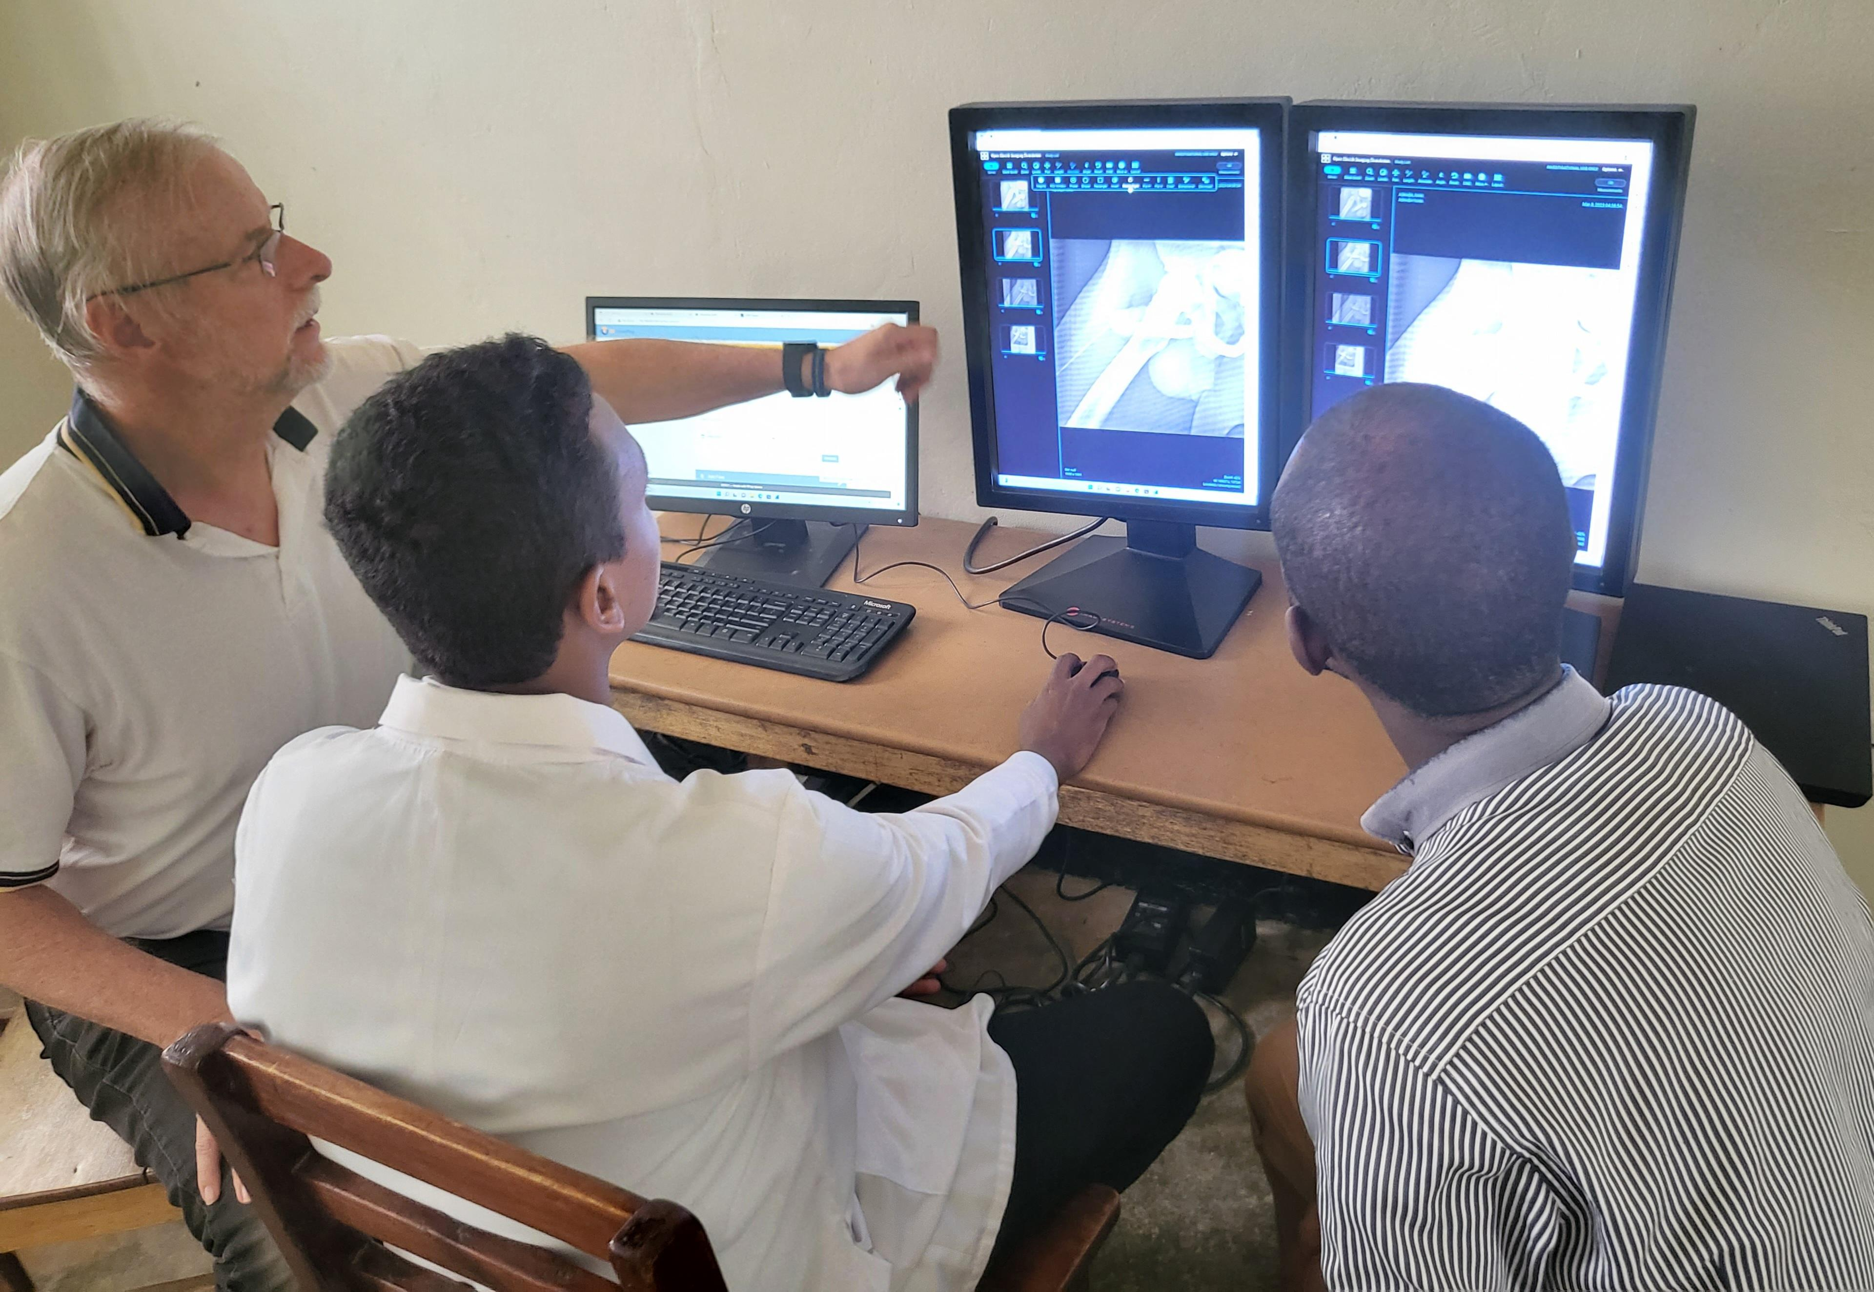
Conclusion:
DICOM has survived 30 years of deployment
It has evolved to support new modalities, specialties, domains
There are multiple billions of images in DICOM format, however, not all are evenly “clean” and usable for AI training data sets and easily exchangeable (lacking coding)
Its information model and data dictionary have proven to be solid
There are still hold-outs: DICOM workflow, Pathology, Dentistry, Ophthalmology, and others who are not quite on board
LMIC countries have an opportunity to jump-start technology but lack training and government involvement
To be discovered

Slide 15
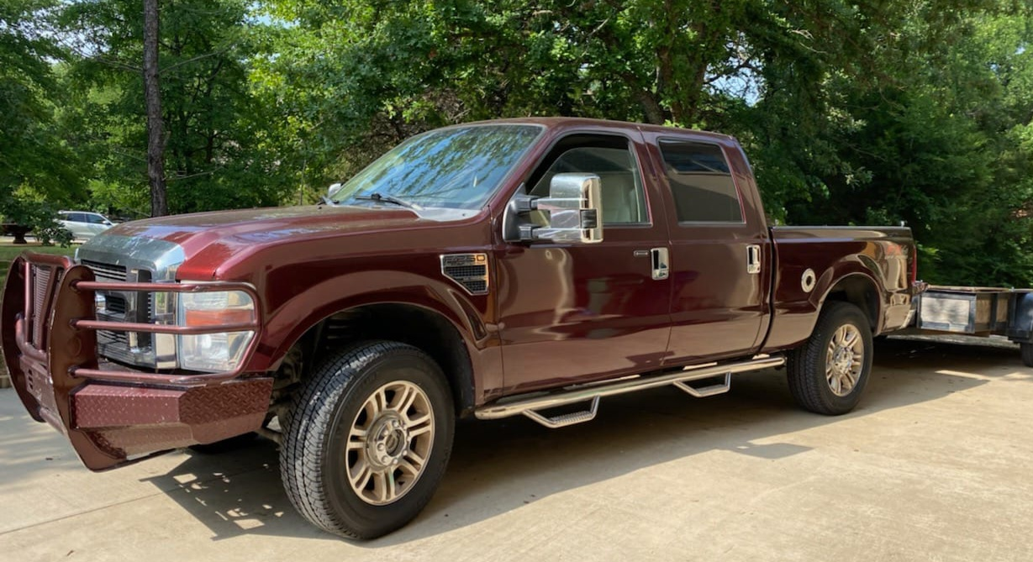
Discussion/ Q and A
What do you think will be the next new technology DICOM should tackle?
Will DICOM survive another 30 years?
What is the most underutilized part of DICOM?
If you would start from the ground up with a new standard, what would you change?
Suggestions for LMIC countries deployment?
To be discovered
6.2L V8, 385 hp

