Slide 1
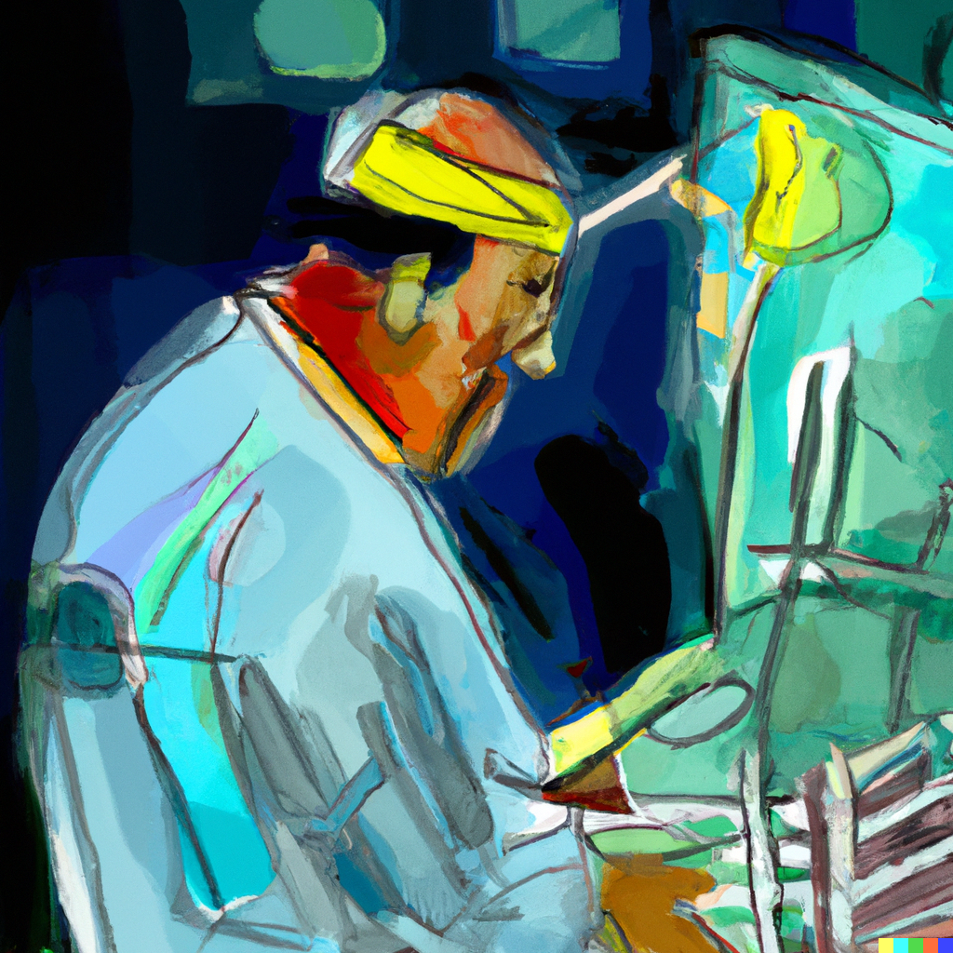
Art or SCIENCE
The modern SURGEON

Slide 2
Where is it?

Slide 3
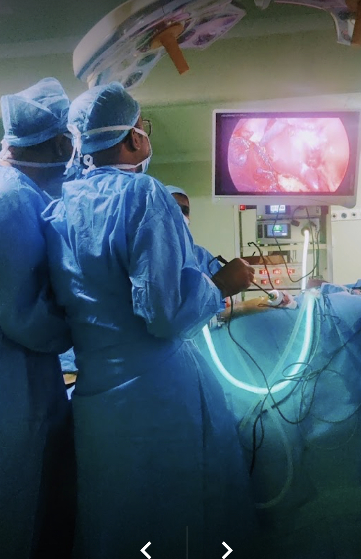
Vinayak S REngan
Founder, Curium.life
Senior Resident, Dept of Paediatric Surgery, SMS Medical College, Jaipur
Adjunct Faculty, Medical imaging and Reconstruction Lab, IIT Madras

Slide 4
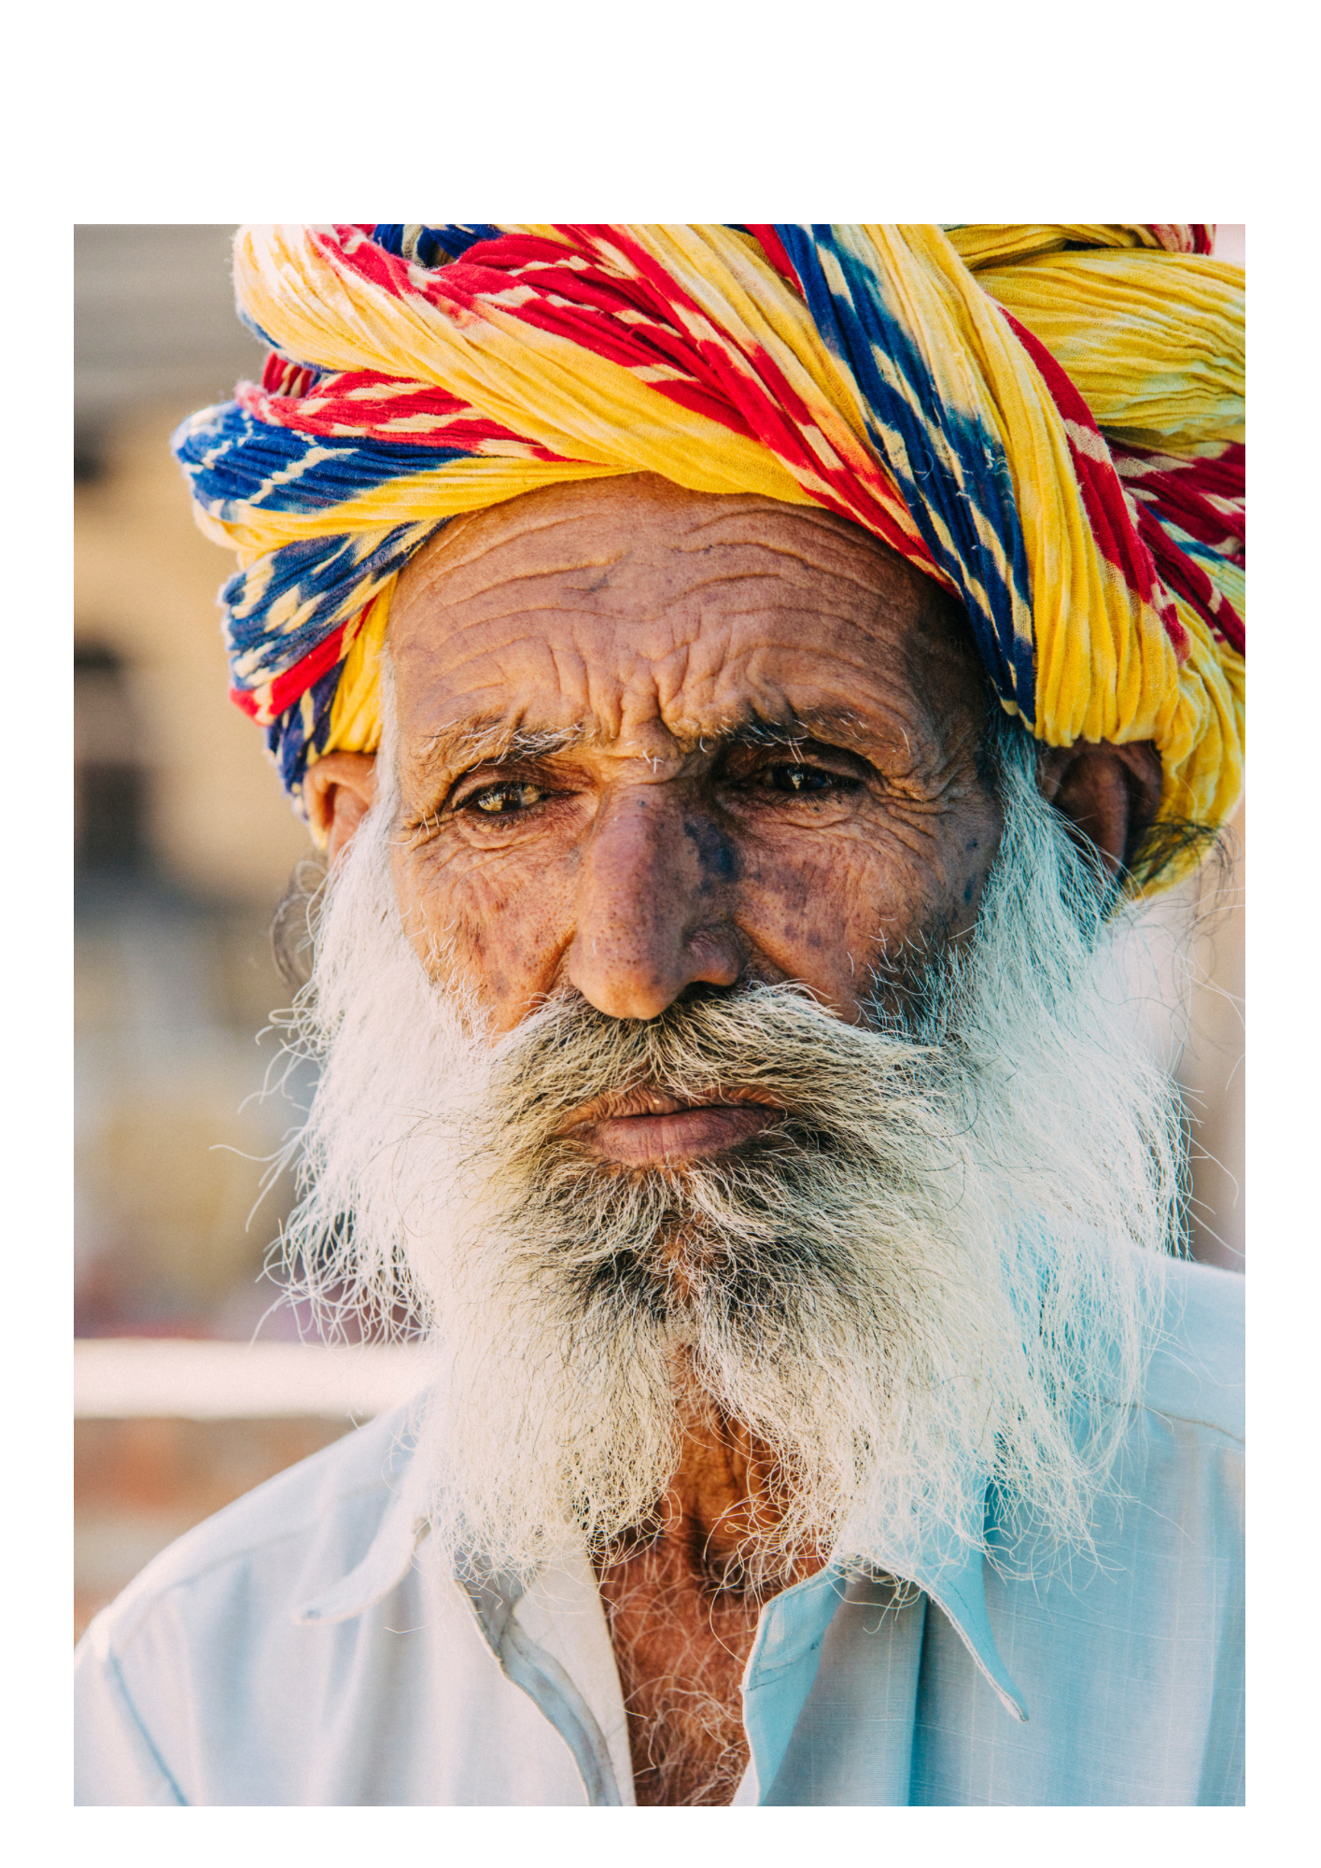
WhY SARCOPENIA?
Loss of Muscle Mass & Function
An index of fraility
Multiple modalities including DEXA scans and radiographic imaging
CT - Modality of choice

Slide 5
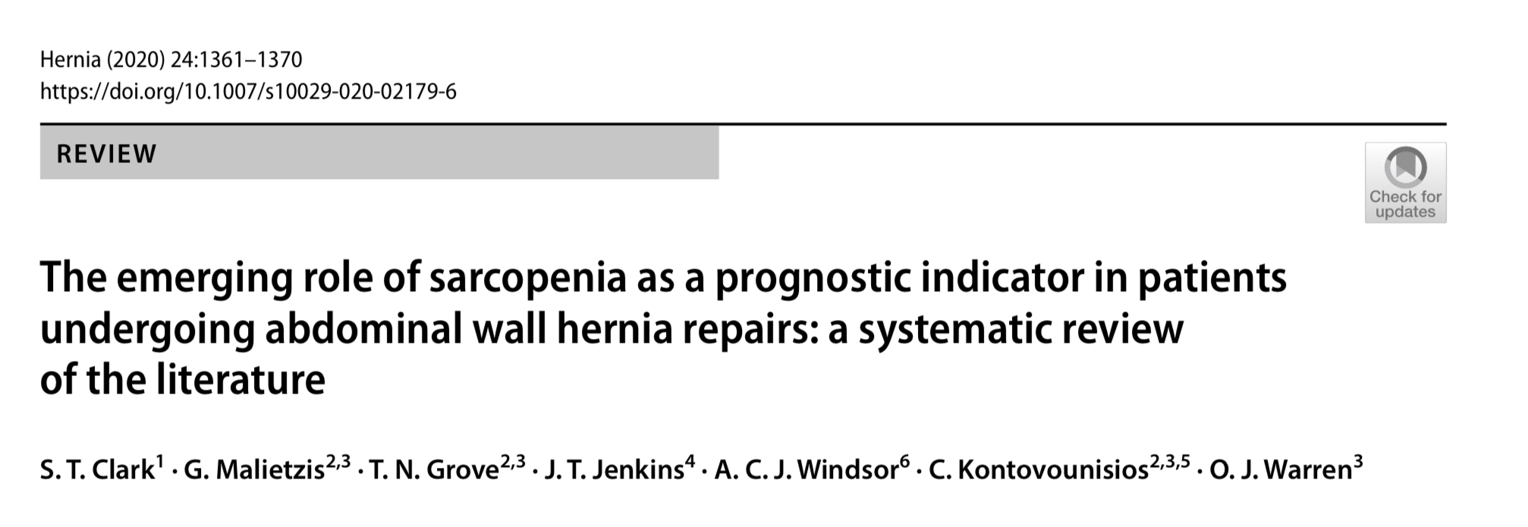
Sarcopenia

Slide 6
Pancreas
Breast
Lung
Liver
Colorectal
STOMACH
Esophagus

Slide 7
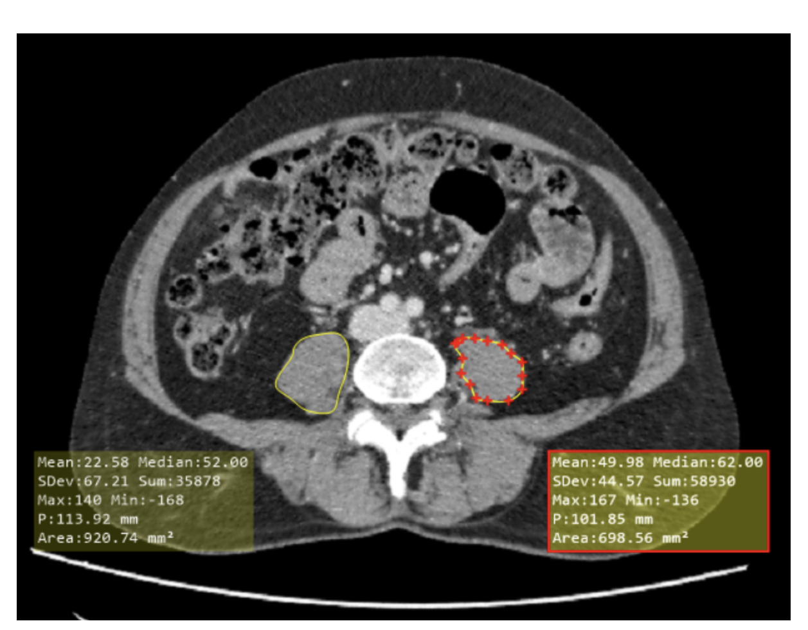

Slide 8
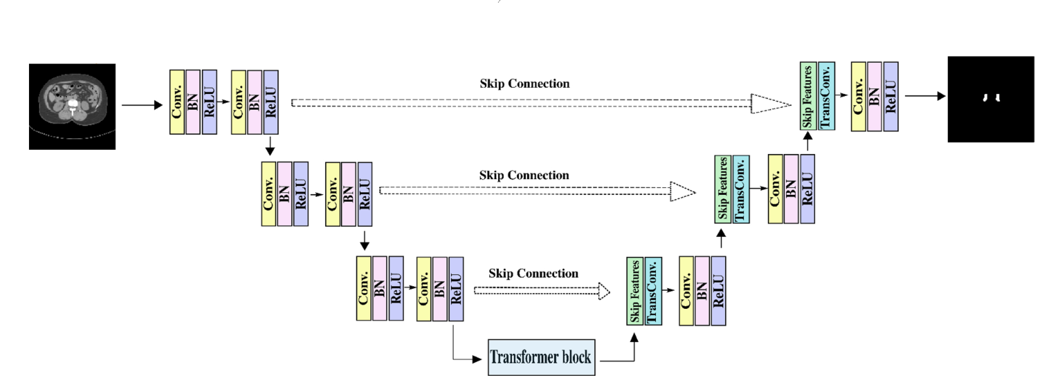

Slide 9
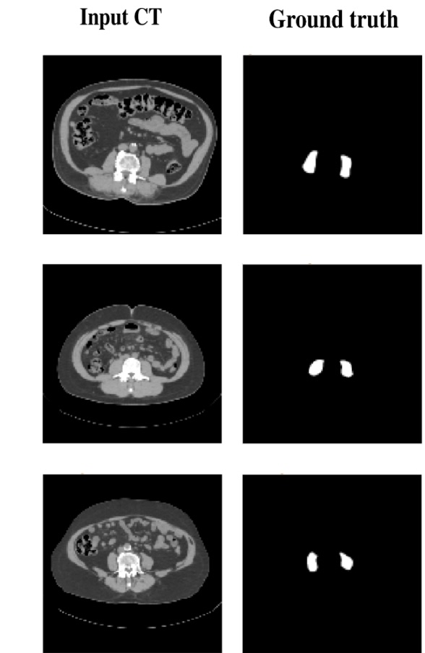

Slide 11
WHY
DICOM??

Slide 12
Standardisation
DATA SECURITY
INTEROPERABILITY
METADATA
ROI selection
CONSISTENCY IN HU
LONGITUDINAL TRACKING

Slide 13
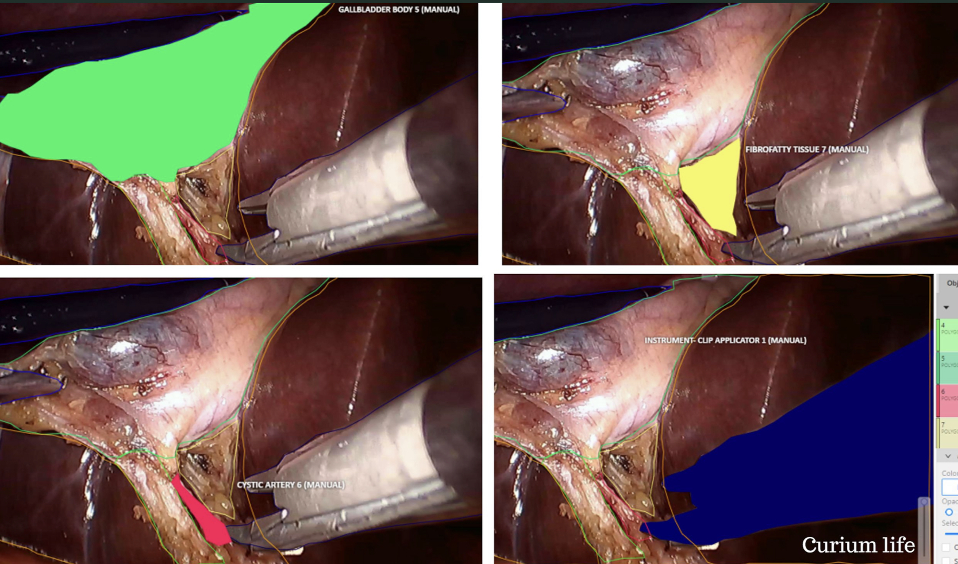

Slide 14
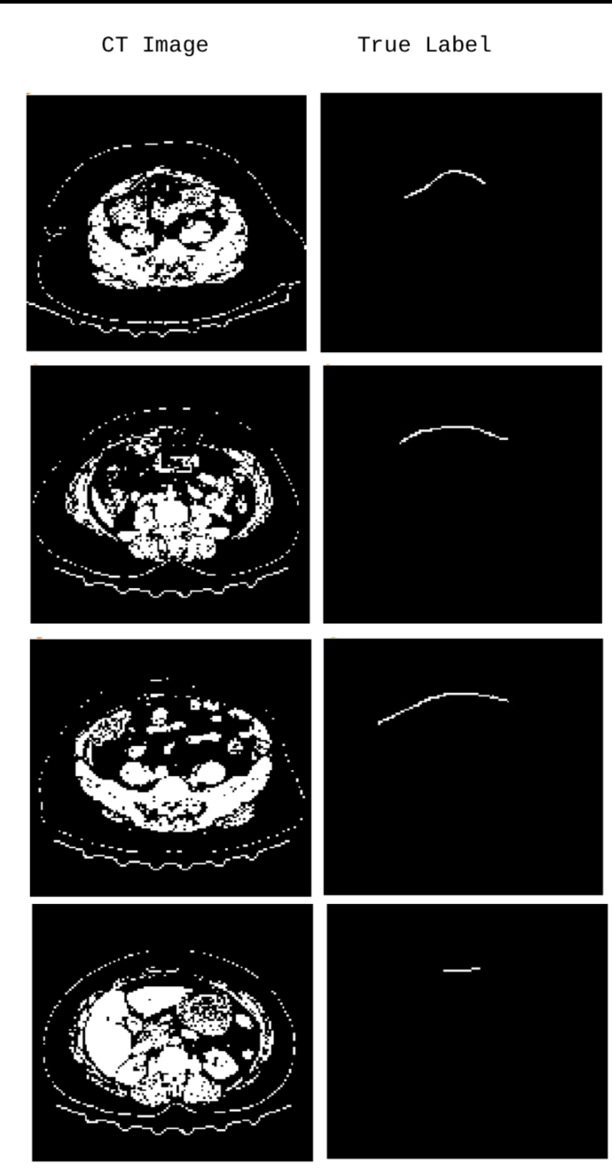
Hernia
MESH DETECTION
Mesh is supposed to integrate
Pilot study shows mesh is difficult to identify

Slide 15
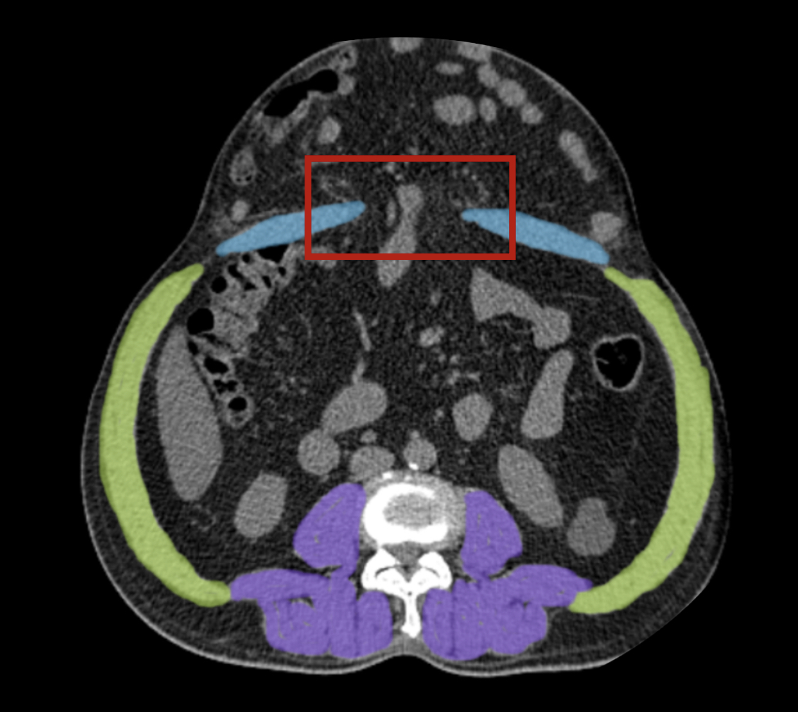
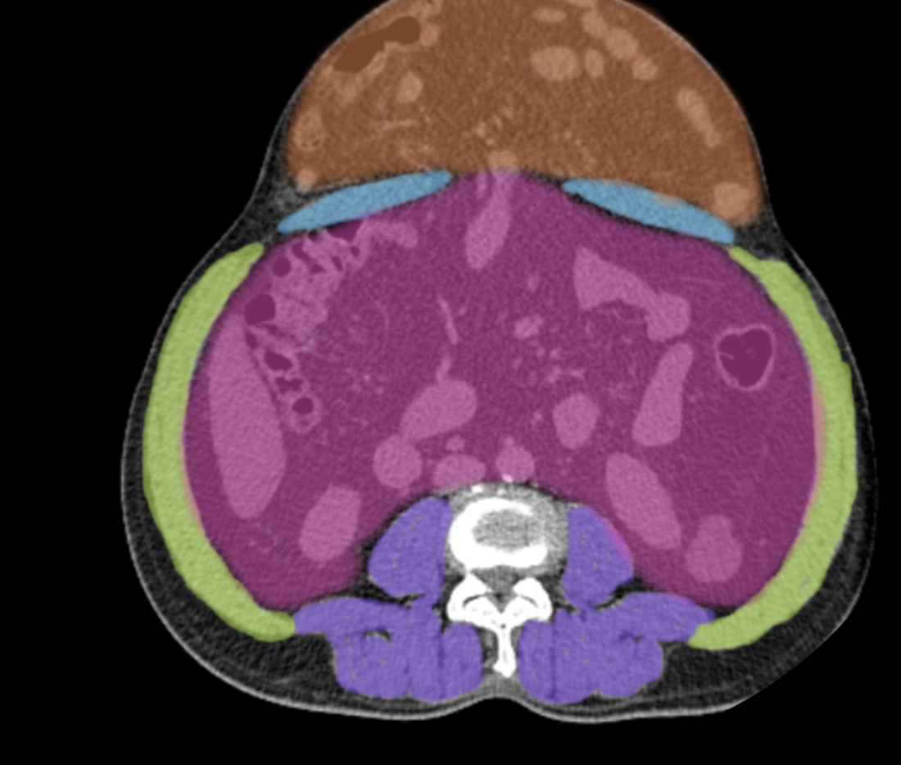
Hernia
Volumetry
Identification of hernia defect and characterisation
Hernia sac volume estimation
Abdominal cavity volume
Tanaka Index

Slide 16
Ureteric ORIFICE
Pediatric Uretric Orifice identification using computer vision and deep learning

Slide 17
“If I had asked people what they wanted, they would have said faster horses.”
–Henry Ford
vinayak@curium.life
+91 99412 75775

