Slide 1
DICOM Educational Conference
Chennai, India
October 9-11, 2023

Slide 2


Introduction
Bijesh Balachandran
Supriya Seemanapalli
Lead architect at Siemens Healthineers Pvt Ltd. He has done masters in Software Systems from BITS Pilani and has over 20 years of software development experience. Bijesh currently specializes on Cloud Computing in healthcare domain.
b.bijesh@siemens-healthineers.com
With a strong academic grounding in Computer Science and close to 11 years in healthcare product management. Supriya is a product manager passionate about healthcare and digital innovation, dedicated to driving positive change. She specializes in creating and implementing transformative solutions that improve patient care, provider experiences, and healthcare accessibility.
supriya.seemanapalli@siemens-healthineers.com

Slide 3
Overview
Is Radiation dose significant In radiology department
Challenges of building a Dose Management System
THE Reality in the field
Data variability
Solution explained
THE Dose registry
Applicability to other domains

Slide 4
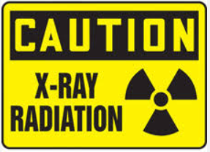

Why Radiation dose is essential to manage?
Adhering to ALARA principles
Reporting to regulatory authorities
Optimizing the Image Quality
Patient Safety
Cumulative dose monitoring
Quality assurance

Slide 5
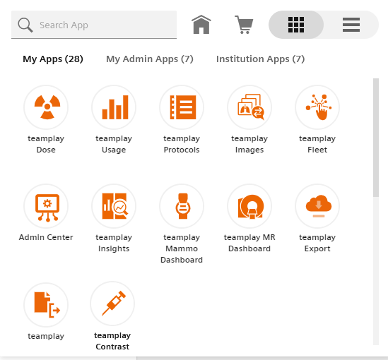
Challenges of building a Dose Management System
Data Integration and Compatibility
Data Accuracy and Quality
Dose Optimization
Regulatory Compliance
Interoperability and Vendor Neutrality
Scalability and Performance

Slide 6
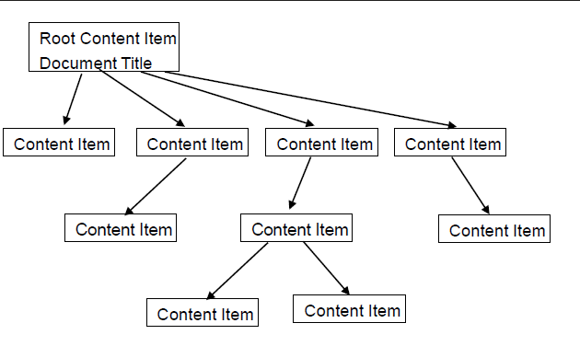
What is supported in DICOM ?
  Radiation Dose Structured Report (RDSR):
    DICOM Structure Report (SR): the standard to exchange structured data produced in the course of image acquisition or post-processing
    RDSR:
      Evidence Document
      Primarily contain radiation dose measurements
      Used for dose control and QC purposes, summary dose information may be extracted and included in final imaging reports (e.g. HL7 CDA)
      Focus is on computer processable document contents
Human-readable Dose Screens
  Not generally machine readable
Notes:
Radiopharmaceutical Radiation Dose Structured Report (R-RDSR)
Supplement 191: Patient Radiation Dose Structured Report (P-RDSR): 1.2.840.10008.5.1.4.1.1.88.73 Adds support for creating a structured report to contain the information concerning the recording of the estimated radiation dose to a patient.
This includes radiation dose from CT, projection X-Ray, and radiopharmaceutical administration (diagnostic and therapeutic). Occupational radiation exposures and dose from external beam therapy, ion beam therapy, or brachytherapy is out of scope.
This SR dose object allows the data flow and data management of patient estimated radiation dose reports to be disentangled from the data flow and data management of images.

Slide 7

Reality in the field!
New scanners support RDSR
Many of the old scanners do not support RDSR
Some old PACS do not support new object
Old images in the archive might not have RDSR
Old scanners provide human readable dose screens
Some systems allow configuration which multiplies the variability

Slide 8
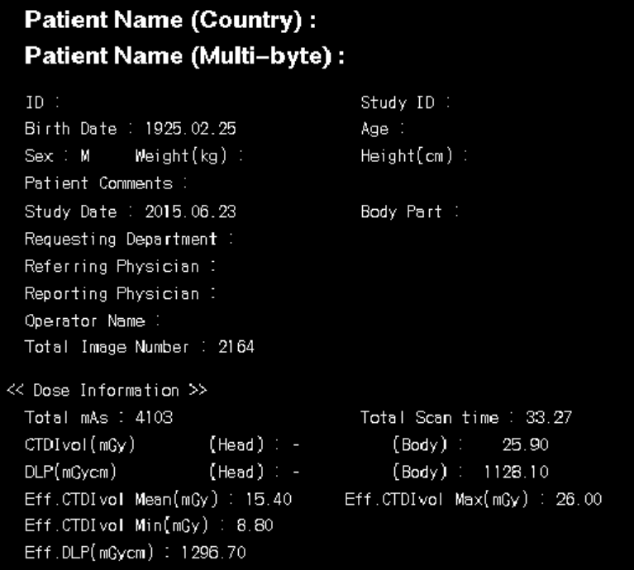
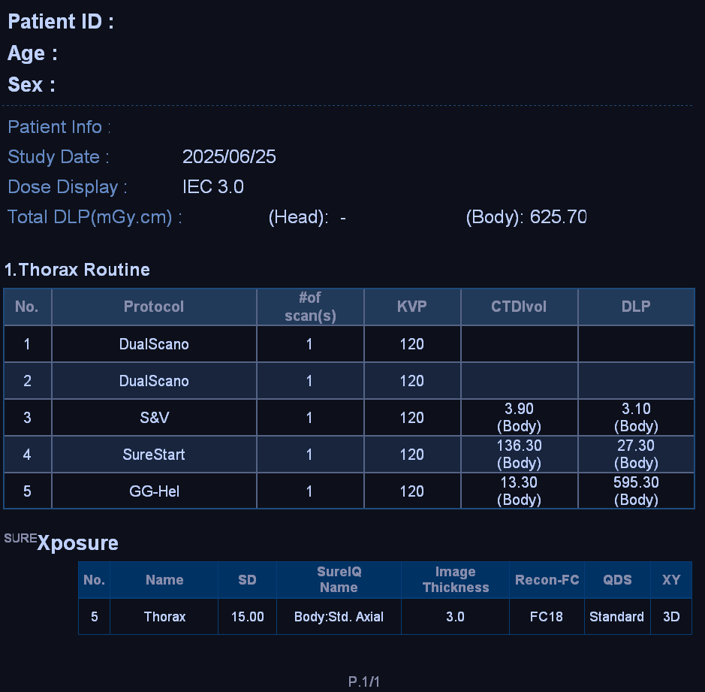
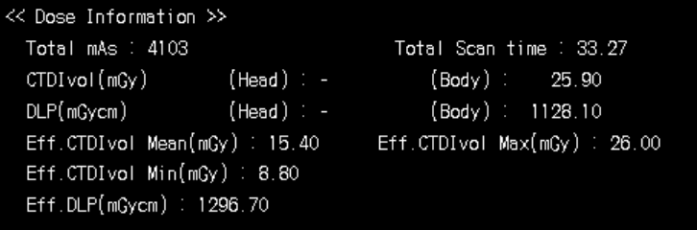
Data variability of Human-readable Dose Screens

Slide 9
How to enable the legacy systems?
Retrieve dose-screens from studies and Extract information from the human-readable dose screens
Prefer private tags over dose screens
Steps involved
  OCR
  Parsing extracted text
  Pattern matching
  Generate RDSR

Slide 10
How to enable the legacy systems? … (contd)
Challenges:
  Each vendor uses different structure and font
  Pre-processing may be needed to extract sufficient information
  Data could be in pixel directly or in overlays (some vendors might have more details in private tags)
  Could span over multiple pages

Slide 11
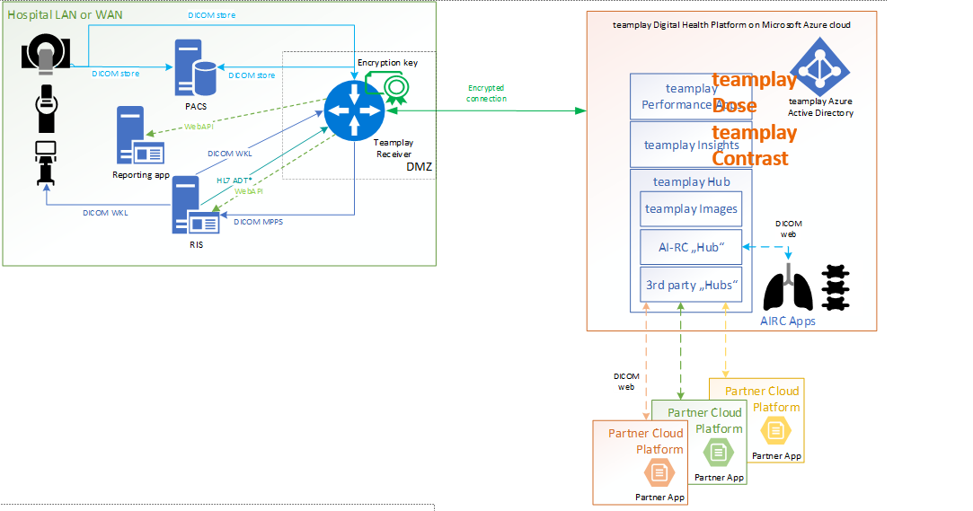
How to scale the solution
As different institution (or different locations of the same institution) might have different scanners
Software update to existing scanners could introduce new dose-screens
Different languages
Protected health information removal
A continuous monitoring and validation system needed that:
  Identifies new scanners from every tenant individually
  For every new scanner, generate the RDSR from a sample study
  Validate the generated RDSR
  Whitelist / blacklist the scanner based on the validation results
  Add support for the new scanner / variant
  Deploy the update, reset the scanner status and repeat the process

Slide 12
Where does India stand on this?
The primary regulatory body responsible for overseeing radiation safety and dose management in medical facilities in India, is the Atomic Energy Regulatory Board (AERB)
JCI is commonly associated with accrediting and certifying healthcare facilities for overall quality and patient safety standards.
Yet many institutions / radiology clinics/ departments are struggling to keep-up and submit the needed documentation on radiation dose.

Slide 13

Dose Registry
Standardize
Improving patient safety & Quality assurance
Benchmark at various levels
  By modality like CT, Mammography
  Geographic regions like country, city
  Different age groups
  Institution types
  Internal benchmark
  Scan settings
Seamless reporting to respective national registries

Slide 14
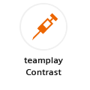
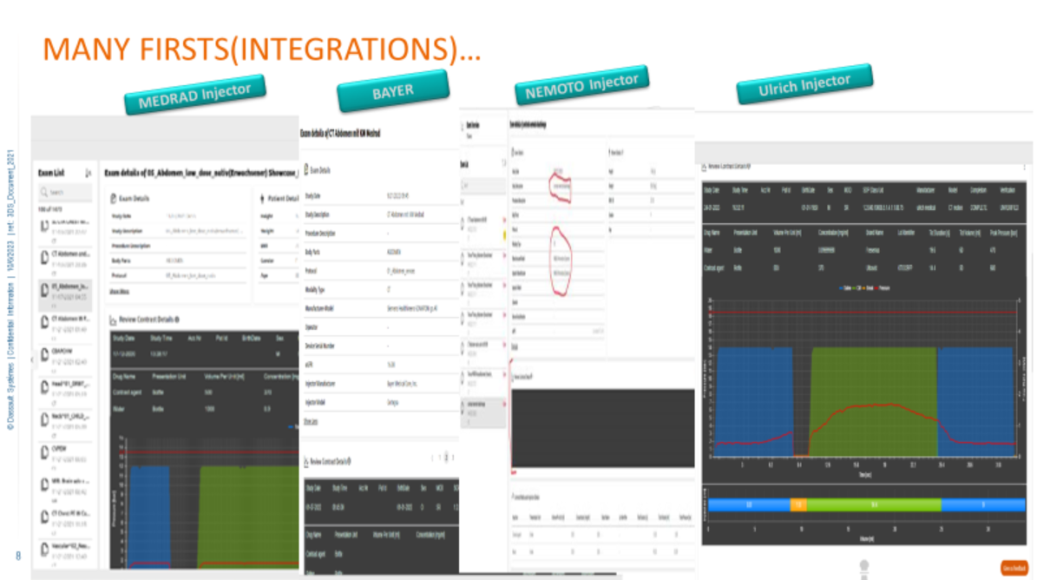
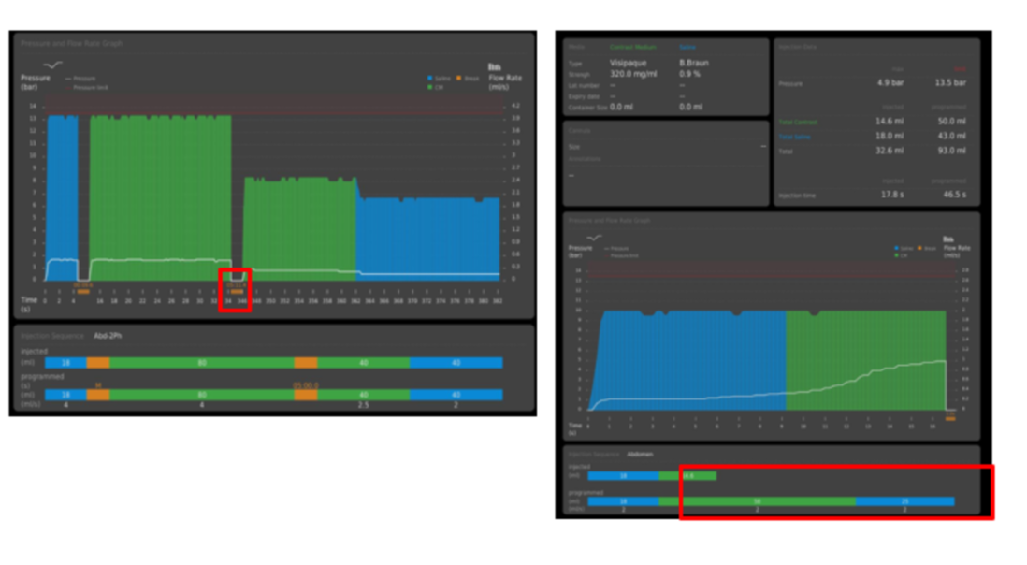
Applicability of the solution to other fields
Data is captured in a similar way for contras media management for examinations that depend on contras enhancements.
Similar solution is applicable for the contrast media management solution and support
  Planned Imaging Agent Administration SR Storage (1.2.840.10008.5.​1.​4.​1.​1.​88.​74)
  Performed Imaging Agent Administration SR Storage (1.2.840.10008.5.​1.​4.​1.​1.​88.​75)

