Slide 1
DICOM Educational Conference
Chennai, India
October 9-11, 2023

Slide 2






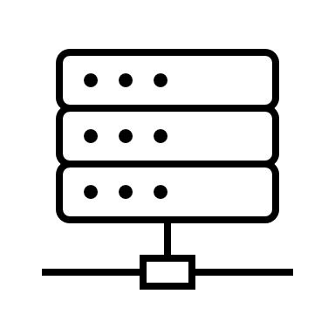







Attack Vectors involved in a Hospital
CRITICAL
HIGH
MEDIUM
LOW
R&D Department
Image transfer
Image store/pull
On prem Central PACS
Hospital
Hospital/lab
Image store/pull
Query/retrieve
HL7
Worklist
Image pull
HIS Client
DICOM
DICOM
Cloud Solution
Viewer
RIS
Modality
Gateway
PACS
Web Server
Log Archive
DICOM for rendering
Query/retrieve
AI rendered DICOM
Image store
FHIR
Radiologist Workstation
CAD
Archive
Non-Imaging Devices

Slide 3
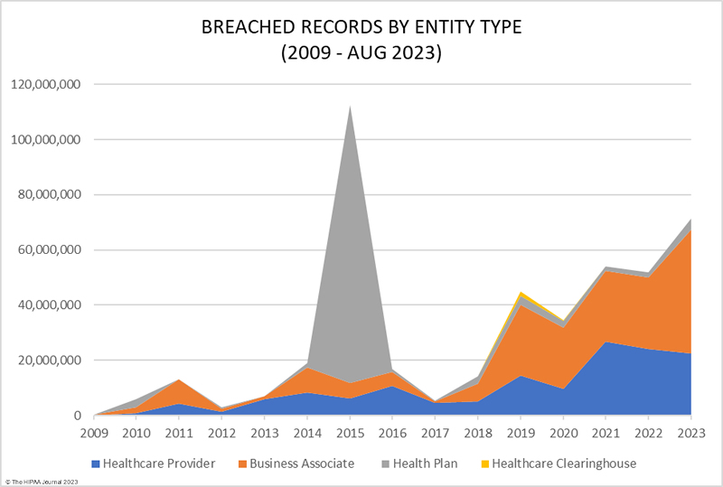
Data Breach Trend Analysis

Slide 4




Zero Trust Architecture
Who are you?
Identity-centric approach to identify the users and devices accessing the DICOM data are not be trusted by default and access controls for validation.
Micro-Segmentation to isolate DICOM systems from other network segments.
MFA, continuous session monitoring and device posture assessment to restrict the non-compliant devices and sessions upon violations.
Vulnerability assessments, security audits and penetration testing to identify and address the weaknesses of the ongoing compliancy of zero trust architecture.

Slide 5
Emerging Technologies in Trend
Cloud
Telemedicine
IoT
AI & ML
Blockchain
Quantum computer

Slide 6
Security in Cloud Solutions
RBAC, risk-based authentication and session management for preventing unauthorized access.
Encrypted data at rest to be protected with automated key rotation, vault based key management system and key access to only authorized personnel.
All the communication channels including APIs and web interfaces to be encrypted with perfect forward secrecy.
Regular monitoring of access logs with the capabilities of SIEM and incident response plan.
Classify DICOM data based on the sensitivity and implement data loss prevention (DLP) measures.
Utilizing data integrity checks, digital signatures, and checksums to detect and prevent tampering of DICOM images during storage and transmission.

Slide 7







Secure Image Sharing and Telemedicine
Services
Establishing the VPN connection between the DICOM devices and the systems for the dispersed facilities.
Encryption at the application layer of the DICOM stack.
Mutual Transport Layer Security (mTLS) for authenticating both client and server.
Secure storage of X.509 certificates for each DICOM device and regular updates to maintain security.
VPN Tunnel
VPN gateway
Users
Client
Server

Slide 8
IoT and Medical Device Security
Regular update of device firmware and software vulnerabilities with over the air capabilities.
Secure boot process and devices with hardware-based security features like TPM.
Regular security scan on the devices to identify the vulnerabilities and patch management process to address them promptly.
Tamper evident seals, confined environment and locks for the additional physical security.
Data retention and disposal policies to ensure that sensitive data is not stored longer than necessary.

Slide 9
AI and Machine learning for DICOM Security
Training the model to identify the unusual access patterns and changes in the image metadata using anomaly detection.
Model to trigger alerts upon any change in behavioral pattern of users, devices and applications within the network.
Models to be integrated to the threat intelligence to identify the real-time threats and vulnerabilities.
AI based IDPS to prevent DDoS.
Models to be trained to the predictive analysis by inclining to the historical data and trends.

Slide 10
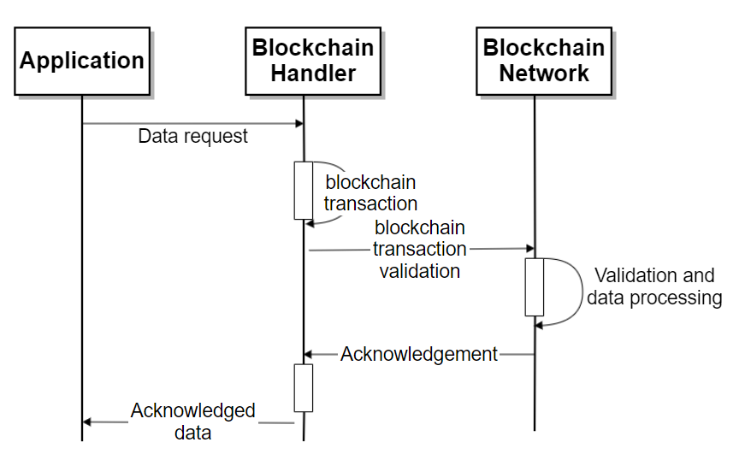
Blockchain for DICOM Integrity
DICOM integrity check using blockchain plays a vital role when data transfer happens between healthcare entities like hospitals, clinics and research institutions.
Patient records and medical images can be securely stored creating a unified and immutable data history that can be accessed by only authorized healthcare providers.

Slide 11
Roadmap for migrating to Post Quantum Cryptography
Identifying the nodes which are susceptible to CRQC.
Identifying the protocols, applications and associated libraries with the help of cryptographic discovery tools.
Discussing PQC readiness with technology vendors.
Algorithm selection and integration testing in the current DICOM infrastructure. Considering encryption speed, key sizes, robust key management and interoperability.

Slide 12
Conclusion
In the escalating threat landscape of cyber attacks and data breaches, DICOM security should be dynamic and encourage the collaboration amongst healthcare stakeholders to adapt to the emerging technologies correlating to evolving challenges.
Thank you!

Slide 13
References
Healthcare Data Breach Statistics (hipaajournal.com)
U.S. Department of Health & Human Services - Office for Civil Rights (hhs.gov)
PS3.1 (nema.org)
Understanding and Using DICOM, the Data Interchange Standard for Biomedical Imaging - PMC (nih.gov)
Gartner Top Strategic Cybersecurity Trends 2023
Scheduled Workflow - IHE Wiki
Benefits of the DICOM Modality Performed Procedure Step - PMC (nih.gov)
Post-Quantum Cryptography | CSRC (nist.gov)
Zero Trust Architecture (nist.gov)

