Slide 1
DICOM Educational Conference
Chennai, India
OCTOBER 9-11, 2023
Leveraging DICOM and IHE standards to deploy AI for Diabetic Retinopathy Screening at Vision centers in Rural Tamil Nadu
Ravindran Padmanabhan
CTO, Innowave Healthcare Pvt Limited, India.

Slide 2
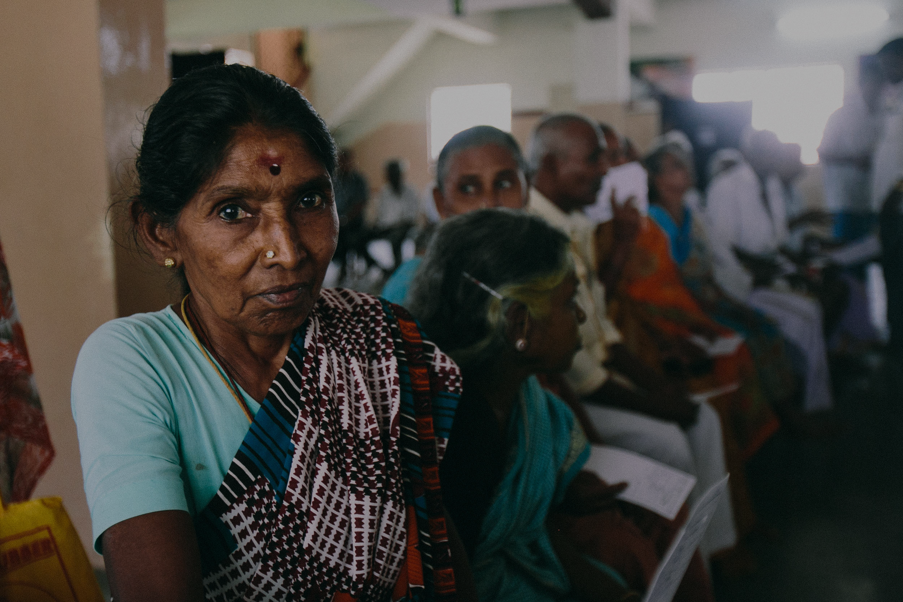
SHANTHI
Tailor by profession from
Alanganallur, Tamil Nadu
Note: Identity changed

Slide 3

We believe these could be a Solution.
Improve Access to Patients - outreach
Provide Quality Care
Reduce Cost for both Patient and Provider
60M
Visually Impaired people in India
80%
of this visual impairment is preventable
25K
Ophthalmologists to prevent blindness!
Source: Vision 2020, IAPB

Slide 4





7
Specialty Care
Research
Training
Tertiary
Care Centers
1000-3000 patients/day
7
Cataract Services Specialty Diagnosis
Secondary
Patients handled
on an average day
15,000 – 20,000 Outpatients
1500 – 2000 Surgeries
by a
Clinical team of 3000+
Care Centers
150-400 patients/day
6
Comprehensive Eye Examination Treatment of Minor ailments
+
Outpatient
100-150 patients/day
Centers
105
Comprehensive Eye Examination
+
Primary Care
20 -35 patients/day
Centers

Slide 5
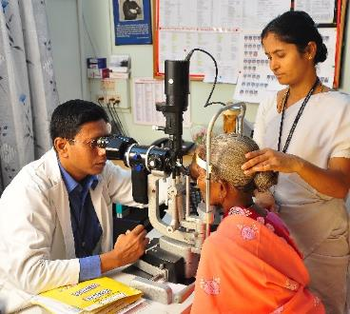
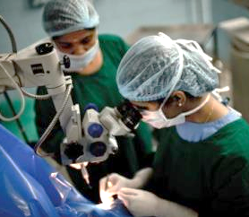
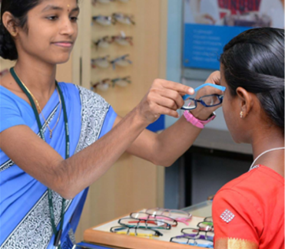
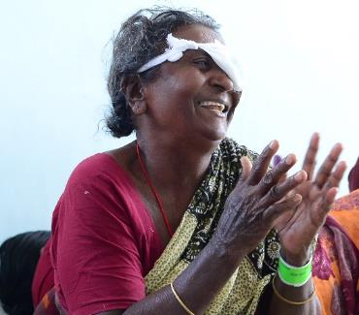
Aravind in 2021-22
4.33 million Outpatient Examinations
524,672
Surgeries, Lasers & other procedures
651,413 spectacles dispensed
45%
of procedures
are free or
steeply subsidized

Slide 6

Prevent Needless Blindness
Quality Care no compromise
Cost Effectiveness
at Scale
believe in Knowledge Sharing

Slide 7
Overview…
About Aravind
What is Diabetic Retinopathy
What is Vision Center
Workflow in a Vision Center

Slide 8
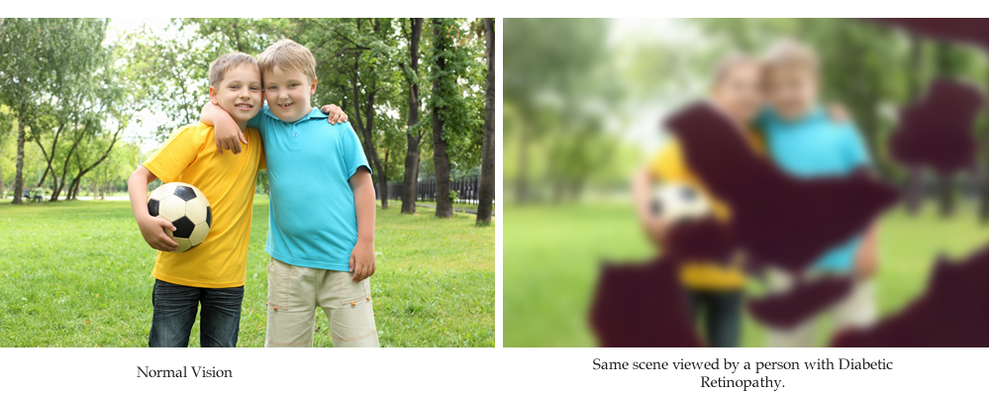

Slide 9
Overview…
About Aravind
What is Diabetic Retinopathy
Typical Workflow

Slide 10
Building Blocks of Telemedicine [DR Screening]
Images are read by Physician
[Retina Specialist]
[Certified Grader]
[AI Models]
1
Base Hospital
Image [videos] are sent to base hospital for diagnosis
Reports are generated and transferred back to Remote location
2
Transit
Patients [Fundus] Images are Captured
Patient is advised to visit Base Hospital for further Treatment.
3
Remote Location

Slide 11
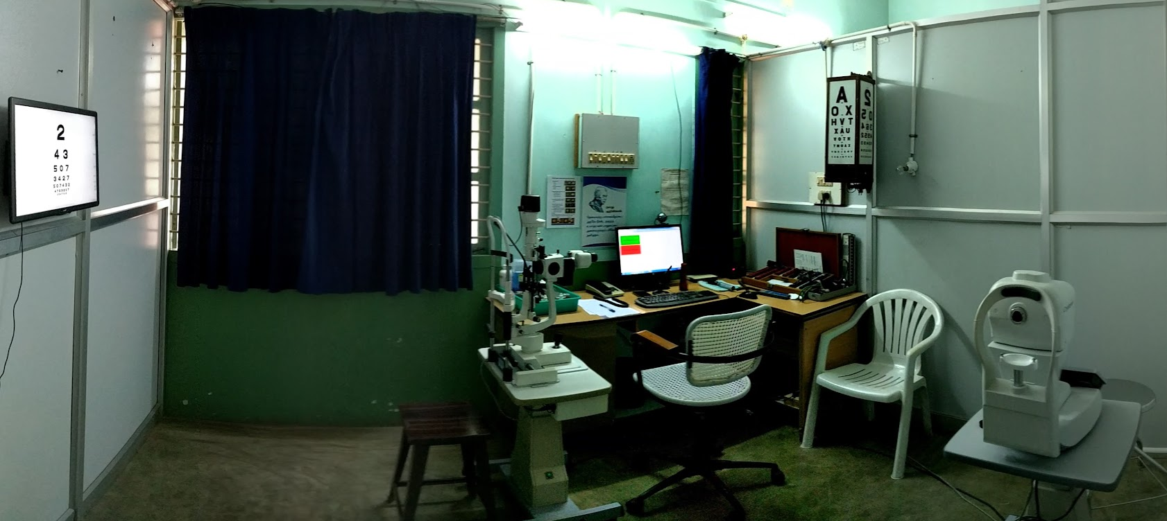
Typical Vision Center Setup

Slide 12
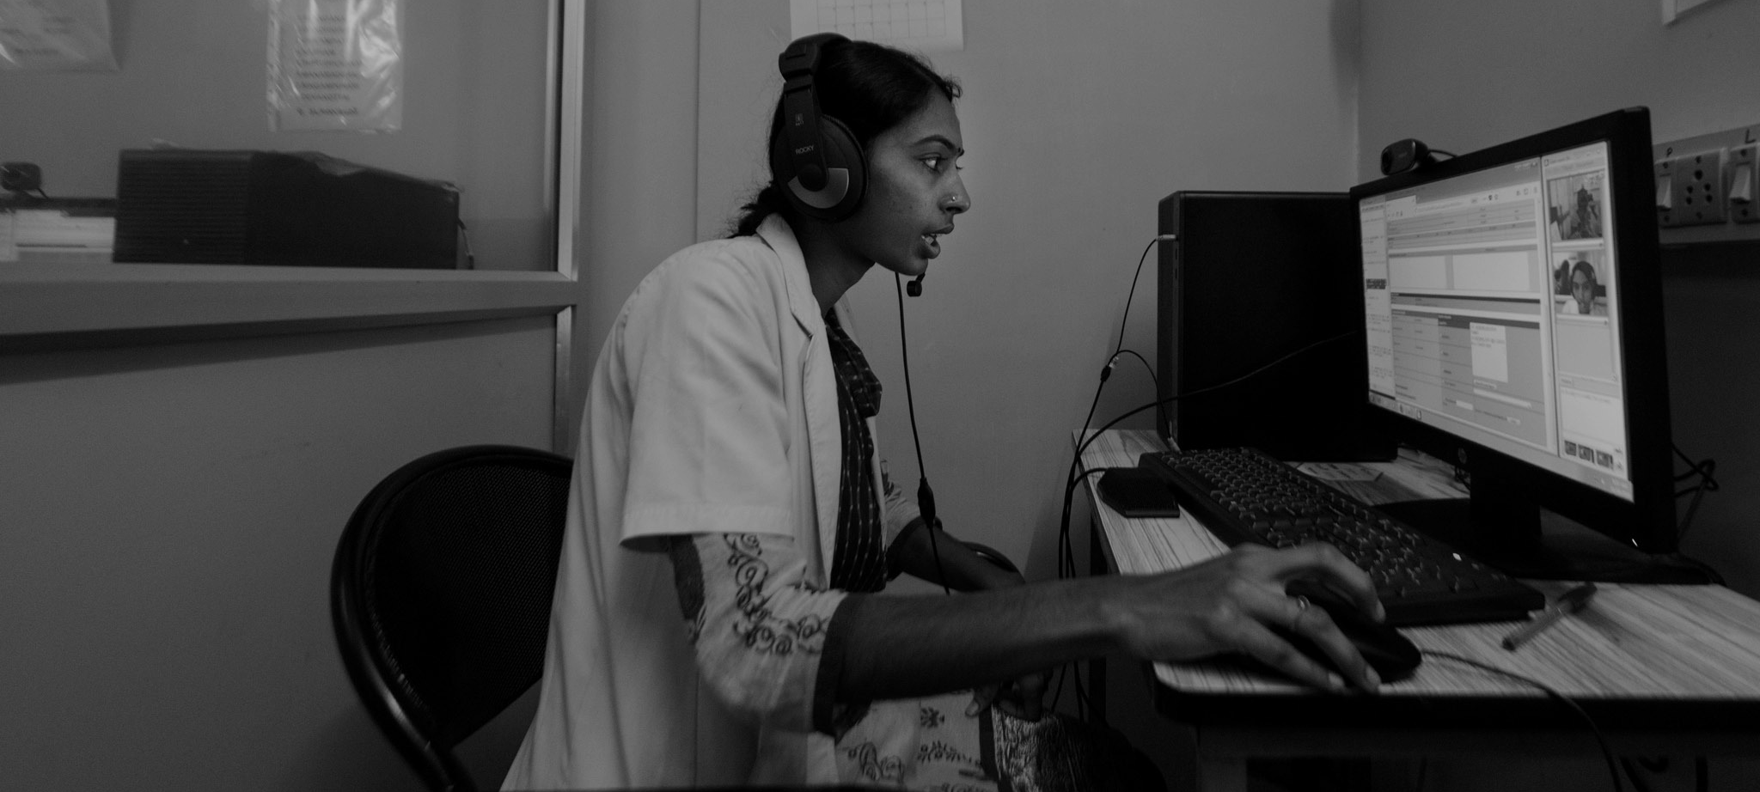
Typical Base Hospital Setup

Slide 13
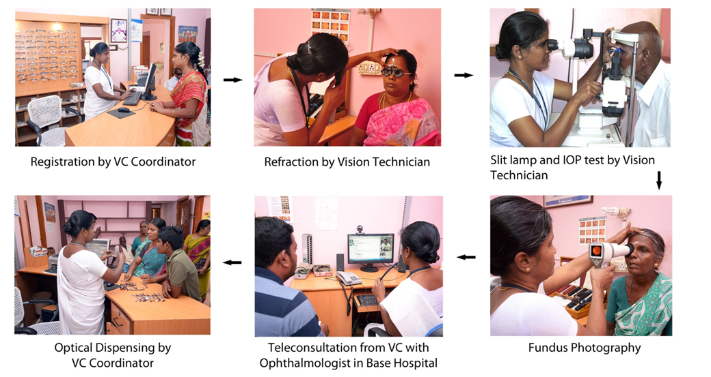
AI

Slide 14
Evolution 2000 - 2023
Year | Early 2000 | 2004 | 2006 | 2012 | 2023 | Future
Patient Location | Camps / Rural [Van] | Camps / Rural [Van] | Camps / Rural [Van] | Vision Centers / Diabetic Centers | Vision Centers / Diabetic Centers | Primary Care / Labs / Spectacle Shops
Camera | High End Table Top | High End Table Top | High End Table Top | Handheld | Economical Table Top semi-automatic | Mobile Semi / Fully Automatic
Operator | From Base Hospital | From Base Hospital | From Base Hospital | Trained MLOP | Trained MLOP | Anybody
Connectivity | Store & Forward[HDD] | VSAT | VSAT | Fixed WLL / WCDMA | BroadBand / 3G / 4G | Build in AI
Software | Camera | ADRES V1 | ADRES V2 | ADRES V2 | ADRES V3 | Camera
Diagnosis | Retina Specialist | Retina Specialist | Certified Grader | Certified Grader | AI Model | AI Model
Report TAT | 3-4 days | +1 | Same Day | 2 Days | 5 Minutes | Instant
Detectable DR | Low | Low | Moderate | Moderate | Moderate/High | High
Cost | Exorbitant | Exorbitant | Expensive | High | Moderate | Moderate - Low
Frequency | Low | Low | Moderate | Daily | Daily / Every Patient | Every Patient

Slide 15
DICOM / IHE Standard at work…
Evolution DICOM / AI @ Aravind
IHE - Unified Eye Care Workflow
DICOM Services at Work

Slide 16
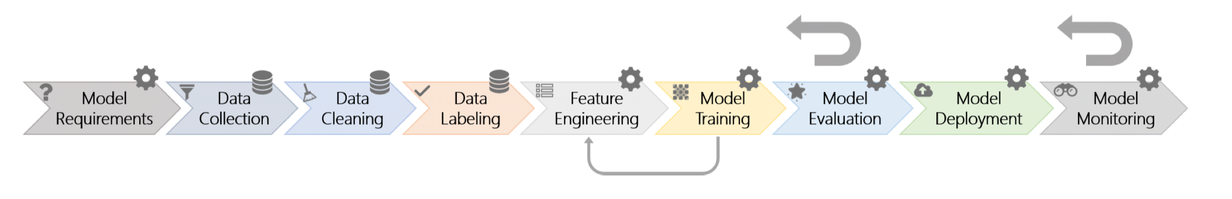
Evolution DICOM / AI @ Aravind
Production Deployment
Research, Build, Test AI Models
Use Case and Data Collections
Model orientation
Phase One : JPEG Files and Data Cleaning and Labeling was done by AI Company, curation was an issue.
Prospective Study
Clinical Launch, Post Go Live Monitoring and AI Model Optimization.
DICOM Store was used to interact with Camera, All patient tags are anonymized, DICOM Ophthalmic Photography IOD was introduced
DICOM Store was used to interact with Camera, All patient tags are anonymized, DICOM Ophthalmic Photography IOD was introduced
Phase Two : DICOM Files and Presentation State files are generated by a team of Ophthalmologist in the Hospital and sent to AI vendor as Clean, Labeled & Curated Data.
DICOM SC
DICOM GSPS
DICOM GSPS
DICOM SCP
DICOM OP
DICOM Anonymization
DICOM SC / OP
DICOM Anonymization
DICOM MWL
DICOM Store
DICOM Web

Slide 17
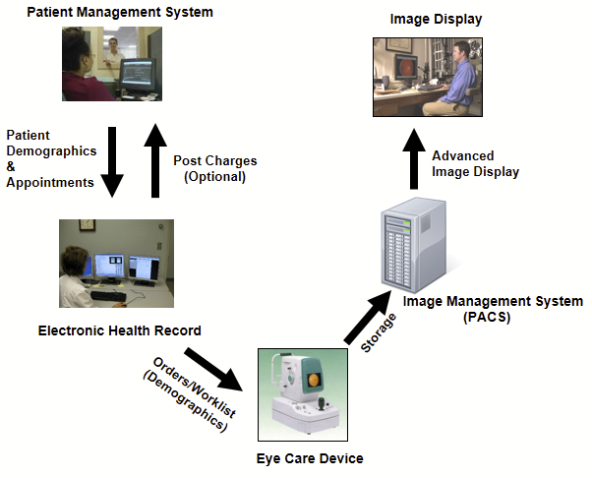
IHE - Unified Eye Care Workflow
(Integrating the Healthcare Enterprise)
Integration influenced by : Real World Model I - EHR Implements DICOM Modality Worklist and Integrates with a PACS
AI Model

Slide 18
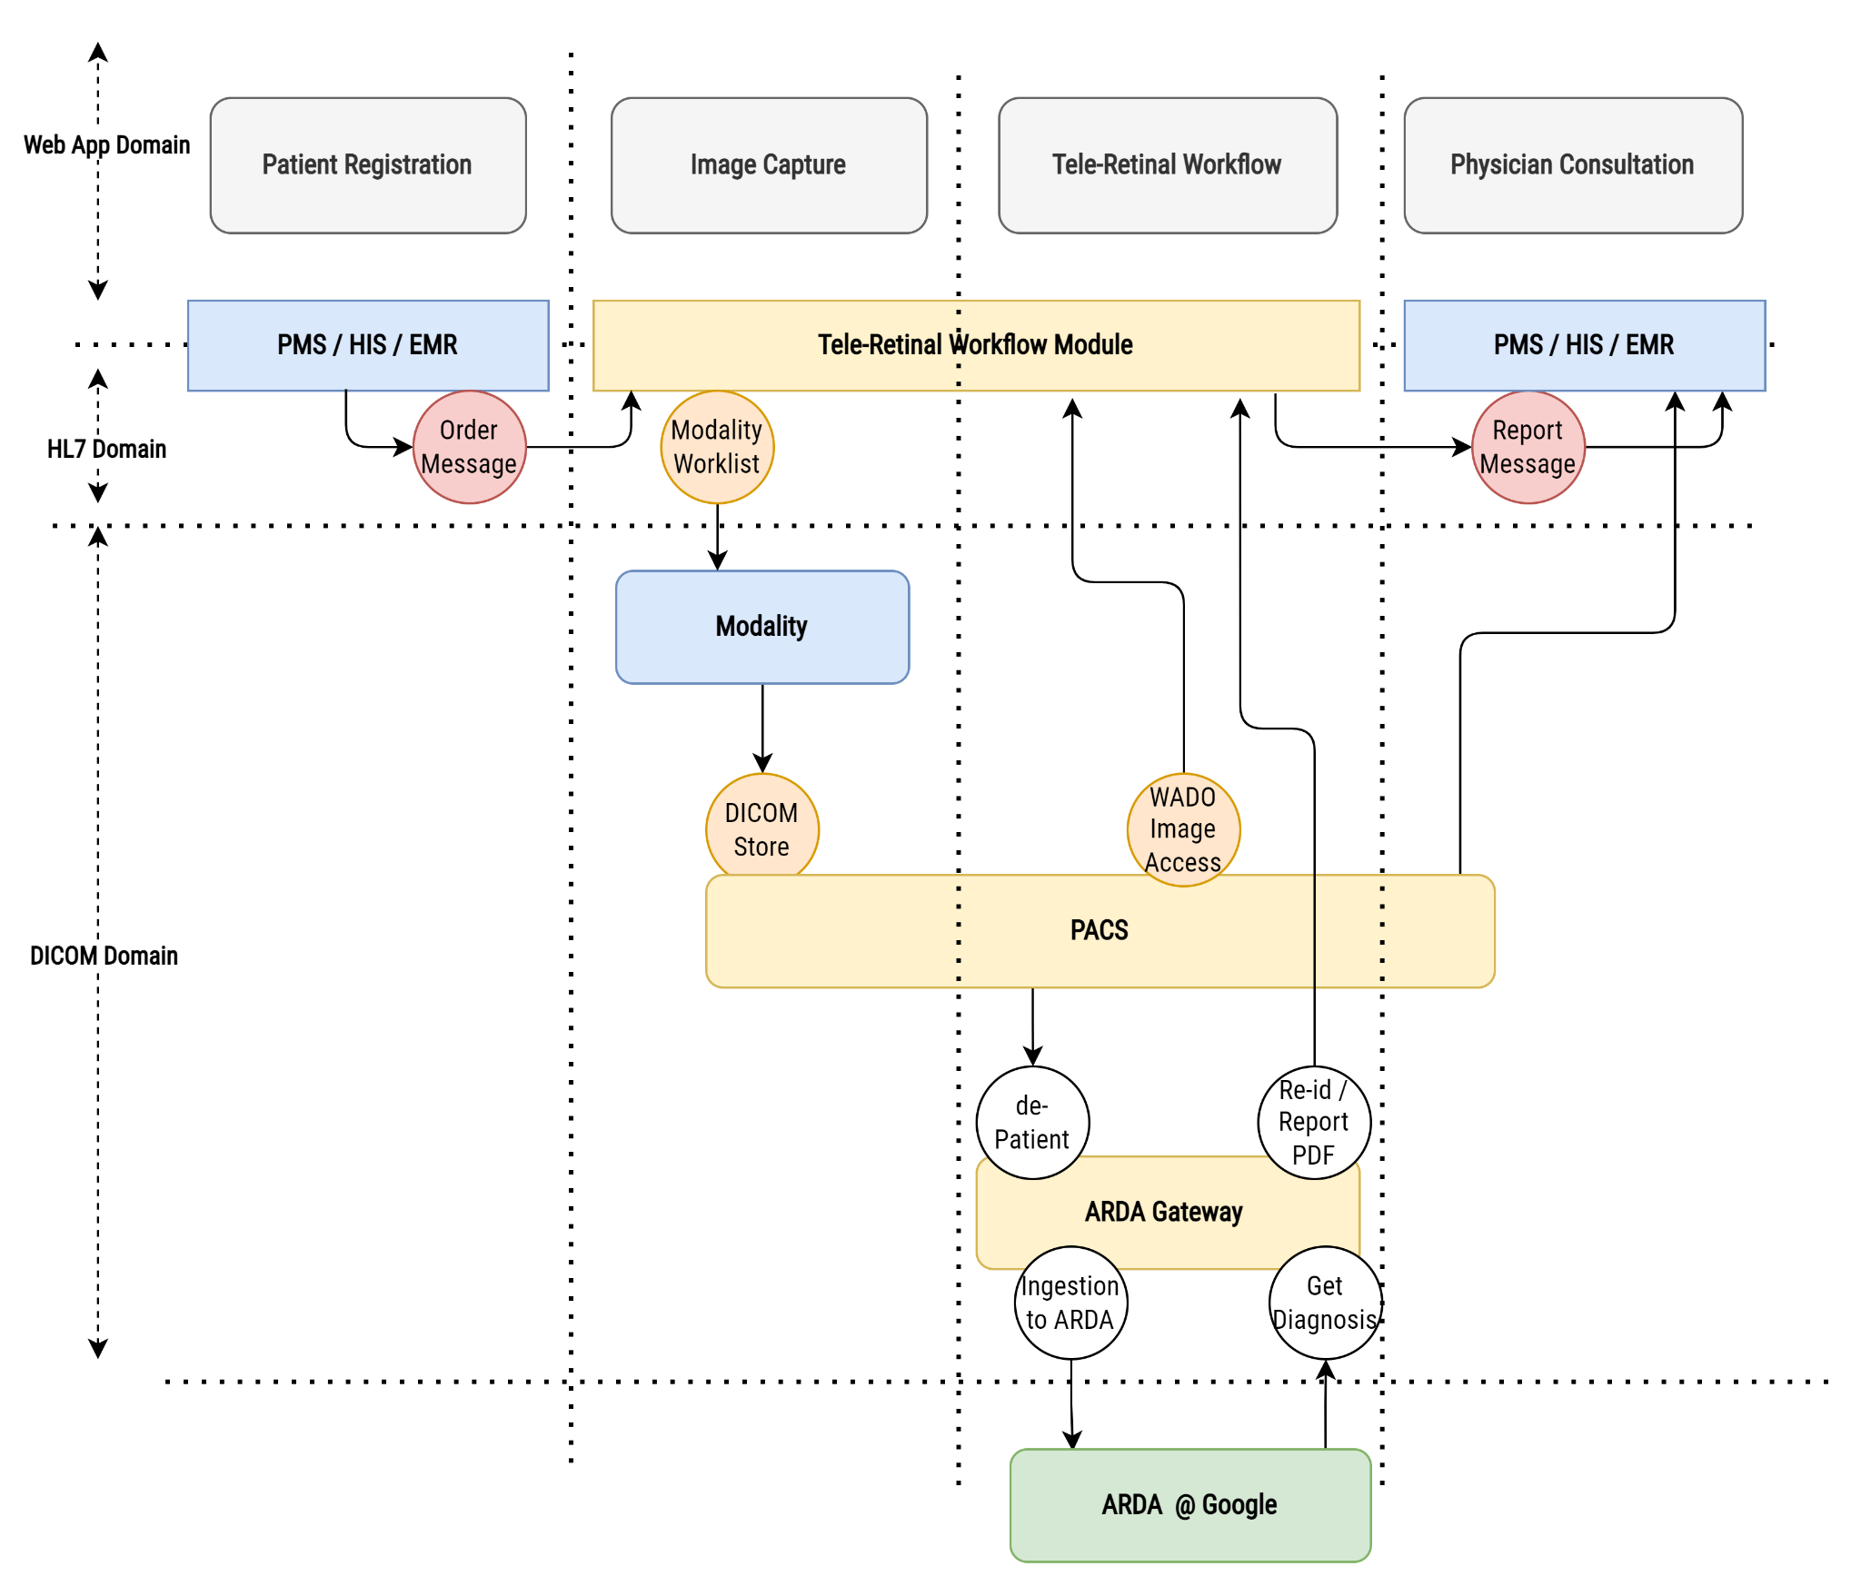
Workflow and Integration

Slide 19
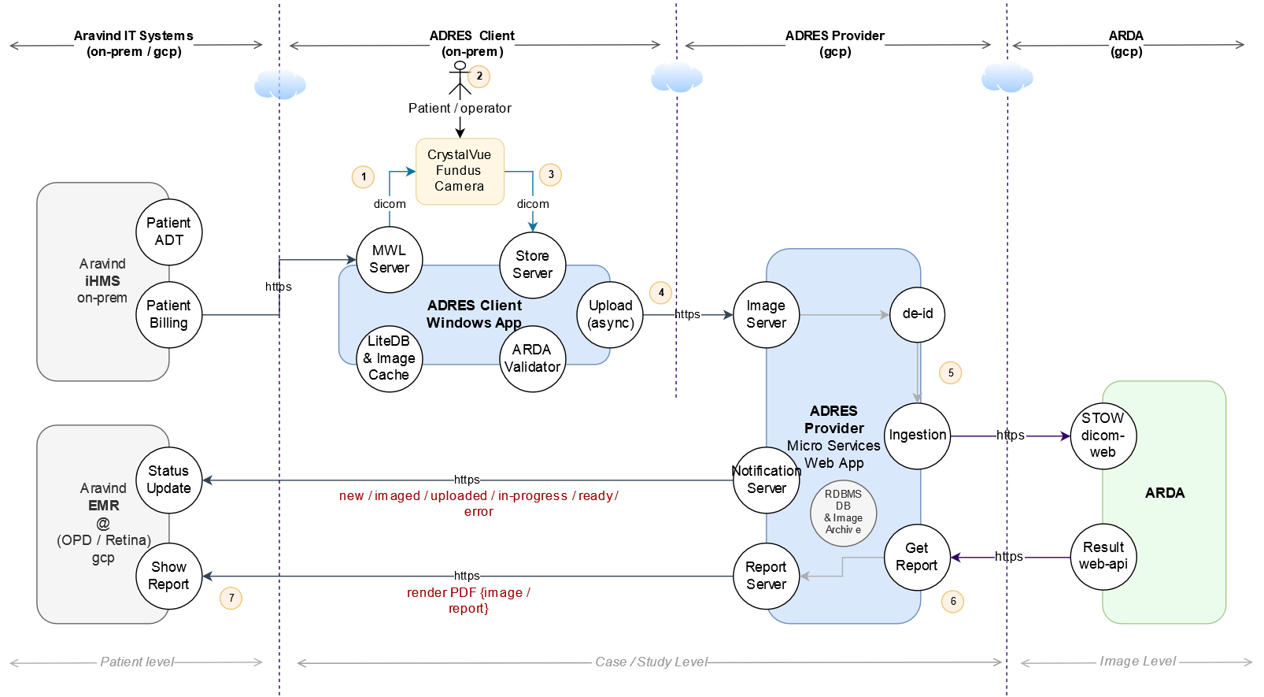
Workflow and Integration

Slide 20
DICOM IOD - SC and OP
DICOM SOP - SC and OP
Training and Testing Dataset (SC /GSPS)
Production DataSet (OP)
Subject Identification
Image Labeling
Image Quality
  Brightness / Contrast
  Orientation
Labeling
  Circle, Line & Text
Subject Identification
Anonymization
Image Validation
Image Quality
Private tags
  Tenant
  Diabetic or Cataract
  Consent
Compression Quality

Slide 21
DICOM (MWL) - Modality and EMR integration
Modality (MWL)
Modality, PACS, AI Model and EMR
Filter only Valid Patient from Order Scheduled
  Tenant
  Clinical Conditions
Passing Patient and Study Info
Accession No and Study Instance UID workflow integration
Study Instance UID
  Modality, PACS and AI Model
  De-id & AI Model Ingestion
  Re-Id & Result Generation
Accession No / Patient MRN
  EMR Integration

Slide 22
Store / Retrieve - DICOM (dimse) / DICOMWeb (RS)
Camera, EMR, PACS & AI Integration
DICOM (dimse)
DICOM Web (RS)
Modality to DICOM Gateway (DICOM Store)
Central PACS and AI Model Integration with
  QIDO to find existing Images
  STOW to upload dicom dataset after Anonymization
PACS Viewer Integration
  WADO to pull images

Slide 23
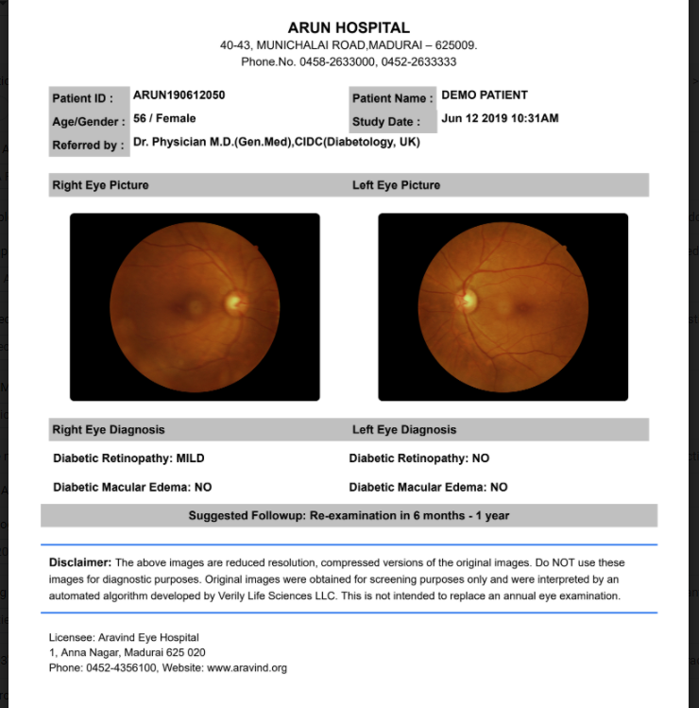
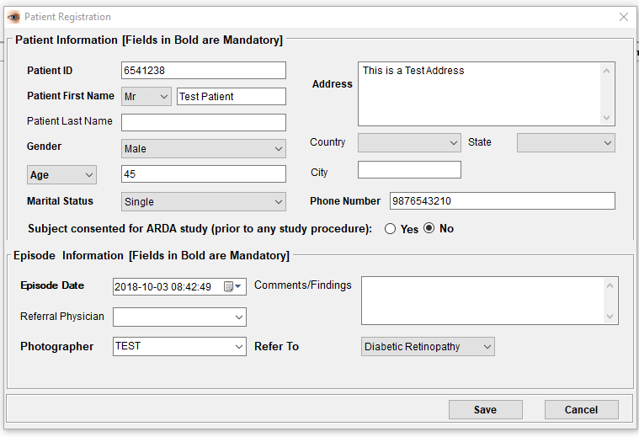
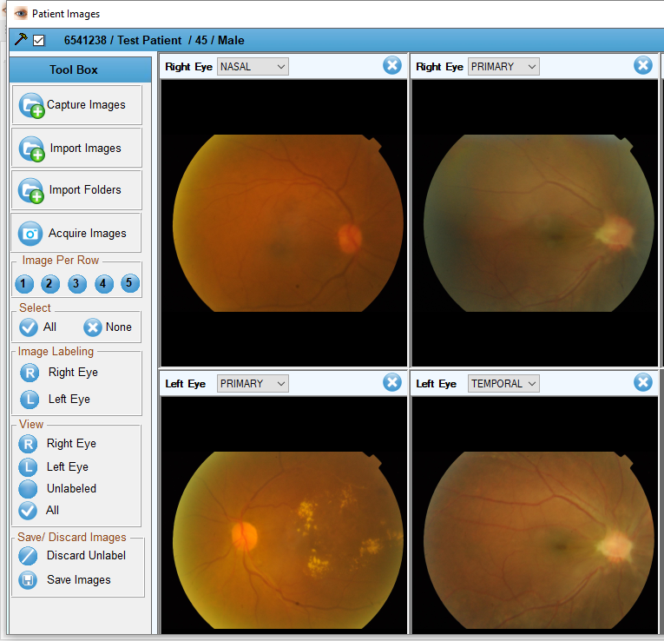
ADRES - Screens & Report
From EMR
From PACS
From AI

Slide 24
Outcomes…
Volume and Results
Blogs and Research Publications…

Slide 25
Outcomes Since 2019
No of Patient Scanned 285,000
No of Locations the solution deployed 79
  71 - Rural / City Centers & Camps
  8 - Diabetic Centers / Diagnostic Centers
Type of Cameras used
  TopCon
  CrystalVue
  TelemedC
  Forus Health (economical / AI model re-training done.)

Slide 26
Statistics till 2023
 | Ungradable % | Normal Eyes % | Referrable DR % | All DR %
Vision Center | 15.65% | 76.99% | 4.26% | 7.36%
Diabetic Centers | 21.13% | 61.02% | 11.19% | 17.85%
Camps | 26.36% | 57.81% | 10.71% | 15.83%
CitiCenters | 25.81% | 54.52% | 15.02% | 19.67%
Diagnostic Centers | 18.00% | 78.78% | 1.56% | 3.22%

Slide 27

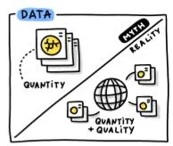
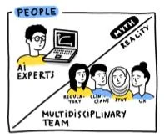
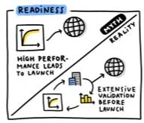
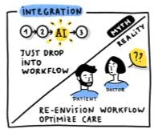
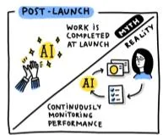
Lessons learned from translating AI from
development to deployment in healthcare
DICOM is critical for AI Model to perform better in a clinical setup
URL : https://blog.google/technology/health/5-myths-about-medical-ai-debunked/

Slide 28
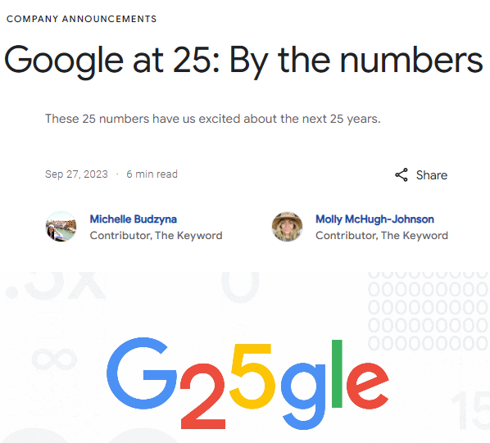
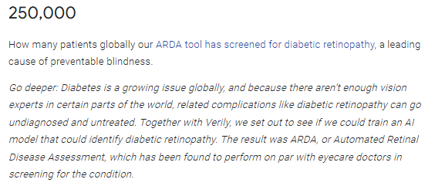
Google at 25: By the numbers
URL : https://blog.google/inside-google/company-announcements/google-fun-facts-25th-birthday/

Slide 29
Improvements
FHIR for Orders and Results integration with EMR
DICOM-Web UPS-RS for MWL and MPPS
Service discovery for Multiple AI Integration (currently in trial)
JSON Representation of DICOM Structured Reports (currently in Trial)

Slide 30
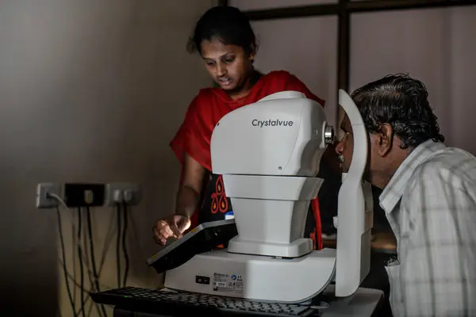
Q&A

