Slide 1
DICOM Educational Conference
Chennai, India
October 9-11, 2023

Slide 2
Overview
Introduction
DICOM Objects for Communicating AI Results
Introduction to DICOM SR
TID 1500 for encoding AI Results
Other Representations of TID 1500
References

Slide 3




Introduction
Pneumothorax
Detection
Stroke
Lung
Nodules
Breast
Assesment
Coronary
Calcium
Liver
Lesions

Slide 4
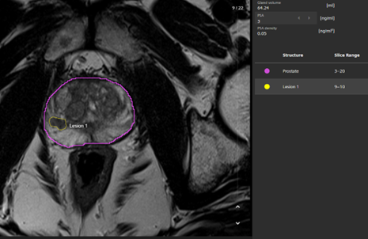
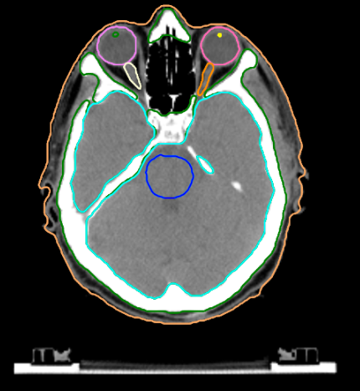
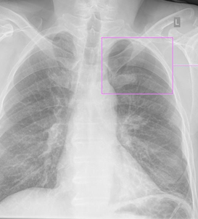
Types of AI Results
AI Results
These results may be
Qualitative assesment of either normal or pathological structures
  e.g. Pneumothroax present
Measurements of normal or pathological structures
  e.g. Prostate Gland Volume = 64 ml
Segmentation of normal or pathological structures
A combination of all mentioned above
Independent of an image reference
Associated with an image or a derived DICOM Object
  e.g. Segmentation object
Associated with a region in the image
  e.g. a bounding box, a polyline, …

Slide 5
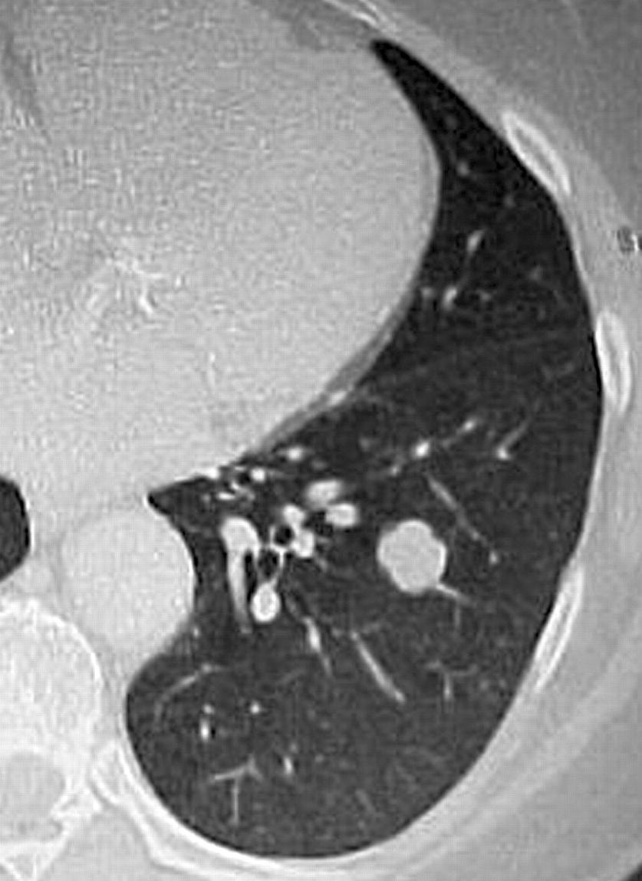
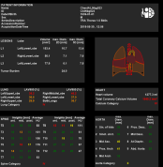
DICOM Objects for Communication of AI Results
Secondary Capture
  AI results burned into the image or screenshots of results screens
  Supported by almost all of the systems
  Unflexible
  Duplication of data
Grayscale Softcopy Presentation State (GSPS)
  Image transformation and overlays to be applied to image
  Small objects referencing image data, no duplication of image data
  No structured information
  Relatively well supported by industry
1.5 cm
1.5 cm

Slide 6
DICOM Objects for Communication of AI Results
Segmentation
Segmentation Objects
  Contains segmented objects as mask data or surface mesh
  Multiple labels supported
  No structured information
  Not as widely supported by industry
Structured Reports
  Contains finding information and spatial references to be
  applied to the images
  Structured (machine readable) information
  Complex implementation
Structured Report
NUM: Diameter=1.5 cm
INFERED FROM
SCOORD: Polyline (180,250,190,275)
SELETED FROM
IMAGE: 1.2.3.4.5.123.3..

Slide 7
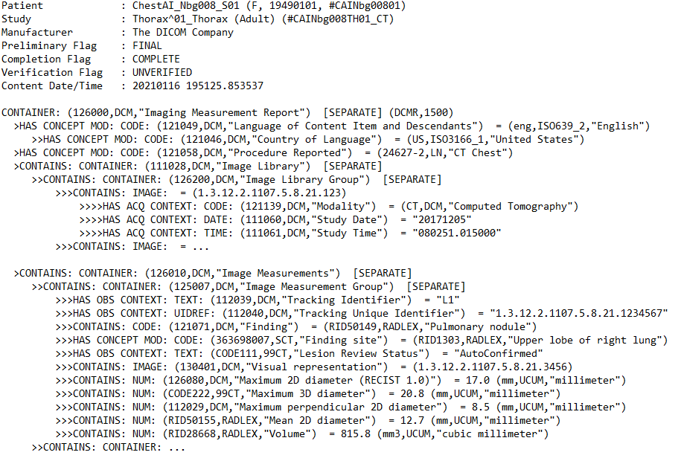
Introduction of DICOM SR
DICOM Header for Meta-Data
Structured Content organized as a tree based on a given Template (TID)
Root node for document type
Each node (Content Item) is encoded as a name value pair
  Coded Concept Name (e.g. 121071, DCM, „Finding“)
  Value of different types:
    CODE, TEXT, DATE, TIME, NUM, IMAGE, SCOORD, … ¹⁾
  Different relationship types between parent and child nodes
    HAS ACQ CONTEXT, CONTAINS, HAS OBS CONTEXT, … ¹⁾
The definition of the DICOM SR IODs can be found in
DICOM PS3.3 Section A.35
¹⁾ See DICOM PS3.3 Section C.17.3.2
Notes:
Now let‘s first start looking into the general structure of a DICOM SR:
Just as any other DICOM object it contains a DICOM header for the Meta data like Patient, Study, Series data as well as SR specific information as to whether the SR is complete and verified.
The actual structured content is organized in a tree structured. This tree can be organized for special clinical content and is based on templates, so called TIDs.
The root node defines the type of document based on a given TID, for example an imaging measurement report.
All content items below are encoded as a name values pair, which consists of a coded concept name. The actual value can have different types. It could be codes as well, or text or dates and times, numbers, coordinates. The full list of supported value types can be found in Part 3 of DICOM in the SR Document Content section
There are relationsship types defined between parent and child nodes to indicate how they relate to each other, e.g. that is an acquisition or an observation context or whether one contains the others, …

Slide 8
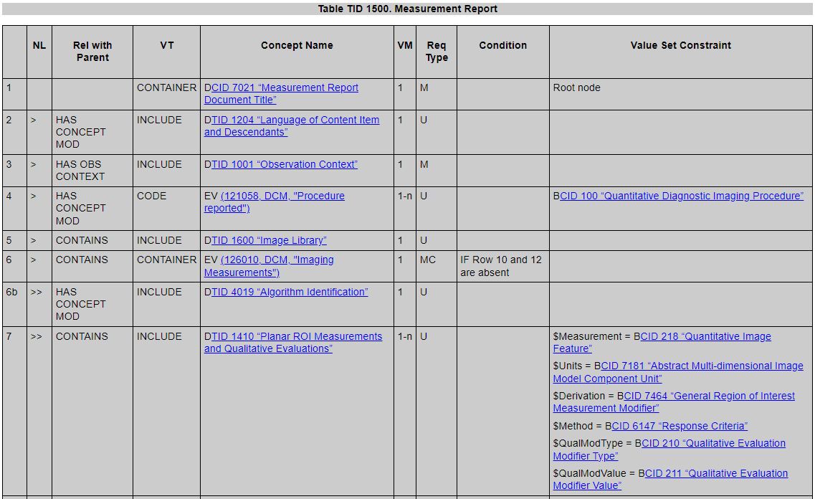
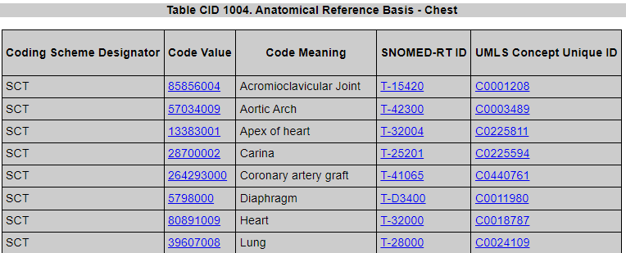
SR Content Encoding
SR Content Tree is constrained by Templates (TIDs)
  Measurement Report, Mammography CAD SR, Adult Echocardiography Procedure Report
Root Template defines the entire document structure
Sub Templates define re-useable parts of this structure
  Measurement, Image Library, Linear Measurement, Observation
  Context
Heavily relies on coded entries for e.g. clinical findings,
anatomical sites, measurements, units, qualitative information
Use of external lexicons like
  SNOMED, LOINC, RADLEX, UCUM, …,
  DICOM defined Terms
  Defined in DICOM Context Groups (CIDs)
Templates and Context Groups are defined in PS3.16

Slide 9
Measurement Report (TID 1500)
CONTAINER: (126000,DCM,"Imaging Measurement Report ) [SEPARATE] (DCMR,1500)
>HAS CONCEPT MOD: CODE: (121049,DCM,"Language of Content Item and Descendants") = (eng,RFC5646,"English")
>>HAS CONCEPT MOD: CODE: (121046,DCM,"Country of Language") = (US,ISO3166_1,"United States")
>HAS OBS CONTEXT: UIDREF: (121012,DCM,"Device Observer UID") = "1.2.3.4.5.1111...."
>HAS OBS CONTEXT: TEXT: (121014,DCM,"Device Observer Manufacturer") = "DICOM Conference"
>HAS OBS CONTEXT: TEXT: (121015,DCM,"Device Observer Model Name") = "AI-2023"
>HAS CONCEPT MOD: CODE: (121058,DCM,"Procedure Reported") = (24627-2,LN,"CT Chest")
>CONTAINS: CONTAINER: (111028,DCM,"Image Library") [SEPARATE]
>>CONTAINS: CONTAINER: (126200,DCM,"Image Library Group") [SEPARATE]
>>>CONTAINS: IMAGE: = (1.2.3.4.5.1112....)
>>>>HAS ACQ CONTEXT: CODE: (121139,DCM,"Modality") = (CT,DCM,"Computed Tomography")
>>>>HAS ACQ CONTEXT: DATE: (111060,DCM,"Study Date") = "20130502"
>>>>HAS ACQ CONTEXT: TIME: (111061,DCM,"Study Time") = "191127.995000"
>>>CONTAINS: IMAGE: = ...
>CONTAINS: CONTAINER: (126010,DCM,"Image Measurements") [SEPARATE]
>>HAS CONCEPT MOD: TEXT: (111001,DCM,"Algorithm Name") = "Nodule Technology Lesion Segmentation"
>>HAS CONCEPT MOD: TEXT: (111003,DCM,"Algorithm Version") = "0.5.0"
>>CONTAINS: CONTAINER: (125007,DCM,"Measurement Group") [SEPARATE]
>>>HAS OBS CONTEXT: TEXT: (112039,DCM,"Tracking Identifier") = "L1"
>>>HAS OBS CONTEXT: UIDREF: (112040,DCM,"Tracking Unique Identifier") = "1.2.3.4.5.1113...."
>>>CONTAINS: CODE: (121071,DCM,"Finding") = (RID50149,RADLEX,"Pulmonary nodule")
>>>HAS CONCEPT MOD: CODE: (363698007,SCT,"Finding site") = (39607008,SCT,"Lung")
>>>>HAS CONCEPT MOD: CODE: (106233006,SCT,"Topographical modifier") = (42400003,SCT,"Upper lobe …")
>>>HAS CONCEPT MOD: CODE: (RID6037,RADLEX,"Attenuation Characteristic") = (RID5741,RADLEX,"Solid")
>>>CONTAINS: IMAGE: (130401,DCM,"Visual representation") = (1.2.3.4.5.1114....)
>>>CONTAINS: NUM: (103339001,SCT,"Long Axis") = 10.1953 (mm,UCUM,"millimeter")
>>>>INFERRED FROM: SCOORD: = POLYLINE {109.5,341.5,121.5,350.5}
>>>>>SELECTED FROM: IMAGE: = (1.2.3.4.5.1111....)
>>>CONTAINS: NUM: (103340004,SCT,"Short Axis") = 6.7969 (mm,UCUM,"millimeter")
>>>>INFERRED FROM: SCOORD: = POLYLINE {109.5,348.5,115.5,340.5}
>>>>>SELECTED FROM: IMAGE: = (1.2.3.4.5.1111....)
>>>CONTAINS: NUM: (RID50155,RADLEX,"Mean 2D diameter") = 8.5 (mm,UCUM,"millimeter")
>>>CONTAINS: NUM: (RID28668,RADLEX,"Volume") = 267.9 (mm3,UCUM,"cubic millimeter")
>>CONTAINS: CONTAINER: (125007,DCM,"Measurement Group") [SEPARATE] ...
Measurement Report (TID 1500)
Language of Content Items (TID 1204)
Observation Context (TID1001)
Procedure Reported
Image Library (TID 1600)
Image Measurement
Algorithm Identification (TID 4019)
Planar Measurements (TID 1410)
Volumetric Measurements (TID 1411)
Measurements and Qualitative evaluations
(TID 1501)
Derived Measurements
Qualtiative Evaluations
Notes:
image library catalogue of relevant images
Algorithm identification can be the same for all measurements or can be encoded insided the measurement group for the measurement itself

Slide 10
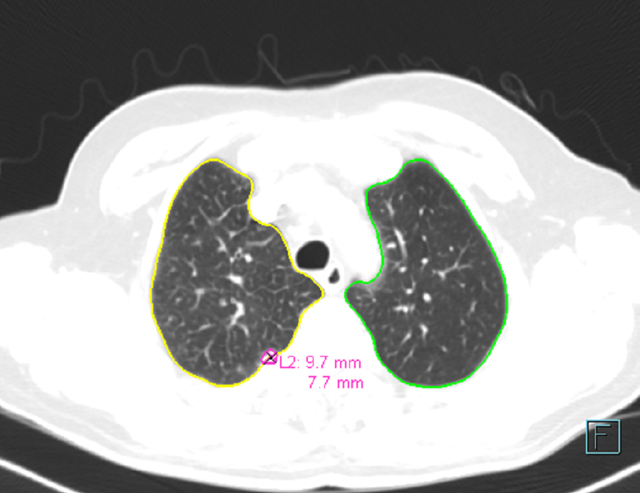
Measurement and Qualitative Evaluation (TID 1501)
>>CONTAINS: CONTAINER: (125007,DCM,"Image Measurement Group") [SEPARATE]
>>>HAS OBS CONTEXT: TEXT: (112039,DCM,"Tracking Identifier") = "L2"
>>>HAS OBS CONTEXT: UIDREF: (112040,DCM,"Tracking Unique Identifier") = "1.2.3.4.5.11133..."
>>>CONTAINS: CODE: (121071,DCM,"Finding") = (RID50149,RADLEX,"Pulmonary nodule")
>>>HAS CONCEPT MOD: CODE: (363698007,SCT,"Finding site") = (39607008,SCT,"Lung")
>>>>HAS CONCEPT MOD: CODE: (106233006,SCT,"Topographical modifier") =
(42400003,SCT,"Upper lobe of right lung")
>>>HAS CONCEPT MOD: CODE: (RID6037,RADLEX,"Attenuation Characteristic") =
(RID5655,RADLEX,"Unknown")
>>>HAS CONCEPT MOD: CODE: (129737002,SCT,"Radiographic Lesion Margin") =
(129738007,SCT,"Lesion with circumscribed margin")
>>>HAS OBS CONTEXT: CODE: (RID50134,RADLEX,"Lung-RADS assessment") =
(RID50135,RADLEX,"Lung-rads 0")
>>>CONTAINS: IMAGE: (130401,DCM,"Visual representation") = (1.2.3.4.5.1221...)
>>>CONTAINS: NUM: (103339001,SCT,"Long Axis") = 9.6602 (mm,UCUM,"millimeter")
>>>>INFERRED FROM: SCOORD: = POLYLINE {210.5,348.5,221.5,339.5}
>>>>>SELECTED FROM: IMAGE: =(1.2.3.4.5.114...)
>>>CONTAINS: NUM: (103340004,SCT,"Short Axis") = 7.7496 (mm,UCUM,"millimeter")
>>>>INFERRED FROM: SCOORD: = POLYLINE {214.3,338.6,221.6,347.4}
>>>>>SELECTED FROM: IMAGE: = (1.2.3.4.5.1114...)
>>>CONTAINS: NUM: (RID50155,RADLEX,"Mean 2D diameter") = 8.7 (mm,UCUM,"millimeter")
>>>CONTAINS: NUM: (RID28668,RADLEX,"Volume") = 259.6 (mm3,UCUM,"cubic millimeter")
>>>CONTAINS: NUM: (122157,DCM,"Probability of cancer") = 0 (%,UCUM,"Percent")

Slide 11
Examples for the different types of AI Resutls
>>CONTAINS: CONTAINER: (125007,DCM,"Image Measurement Group") [SEPARATE]
>>>HAS OBS CONTEXT: TEXT: (112039,DCM,"Tracking Identifier") = "L2"
>>>HAS OBS CONTEXT: UIDREF: (112040,DCM,"Tracking Unique Identifier") = "1.2.3.4.5.11133..."
>>>CONTAINS: CODE: (121071,DCM,"Finding") = (RID50149,RADLEX,"Pulmonary nodule")
>>>HAS CONCEPT MOD: CODE: (363698007,SCT,"Finding site") = (39607008,SCT,"Lung")
>>>>HAS CONCEPT MOD: CODE: (106233006,SCT,"Topographical modifier") =
(42400003,SCT,"Upper lobe of right lung")
>>>HAS CONCEPT MOD: CODE: (RID6037,RADLEX,"Attenuation Characteristic") =
(RID5655,RADLEX,"Unknown")
>>>HAS CONCEPT MOD: CODE: (129737002,SCT,"Radiographic Lesion Margin") =
(129738007,SCT,"Lesion with circumscribed margin")
>>>HAS OBS CONTEXT: CODE: (RID50134,RADLEX,"Lung-RADS assessment") =
(RID50135,RADLEX,"Lung-rads 0")
>>>CONTAINS: IMAGE: (121214,DCM,"Referenced Segmentation Frame")= (1.2.3.4.5.1221...)
>>>CONTAINS: NUM: (103339001,SCT,"Long Axis") = 9.6602 (mm,UCUM,"millimeter")
>>>>INFERRED FROM: SCOORD: = POLYLINE {210.5,348.5,221.5,339.5}
>>>>>SELECTED FROM: IMAGE: =(1.2.3.4.5.114...)
>>>CONTAINS: NUM: (103340004,SCT,"Short Axis") = 7.7496 (mm,UCUM,"millimeter")
>>>>INFERRED FROM: SCOORD: = POLYLINE {214.3,338.6,221.6,347.4}
>>>>>SELECTED FROM: IMAGE: = (1.2.3.4.5.1114...)
>>>CONTAINS: NUM: (RID50155,RADLEX,"Mean 2D diameter") = 8.7 (mm,UCUM,"millimeter")
>>>CONTAINS: NUM: (RID28668,RADLEX,"Volume") = 259.6 (mm3,UCUM,"cubic millimeter")
>>>CONTAINS: NUM: (122157,DCM,"Probability of cancer") = 0 (%,UCUM,"Percent")
Qualitative assesment of either normal or pathological structures
Segmentation of normal or pathological structures
Measurements of normal or pathological structures
Associated with a region in the image

Slide 12
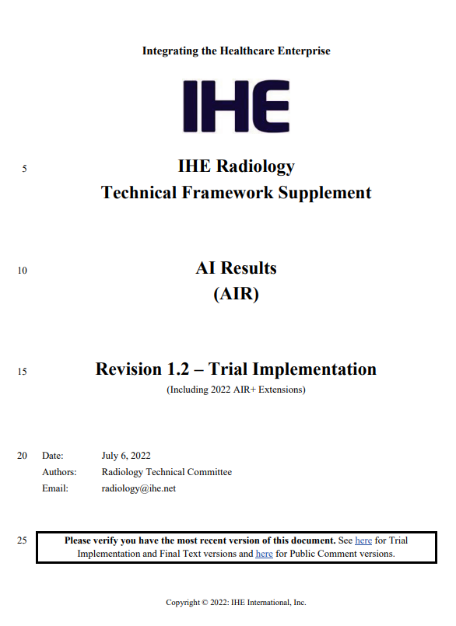
IHE Radiology AIR Results Profile
Profile addresses
  Encoding requirements for analysis results based on a set of result primitives
    Result primitives represent information elements encoded in a DICOM SR based on TID 1500
      Qualtitative Findings
      Measurements
      Locations
      Segmentations/Parametric Maps
      Tracking Ids
      Image References
  Transactions for storing and retrieving the data (DIMSE and DICOMWeb)
  Baseline display requirements for each primitive

Slide 13
Some extension of TID 1500
To further improve interoperability of AI results some extension are helpful
  Encoding of the same measurement at different points in time (e.g. tumor growth curves)
  Encoding of derived measurements, beyond statistical derivation (e.g. total tumor burden)
  Encoding of (anatomical) landmarks and deriving information from multiple of these landmarks (e.g. distances between a vessel and a tube tip)
  Explicit description of encoding Criticality, Confidence, Certainty of findings, …
  Encoding of result/finding status after review (accepted/rejected/modified)

Slide 14
Alternate Respresentations of TID 1500
JSON Representation of DICOM Structured Reports (Supplement 219)
DICOM SR implementation is not trivial. Al developers prefer a JSON representation of AI Results
Supp. 219 describes a JSON representation and a transformation pipeline to create binary SRs which can be used by DICOM devices (e.g. PACS)
  Starting with minimally necessary information provided by the AI Algorithm
  this information will be extended with relevant composite
  context and meta data needed to create an SR
  DICOM tags and codes are replaced by „business names“
  defined in a separate JSON File
Just Number, Coordinates and Image Reference
+ Lesion Identifiers
+ Image Library and Evidence Sequences
+ Composite Context
AI Algorithm
Lesion Manager
DICOM Image Aware System
Patient-Study Aware System
PACS
Image soruce https://www.dicomstandard.org/News-dir/ftsup/docs/sups/Sup219.pdf

Slide 15
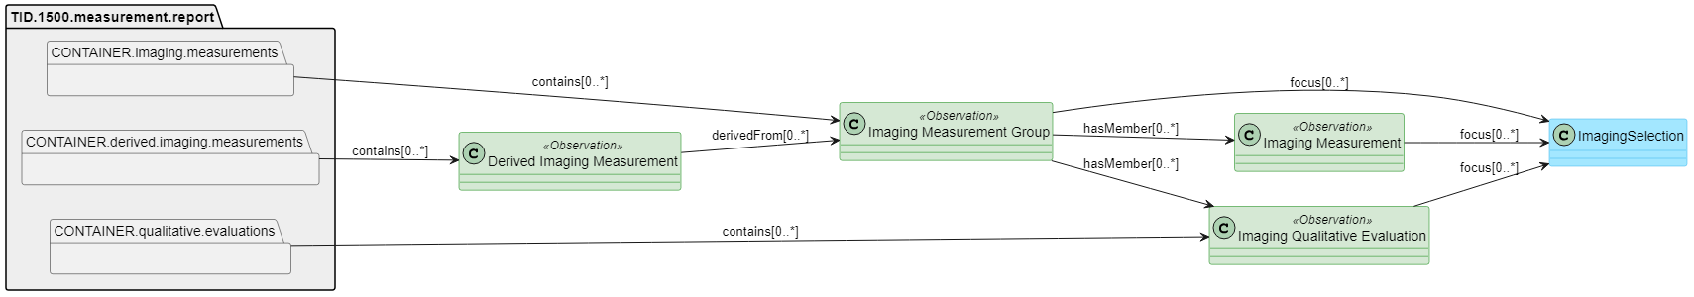
Alternate Respresentations of TID 1500
DICOM SR to FHIR® Resource Mapping IG
Aim is to make measurement information available outside the radiology department
Definition of resource profiles based on
  Observation for
    Imaging Measurement Groups (as defined int TID1410, 1411, 1501)
    Imaging Measurements (as defined in TID 4019, 300)
    Derived Imaging Measurements (TID 1420)
    Imaging Qualitative Evaluation
  Imaging Selection for image regions, segmentation, illustrations of ROI and visual explanations
  Device for algorithm information, device participants and general equipment
  BodyStructure for finding sites
Image soruce https://build.fhir.org/ig/HL7/dicom-sr/architecture.html

Slide 16
References
DICOM Standard
  PS 3.3: Information Object Definitions
  PS 3.16: Content Mapping Resource
David Clunie: DICOM Structured Reporting
IHE Radiology AIR Results profile
DICOM SR to FHIR® Resource Mapping IG
JSON Representation of DICOM Structured Reports

Slide 17
Thank you for your attention
Antje Schroeder
SHS DI D&A PL IC
Siemens Healthcare GmbH
Hartmannstr. 16
91052 Erlangen, Germany
siemens-healthineers.com
Phone: +49 162 283 7392
aschroeder@siemens-healthineers.com

