Slide 1
DICOM Educational Conference
Chennai, India
October 9-11, 2023

Slide 2





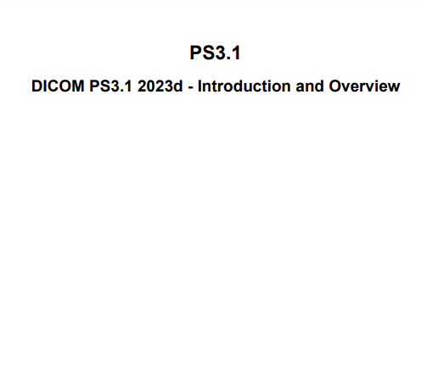

The Promise of AI
Improved patient outcomes
More efficient care delivery
Happy patients and staff
Less clinician burnout
<…>
Medical images
Orders / reports
Health record
Operational data
<…>
AI
STANDARDS!
Notes:
All images are MS PPT icons

Slide 3
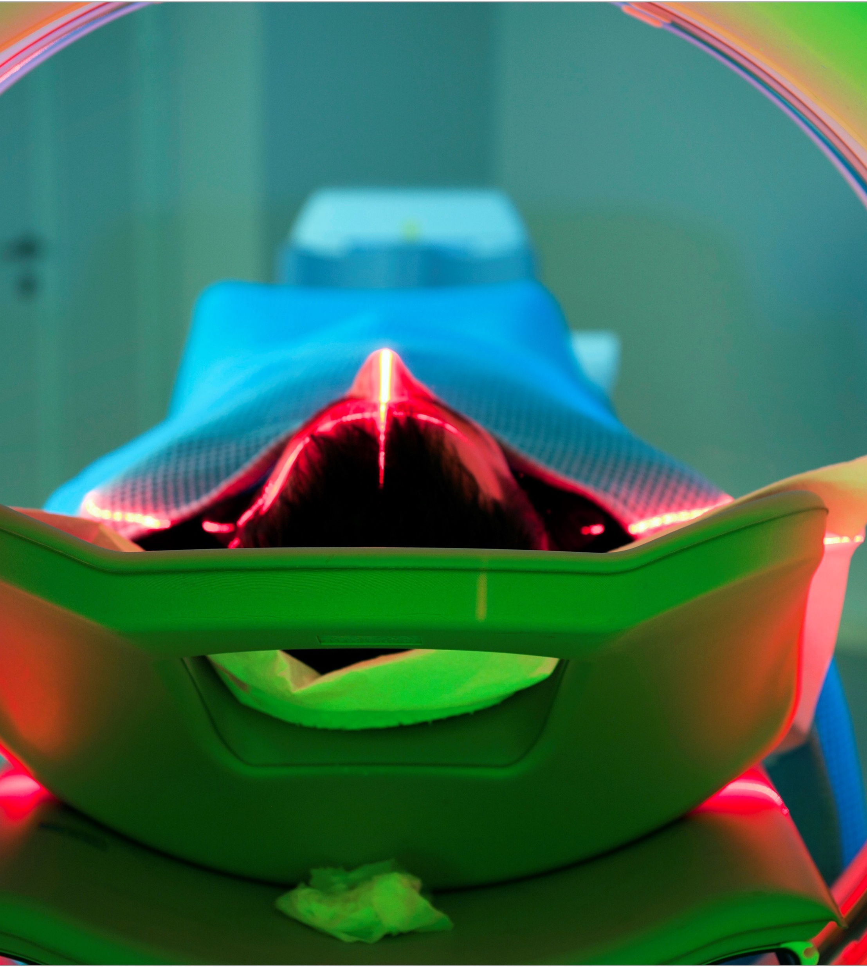
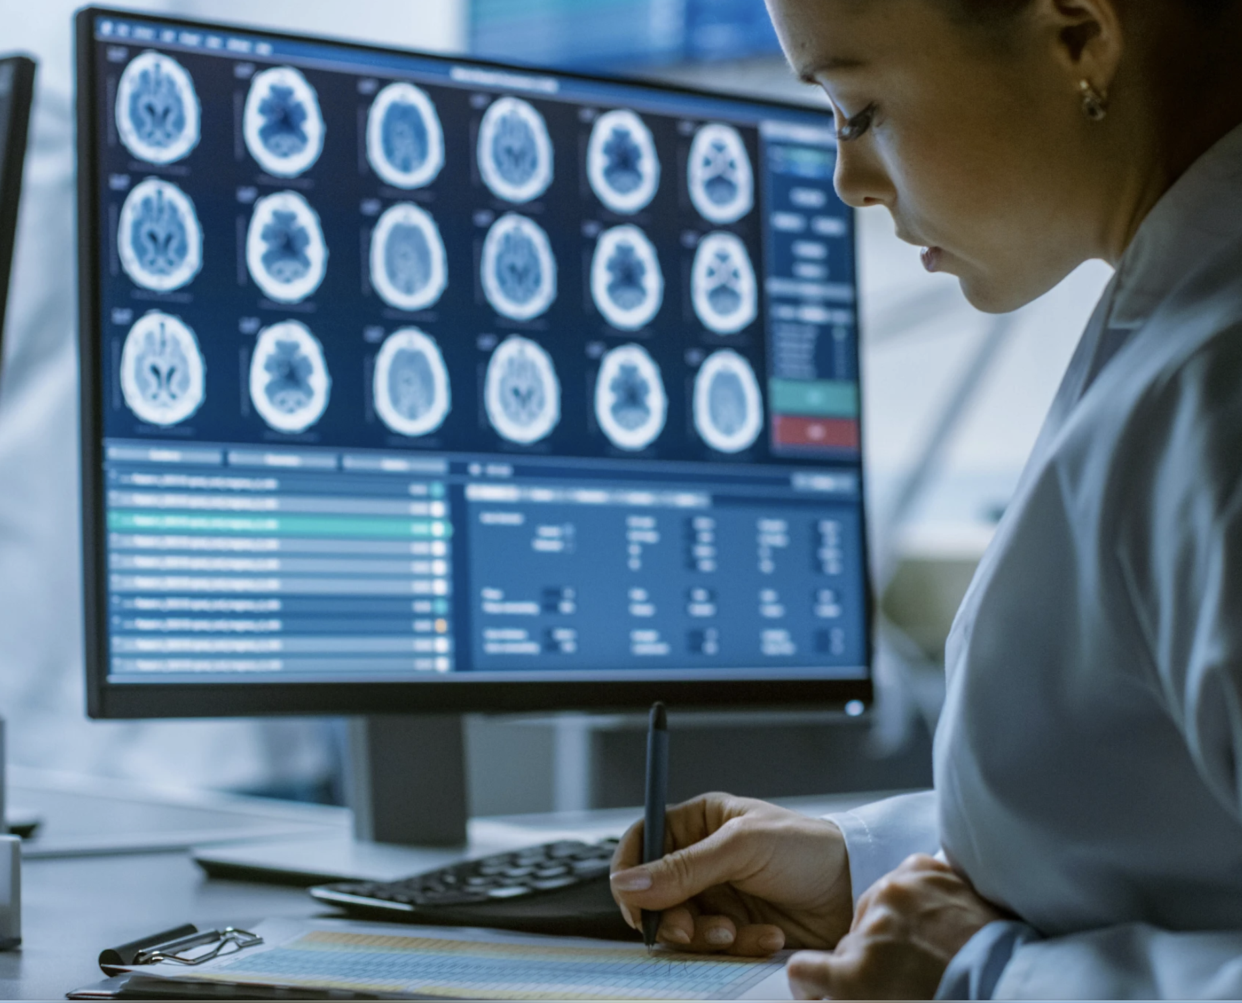

AI for Medical Imaging has Domain-Specific Requirements
Multi-Modal and Multi-AI Use Cases
Domain Specific Platforms
Ecosystem Interoperability
Triage
Acquisition, post-processing, registration
Segmentation and classification
Reporting across diagnostic modalities and instruments
3D and High Resolution Datasets
Data Augmentation and Expert Labeling
Model architectures and model zoos
AutoML and Federated Learning
PACS, VNAs, DICOM routers
AI Marketplaces
HL7 Engines, EMRs
Integration of instruments into ecosystem
Notes:
Medical imaging analysis, the largest use case in healthcare, will reach $2.6 billion (30% CAGR) in 2027. By 2025, 30% of healthcare providers globally will have invested in AI-enabled imaging solutions that aim to improve image analysis, diagnosis accuracy and efficiency, and real-time decision-making support to healthcare providers.
Data Scientists, Developers, and Hospital IT departments face challenges, often driven by impediments resulting from legacy software and hardware systems, when driving healthcare innovation. To drive a platform that can unlock the value of medical imaging data, the core of healthcare innovation, they need the following to be in place:
Support for multi-modal use cases: From Triage, to image acquisition and segmentation, to reporting insights across modalities and instruments, developers need a common, accelerated computing platform that can support various imaging modalities(e.g., MR, CT, Ultrasound, Xray, Video, Photo) used to collect and analyze patient data. This will help streamline doctor workflows with a unified patient record
Domain-Specific Platforms: The medical imaging community needs domain-specific capabilities to train AI models for imaging. This domain specificity allows for streamlined development workflows for building state-of-the-art deep learning models that can scale AI to clinical production.
Ecosystem Interoperability: Hospital IT departments and application providers who sell to hospitals need an increasingly diverse application ecosystem to manage, secure, and scale. A common delivery platform, powered by accelerated compute and networks, but be interoperable within hospital ecosystem.​
​
​

Slide 4









Common AI Workflows in Medical Imaging
Inference
Acquire
Modalities, PACS
Process
Transform, Infer, Result
Render
Text, Overlays, Workflow
Feedback
Collect, Share, Iterate
Train
Curate
View, Organize, Annotate
Train
Create, Fine-tune
Export
Validate, Evaluate
Build
Create AI Applications

Slide 5
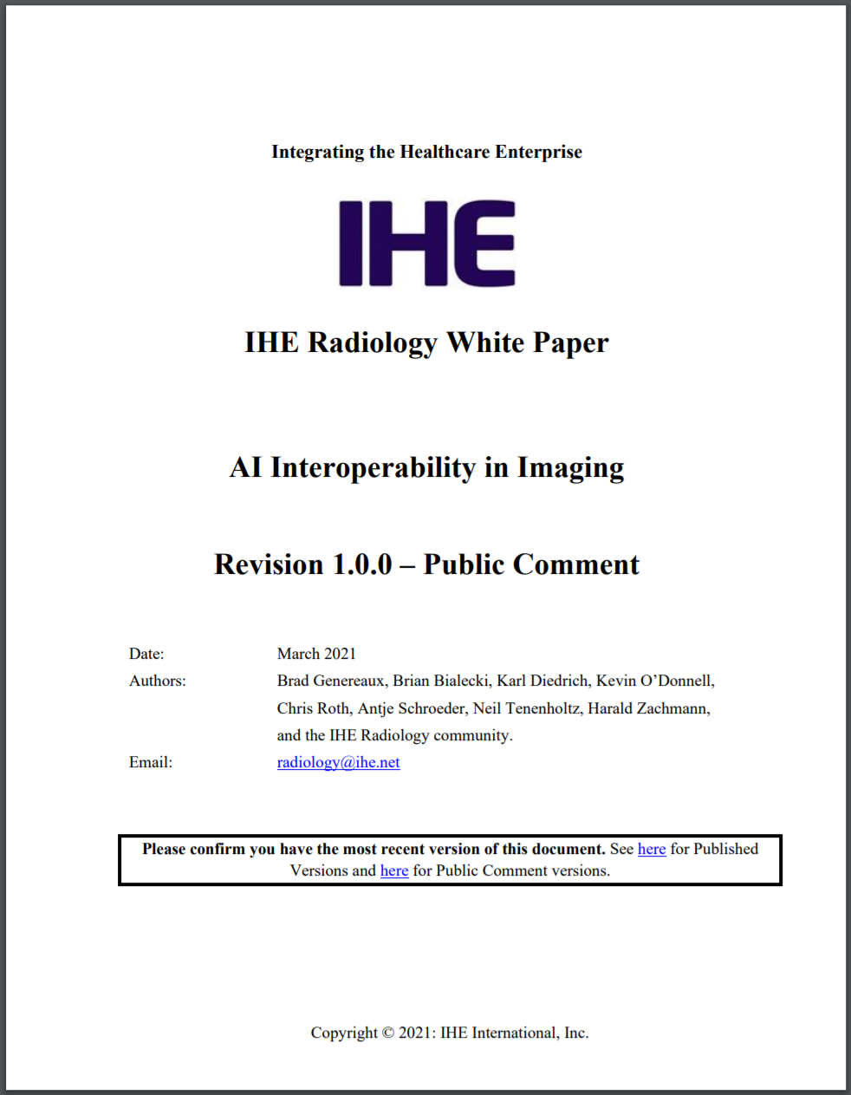
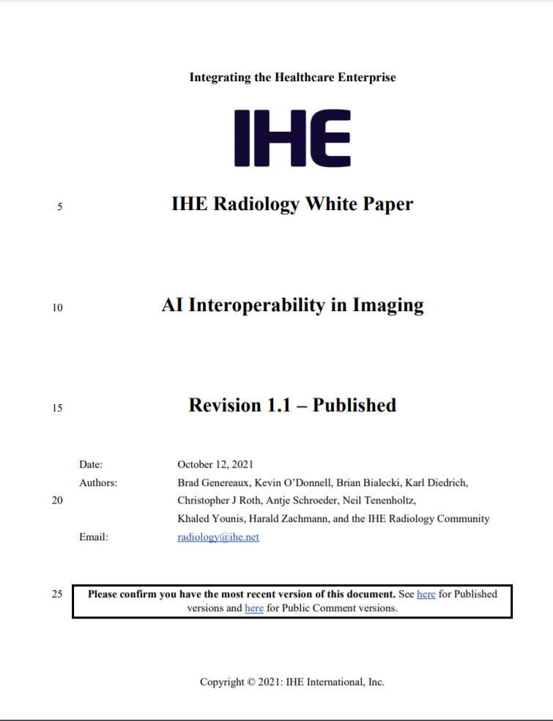
AI Interoperability in Imaging
Large Problem Space
  Creating, training, validating, deploying, monitoring the performance of, and using artificial intelligence components
Democratic Adoption at Scale
  Having a roadmap will make it much easier to select, properly scope, and prioritize/sequence profile development
Consensus Building
  Identifying logical next steps will ensure new AI profiles integrate well with each other and with existing imaging infrastructure to shape the overall ecosystem
See: https://www.ihe.net/uploadedFiles/Documents/Radiology/IHE_RAD_White_Paper_AI_Interoperability_in_Imaging.pdf

Slide 6

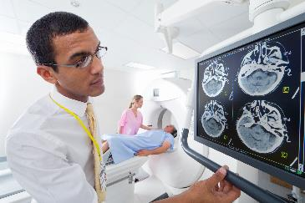
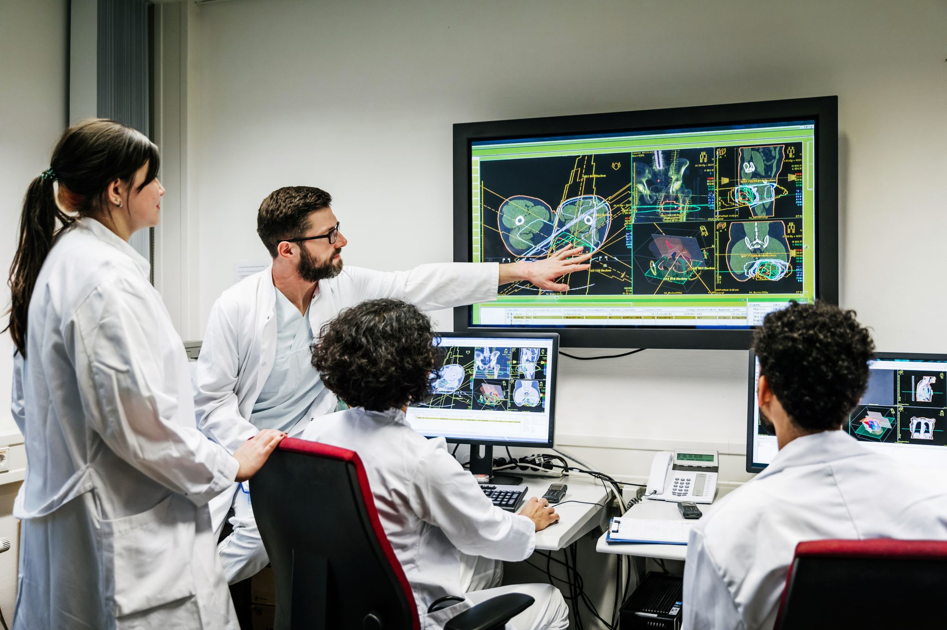

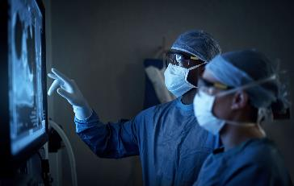



Applications of AI in Imaging
1. Ordering and Scheduling
Ranking and prioritizing, no shows …
2. Guidance & 3. Acquisition
Protocoling, exposure reduction, …
4. Image Generation
Reducing noise and artifacts, …
5. Image Analysis
Presence, measure, characterize, …
6. Image Interpretation
Worklists, summary composition, …
7. Mgmt & Treatment Planning
Recommenders for intervention, …
8. Population Health
Identifying trends, clinical trials, …
9. Departmental Operations
KPIs, trends, resource utilization, …
Notes:
Images from Microsoft clipart

Slide 7

Example: Image Analysis
Detecting the presence of a target
Ruling out the presence of a target
Locating a target
Segmenting a target
Measuring a quantitative characteristic of a target
Determining the appropriate "score/grade/code" from a grading or classification system
Characterizing a qualitative characteristic of a target (shape, spiculation, heterogeneity, or density)
Dynamic / time-based measurements or assessments (e.g., blood flow)
Assessing changes between a current and prior study, across same or different modalities
Spatially registering studies with current / prior study across same or different modalities
Autogenerating teaching files
A “target” of the image analysis might be a device (like a pacemaker, a stent, or central line), a condition (like pneumothorax, or osteopenia), a pathological structure (like a tumor or aneurysm), or an anatomical structure (like a kidney, colon, or blood vessel)

Slide 8
IHE AI White Paper Clinical Usage Use Cases
1. Initiate
2. Access Data
AI Orchestrator
Task Manager
6. Use
1. Initiate
3. Perform
4. Create Results
Viewer
Image Display
Task Requester
1. Initiate
1. Initiate
PACS / VNA
Image Manager
Task Requester
3. Perform
2. Access Data
AI Application
Evidence Creator
Task Performer
5. Deliver
6. Use Results
5. Deliver
4. Results
* Example topology; other applications could be these actors

Slide 9
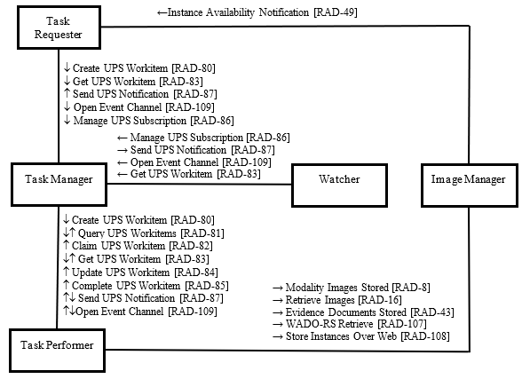
IHE AI Workflow for Imaging [AIW-I]
Send job using [DICOM UPS / DICOMweb UPS-RS]
Claim and retrieve job using UPS-RS
Retrieve DICOM using QIDO-RS and WADO-RS
Store DICOM results using STOW-RS
Mark job completed using UPS-RS
See https://www.ihe.net/uploadedFiles/Documents/Radiology/IHE_RAD_Suppl_AIW-I.pdf

Slide 10
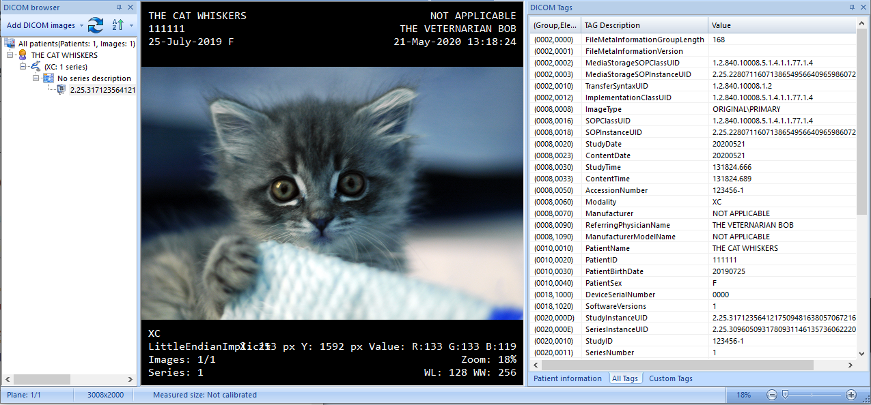
Hackathon Proof of Concept : Kitten Image Flipper
Goal: Send DICOM studies (XC of Kitten) to an AI model and flip pixels upside-down)

Slide 11
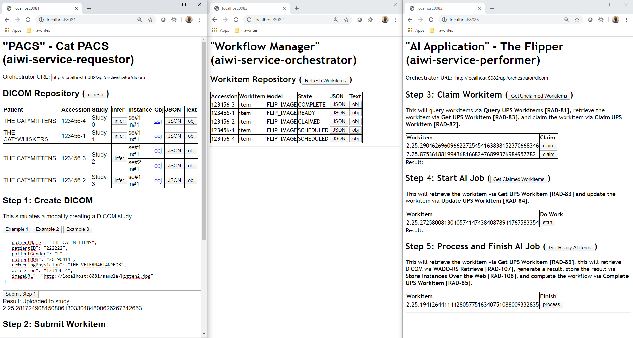
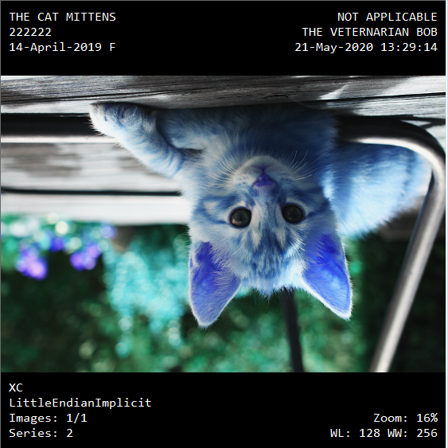

Hackathon Proof of Concept : Kitten IMAGE Flipper
Flask + PyDicom
Flask + PyDicom
Flask + PyDicom + PIL + Numpy
2
3
4
5
1
Notes:
Brad’s pictures

Slide 12
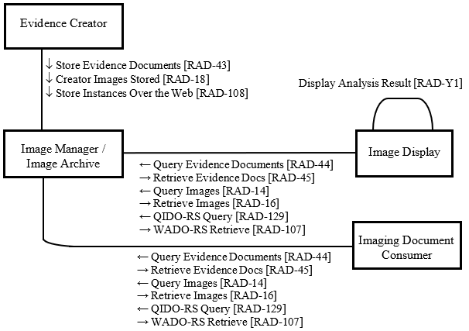
IHE AI Results [AIR]
Type of AI Result: | Use This:
Qualitative Finding | DICOM SR TID 1500
Measurement | DICOM SR TID 1500
Location | DICOM SR TID 1500
Segmentation | DICOM Segmentation
Parametric Map | DICOM Parametric Map
Tracking ID | DICOM SR
Imaging Reference | DICOM KOS
See https://www.ihe.net/uploadedFiles/Documents/Radiology/IHE_RAD_Suppl_AIR.pdf

