Slide 1


DICOM Educational Conference
Chennai, India
October 9-11, 2023
Prof. Dr. Christian
Kücherer
Prof. Dr. Oliver
Burgert
¹ Hochschule Reutlingen, School of Informatics, Reutlingen, Germany
² IRCAD Strasbourg, Strasbourg, France
³ IHU Strasbourg, Strasbourg, France
⁴ Dept. of Otorhinolaryngology, University Hospital Düsseldorf, Düsseldorf, Germany
⁵ Heidelberg University Hospital, Department of General, Visceral and Transpl. Surgery, Heidelberg, Germany
⁶ National Center for Tumor Diseases Heidelberg, Heidelberg, Germany
⁷ Center for the Tactile Internet with Human in the Loop (CeTI), Technical University Dresden, Dresden, Germany

Slide 2
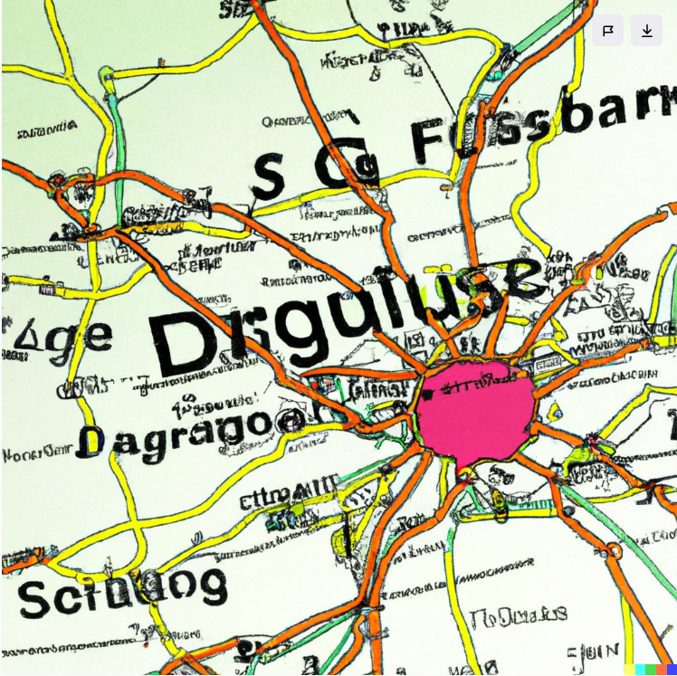


Overview
Short Introduction to DICOM WG-24: “Surgery”
Towards DICOM Structured Reporting Templates to support the documentation of surgical operations
Spoiler Alert: Don‘t trust AI for such purposes
Prompt: Draw a map with Reutlingen, Düsseldorf, Strasbourg and Dresden drawn on it
Dall.E
Ideogram.ai

Slide 3

DICOM WG-24 “Surgery”
Scope:
  To develop DICOM objects and services related to image guided surgery (IGS).
  Disseminate knowledge gained following the roadmap through workshops, conferences, and special seminars.
Short Term Goals:
  Work item “Visual Light related multi-modal sensor and computed structured data”:
  CP-2161 “Photogrammetric Model Enhancement of VL IODs”
  Support for surgical reports by DICOM Structured Reports
Completed Supplements
  Supp 131 Bone Mounted Implant Description Storage SOP Class
  Supp 132 Surface Segmentation Storage SOP Class
  Supp 134 Implantation Plan SR Document Storage SOP Class
  Supp 138 Crestal Implant Storage SOP Class (jointly with DICOM WG 23 Dentitry)
  Supp 154 Optical Surface Scanner Storage SOP Class
wg24chairs@dicomstandard.org

Slide 4
Introduction – Documentation of surgical operations
  Human-readable documentation
    Well-known (current gold standard)
    Mostly unstructured
    Based on memorization of the intervention
  Machine-readable documentation for
    Surgical data mining
    Surgical workflow support
    Machine learning
    Automatic evidence reporting
    Generation of human-readable reports
    …

Slide 5
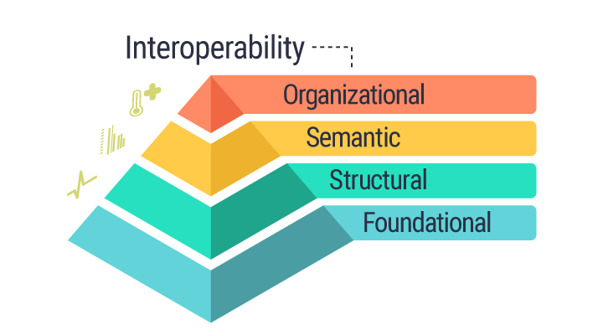
Documentation has to be standardized to be interoperable
Potential wide-spread (medical) standards are:
  HL7 v2
  HL7 v3 / CDA
  HL7 FHIR
  DICOM
    SOP-Classes
    Structured Reports (SR)
  IHE
    Coordinated use
Levels of interoperability according to HIMSS¹
¹https://www.himss.org/resources/interoperability-healthcare,
illustration from https://www.imprivata.com/blog/himss-proposes-a-new-interoperability-definition-in-healthcare-what-it-means-for-patients-and-professionals

Slide 6
Step 1: Mapping of the contents of one intervention to DICOM SR
At IRCAD, a DICOM SR template was developed focusing on the use case of surgical data mining:
Nesting Level (NL) | Relationship With Parent | Value Type (VT) | Concept Name | Value Multiplicity (VM) | Requirement Type | Condition | Value Set Constraint
 |  | CONTAINER | EV (00.0, DCM, EV (00.0, DCM, “Laparoscopic Cholecystectomy Report“ ) | 1 | M |  | Root node
> | HAS CONCEPT MOD | CODE | EV (121058, DCM, "Procedure reported") | 1 | M |  | DCID 00.0 “Laparoscopic cholecystectomy Procedure”
> |  | INCLUDE | DTID 3601 “Procedure Context” | 1 | M
> | CONTAINS | INCLUDE | DTID 1002 “Observer Context” | 1-n | M
> | CONTAINS | INCLUDE | DTID 00.1 “Anesthesia“ | 1 | M
> | CONTAINS | CODE | EV (113743, DCM, "Patient Orientation") | 1 | U |  | DCID 19 “Patient Orientation”
>> | HAS CONCEPT MOD | CODE | EV (113744, DCM, "Patient Orientation Modifier") | 1 | M |  | DCID 20 “Patient Orientation Modifier”
> | CONTAINS | INCLUDE | DTID 00.2 “Laparoscopic ports” | 1 | M
> | CONTAINS | CODE | EV (00.3, DCM, “Cholecystectomy findings”) | 1 | M |  | DCID 00.11 “Cholecystectomy findings”
>> | ﻿INFERRED FROM | INCLUDE | ﻿DTID 3909 “Best Illustration of Findings” | 1 | U
> | CONTAINS | INCLUDE | DTID 00.4 “Callot Triangle Dissection Score” | 1 | M
>> | ﻿INFERRED FROM | INCLUDE | ﻿DTID 3909 “Best Illustration of Findings” | 1 | U
> | CONTAINS | INCLUDE | DTID 00.5 “Clip application” | 1-n | U
> | CONTAINS | INCLUDE | DTID 00.6 “Gallbladder Dissection Score” | 1 | M
> | CONTAINS | INCLUDE | DTID 00.7 “Cholecystectomy Event“ | 1-n | M

Slide 7
Can this be standardized?
DICOM SR is a standard, so it is already standardized
on a structural level
For the semantic level,
the SR Template has to be part
of the standard as well
So IRCAD approached DICOM WG-24 “Surgery”.
Two options:
Independent DICOM SR Templates for each intervention
A more general approach covering several interventions
Levels of interoperability according to HIMSS¹
¹https://www.himss.org/resources/interoperability-healthcare,
illustration from https://www.imprivata.com/blog/himss-proposes-a-new-interoperability-definition-in-healthcare-what-it-means-for-patients-and-professionals

Slide 8
Step 2: Modelling different interventions: a) Cochlear implantation
We modeled the Cochlear implantation procedure as performed at the University Hospital in Düsseldorf:
Nesting Level (NL) | Relationship With Parent | Value Type (VT) | Concept Name | Value Multiplicity (VM) | Requirement Type | Value Set Constraint
 |  | CONTAINER | EV (00.0, DCM, “Cochlear Implantation Report“ ) | 1 | M | Root node
> | HAS CONCEPT MOD | CODE | EV (121058, DCM, "Procedure reported") | 1 | M | DCID 00.0 “Cochlear Implantation Procedure”
> |  | INCLUDE | DTID 3601 “Procedure Context” | 1 | M
> | CONTAINS | INCLUDE | DTID 1002 “Observer Context” | 1-n | M
> | CONTAINS | CODE | EV (00.1, DCM, "Patient Side") | 1 | U | DCID 00.1 “Patient Side”
> | CONTAINS | INCLUDE | DTID 00.1 “Implantbed” | 1 | M
> | CONTAINS | INCLUDE | DTID 00.2 “Implant description” | 1 | M
> | CONTAINS | CODE | ﻿DTID 00.3 “Cochlear findings”) | 1 | M | DCID 00.02 “Cochlear findings”
> | CONTAINS | INCLUDE | DTID 00.7 “Cochlear Event“ | 1-n | M
> | CONTAINS | INCLUDE | DTID 00.8 “Cochlear Step” | 1-n | M
> | CONTAINS | INCLUDE | DTID 00.9 “Cochlear Follow-Up” | 1 | M

Slide 9
Step 2: Modelling different interventions: b) RAMIE¹
Nesting Level (NL) | Relationship With Parent | Value Type (VT) | Concept Name | Value Multiplicity (VM) | Requirement Type | Value Set Constraint
 |  | CONTAINER | EV (00.0, DCM, “Esophagectomy Report“ ) | 1 | M | Root node
> | HAS CONCEPT MOD | CODE | EV (121058, DCM, "Procedure reported") | 1 | M
> | CONTAINS | INCLUDE | DTID 3601 “Procedure Context” | 1 | M
> | CONTAINS | INCLUDE | DTID 1002 “Observer Context” | 1-n | M
> | CONTAINS | CODE | EV (113743, DCM, "Patient Orientation") | 1 | U
>> | HAS CONCEPT MOD | CODE | EV (113744, DCM, "Patient Orientation Modifier") | 1 | M | DCID 20 “Patient Orientation Modifier”
> | CONTAINS | INCLUDE | DTID 00.1 “Esophagectomy Ports” | 1-n | M
> | CONTAINS | INCLUDE | ﻿DTID 00.2 “Esophygectomy Findings” | 1 | M
> | CONTAINS | INCLUDE | DTID 00.6 “Esophagectomy Event“ | 1-n | M
> | CONTAINS | INCLUDE | DTID 00.7 “Esophagectomy Step” | 1-n | M
¹Robotically Assisted Minimally Invasive Esophagectomy

Slide 10

Step 3: Generation of a Basic DICOM SR Template
Harmonize the structure of the three templates
Find common concepts among all three templates
Extract those concepts to a Basic DICOM SR Template
Allow for the addition of intervention-dependent concepts
Allow for the addition of unforeseen or proprietary concepts
DALL-E – Prompt: A Machine converting sheets of paper to data in Steampunk Style

Slide 11
Basic DICOM SR Template (Top Level¹)
Nesting Level (NL) | Relationship With Parent | Value Type (VT) | Concept Name | Value Multiplicity (VM) | Requirement Type | Condition | Value Set Constraint
 |  | CONTAINER | EV (00.0, DCM, “Surgery Report“ ) | 1 | M |  | Root node
> | HAS CONCEPT MOD | CODE | EV (121058, DCM, "Procedure reported") | 1 | M
> | CONTAINS | INCLUDE | DTID 3601 “Procedure Context” | 1 | M
> | CONTAINS | INCLUDE | DTID 1002 “Observer Context” | 1-n | M
> | CONTAINS | CODE | EV (113743, DCM, "Patient Orientation") | 1 | U
>> | HAS CONCEPT MOD | CODE | EV (113744, DCM, "Patient Orientation Modifier") | 1 | M |  | DCID 20 “Patient Orientation Modifier”
> | CONTAINS | INCLUDE | ﻿DTID 00.1 “Surgery Findings” | 1 | M
> | CONTAINS | INCLUDE | DTID 00.5 “Surgery Event“ | 1-n | M
> | CONTAINS | INCLUDE | DTID 00.6 “Surgery Step” | 1-n | M
¹The full description is given as a supplement of the correponding IJCARS paper (under review)

Slide 12
Next steps
Including more different surgical interventions
External review of the derived structure
Ensure coverage of all use cases from
  a medical (patient care) standpoint,
  medical research perspective,
  scientific perspective,
  industry perspective,
  …
Thank you for your attention!
Please get involved!
DICOM WG-24 „Surgery“
wg24chairs@dicomstandard.org

