Slide 1
DICOM Educational Conference Chennai, India
October 9-11, 2023
DICOM Security 101
Lawrence Tarbox, Ph.D.
University of Arkansas for Medical Sciences
DICOM Standards Committee and WG 14, 23, & 29 User Co-chair

Slide 2
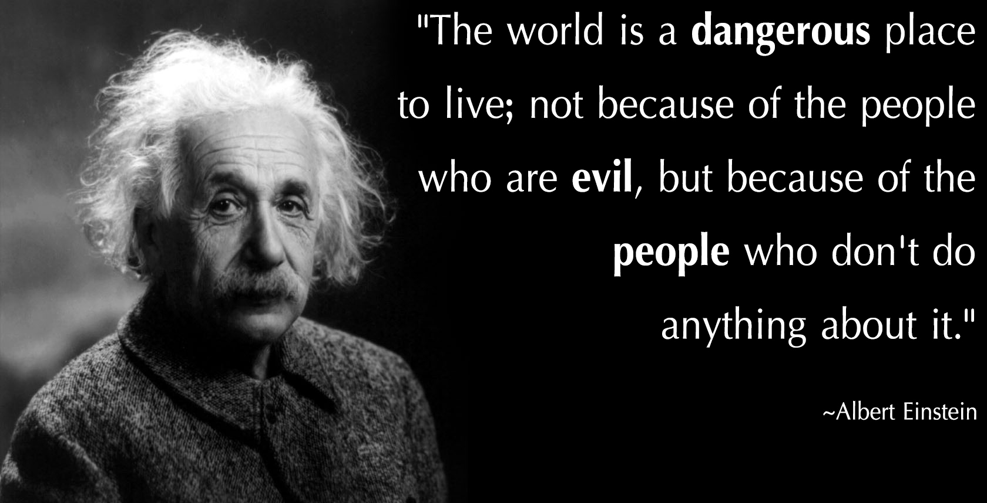

Slide 3
Step 1 – Security Requires Planning
Set policies
Implement controls
Procedural – what people should do
Technological – what machines should do
Physical – the environment in which people and machines operate
Educate Staff
Monitor and Evaluate Effectiveness

Slide 4
Sources of Guidance - NIST
National Institute of Standards and Technology (NIST)
Cybersecurity Framework (https://www.nist.gov/cyberframework)
Points to lots of other documents from multiple sources, not just NIST documents
Computer Security Resource Center Publication series (https://csrc.nist.gov/publications/sp)
Lots of procedures, probably overkill, but one possible view of ‘best practices’. Though focused on government systems, lots of good ideas.
SP 800-53 “Security and Privacy Controls for Federal Information Systems and Organizations” is of particular interest (https://csrc.nist.gov/publications/detail/sp/800-53/rev-4/final).

Slide 5
Sources of Guidance
National Security Agency | Central Security Service
Cybersecurity (https://www.nsa.gov/Cybersecurity/)
Multiple tools, guidance and advisory documents
Guidelines from other countries, trade organizations
Joint Security and Privacy Committee (NEMA, COCIR, JIRA)
Books
Online guides
Consultants, etc.

Slide 6
Security Plans Vary
Different organizations assess and mitigate risks differently
Responsibilities vary
Staff size varies
Typically one person has overall responsibility, for example
Chief Information Officer (CIO)
Chief Information Security Officer (CISO)
Security Plans are necessary, but outside the scope of DICOM
DICOM has features that can be call upon by security plans, primarily as technological controls

Slide 7
DICOM Security Features
Protect data at rest
Digital Signatures
Attribute Confidential, including de-identification
Media Storage Security
Protect data in transit, including node authentication
User credentialing (optional part of Association Negotiation or session establishment)
Audit logging

Slide 8
Protecting Data at Rest
Digital Signatures
Persistent integrity check (tamper detection)
Identifies users or devices that handled the object, with optional secure timestamp
Selective Encryption or De-identification
Persistent privacy protection
Hide sensitive Attributes, except from certain users (optional)
Whole object encryption
Uses a Cryptographic Message Syntax Envelope
Retricts access to specific individuals

Slide 9
Digital Signatures
Embedded in SOP Instances
Can make secure references to unsigned objects
Multiple Signatures
Overlapping subsets
Multiple signers
Sign individual items
Signature purposes
Defined in profiles

Slide 10
Attribute Level Encryption
Can encrypt all of the SOP Instance, selected Attributes, or even just a single Attribute.
Security Profiles describe the Attributes to protect
Local profiles can be used for special needs
Only encrypt patient information, not equipment or image
Only encrypt report contents, not patient ID
Encrypted Attributes optionally move to inside a Cryptographic Message Syntax envelope inside a sequence, to allow re-identification
The Attributes to be protected are de-identified

Slide 11
SOP Instance
Attributes (unencrypted or de-identified)
Encrypted Attributes Sequence
Item 1 (of n)
Encrypted Content Transfer Syntax
Encrypted Content
Multiple Sequence Items can be used to reveal different subsets of Attributes to different intended recipients.
The subsets may overlap.
Cryptographic Message
Syntax envelope
CMS attributes
encrypted Content
Modified Attributes Sequence
Item 1 (of only 1)
Attributes to be encrypted
Item 2 (of n)
Encrypted Content Transfer Syntax
Encrypted Content
CMS envelope
Item n (of n)
Encrypted Content Transfer Syntax
Encrypted Content
CMS envelope

Slide 12
Keeping the object consistent
Attributes being protected should be intelligently replaced
The Attribute Type and conditions conventions must be honored
A Type 1 (Required) Attribute must have a reasonable replacement (e.g. Patient IDs, dates, names)
A Type 3 (Optional) Attribute could be removed
See tables in the profiles for recommendations
UIDs should maintain referential consistency – if a UID is replaced, the new UID should replace the old UID in all references
Leave out the Encrypted Attributes Sequence, and the new object is irreversibly de-identified

Slide 13
Media Security
Applies to all DICOM specified media, e.g., CD-R, DVD-R, E-mail, USB device
The media’s file system remains unencrypted
No special drivers or file system software needed
Easy to process and copy
Object are enclosed within Cryptographic Message Syntax (CMS) Envelopes placed inside regular files
CMS is often used to secure e-mail
Optional encryption to protect against unauthorized disclosure
Optional integrity check to protect against tampering

Slide 14
Protecting Data in Transit
DICOM Traffic
TLS Protection against unauthorized listeners
DICOM Specifies the use of TLS for encrypting traffic.
HTTP over TLS is known as HTTPS, and is the most common method of protecting Web traffic.
DICOM over TLS has equally strong protection against unauthorized listeners.
Protection against unauthorized network listeners by means of encryption

Slide 15
Node Authentication
DICOM Traffic
AE-1
AE-3
TLS Node Authentication uses public certificate technology to identify both end points.
AE-1 knows with certainty that the other endpoint is AE-3, not AE-7 or some other system.
AE-3 knows with certainty that the other endpoint is AE-1, not AE-5 or some other system.
AE-5
AE-7
Identifying communication partners

Slide 16
Node Authentication
DICOM does not specify how this authentication will then be used. Possible uses include:
Ensuring that only internal hospital machines are allowed to connect.
Ensuring that acquired images are sent to the correct machine.
Though not commonly turned on, most web infrastructure does support bi-directional mutual authentication

Slide 17
Advantages to using TLS
TLS encryption protects public internet connections.
This will need to be explained to security staff.
DICOM over TLS is like HTTPS and should be allowed.
Node Authentication uses can be extensively customized.
Each connection can be verified in detail, or connections just checked to ensure that they are all within facility connections.
DICOM enables a very wide variety of authentication and access control policies.
DICOM does not mandate any particular policies
TLS works for both traditional DICOM and DICOMweb™

Slide 18
TLS Configuration
Very configurable
Best practices captured in BCP195 from IETF (Internet Engineering Task Force)
Referenced by the DICOM Standard in Part 15 Profiles:
BCP 195 RFC 8996 TLS Secure Transport Connection Profile
Modified BCP 195 RFC 8996 TLS Secure Transport Connection Profile
Restricts negotiation of cipher suites, with additional baseline ciphersuite support
Meets Japanese recommendations
Changes as BCP changes

Slide 19
Certificate Management
Certificates are used to identify systems (and perhaps Application Entities)
Certificates can be self-generated, facility signed, or signed by internationally recognized authorities.
Most equipment supports
Individually provided certificates per system (self-signed or otherwise)
Certificates for facility authorities. Certificates signed by these authorities are recognized as authorized
The SPC paper “Managing Certificates” describes this in more detail
The Automatic Certificate Management Environment (ACME) protocol, being standardized by IETF may be useful

Slide 20
User Credentialling
Option 1: Trust the sender
Mutual TLS Authentication
Option 2a: Assertions during Association Negotiation (traditional DICOM)
SAML
Kerberos
OAuth2/OpenID Connect Tokens
Option 2b: Leverage Web mechanisms (DICOMweb™)
SAML
OpenID Connect

Slide 21
Extended Negotiation – No Response Expected
DICOM Application Entity "A"
A-ASSOCIATE
User ID Sub-item (58H)
ID Type (3)
User ID
Request
(A B)
DICOM Application Entity "B"
A-ASSOCIATE
(No Sub-Item)
Response
(A B)

Slide 22
Extended Negotiation – Response Expected
DICOM Application Entity "A"
A-ASSOCIATE
User ID Sub-item (58H)
ID Type (3)
User ID
Request
(A B)
DICOM Application Entity "B"
User ID Sub-item (58H)
Server-Response
A-ASSOCIATE
Response
(A B)

Slide 23
User Credential Type Profiles
Un-authenticated identity assertion
Systems trust each other
Username plus passcode
Systems in a secure network
Kerberos-based authentication
Strong security, more involved implementation and deployment
Generic SAML assertion or OAuth2 token
Nice mix of simplicity and security

Slide 24
DICOM User Credentialling Design Goals
Independent of other security mechanisms
No changes to other DICOM security mechanisms
Avoid incompatibility with the installed base
Minimum changes to existing implementation libraries
Extensible for future credential types
Established during association negation
Before any regular DIMSE transactions take place
Allows SCP to reject associations based on ID

Slide 25
Prepared for the Future
Could support any mechanism that supports uni-directional assertion mechanisms (e.g. using PKI and Digital Signatures)
Does not support identity mechanisms that require bi-directional negotiation (e.g. Liberty Alliance proposals)

Slide 26
Example Applications of User Credentials
Facilitates audit logging
Step toward cross-system authorization and access controls
DICOM still leaves access control in the hands of the application
Query filtering
For productivity as well as security

Slide 27
Several Options
User identity alone, with no other security mechanisms
User identity plus DICOM TLS
User identity plus future lower level transport mechanisms (e.g. IPv6 with security option)
User identity plus VPN
Practically any combination needed

Slide 28
Securing Access to Data
Access Control
Get permission before allowing action
Suitable for certain situations, e.g. restricting access to authorized medical staff
Access
Control
Audit Control
Allow action without interference, trusting the judgment of the staff.
Monitor behavior to detect and correct errors.
Activity
Audit Message
Sent to Repository
Both have a place in security systems
Local security policies determine what is handled by access control, and what is handled by audit controls.

Slide 29
DICOM’s Contribution to Access Control
DICOM does not specify computer access control
These are subject to local policy
These are very application specific
These are very implementation specific
DICOM can convey user credentialing
DICOM does expect that the use of audit trails and activity monitoring will be part of the local security system.
DICOM defines a standard interface for reporting user and computer activity to a centralized audit repository.

Slide 30
Audit Repository
M1
M2
M3
M4
M5
M6
11:00 M1 Dr Wu logs in
11:01 M1 Dr Wu views patient Chang’s CT exam
11:03 M4 Dr Wang views patient Chow’s MR exam
11:04 M1 Dr Wu creates patient Chang report
11:06 M3 Login authorization failure
11:07 M1 Dr Wu views patient Chung CT exam
11:07 M4 Dr Wang logs out
The audit log messages allow the repository to record a synchronized view of all the activity on all the different systems.
The actual log content is encoded as structured XML messages.
Audit
Repository
The audit repository can be used to record and monitor the entire network.
The security detection mechanisms may be as simple as flagging a login failure, or be highly complex behavior pattern recognition. DICOM enables these mechanisms. DICOM does not specify them.

Slide 31
Presenter’s contact information
Lawrence Tarbox
LTarbox@uams.edu
Department of Biomedical Informatics
University of Arkansas for Medical Sciences
4301 W. Markham, Slot 782
Little Rock, Arkansas 72205, USA
Thank you for your attention.
And thanks to Eric Pan for providing material for slides, Rob Horn for his brilliance, and the other participants of DICOM WG-14 Security who put forth the effort to make this happen.

